Slide 1

Department of Computer Science and Engineering
Smart Voting
System
Under the esteemed guidance
Of
Mrs. P. Subhadra,
(Assoc. Prof. CSE Department)
Mr. G. Srikanth
(Assoc. Prof. CSE Department)
Batch no. 19PB15
G. Bhargava – 19P61A0567
G. Rohit – 19P61A0572
G. Pranay – 19P61A0577

Slide 2
Contents
Problem statement
Objective
Existing system
Proposed system
Software & Hardware Requirements
System design(UML Diagrams)
Modules
Algorithm
Coding screenshots
Conclusion

Slide 3
Problem statement
The poll booth system takes a lot of time. It involves standing in a long queue and a lot of paper work for identity verification.

Slide 4
objective
The objective of this project is to conduct an election in an easy manner. The online execution of the voting system enables the voters to cast their vote simply by verifying their identity by sitting at home. It also avoids any rigging process.

Slide 5
Existing system
Ballet method is a regular opted method for conducting elections which includes a lot of paper work and man hours
EVM’s have come into usage which is a complete machine dependent procedure of conducting elections

Slide 6
Proposed system
An online portal used to cast their vote
A two-step verification to ensure the identity of the voter
Easily accessible database for maintaining the voters data

Slide 7
Software & hardware Requirements
Software Specifications
Operating system : Windows 7 Ultimate or above.
Coding Language : Python.
Front-End : Python.
Back-End : Django

Slide 8
Software & hardware Requirements
Hardware Specifications:
RAM : 2 GB or above
Hard Disk : 40 GB or above
Key Board : Standard Windows Keyboard
Mouse : Two or Three Button Mouse
Monitor : SVGA 21"

Slide 9
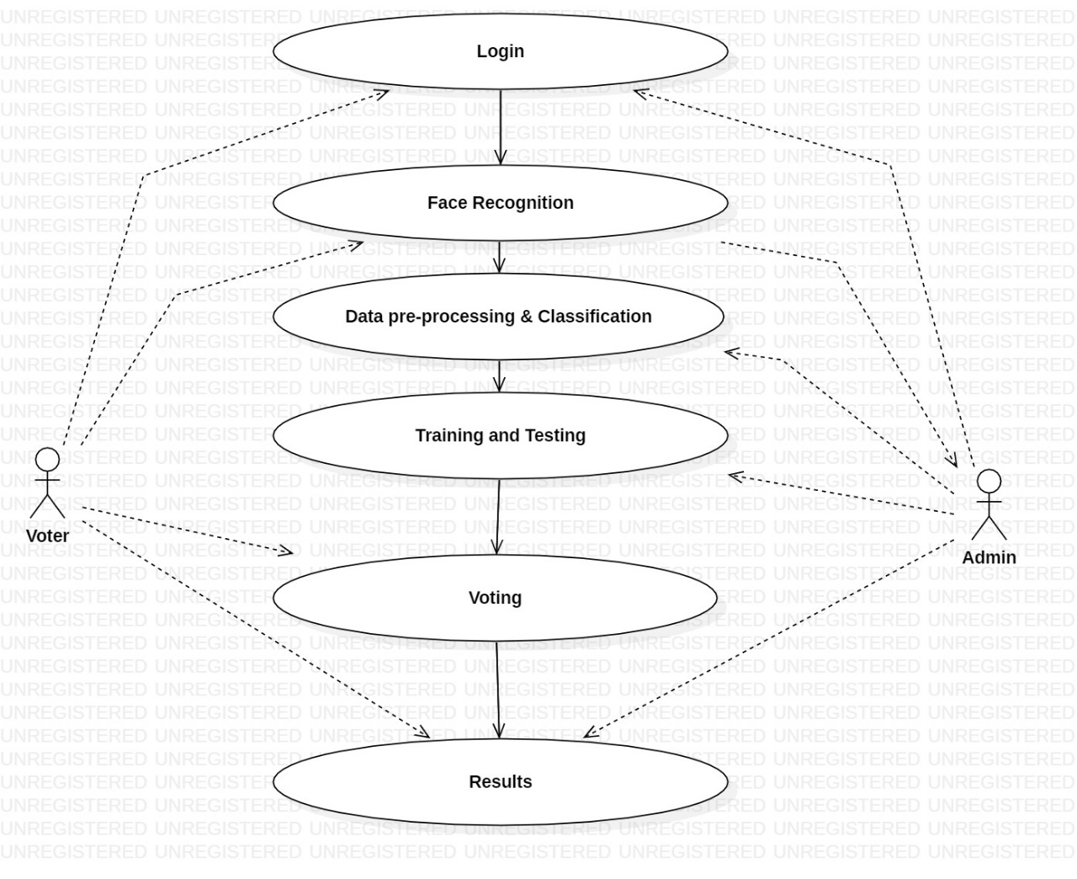
System design (use case diagram)

Slide 10
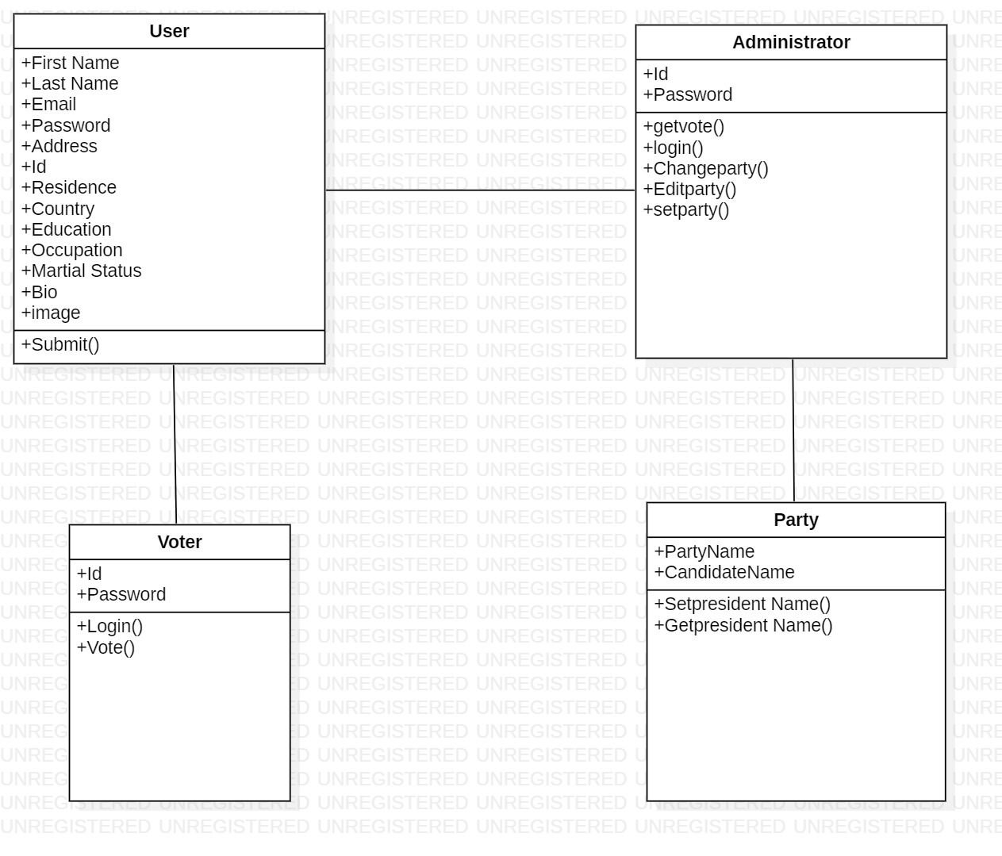
Class diagram

Slide 11
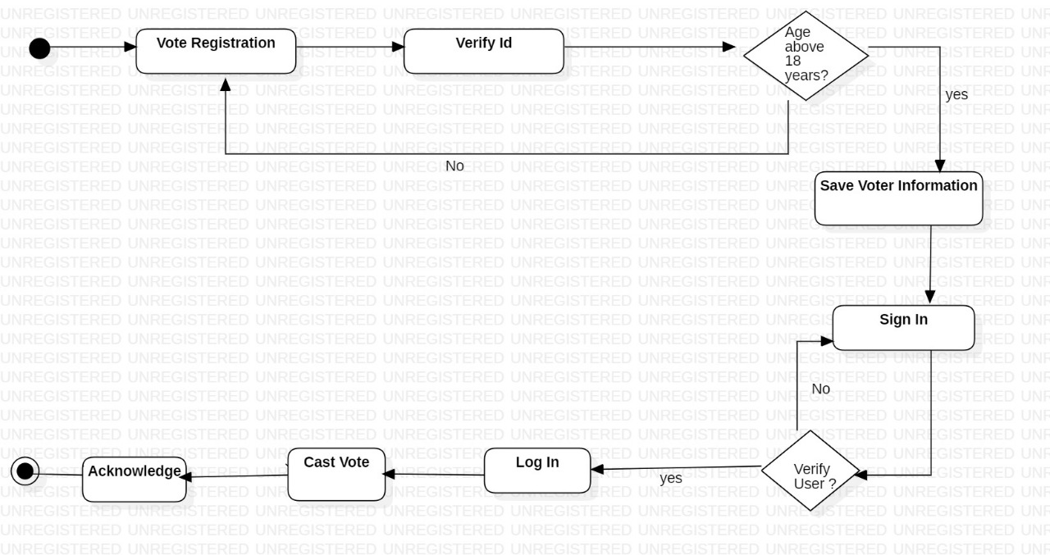
Activity diagram

Slide 12
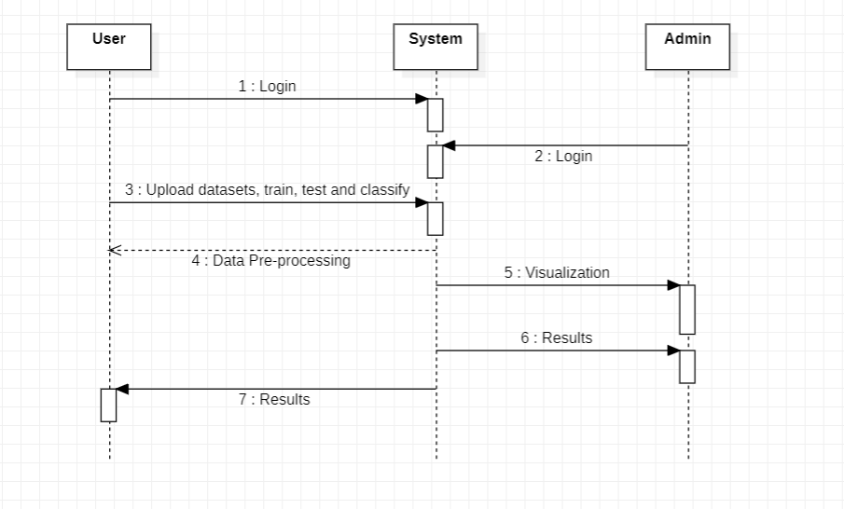
Sequence diagram

Slide 13
modules
Voter:
This allows user to login with face recognition vote for the respective candidate and allows the user to view the candidate details, allows user to view the details of the respective person he voted for.
Feature Extraction:
We extract the pupils and iris using a couple of techniques. We normalize the extracted iris to make the comparison possible. In this part, we verify the image using a couple of filters.
Training:
Here training and testing data set process will done. When we click on training data set button.

Slide 14
Cont.
Comparison and Validation:
Here it's the comparison part: we check in the database for an image equals/similar to the iris processed. If the image is in the database, we validate it. If not, there's a possibility to insert for future verifications.
Admin:
This module has to maintain the information of the candidate and shows the details of the candidate. And also maintains the records of the party and the candidate. This module, the admin, can able to add the candidates who are going to constitute in the particular election.
Result:
In this module we can get the results of the election i.e who had won the election with how many votes.

Slide 15
algorithm
LBPH Algorithm:
LBPH (Local Binary Pattern Histogram) is a Face-Recognition algorithm it is used to recognize the face of a person. It is an excellent feature for the classification of certain textures like faces. It requires four distinct parameters to process an image, they are radius (r), neighbours (n), X-axis and Y-axis.
This algorithm is robust when it comes to lightning. If you put a flashlight on the image, the value of the pixels will increase. Higher the values the brighter the image and when values are lower darker the image will be. For this reason, this algorithm has good results in light and dark images.

Slide 16
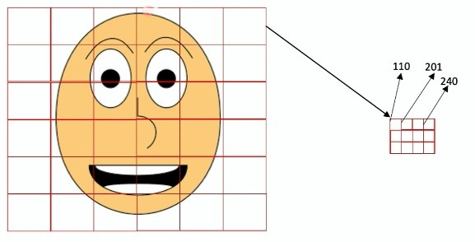
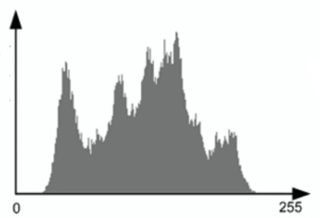
Cont.
All images are represented in the Matrix formats, as you can see here, which are composed of rows and columns. The basic component of an image is the pixel. An image is made up of a set of pixels. Each one of these is small squares.
Histogram - count of how many times each colour appears in each square

Slide 17
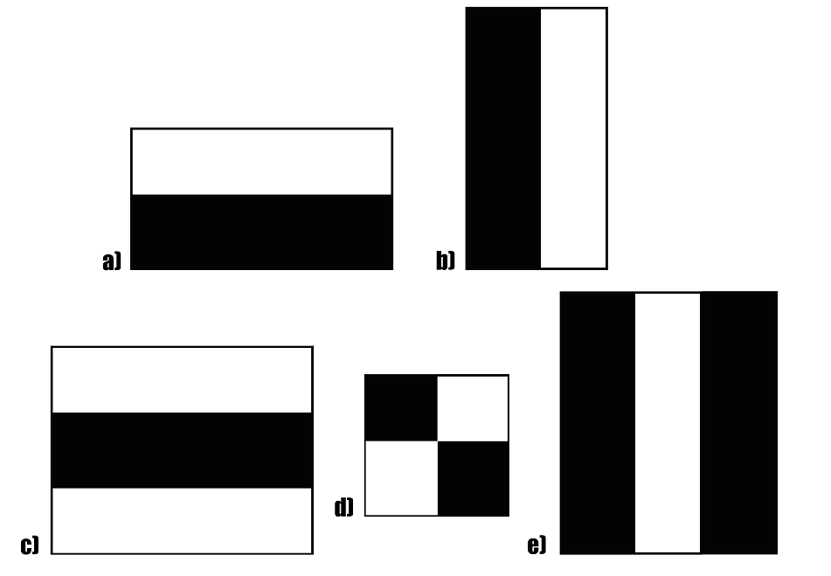
Cont.
Haar Cascade:
It is an Object Detection Algorithm used to identify faces in an image or a real time video.
The darker areas in the haar feature are pixels with values 1, and the lighter areas are pixels with values 0. Each of these is responsible for finding out one particular feature in the image. Such as an edge, a line or any structure in the image where there is a sudden change of intensities.

Slide 18
cont.
SVM Classifier:
Support vector machines(SVM) are a set of supervised learning methods used for classification and regression tasks in machine learning. In this method, the training data consist of a set of training examples, where each example is a pair consisting of an input and an anticipated output value.
In this module, we have considered several vectors for training the dataset. For example the vectors include include pupil, iris, position of nose, eyes and eyebrows

Slide 19
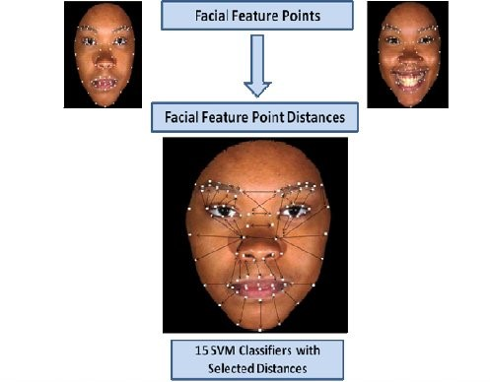
Cont.

Slide 20
Architecture diagram
Authentication
page
Try again
Fail
Enter
ID & password
Invalid
details
Success
Face verification
Voter
details
Vote Casted
Candidates
List
Fail
Invalid
user

Slide 21
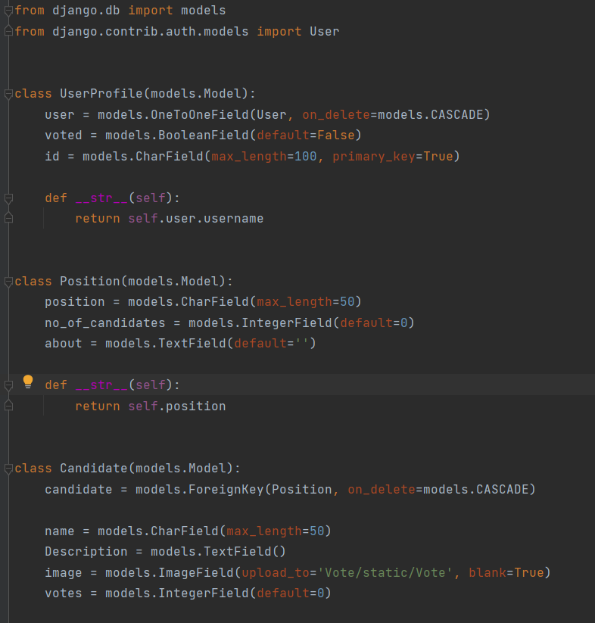
Coding screenshots(1)

Slide 22
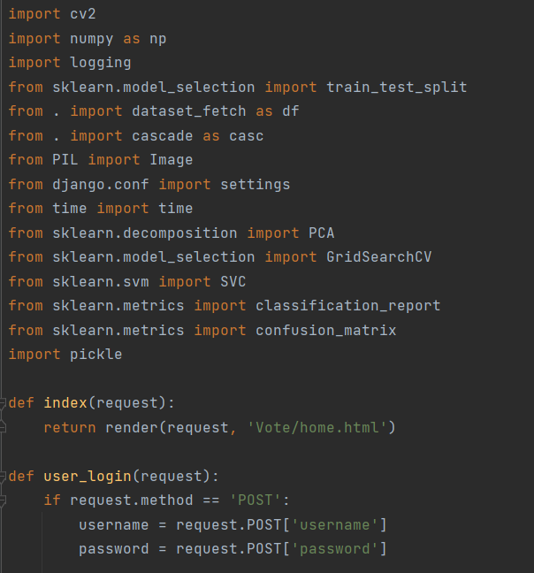
Coding screenshots(2)

Slide 23
Future scope of project
An additional verification stage can added by the help of fingerprint validation method.
We can use OTP method for quick validation of user’s account.

Slide 24
conclusion
This project can help any group of people to conduct a fair and rigging free election across the regions in an quick and easy manner. It promises a simple solution to the election committee for conducting elections. It also helps the committee to present the results quickly.

Slide 25
Thank
You

