Slide 1
HR Reporting & Workflow Automation
Business Case Study | Business Analyst Portfolio
Prepared by Rohit P. B.
LinkedIn: linkedin.com/in/rohit-p-b-a04b87369
GitHub: github.com/Rohit17-TVM
Medium: medium.com/@rohitpb17
June 2026
Professional Profiles

Slide 2
Executive Summary
Enhanced KPI visibility using centralized dashboards
Improved HR reporting efficiency through workflow optimization
Reduced manual reporting dependencies
Supported data-driven HR decision-making
Rohit P. B. | Business Analyst Portfolio
2

Slide 3
Business Context
Spreadsheet-based HR reporting workflows
Delayed KPI visibility and workforce insights
Need for centralized reporting dashboards
Rohit P. B. | Business Analyst Portfolio
3

Slide 4
Problem Statement
Manual KPI calculations and reporting activities
Limited dashboard visibility and reporting consistency
Time-consuming report preparation process
Operational inefficiencies in workforce reporting
Rohit P. B. | Business Analyst Portfolio
4

Slide 5
Business Objectives
Improve reporting efficiency
Centralize workforce analytics visibility
Enable interactive dashboard reporting
Support analytical decision-making
Rohit P. B. | Business Analyst Portfolio
5

Slide 6
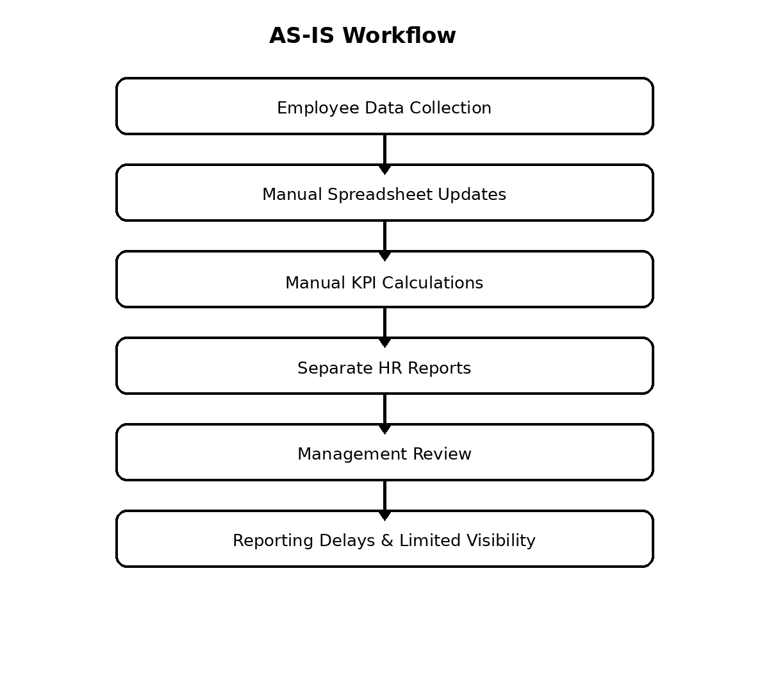
Current State Analysis (AS-IS Workflow)
Rohit P. B. | Business Analyst Portfolio
6

Slide 7
Proposed Solution
Centralized dashboard-based reporting
Workflow optimization and KPI visibility enhancement
Interactive HR analytics dashboards
Structured reporting workflows
Rohit P. B. | Business Analyst Portfolio
7

Slide 8
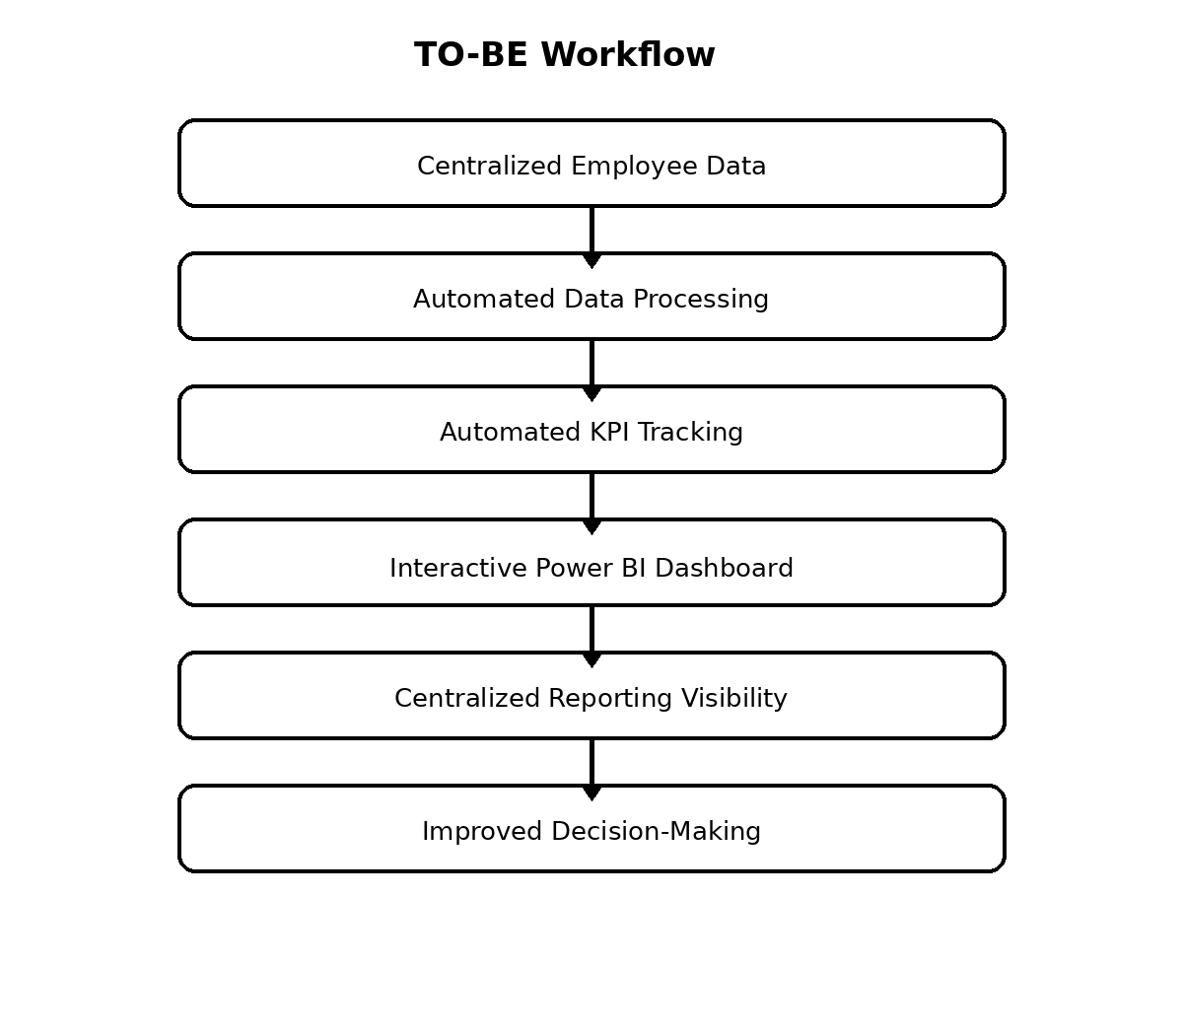
Future State Analysis (TO-BE Workflow)
Rohit P. B. | Business Analyst Portfolio
8

Slide 9
Key Insights
Interactive dashboards improved reporting visibility
Centralized analytics supported operational planning
Improved KPI accessibility for management review
Rohit P. B. | Business Analyst Portfolio
9

Slide 10
Recommendations
Standardize HR reporting workflows
Reduce manual reporting dependencies
Improve dashboard visibility
Enhance KPI tracking governance
Rohit P. B. | Business Analyst Portfolio
10

Slide 11
Business Impact
Reduced manual reporting effort
Improved workforce KPI visibility
Enhanced operational reporting consistency
Faster business decision-making
Rohit P. B. | Business Analyst Portfolio
11

Slide 12
Tools & Technologies
Microsoft Excel
Power BI
Power Query
Workflow Analysis
Dashboard Development
Rohit P. B. | Business Analyst Portfolio
12

Slide 13
Thank You
Thank you for reviewing this Business Analyst portfolio case study.
Rohit P. B.
Business Analyst Portfolio
LinkedIn: linkedin.com/in/rohit-p-b-a04b87369
GitHub: github.com/Rohit17-TVM
Medium: medium.com/@rohitpb17
Email: rohitpb17@gmail.com
Rohit P. B. | Business Analyst Portfolio
13

