Slide 1
LOWELL GENERAL HOSPITAL PROJECT
This project is about analyzing Insights of Lowell General Hospitals.
Lowell General Hospitals prioritizes patients over anything else.
Management considers there are multiple factors that could lead to dissatisfaction of patient.
To ensure, patients are well treated inside the hospital and hospital continues to be in the best name, management has decided to analyze Metrics as below:
Average Licensed Bed Occupancy Rate
Staff responsiveness Top Box score
Unassisted fall rates per 1000 patient days
1.Average Occupancy Rate | 2.Staff Responsiveness Top Box Score | 3.Unassisted Patient Falls per 1000 Patient Days
This measure is captured internally and measured as % Number of Patients in licensed Beds per day *100/ Number of Licensed Beds | This measure is captured by the Hospital Consumer Assessment of Healthcare Providers and Systems(HCAHPS) Survey, which is a survey sent out to patients following discharge from the hospital. It includes 2 questions: During the hospital stay, after you pressed the call button, how often did you get help as soon as you wanted it? How often did you get help in getting to the bathroom or in using a bedpan as soon as you wanted? Number of patients answering “Always” to both questions *100/ Number of patients answering both questions | This measure is captured by the National Database of Nursing Quality Indicators(NDNQI). A patient fall is defined as an unplanned descent to the floor with or without injury. Unassisted falls are where there is no staff member present to assist the patient. This is measured as: Number of patient falls*1000/ Number of patient days

Slide 2
Dataset Provided
Month | Average Licensed Bed Occupancy Rate | Unassisted Fall Rate per 1,000 Patient Days | Staff Responsiveness Domain Top Box Score | Unassisted Fall % | Staff Responsiveness Domain Top Box Score % | Staff Responsiveness Top Box Score Benchmark
Jan-20 | 96% | 2.21 | 68.34 | 0.221 | 0.6834 | 65
Feb-20 | 96% | 1.79 | 72.75 | 0.179 | 0.7275 | 65
Mar-20 | 81% | 1.03 | 67.07 | 0.103 | 0.6707 | 65
Apr-20 | 94% | 1.97 | 71.21 | 0.197 | 0.7121 | 65
May-20 | 101% | 3.41 | 57.68 | 0.341 | 0.5768 | 65
Jun-20 | 98% | 2.61 | 67.86 | 0.261 | 0.6786 | 65
Jul-20 | 95% | 2.42 | 66.09 | 0.242 | 0.6609 | 65
Aug-20 | 94% | 2.09 | 70.38 | 0.209 | 0.7038 | 65
Sep-20 | 95% | 3.11 | 53.31 | 0.311 | 0.5331 | 65
Oct-20 | 92% | 1.6 | 67.55 | 0.16 | 0.6755 | 65
Nov-20 | 95% | 2.31 | 60.35 | 0.231 | 0.6035 | 65
Dec-20 | 98% | 2.47 | 61.33 | 0.247 | 0.6133 | 65
Jan-21 | 100% | 3.03 | 61.06 | 0.303 | 0.6106 | 65
Feb-21 | 99% | 2.35 | 65.23 | 0.235 | 0.6523 | 65
Mar-21 | 95% | 2.47 | 64.02 | 0.247 | 0.6402 | 65
Apr-21 | 96% | 1.94 | 70.11 | 0.194 | 0.7011 | 65
May-21 | 94% | 2.54 | 68.16 | 0.254 | 0.6816 | 65

Slide 3
Metrics
Avg Bed Occupancy rate from 2020-2024
Staff Responsiveness Top Box Score with Benchmark
Unassisted Patient fall rate
Average Licensed Bed Occupancy Rate :
This metric remains consistently high, increasing slightly from 95% in 2020 to 97% from 2022 to 2024.
The stability indicates strong utilization of licensed beds across the years.
Average of Staff Responsiveness Domain Top Box Score Percentage
Staff responsiveness scores declined from 65% in 2020 to 61% in 2022, then slightly recovered to 64% in 2024.
Efforts to improve staff responsiveness appear to be yielding some results but still require attention.
Average of Unassisted Fall Percentage
The percentage of unassisted falls increased slightly from 23% in 2020 to 28% in 2022 and 2023 but decreased to 26% in 2024.
This could point to a need for further efforts to prevent unassisted falls.

Slide 4
Time in Range

Slide 5
Co-relation between KPIs
Co-relation co-efficient
Average Licensed Bed Occupancy Rate & Unassisted Fall % | Average Licensed Bed Occupancy Rate & Staff Responsiveness Top Box Score | Unassisted Fall Rate & Staff Responsiveness Domain Top Box Score
0.700112 | -0.37182 | -0.79134

Slide 6
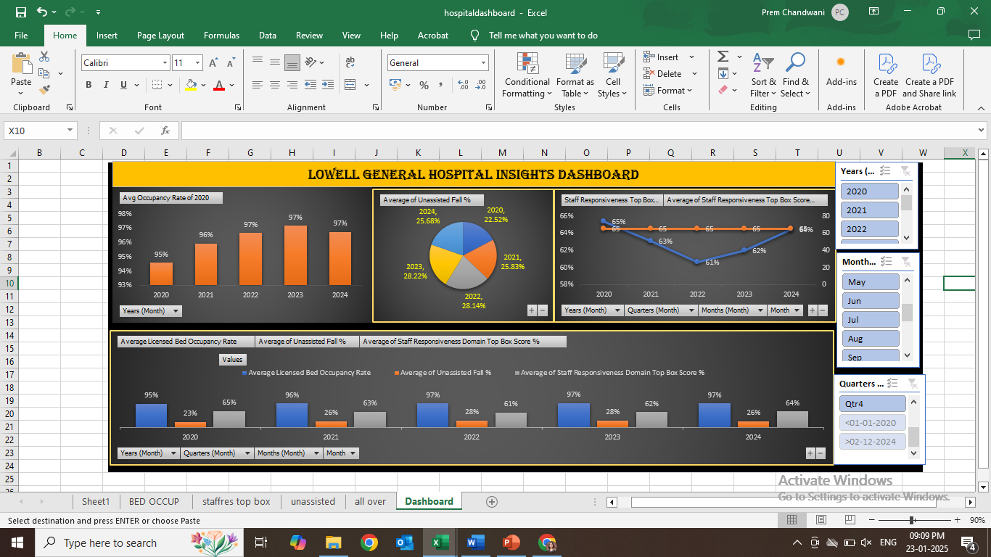
Dashboard

Slide 7
Summary of the Project
Project Objective: The project aimed to analyze insights from Lowell General Hospital to maintain quality and performance. 3 Metrics were considered to identify areas for improvement.
Findings:
Average Bed Occupancy Rate: Consistently high, suggesting the need for efficient resource allocation.
Staff Responsiveness: Correlated with patient safety, especially during periods of high bed occupancy.
Unassisted Fall Rate: Increased with higher occupancy, highlighting a need for better staff-patient ratios.
Key Insights & Recommendations:
Staff-Patient Ratio: A balanced ratio is crucial for reducing staff unresponsiveness and unassisted fall rates.
Staff Training: Focus on increasing alertness and responsiveness, especially during peak occupancy times, to improve patient safety and reduce falls.
Operational Efficiency: Regularly adjust staffing levels based on bed occupancy trends to ensure quality care at all times.
Conclusion: Maintaining an optimal bed occupancy rate, alongside improved staff responsiveness, is essential for ensuring patient safety and overall hospital performance. Long-term success depends on continuously refining staff training and operational strategies.

Slide 8
THANK YOU!! ROHIT PARYANI

