Slide 1

AI TRAFFIC CONTROLLER
Ideation Sprint, CBE

Slide 2
AI-based Smart traffic management and enforcement system
To overcome the problems of traffic management, solutions that can improve traffic signal controlling, violation detection and e-challan generation, public address systems are being invited.
AUTOMATION | AI-TRAFFIC CONTROLLER

Slide 3
Significance
Every day, almost 3,700 people are killed globally in road traffic crashes. (Nearly 2 people every minute)
Many people are affected daily by traffic issues as physically and mentally
Traffic violation and Less priority to emergency Vehicles causes more death

Slide 4
Target User
Use case
Reduce traffic timing
Violation detection
Traffic prediction and Route Sugesstion
E – challan Generation
Ambulance Detection
Government
Logistic Services
For General Public

Slide 5
Existing Solutions
Current Traffic system management uses:
“Fixed timers” for Each lane .
“Speed cameras” to detect High speed vehicles.
“ Intelligent Cameras” to detect violation detection.

Slide 6
Adoption Barriers
Adaption of Edge Computing
High Quality Cameras
Method of implementation in Large Scale

Slide 7
Value Proposition
1.“Camera Radar fusion” to detect and analyze the traffic density of a lane.
2. Emergency Vehicle Detection.
3. Violation Detection System with more Accuracy and e-challan generation.
4. By using Edge Computing to solve latency issues.

Slide 8
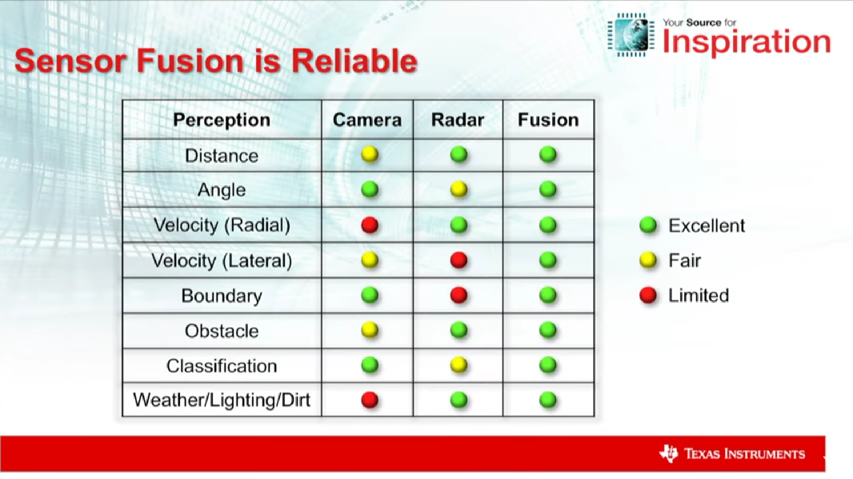
Solution Concept (MUP)
Camera radar fusion technology
robust under extreme weather conditions
High density lane with more Green signal time.

Slide 9
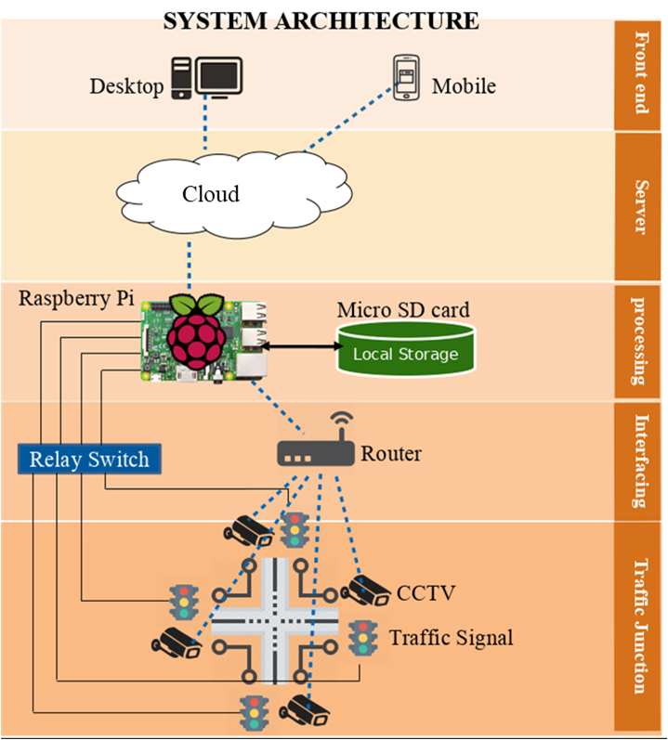
sound of the traffic matched with ambulance frequency(DL model), if found - high priority.
No helmet, wrong turn – number plate recognized - reported to the control room and e-chalaan will be generate.
Edge Computing is used and producing the output in signal time
The data from the camera is fed to the ml model and in the future is used to predict the traffic congestion in a particular area and suggest routes for users.

Slide 10
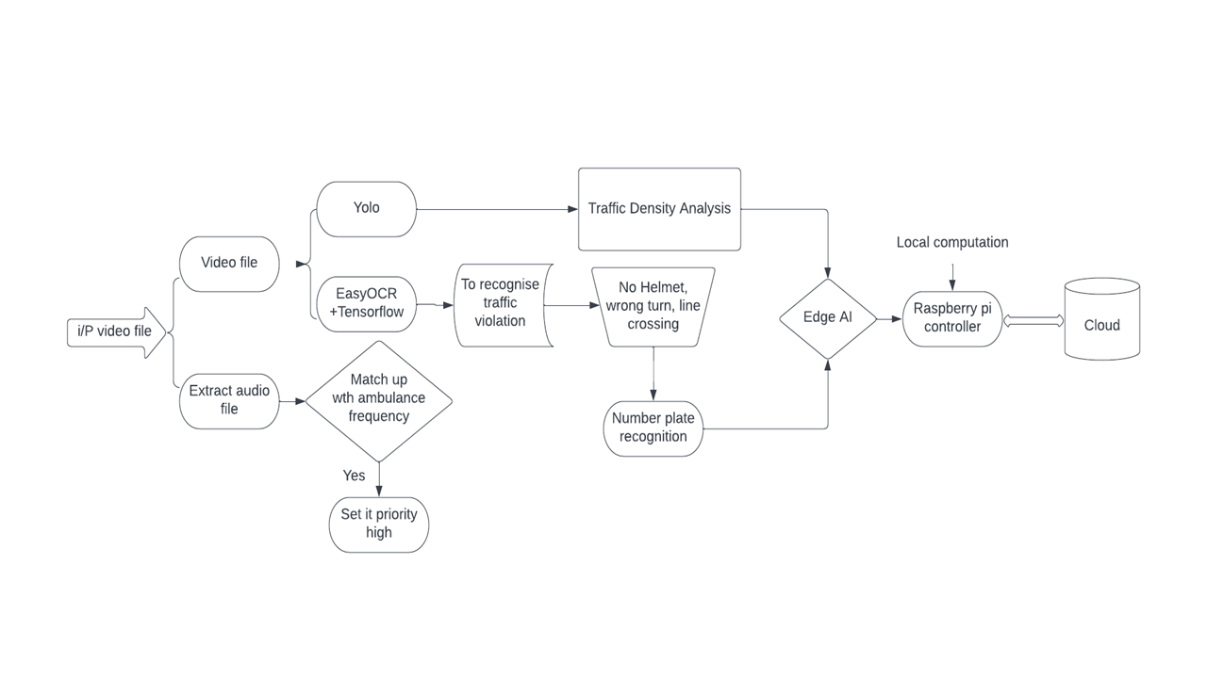

Slide 11
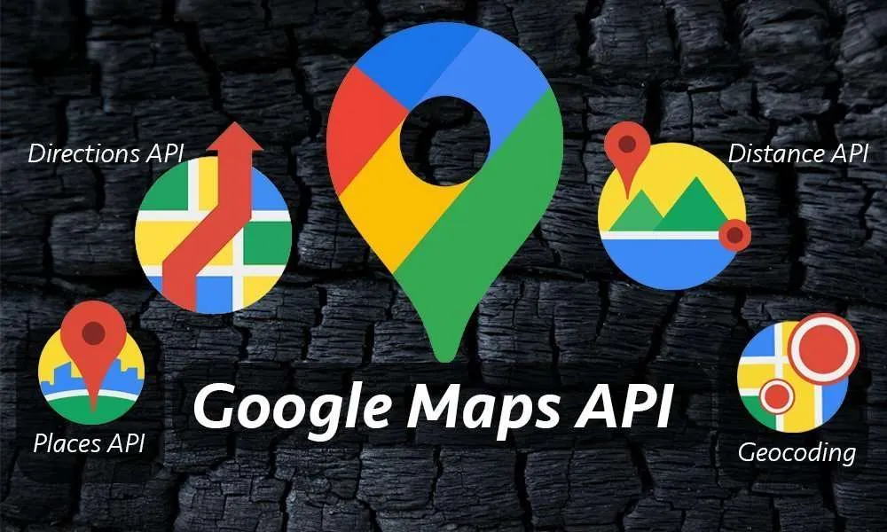

Next Steps
Construction sites provide 23% of traffic congestion as people are not aware of it
Google maps lag construction workplaces data
By integrating with the government and knowing about construction workplaces
Using google map API + the above data to create a more accurate traffic prediction model

Slide 12
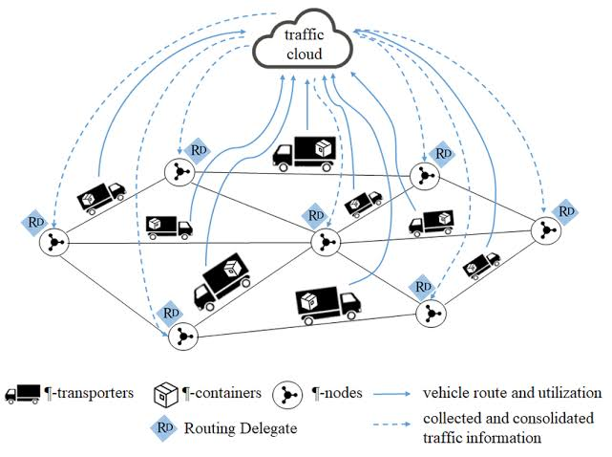
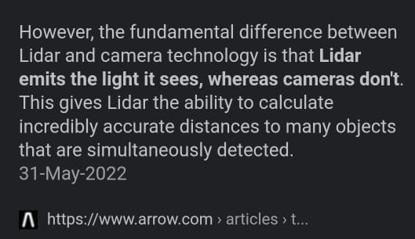

Slide 13
Thank You

