Slide 1
Theory of Computation
1
UNIT 1
FORMAL LANGUAGE THEORY AND FINITE
AUTOMATA

Slide 2
Computation
2
Computation is a general term for any type of information processing that can be represented as an algorithm precisely (mathematically).

Slide 3
Computation
3
Computation is a general term for any type of information processing that
can be represented as an algorithm precisely (mathematically).
Examples:
⯍ Adding two numbers in our brains, on a piece of paper or using a calculator.

Slide 4
Computation
4
Computation is a general term for any type of information processing that
can be represented as an algorithm precisely. (mathematically)
Examples:
⯍ Adding two numbers in our brains, on a piece of paper or using
a calculator.
⯍ Converting a decimal number to its binary presentation or vise versa.

Slide 5
Computation
5
Computation is a general term for any type of information processing that
can be represented as an algorithm precisely (mathematically).
Examples:
Adding two numbers in our brains, on a piece of paper or using a calculator.
Converting a decimal number to its binary presentation or vise
versa.
Finding the greatest common divisors of two numbers.

Slide 6
Why Theory in Computation ?
6
Theory gives us
Concepts
Principles
Steps
Limitations
Advantages
etc

Slide 7
Theory of Computation
7
A very fundamental and traditional branch of Theory of Computation seeks:
A more tangible definition for the intuitive notion of algorithm which results in a more concrete definition for computation.

Slide 8
Theory of Computation
8
A very fundamental and traditional branch of Theory of Computation seeks:
A more tangible definition for the intuitive notion of algorithm which results in a more concrete definition for computation.
Finding the boundaries (limitations) of computation.

Slide 9
Algorithm
9
A finite sequence of simple instructions that is guaranteed
to halt in a finite amount of time.

Slide 10
Basic Concepts
10
The Basic Concepts of TOC are
Languages
Grammar
Automata (Automaton)

Slide 11
Languages
11
A language is a structured system of communication used by humans,
based on speech and gesture (spoken language), sign, or often writing.
Language consist of
Symbols
Alphabets
Strings

Slide 12
Strings and Languages
12
Symbols: are Building blocks of language.
Ex. {a, b, c, d, e,…… 1, 2, 3, 4,……., A, B, C, D……..}
Alphabet: Finite, nonempty set of symbols
Examples:
∑ = {0, 1}: binary alphabet
∑ = {a, b, c, …, z}: the set of all lower case letters
The set of all ASCII characters
String: Finite sequence of symbols from an alphabet ∑ is represented by w
Examples:
01101 where ∑ = {0, 1} =0,1,01,10, 11,
abracadabra where ∑ = {a, b, c, …, z}

Slide 13
Strings and Languages
13
Empty String: The string with zero occurrences of symbols from ∑ and is denoted e or λ or ε
Length of String: Number of symbols in the string
The length of a string w is usually written |w| w=1010
|1010| = 4
|e| = 0
|uv| = |u| + |v|
Reverse : w^{R}
If w = abc, w^{R} = cba

Slide 14
Strings and Languages
14
Concatenation: if x and y are strings, then xy is the string obtained by placing a copy of y immediately after a copy of x
x = a₁a₂ …a_{i}, y = b₁b₂ …b_{j}
xy = a₁a₂ …a_{i}b₁b₂ …b_{j}
Example: x = 01101, y = 110, xy = 01101110
xe = ex = x

Slide 15
Strings and Languages
15
Substring: any string of consecutive characters in some string w
If w = abc
e, a, b, c, bc, ab, abc are substrings of w
Prefix and suffix:
if w = vu
v is a prefix of w
u is a suffix of w
Example 1:
If w = abc
a, ab , abc are prefixes of w
c, bc, abc are suffixes of w
Example 2:
Unhappy in this “un” is prefix and in quickly “ly” is suffix

Slide 16
Strings and Languages
16
Suppose: S is the string banana
Prefix : ban, banana
Suffix : ana, banana
Substring : nan, ban, ana, banana

Slide 17
* Closure/ Kleene Closure/ Power of an (∑) Alphabet
17
Power of an (∑) Alphabet: Σ^{k} = the set of strings of length k
with symbols from Σ
Example: Σ = {0, 1}
Σ⁰ =set of all string of length zero {ε}=2⁰ =1
Σ¹ = set of all string of length 1 = Σ = {0, 1} =2¹
Σ² = set of all string of length 2
= Σ. Σ = {0, 1}. {0, 1} = {00, 01, 10, 11} =2²
Σ³ = set of all string of length 3 = Σ. Σ . Σ =2³
= Σ². Σ = {00, 01, 10, 11} . {0, 1} = {000, 010, 100, 110, 001,
011, 101, 111}

Slide 18
Kleene Closure/ Power of an (∑) Alphabet
18
The set of all possible strings over Σ is called Kleene Closure denoted by
_{Σ}*
Σ^{*=} Σ^{n=} = Σ⁰ ∪ Σ¹ ∪ Σ² ∪ Σ³ ∪ …
Positive Closure
Σ⁺ = Σ¹ ∪ Σ² ∪ Σ³ ∪ …
Σ* = Σ⁺ ∪ {ε} or Σ⁺ + {ε}
Σ⁺ = Σ* - {ε}

Slide 19
Strings and Languages
19
Language: set of strings chosen from some alphabet
A language is a subset of Σ*
Example of languages:
⯍ The set of valid Arabic words
⯍ If ∑=(a, b) then L1 is Language of all strings of length two.
L1={aa, bb, ab, ba}
⯍ If ∑=(a, b) then L2 is Language of all strings of length three.
L2={aaa, bbb, aba, aab, abb, bab, bba, baa }
⯍ The set of strings consisting of n 0’s followed by n 1’s if ∑=(0, 1)
{e, 01, 0011, 000111, …}
⯍ The set of strings with equal number of 0’s and 1’s if ∑=(0, 1)
{e, 01, 10, 0011, 0101, 1010, 1001, 1100, …}

Slide 20
Strings and Languages
20
Empty language: ∅ = { }
The language { } consisting of the empty string
Note: ∅ ≠ {e}
Languages can be finite or infinite
L1 = {a, aba, bba}
L2 = {a^{n} | n > 0}={a, aa, aaa, aaaa,…….}
If ∑=(a, b) then L3 is Language of all strings starts with a. L3={a, aa, aaa, aaaa,…….ab, abb, aab,………..}

Slide 21
Strings and Languages
21
Can concatenate languages
L₁L₂ = {xy | x ∈ L₁, y ∈ L₂}
L^{n} = L concatenated with itself n times
L⁰ = {e}
L¹ = L
Star-closure
L* = L⁰ ∪ L¹ ∪ L² ∪ ...
L⁺ = L* - L⁰

Slide 22
 | St | rings and Languages 22
 | OPERATION | DEFINITION
 | union of L and M written L ∪ M | L ∪ M = {s | s is in L or s is in M}
 | concatenation of L and M written LM | LM = {st | s is in L and t is in M}
 | Kleene closure of L written as L* | L* = L⁰ ∪ L¹ ∪ L² ∪ ... L* denotes “zero or more concatenations of “ L
 | positive closure of L written as L⁺ | L⁺ = L¹ ∪ L² ∪ ... L⁺ denotes “one or more concatenations of “ L L⁺ = LL*

Slide 23
Strings and Languages (Example)
23
The language L consists of strings over {a,b} in which each
string begins with an a should have an even length
aa, ab ∈ L
aaaa, aaab, aaba ,aabb ,abaa, abab, abba, abbb ∈ L
baa ∉ L
a ∉ L

Slide 24


Strings and Languages (Example)
24
The language L consists of strings over {a,b} in which each occurring of b is
immediately preceded by a
e ∈ L
ab ∈ L
abaabab ∈ L
bb ∉ L
bab ∉ L
abb ∉ L

Slide 25

Strings and Languages (Example)
25
Let X = {a,b,c} and Y = {abb, ba}. Then
XY = {aabb, babb, cabb, aba, bba, cba}
X⁰ = {e}
X¹ = X = {a,b,c}
X² = XX = {aa,ab,ac,ba,bb,bc,ca,cb,cc}
X³ = XXX =
{aaa,aab,aac,aba,abb,abc,aca,acb,acc,baa,bab,bac,bba,bbb,
bbc,bca,bcb,bcc,caa,cab,cac,cba,cbb,cbc,cca,ccb,ccc}

Slide 26
Strings and Languages (Example)
26
The language L = {a,b} consists of the strings over {a,b} that contain the substring bb
bb ∈ L
abb ∈ L
bbb ∈ L
aabb ∈ L
bbaaa ∈ L
bbabba ∈ L
abab ∉ L
bab ∉ L
b ∉ L

Slide 27
Strings and Languages (Example)
27
Let L be the language that consists of all strings that begin
with aa or end with bb
L₁ = {aa}{a,b}*
L₂ = {a,b}*{bb}
L = L₁ ∪ L₂ = {aa}{a,b}* ∪ {a,b}*{bb}
bb ∈ L
abb ∈ L
bbb ∈ L
aabb ∈ L
bbaaa ∉ L
bbabba ∉ L
abab ∉ L
bab ∉ L
ba ∉ L

Slide 28
Finite Representations of Languages
28
Languages may be infinite sets of strings. We need a finite notation
for them. There are at least four ways to do this:
Language generators. The language can be represented as a mathematical sequence w1, w2, w3,……. such that the language is equal to the {w1, w2, w3………}. Given an integer i, the generator will produce the string wi.
Language acceptors. The language can be represented as a mathematical predicate, a membership tester. Given a string, this will tell if the string is in the language.
Mathematical descriptions, like { a^{n} b^{n} : n>=0 }
Explicit listings, like {0, 1, 01, 10}.

Slide 29
Finite Representations of Languages
29
Explicit listings work only for finite languages.
Math descriptions are very general, but it may be hard to know if a string is in the language.
Language acceptors have a hard time answering some questions, such as whether the language is empty.
Language generators have a hard time testing if a string is in the language.
There are uncountably many languages over a nonempty set ∑ but only countable many representations in a finite set of symbols. Therefore most languages will never have a finite representation.

Slide 30
Regular Expressions
for Representations of Languages
30
Regular Expressions: Regular expressions are one way to represent languages. They are analogous to arithmetic expressions for representing quantities. This notation will turn out to be useful for describing programming languages and also for text searching applications.
There are rules of inference for constructing regular expressions over an alphabet .
If a Є ∑ then a itself is a regular expression over ∑.
φ is a regular expression over ∑ .
If E and F are regular expressions over ∑ then so is (EF).
If E and F are regular expressions over ∑ then so is (E U F).
If E is a regular expression over ∑ then so is (E).
Parentheses can often be omitted.
.

Slide 31
Regular Expressions
for Representations of Languages
31
Example: Suppose Σ = {0, 1}.
Then 0 is a regular expression over {0, 1} by 1.
So (0) is a regular expression over {0, 1} by 5.
Also, 1 is a regular expression over {0, 1} by 1.
So 1.(0) is a regular expression over {0, 1} by 3.
Also (1) is a regular expression over {0, 1} by 5.
So 0.(1) is a regular expression over {0, 1} by 3.
Thus 1(0)U0(1) is a regular expression over {0, 1} by 4.

Slide 32
Regular Expressions
for Representations of Languages
32
Language Represented by a Regular Expression
If E is a regular expression then let L(E) be the language it represents.
We have the following rules:
If a Є ∑ then L(a) = {a}
L(φ) = φ;
L(EF) = L(E) . L(F)
L(E U F) = L(E) U L(F)
L(E*) = L(E)*

Slide 33
Grammar
for Representations of Languages
33
A grammar for a natural language tells us whether a particular sentence is well-formed or not.
It also tells us weather the sentence /string is a part of language or not.
Formal grammar:
G = (V, T, S, P)
V: finite set of variables
T: finite set of terminal symbols S∈V: start variable
P: finite set of productions

Slide 34
Grammar
for Representations of Languages
34
G ({S, A}, {a,b}, S, P)
where P
S -> Ab,
A -> aAb, A -> L.

Slide 35
Automata
35
An automaton also known as finite automata (FA) or Finite state machine (FSM) is an abstract model of a digital computer.
A finite automaton (FA) is a simple idealized machine used to recognize patterns within input taken from some character set (or alphabet) C.
The job of an FA is to accept or reject an input depending on whether the pattern defined by the FA occurs in the input.
Includes:
Input file:
Read as a string
One symbol at a time, left to right, EOF.
Can produce output
Has temporary storage
⯍ Unlimited, one character, may change
Control unit
⯍ Finite number of internal states, may change

Slide 36
Automata
36
A finite automaton (FA) is used for solving some common types of
algorithms such as.
Design of digital circuit
String Matching
Communication protocols for information exchange
Lexical analyzer of a compiler

Slide 37

Automata
37
Input file
Control Unit
Output
Accept / Reject
Storage

Slide 38
Automata
38
Input file: is divided into squares.
Input is a string over a given alphabet.
Each input square holds a symbol.
The symbols are read from left to right, one at a time.
The end of the input string can be detected.
Storage: consists of an unlimited number of cells.
Each cell can hold a symbol from an alphabet (which can be different from the input alphabet).
The contents of the storage cells can be read and changed.

Slide 39
Automata
39
Control unit: has a finite number of internal states.
Can be in any one of the internal states.
Can change state in some defined manner.

Slide 40
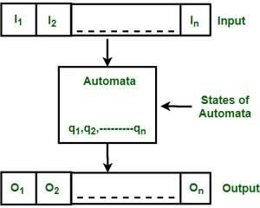
Automata
40
Finite Automata(FA) is the simplest machine to recognize patterns. The finite automata or finite state machine is an abstract machine which have five elements or tuple. It has a set of states and rules for moving from one state to another but it depends upon the applied input symbol. Basically it is an abstract model of digital computer. Following figure shows some essential features of a general automation.
Formal specification of machine is
{ Q, Σ, q, F, δ }.
Q : Finite set of states.
Σ : set of Input Symbols. q : Initial state.
F : set of Final States.
δ : Transition Function.

Slide 41






Automata 41
To understand consider the example. Consider the two state and if the input b is applied then its state is change in the same state. a _{b} a | states q0, q1. q0 is a Initial state while q1 is final s from q0 to q1 or q1 to q0. for input a it remains Input file
q | a | b | b | a | a
₀ q1 b
Q0b→Q1 |  | Control Unit
Q0a→Q0 Q1b→Q0
^{Q1a→q1} Storage Output
Accepted / Rejected

Slide 42
Basic Machine Vs Finite Automata
42
Machine is a system in which energy, material or information can be transformed human interaction.
Ex. Photo printing machine, metal cutting machine etc.
But it is very difficult to incorporate decision making power in machine using mechanical control
system.
FA is mathematical model for actual physical process and it can be viewed as a several restricted
model of computer.
A finite automaton (FA) is used for solving some common types of algorithms such as.
Design of digital circuit
String Matching
Communication protocols for information exchange
Lexical analyzer of a compiler
without any

Slide 43
Limitations of Finite Automata
43
It cannot be used for computations.
It cannot modify its input.
It cannot be used for context free language.
It cannot be used for recursive languages
It has a finite number of states and hence It cannot recognize
string of the form a^{n}b^{n}

Slide 44
Types of Finite Automata
44
Deterministic Finite Automata
Non Deterministic Finite Automata

Slide 45
Deterministic Finite Automata (DFA)
45
In DFA, for each input symbol, one can determine the single state to which the machine will move. Hence, it is called Deterministic Automaton.
As it has a finite number of states, the machine is called Deterministic Finite Machine or Deterministic Finite Automaton.
A DFA can be represented by a 5-tuple (Q, ∑, δ, q₀, F) where −
Q is a finite set of states.
∑ is a finite set of symbols called the alphabet.
δ is the transition function where δ: Q × ∑ → Q
q₀ is the initial state from where any input is processed (q₀ ∈ Q).
F is a set of final state/states of Q (F ⊆ Q).

Slide 46
Deterministic Finite Automata (DFA)
46
A DFA is represented by digraphs called state diagram.
The vertices represent the states.
The arcs labeled with an input alphabet show the transitions.
The initial state is denoted by an empty single incoming arc.
The final state is indicated by double circles
Example: Construct FA (state Diagram) for given M
Let a deterministic finite automaton be →
M=(Q, ∑, δ, q₀, F) where
Q = {a, b, c},
∑ = {0, 1},
q₀ = {a},
F = {c}, and

Slide 47

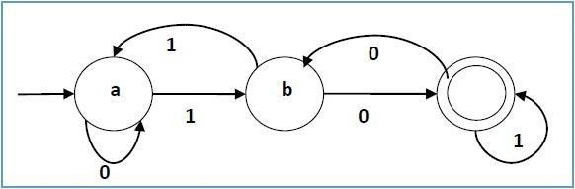
Deterministic Finite Automata (DFA)
47
Transition function δ or state transition table can be shown as following
table −
Present State | Next State for Input 0 | Next State for Input 1
a | a | b
b | c | a
c | b | c
State Transaction diagram :
Initial State
Intermediate State
c
Final State

Slide 48
Example on Counting of Symbols (DFA)
48
Ex 1. Give DFA accepting the following language over the alphabet {0,1}
1. Number of 1’s is multiple of 3.
2. Number of 1’s not multiple of 3.
Solution:
Number of 1’s is multiple of 3: number of 1’s seen so far by machine can be written as
3n ii. 3(n+1) iii. 3(n+2)
Corresponding to three states mentioned above there will be 3 states.
State q0- no of 1’s so far is 3n
State q1- no of 1’s so far is 3n+1
State q2- no of 1’s so far is 3n+2
Possible transactions that can cause are
q0 to q1 if machine is in q0
q1 to q2 if machine is in q1
q2 to q0 if machine is in q2
An input of 0 will cause transaction to same state.

Slide 49




Example on Counting of Symbols (DFA)
Solution: 1. Number of 1’s is multiple of 3.
0 0
0
1
1
q0
q1
q2
1
Input Symbols |  | 0 | 1
 | q0* | q0 | q1
q1 |  | q1 | q2
q2 |  | q2 | q0

Slide 50
Example on Counting of Symbols (DFA)
Solution: 1. Number of 1’s is multiple of 3.
M=(Q, ∑, δ, q₀, F) where
Q = {q0, q1, q2},
∑ = {0, 1},
q₀ = {q0},
F = {q0}, and
Input Symbols |  | 0 | 1
 | q0* | q0 | q1
q1 |  | q1 | q2
q2 |  | q2 | q0

Slide 51




Example on Counting of Symbols (DFA)
Solution: Number of 1’s not multiple of 3.
Let L be the language having Number of 1’s is multiple of 3 so:
Thus L= { w ∈ {0,1} | no of 1’s in w multiple of 3. }
So Complement of L will be given by
L’= { w ∈ {0,1} | no of 1’s in w not multiple of 3. }
So DFA for L’ can be obtained by following modifications in L:
Every Final state in L becomes non accepting / non final state in L’.
Every non Final state in L becomes accepting / final state in L’.
0 0
0
 | Input Symbols |  | 0 | 1
 |  | q0 | q0 | q1
 | Q1* |  | q1 | q2
 | Q2* |  | q2 | q0
1
1
q0
q1
q2
1
q1, q2 are final states. Machine will be in final state if number of 1’s read not in Multiple of 3n. Thus L= { w ∈ {0,1} | no of 1’s in multiple of 3. }

Slide 52
Example on Substring (DFA)
Ex 1. Draw DFA for the following language over the alphabet {a,b}
1. All strings starting with abb.
2. All strings with abb as substring.
3. All strings ending in abb.
Solution:
1. All strings starting with abb.
First input b will take the machine to failure State.
First two input as “aa” will take the machine to failure State.
First three input as “aba” will take the machine to failure State.
First three input as “abb” will take the machine to final State.
So consider the states q₀, q₁, q₂ and q₃.
Where q0 is initial state and q3 will be the final state.
Failure state will be represented by q_{φ}
SO DFA can be constructed as

Slide 53









Example on Substring (DFA)
a, b
a
b
b
q0
q1
q2
q3
a
b
a
q_{φ}
a, b
State Transition Diagram
 | Input Symbols |  | a | b
 |  | q0 | q1 | q_{φ}
 | q1 |  | q_{φ} | q2
 | q2 |  | q_{φ} | q3
 | q3* |  | q3 | q3
 | q_{φ} |  | q_{φ} | q_{φ}
State Transition table

Slide 54
Example on Substring (DFA)
Solution:
2. All strings with abb as substring.
q0 is the initial state First input a will take the machine to q1 State.
For state q1 preceding character is a and required ab to complete abb, so let us take b input to reach next State q2.
For state q2 preceding characters are “ab” and required b to complete abb, so let us take b input to reach next State q3.
A input b to state q0 will bring it to same state.
A input a to state q1 will bring it to same state.
A input a to state q2 will bring it to q1 state.
Q3 is the final state.
So let us draw State Transition Diagram and State Transition table.

Slide 55


Example on Substring (DFA)
b
a a, b
a
b
b
q0
q1
q2
q3
a
 | Input Symbols |  | a | b
 |  | q0 | q₁ | q₀
 | q1 |  | q₁ | q₂
 | q2 |  | q₁ | q₃
 | q3* |  | q₃ | q₃
State Transition Diagram
State Transition table

Slide 56
Example on Substring (DFA)
Solution:
3. All strings ending in abb.
q0 is the initial state First input a will take the machine to q1 State.
For state q1 preceding character is a and required ab to complete abb, so let us take b input to reach next State q2.
For state q2 preceding characters are “ab” and required b to complete abb, so let us take b input to reach next State q3.
A input b to state q0 will bring it to same state.
A input a to state q1 will bring it to same state.
A input a to state q2 will bring it to q1 state.
A input a to state q3 will bring it to q1 state.
A input b to state q3 will bring it to q0 state.
Q3 is the final state.
So let us draw State Transition Diagram and State Transition table.

Slide 57





Example on Substring (DFA)
a
a
b
a
b
b
q0
q1
q2
q3
b
a
 | Input Symbols |  | a | b
 |  | q0 | q₁ | q₀
 | q1 |  | q₁ | q₂
 | q2 |  | q₁ | q₃
 | q3* |  | q₁ | q₀
State Transition Diagram
State Transition table

Slide 58
Example on Substring (DFA)
Ex. 2: Design DFA that reads strings made up of letters in the word “CHARIOT” and recognize these strings that contain the word CAT as a substring.
q0 is the initial state First input C will take the machine to q1 State.
For state q1 preceding character is C and required AT to complete CAT, so let us take A input to reach next State q2.
For state q2 preceding characters are “CA” and required T to complete
CAT, so let us take T input to reach next State q3.
Any input (A,H,I,O,T,R) other than C to state q0 will bring it to same state.
An input C to state q1 will bring it to same state.
An input C to state q2 will bring it to q1 state and Any input (H,I,O,T,R)
other than C & T will bring it to q0 state .
Any input to state q3 will bring it to same state.
Q3 is the final state.
So let us draw State Transition Diagram and State Transition table.

Slide 59







Example on Substring (DFA)
a
A,C,H,I,O,T,R
A,H,I,O,T,R
C
H,I,O,T,R
State Transition Diagram
A
T
q0
q1
q2
q3
C
A,H,I,O,R
C
State Transition table
 | Input Symbols |  | C | H | A | R | I | O | T
 |  | q0 | q₁ | q₀ | q₀ | q₀ | q₀ | q₀ | q₀
 | q1 |  | q₁ | q₀ | q₂ | q₀ | q₀ | q₀ | q₀
 | q2 |  | q₁ | q₀ | q₀ | q₀ | q₀ | q₀ | q₃
 | q3* |  | q₃ | q₃ | q₃ | q₃ | q₃ | q₃ | q₃

Slide 60
Example on Divisibility(DFA)
Ex. 1: Design DFA Which can accept a binary number divisible by 3. Solution:
A binary number is divisible by 3 if the reminder is 0. So we must derive
the machine to determine the final reminder.
The binary number system having only two symbols {0, 1}.
The possible reminders could be
0→ Associated state q0
1→ Associated state q1
2→ Associated state q2
Now let us try to evaluate reminder for binary numbers.
Consider the following table to calculate reminder.

Slide 61
Example on Divisibility(DFA)
Ex. 1: Design DFA Which can accept a binary number divisible by 3. Solution:
Input | Binary Number | Division of Binary Number By 3 | Reminder | Input ends in state
0 | 00 | 00 % 3 | 0 | q0
1 | 01 | 01 % 3 | 1 | q1
0 | 10 | 10 % 3 | 2 | q2
1 | 11 | 11 % 3 | 0 | q0
0 | 100 | 100 % 3 | 1 | q1
1 | 101 | 101 % 3 | 2 | q2
0 | 110 | 110 % 3 | 0 | q0

Slide 62

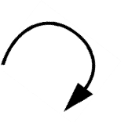




Example on Divisibility(DFA)
Ex. 1: Design DFA Which can accept a binary number divisible by 3. Solution:
So now let us draw the DFA for the given problem.
0
0
1
1
0
q0
q1
q2
1
 | Input Symbols |  | 0 | 1
 |  | q0* | q0 | q1
 | q1 |  | q2 | q0
 | q2 |  | q1 | q2

Slide 63
Example on Divisibility(DFA)
Ex. 2: Design DFA Which can accept a Decimal number divisible by 3. Solution:
A number is divisible by 3 if the reminder is 0. So we must derive the
machine to determine the final reminder.
A decimal Number system having 10 symbols.
∑ = {0, 1, 2, 3, 4, 5, 6, 7, 8, 9}
The possible reminders could be
0→ Associated state q0
1→ Associated state q1
2→ Associated state q2
➢
Now let us try to evaluate reminder for decimal numbers.

Slide 64
Example on Divisibility(DFA)
Ex. 2: Design DFA Which can accept a Decimal number divisible by 3. Solution:
As there are only three possible reminders so consider the transitions for
only three inputs
– 0 for (0, 3, 6, 9)
– 1 for (1, 4, 7)
– 2 for (2, 5, 8)
Now let us draw the table to derive the reminders for decimal number.

Slide 65
Example on Divisibility(DFA)
Ex. 1: Design DFA Which can accept a decimal number divisible by 3. Solution:
Input | Decimal Number | Division of Binary Number By 3 | Reminder | Input ends in state
0 | 0 | 0 % 3 | 0 | q0
1 | 1 | 1 % 3 | 1 | q1
2 | 2 | 2 % 3 | 2 | q2
0 | 3 | 3 % 3 | 0 | q0
1 | 4 | 4 % 3 | 1 | q1
2 | 5 | 5 % 3 | 2 | q2
0 | 6 | 6 % 3 | 0 | q0
1 | 7 | 7 % 3 | 1 | q1
2 | 8 | 8 % 3 | 2 | q2
0 | 9 | 9 % 3 | 0 | q0
1 | 10 | 10 % 3 | 1 | q1

Slide 66
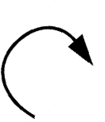

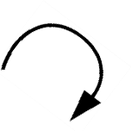







Example on Divisibility(DFA)
Ex. 1: Design DFA Which can accept a decimal number divisible by 3. Solution:
So now let us draw the DFA for the given problem.
0
2 2
0
1
1
q0
q1
q2
0
2
1
 | Input Symbols |  | 0 | 1 | 2
 |  | q0* | q0 | q1 | q2
 | q1 |  | q1 | q2 | q0
 | q2 |  | q2 | q0 | q1

Slide 67
Non Deterministic Finite Automata (NFA)
In NFA, for each input symbol, one can determine the multiple states to which the machine will move. Hence, it is called Non Deterministic Automaton.
In NFA, FA can reside in multiple states at same time for single input symbol.
As it has a finite number of states, the machine is called Deterministic Finite Machine or Deterministic Finite Automaton.
A NFA can be represented by a 5-tuple M=(Q, ∑, δ, q₀, F) where −
Q is a finite set of states.
∑ is a finite set of symbols called the alphabet.
δ is the transition function where δ: Q × ∑ → Q
q₀ is the initial state from where any input is processed (q₀ ∈ Q).
F is a set of final state/states of Q (F ⊆ Q).

Slide 68



Example of NFA
0,1
0, 1
1
0
q0 q1
State Transition Diagram
q2
Input Symbols |  | 0 | 1
 | q0 | {q0} | {q0,q1}
q1 |  | {q2} | φ
q2* |  | {q2} | {q2}
State Transition table

Slide 69



Processing of String by NFA
A string w ∈ ∑* is accepted by NFA M if δ* =(q0,w) containing a final state. Let us See how the String 011010 is processed by given NFA.
0,1
1
0
q0
q1
q2
State Transition Diagram

Slide 70






















Processing of String by NFA 011010
{q₀}
0
1
1
0
1
0
0
q₀
q₀
q₀
q₀
q₀
q₀
q₀
{q }
1
1
0
1
1
q₁
q₁
q₁
{q_{0,} q₁}
1
0
0
φ
q
1
2
q₂
{q q φ}
0
1
0, 1,
0
φ
φ
1
0
{q_{0,} q_{2,} φ}
φ
φ
1
0
{q_{0,} q_{1,} φ}
φ
0
70
{q_{0,} q_{2,} φ}

Slide 71























Non Deterministic Finite Automata (NFA)
On input 011010 the automata can take any of the following four Path.
0
1
1
0
1
0
1.
q₀
q₀
q₀
q₀
q₀
q₀
q₀
0
1
1
0
1
0
2.
q₀
q₀
q₀
q₀
q₀
q₁
q
2
0
1
1
0
1
0
3.
q₀
q₀
q₀
q₁
q₂
φ
φ
0
1
1
0
1
0
4.
q₀
q₁
φ
q₀ φ
φ
φ
So from above we can conclude that the given string is accepted as one of the solution (2)
Is ending to final state. Also every string ending with 10 is accepted by NFA.

Slide 72





Examples on NFA
EX.1 Draw NFA to accept strings containing the substring 00101.
0,1
0
0,1
0
1
0
1
q0
q1
q2
q3
q₄
State Transition Diagram
To reach the final string from q0 to final state q4 a substring 0101 is required.
Any string containing sub string 0101 is
accepted by above NFA.
Input Symbols |  | 0 | 1
 | q0 | {q0,q1} | {q0}
q1 |  | {q1} | {q2}
q2 |  | {q3} | φ
q3 |  | φ | {q4}
q4* |  | {q4} | {q4}
State Transition Table

Slide 73



Examples on NFA
EX.2 Draw NFA that accept various string from Language L={x ∈ {a,b} | x ends with
abb}.
a
a, b
a
b
b
q0
q1
q2
q₃
a
State Transition Diagram
To reach the final string from q0 to final
state q4 a substring aab is required.
Any string containing sub string aab is accepted by above NFA.
Input Symbols |  | a | b
q0 |  | {q0,q1} | {q0}
q1 |  | {q1} | {q2}
q2 |  | q1 | {q3}
q3* |  | φ | φ
State Transition Table

Slide 74






Examples on NFA
EX.3 Consider the NFA with states 1-5 and input alphabet {a, b} has following transaction table.
Draw a Transaction Diagram
Calculate δ*(1, ab)
Calculate δ*(1, abaab)
Input Symbols |  | a | b
q1 |  | {1,2} | {1}
q2 |  | {3} | {3}
q3 |  | {4} | {4}
q4 |  | {5} | φ
q5 |  | φ | {5}
Solution: 1.
State Transition Table
b
a, b
a
a, b
a, b
q3
a
q5
q1
q2
q4
State Transition Diagram

Slide 75
Examples on NFA
Solution:
2.
δ*(1, ab) = δ((δ(1, a), b)
=δ ((δ(1, 2), b)
= δ(1, b), U δ(2, b) ={1, 3}
3. δ*(1, abaab)= δ* (δ(1, a), baab) =δ* ((1, 2), baab)= δ* (δ(1,2),b),aab)
= δ* (1, 3), aab)
= δ* (1, 2, 4), ab)
= δ (1, 2, 3, 5), b)
= {1, 3, 4, 5}

Slide 76
NFA to DFA Conversion
The conversion of NFA to equivalent DFA is based on Subset construction. If a NFA consists of three states, Q= {q0,q1,q2}
The Machine could be in any of the following states:
φ
(q0), (q1), (q2)
(q0, q1), (q1, q2), (q0, q2)
(q0, q1, q2)
The no of possible states are 2^{Q}
The procedure of finding whether the given string is accepted by NFA includes following
steps.
Finding all possible paths followed by machine for given string.
Finding the set of states reached final state from the starting state by applying the string.
If the set of states obtained in step 2 contain a final state the given string is accepted by NFA.
This procedure can be applied to any string by constructing a successor table.

Slide 77
NFA to DFA Conversion
Step 1: Initially Q' = ϕ
Step 2: Add q0 of NFA to Q'. Then find the transitions from this start state.
Step 3: In Q', find the possible set of states for each input symbol. If this set of states is not in Q', then add it to Q'.
Step 4: In DFA, the final state will be all the states which contain F(final states of NFA)

Slide 78


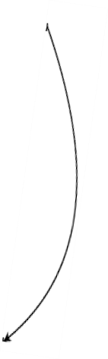
NFA to DFA Conversion Example-1
Ex. 1: Construct the Equivalent DFA from given NFA.
0
Input Symbols | 0 | 1
q0 | {q2} | φ
q1 | φ | {q0, q2}
q2 | {q0, q1} | {q0}
q0
q2
0, 1
1
1
0
q1
Solution: Construct the successor for given NFA. Step by step as explained follow

Slide 79



NFA to DFA Conversion Example-1
Step 1: Starting State {q0} is the first sub state. O successor for q0 is q2 i.e δ: (q0, 0)→ q2
1 successor for q0 is qφ i.e δ: (q0, 1)→ qφ
0
q0
q2
Input Symbols | 0 | 1
{q0} | {q2} | φ
1
φ
So in this step new substate q2 is generated so find the successor for q2

Slide 80




NFA to DFA Conversion Example-1
Step 2: Consider sub State {q2} is the recently generated sub state. O successor for q2 is q2 i.e δ: (q0, 0)→ (q0, q1)
1 successor for q2 is qφ i.e δ: (q0, 1)→ q0
1
0
Input Symbols | 0 | 1
{q0} | {q2} | φ
{q2} | {q0, q1} | {q0}
{q0}
{q2}
1
0
φ
{q0,q1}
So in this step new sub state {q0, q1} is generated so find the successor for {q0, q1}

Slide 81


NFA to DFA Conversion Example-1
Step 3: Consider sub State {q0, q1} is the recently generated sub state. O successor for {q0, q1} is q2 i.e δ: ((q0,q1), 0)→ (q2)
1 successor for {q0, q1} are q0, q2 i.e δ: ((q0,q1), 1)→ (q0, q2)
1
0
Input Symbols | 0 | 1
{q0} | {q2} | φ
{q2} | {q0, q1} | {q0}
{q0, q1} | {q2} | {q0, q2}
{q0}
{q2}
1
0
φ
0
{q0,q2}
{q0,q1}
1
So in this step new sub state {q0, q2} is generated so find the successor for {q0, q2}

Slide 82


NFA to DFA Conversion Example-1
Step 4: Consider sub State {q0, q2} is the recently generated sub state. O successor for {q0, q2} are q0, q1, q2 i.e δ: ((q0,q2), 0)→ (q0, q1, q2) 1 successor for {q0, q2} is q0 i.e δ: ((q0,q2), 1)→ (q0)
1
0
Input Symbols | 0 | 1
{q0} | {q2} | φ
{q2} | {q0, q1} | {q0}
{q0, q1} | {q2} | {q0, q2}
{q0, q2} | {q0, q1, q2} | {q0}
{q0}
{q2}
1
0
φ
1
1
{q0,q2}
{q0,q1}
1
0
So in this step new sub state {q0, q1, q2} is generated so find
the successor for {q0, q1, q2}
{q0, q1, q2}
Prepared
Vipin Wani

Slide 83

NFA to DFA Conversion Example-1
Step 5: Consider sub State {q0, q1, q2} is the recently generated sub state.
O successor for {q0, q1, q2} are q0, q1, q2 i.e δ: ((q0, q1, q2), 0)→ (q0, q1, q2)
1 successor for {q0, q1, q2} are q0, q2 i.e δ: ((q0, q1, q2), 1)→ (q0, q2)
1
0
Input Symbols | 0 | 1
{q0} | {q2} | φ
{q2} | {q0, q1} | {q0}
{q0, q1} | {q2} | {q0, q2}
{q0, q2} | {q0, q1, q2} | {q0}
{q0, q1, q2} | {q0, q1, q2} | {q0, q2}
{q0}
{q2}
1
0
φ
1
1
{q0,q2}
{q0,q1}
1
0
1
As now no new sub state is generated so the process of sub set
generation stops.
{q0, q1, q2}
0
Prepared
Vipin Wani

Slide 84





NFA to DFA Conversion Example-1
Step 6: As the q2 is the final state in NFA so every sub state containing q2 will be final state in DFA.
1
0
 | Input Symbols |  | 0 | 1
 |  | {q0} | {q2} | φ
 | {q2}* |  | {q0, q1} | {q0}
 | {q0, q1} |  | {q2} | {q0, q2}
 | {q0, q2}* |  | {q0, q1, q2} | {q0}
 | {q0, q1, q2}* |  | {q0, q1, q2} | {q0, q2}
{q0}
{q2}
1
0
φ
1
1
{q0,q2}
{q0,q1}
1
0
1
This is the final DFA after representing Final states.
{q0, q1, q2}
Prepared
V pin Wani
0

Slide 85

NFA to DFA Conversion Example-2
Ex. 2: Construct the Equivalent DFA from given NFA.
 |  | Input Symbols | 0 | 1
 | p |  | {p, q} | {p}
 | q |  | {r} | {r}
 | r |  | {s} | φ
 | s* |  | {s} | {s}
Solution: Start the subset generation step by step.
The maximum number of possible sub states are 2^{Q =} 16.

Slide 86
NFA to DFA Conversion Example-2
Input Symbols | 0 | 1
{p} | {p, q} | {p}
{p, q} | {p, q, r} | {p, r}
{p, q, r} | {p, q, r, s} | {p, r}
{p, r} | {p, q, s} | {p}
{p, q, s} | {p, q, r, s} | {p, r, s}
{p, q, r, s} | {p, q, r, s} | {p, r, s}
{p, r, s} | {p, q, s} | {p, s}
{p, s} | {p, q, s} | {p, s}
A new subset {p, q} is generated
A new subset {p, q, r} & {p, r} are generated
A new subset {p, q, r, s} is generated
A new subset {p, q, s} is generated A new subset {p, r, s} is generated A new subset {p, s} is generated
A new subset {p, q, s} is generated No new sub state so stop.

Slide 87
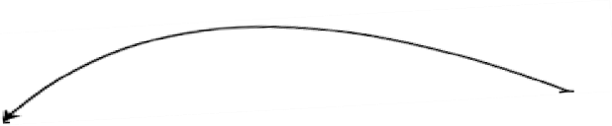














NFA to DFA Conversion Examples-2
1
1
1
0
0
{p}
{p, q}
{p, r}
{p, q, s}
0
0
1
{p, q, r}
1
0
0
1
{p, r, s}
{p, q, r, s}
1
0
0
{p, s}
1

Slide 88
NFA to DFA Conversion Example-3
Ex. 3: Construct the Equivalent DFA from given NFA.
 | Input Symbols |  | 0 | 1
 |  | p | {p, q} | {p}
 | q |  | {r, s} | {t}
 | r |  | {p, r} | {t}
 | s* |  | φ | φ
 | t* |  | φ | φ
Solution: Start the subset generation step by step.
The maximum number of possible sub states are 2^{Q =} 32.

Slide 89
NFA to DFA Conversion Example-3
Input Symbols | 0 | 1
{p} | {p, q} | {p}
{p, q} | {p, q, r, s} | {p, t}
{p, q, r, s} | {p, q, r, s} | {p, t}
{p, t} | {p, q} | {p}
A new subset {p, q} is generated
A new subset {p, q, r, s} & {p, t} are generated
No new sub state so stop.

Slide 90
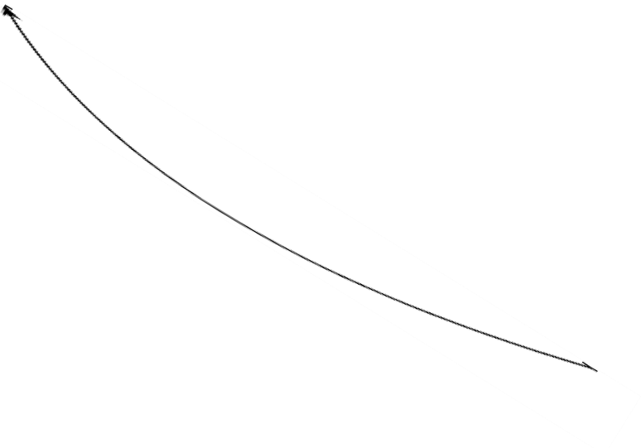



NFA to DFA Conversion Example-3
1
0
{p}
{p, q}
1
1
0
0
1
{p, s}
{p, q, r, s}
0

Slide 91



Construction of NFA & DFA Example-1
Ex. 1: Construct the NFA and then Equivalent DFA accepting strings over {0,1}
For accepting all possible strings of Zero and ones not containing 101 as sub string.
Solution: This problem is fully deterministic. A DFA with φ transitions not mentioned Is Called as NFA
0
1
1
0
q0
q1
q2
0
State q0 is initial state which will cause machine to move in state q1 on input1.
State q1 will cause machine to move in state q2 on input 0.
State q2 will cause machine to move in state q1 on input 0 and on input 1 it will move
to failure state φ.

Slide 92




Construction of NFA & DFA Example-1
NFA can be converted into DFA by introducing an explicate failure state.
So the equivalent DFA can be constructed as follow
0
1
0, 1
0
1
1
q0
q1
q2
φ
0

Slide 93
Construction of NFA & DFA Example-2
Ex. 1: Construct the NFA and then Equivalent DFA accepting strings over {0,1}
For accepting all possible strings of Zero and ones not containing 011 as sub string.
Solution: This problem is fully deterministic. A DFA with φ transitions not mentioned Is Called as NFA
1
0
0
1
q0
q1
q2
0
State q0 is initial state which will cause machine to move in state q1 on input 0.
State q1 will cause machine to move in state q2 on input 1.
State q2 will cause machine to move in state q1 on input 0 and on input 1 it will move
to failure state φ.

Slide 94




Construction of NFA & DFA Example-1
NFA can be converted into DFA by introducing an explicate failure state.
So the equivalent DFA can be constructed as follow
1
0
0, 1
0
1
1
q0
q1
q2
φ
0

Slide 95

NFA with ε −Transitions
ε stands for a null symbol. An ε transition allows transition on ε or no input the empty string . This implies that a Machine can make a transition without any input.
When finding the string describe by path containing arc with label ε, the ε symbols are
discarded.
The use of ε transition may specify the transition graph by reducing numbers of labeled arcs.
Steps to remove e transition from NFA.
ε
S1 S2
Consider the ε transition from state S1 to s2 then follow the following steps to remove transition .
Find all edges starting from S2.
Duplicate all edges to S1 without changing the edge label.
If s1 is initial state then mark s2 also as initial state.
If s2 is final state then mark s1 also as final state.
Remove the dead states.
95

Slide 96











NFA with ε −Transitions Example
Ex. 1: Use direct methods to find an equivalent NFA without ε moves for the given NFA bellow.
0
2
1
ε
ε
q0 q1 q2
Solution:
Step 1: Transition from q2 duplicated on q1, and make a q1 as final state.
0
1
2
ε
2
q0
q1
q2
Step 2: Transition from q1 is duplicated on q0, and make a q0 as final state.
0 1
2
1
2
q0
q1
q2
2

Slide 97







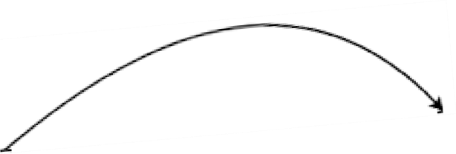






NFA with ε −Transitions Example-2
Ex. 2: Use direct methods to find an equivalent NFA without ε moves for the given NFA bellow.
0
0
ε
B
C
A
1
1
ε
E
D
0
Outgoing transitions from B & D are duplicated on A as δ (A, ε) =B and δ (A, ε) = D.
0
0
0
B
1
C
0,1
A
1
E
D
0
97

Slide 98
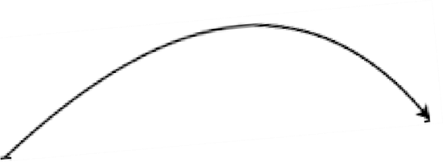





NFA with ε −Transitions Example-2
The state D can be deleted as it don’t have any incoming transitions.
1
0
0
B
1
C
0,1
A
1
E
98

Slide 99










ε −Closures
Give formal definition of ε closures with suitable example. for a null symbol.
ε Closures of state qi is the set of states including qi where qi can be reached by any numbers of ε moves of given non deterministic finite automata.
ε Closure of qi
ε Closure of qi, includes qi
Set of states reachable from qi on ε moves.
Set of states reachable from existing states in ε closure using ε moves and so on .
ε
q2
q3
0
0
ε
ε
ε
ε
q7
q0
q1
q6
ε
1
ε
q4
q5
Prepared by
ε

Slide 100
ε −Closures Example
Find ε Closure for given NFA.
ε Closures of state qi is the set of states including qi where qi can be reached by any numbers of ε moves of given non deterministic finite automata.
so let us determine the ε Closures for each sub state.
Step 1: ε Closures of q0= {q0, q1, q2, q4, q7}
{q0 to q1, q0 to q7, q1 to q2, q1 to q4. }
Step 2: ε Closures of q1= {q1, q2, q4}
The ε moves from q0 are =
q1 to q2,
q1 to q4. }
The ε moves from q1 are = {
Step 3: ε Closures of q2= { q2 }
There are no any ε moves from q2

Slide 101
ε −Closures Example
Step 4: ε Closures of q3= {q3, q6, q7, q1, q2, q4}
{q3 to q6, q6 to q7, q6 to q1 q1 to q2, q1 to q4. }
The ε moves from q3 are =
Step 5: ε Closures of q4= { q4 }
There are no any ε moves from q4
Step 6: ε Closures of q5= {q5, q6, q7, q1, q2, q4}
q5 to q6, q6 to q7, q6 to q1, q1 to q2, q1 to q4}
The ε moves from q5 are = {

Slide 102
ε −Closures Example Step 7: ε Closures of q6= { q6, q7, q1, q2, q4} The ε moves from q6 are = { q6 to q7, q6 to q1, q1 to q2, q1 to q4} Step 8: ε Closures of q7= { q7 }
There are no any ε moves from q7 So the ε Closures of all states can be Summarized in table shown bellow. | State | ε -Closures
 | q0 | {q0, q1, q2, q4, q7}
 | q1 | {q1, q2, q4}
 | q2 | {q2}
 | q3 | {q3, q6, q7, q1, q2, q4}
 | q4 | { q4 }
 | q5 | {q5, q6, q7, q1, q2, q4}
 | q6 | { q6, q7, q1, q2, q4}
 | q7 | {q7}
102

Slide 103













Construction of NFA & DFA Example
Construct NFA and then DFA with reduced states equivalent to (0+1)* (00+11) (0+1)*
Solution: Construction of above mentioned NFA.
0, 1
0, 1
0
0
ε
ε
ε
ε
1
1
Now remove unnecessary ε moves .
0
2
1
{q0, q1, q2}
{ q1, q2}
103
{ q2}

Slide 104















Construction of NFA & DFA Example
Solution: Construction of DFA.
0 2
2
1
2
{q0, q1, q2}
{ q1, q2}
{ q2}
1
0
0, 1
0, 1
The State {q0, q1, q3 } and {q0, q2, q3 } are not repeatable, as they are having common outgoing behavior.
qφ
{ q0, q1}
0
0
0
{q0}
1
{ q0, q3}
1
1
104
0, 1
{ q0, q2}

Slide 105
Deference Between NFA & DFA
DFA | NFA
DFA is Deterministic Finite Automata. | NFA is Nondeterministic Finite Automata.
For each symbolic representation of the alphabet, there is only one state transition in DFA. | For each symbolic representation of the alphabet, there are multiple state transition in NFA.
DFA cannot use Empty String transition. | NFA can use Empty String transition.
DFA can be understood as one machine. | NFA can be understood as multiple little machines computing at the same time.
In DFA, the next possible state is distinctly set. | In NFA, each pair of state and input symbol can have many possible next states.
DFA is more difficult to construct. | NFA is easier to construct.
Time needed for executing an input string is less. | Time needed for executing an input string is more.
All DFA are NFA. | Not all NFA are DFA.
DFA requires more space. | NFA requires less space then DFA.
It is easy to determine weather w ∈ L as transitions are deterministic. | It is difficult to determine weather w ∈ L as transitions are non deterministic.

Slide 106
Finite automata as Output Device (Moore / Mealy Machine)
Finite automata we have discussed so far had limited functionalities.
It was able to either accept or reject the string based on reachability of machine from start to final state.
Finite automata can also be used as an output device.
Such machines don’t have final states.
Such machines can generate output on every input.
The value of output is a function of current state and current input.
This machine can be characterized by two behaviors.
State Transition Function (STF ): denoted by δ
δ: ∑ X Q → Q
Output Function / Machine Function (MAF): denoted by λ
λ: ∑ X Q → O / λ: Q → O

Slide 107








Formal Definition of Mealy Machine
A Mealy machine is a finite-state machine whose output values are determined by both its current state and the current inputs.
A Mealy machine can be represented by a 6-tuple M=(Q, ∑, O, δ, λ, q₀) where −
Q is a finite set of states.
∑ is a finite set of input symbols called the alphabet.
O is a finite set of output symbols.
δ is the transition function where δ: Q × ∑ → Q
5. λ is the output function where λ : Q × ∑ → O
6. q₀ is the initial state from where any input is processed (q₀ ∈ Q).
a/0
q0
a/1
a/0
b/0
b/1
q2
q3
a/0
b/0
b/0
q1
Prepared by: SMtra.VteipitnrWanansiitionDiagram For Mea10ly7machine

Slide 108
Mealy Machine
State table for both transition function (δ) and output function (λ) can be shown as
Input Symbols | a | b
q0 | q0 | q1
q1 | q0 | q2
q2 | q0 | q3
q3 | q3 | q3
States | a | b
q0 | 0 | 0
q1 | 0 | 0
q2 | 1 | 0
q3 | 0 | 0
output function for Mealy machine
State transition function For Mealy machine
Input Symbols | a | b
q0 | q0/0 | q1/0
q1 | q0/0 | q2/0
q2 | q0/1 | q3/0
q3 | q3/0 | q3/0
Here in q1 / 0
q1 is next state on transition.
0 is a output on applying input.
S^{P}t^{r}a^{e}t^{p}e^{are}t^{d}ra^{by}n:s^{M}it^{r.}io^{Vi}n^{pin}an^{W}d^{an}o^{i}utput function combi¹n⁰e⁸dFor Mealy machine

Slide 109







Formal Definition of Moore Machine
A Moore machine is a finite-state machine whose output values are determined solely by its current state only.
A Mealy machine can be represented by a 5-tuple M=(Q, ∑, O, δ, λ, q₀) where −
Q is a finite set of states.
∑ is a finite set of input symbols called the alphabet.
O is a finite set of output symbols.
δ is the transition function where δ: Q × ∑ → Q
5. λ is the output function where λ : Q → O
6. q₀ is the initial state from where any input is processed (q₀ ∈ Q).
q1/ a
0
0
Input Symbols | 0 | 1
q0 | q1 | q2
q1 | q1 | q2
q2 | q1 | q2
State | output
q0 | ε
q1 | a
q2 | b
q0/ε
0
1
1
q2/
b
1
SPtraetpearetdrabyn:sMitr.ioVinpinDWiaagniram
State transition function For Moore machine
output function for Moore machine

Slide 110
Moore Machine
State table for both transition function (δ) and output function (λ) can be shown as
Input Symbols | 0 | 1 | output
q0 | q1 | q2 | ε
q1 | q1 | q2 | a
q2 | q1 | q2 | b
Output in Moore machine is associated with a state and not with transition.
In more machine length of output string will be equivalent to length of input string plus one.
i.e. if length of input string is 5 so length of output string will be 5+1=6.

Slide 111
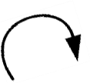





Moore / Mealy Machine Examples
Construct moore & mealy machine for the input {0 ,1 ,2} print the residue module 5 Of the input treated as ternary (Base 3).
2/0
0/0
1/1
0/1
q0
q1
q2
q3
q4
2/2
Output in Moore machine is associated with a state and not with transition.

Slide 112
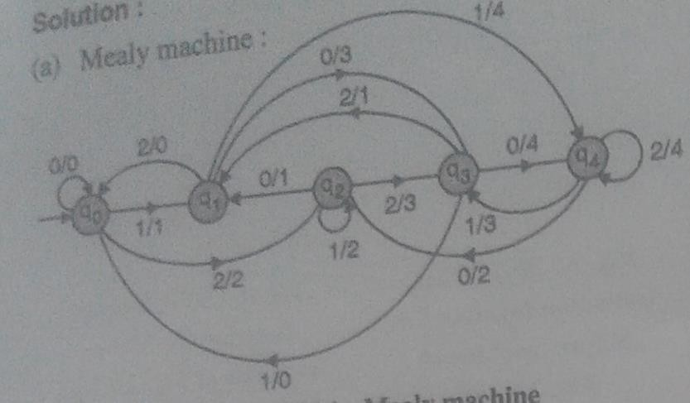
Moore / Mealy Machine Example-1
Ex 1: Construct Moore & mealy machine for the input {0 ,1 ,2} print the residue module 5 Of the input treated as ternary (Base 3).
nstruct moore & mealy machine for the input {0 ,1 ,2} print the residue module 5
of the input treated as ternary (Base 3).
Meaning of various states is given bellow: q0 is Running reminder is 0.
q1 is Running reminder is 1.
q2 is Running reminder is 2.
q3 is Running reminder is 3 =(10)3. q4 is Running reminder is 4=(11)3.
Mealy Machine is shown in above diagram

Slide 113
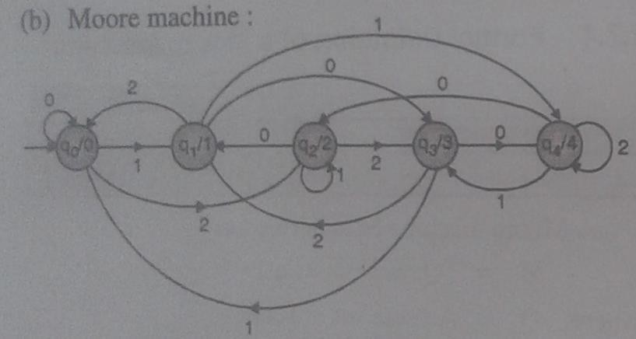
Moore / Mealy Machine Examples
Moore Machine:
Moore Machine is shown in above diagram

Slide 114
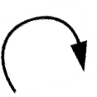



Moore / Mealy Machine Examples-2
Ex 2: Construct mealy machine that gives output of 1 if the input string ends in “bab”.
a/0
b/0
b/1
b/0
a/0
q0
q1
q2
a/0
Meaning of various states.
q0 Starting state.
q1 Make the preceding character b.
q2 generate the preceding character ba
q2 to q1transition will generate the preceding character bab so output will be 1.
Input Symbols | a | b
q0 | q0/0 | q1/0
q1 | q2/0 | q1/0
q2 | q0/0 | q1/1

Slide 115
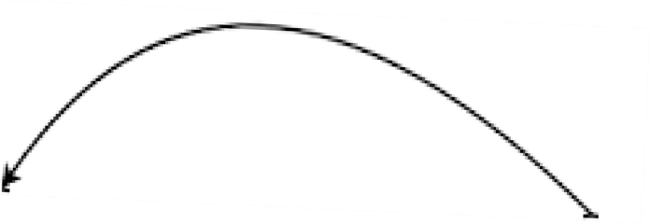




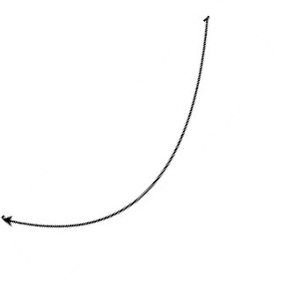
Moore / Mealy Machine Examples-3 Ex 3: Construct Moore machine that gives output of 1 if the input strings ends in “bab”. a a _{b} b a ^{q0/} q1/0 q2/0 0 a b b q3/ 1
Meaning of various states. q0 Starting state. q1 Make the preceding character a. q2 generate the preceding character ba q2 to q3 transition will generate the preceding character bab so output will be 1. | Input Symbols | a | b | Output
 | q0 | q0 | q1 | 0
 | q1 | q2 | q1 | 0
 | q2 | q0 | q3 | 0
 | q3 | q2 | q1 | 1
115

Slide 116

Moore / Mealy Machine Examples-4 Ex 4: Construct Moore machine that gives output of 1’s complement of binary number. 1 1 0 q0/ ⁰ ₀ q1/1 Meaning of various states. q0 Starting state. q0 moves the machine to q1 on input 0
& output 1. O’s complement is 1. q1 moves the machine to q0 on input 1 & output 0. 1’s complement is 0. | Input Symbols | 0 | 1 | Output
 | q0 | q1 | q0 | 0
 | q1 | q1 | q0 | 1
116

Slide 117
Moore / Mealy Machine Examples-5
Ex 5: Construct Mealy machine that gives output of 2’s complement of binary number.
0/0
0/1
1/0
1/1
q0
q1
Meaning of various states.
2’s Complement of binary number can be found by not changing the bits from
Input Symbols | 0 | 1
q0 | q0 / 0 | q0/ 0
q1 | q1 /1 | q1 /1
₁st
right side till ‘1’ and then
complementing remaining bits.
Ex. Consider Binary number 010110 1000
010110 1000
= 1010011000
Complement
No Change
P_{E}r_{v}ep_{e}a_{r}r_{y}ed_{b}b_{i}y_{t}: Mr. Vipin Wani
117

Slide 118

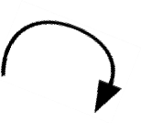

Moore / Mealy Machine Examples-6
Ex 6: Design Mealy machine that will read the sentence made up of vowels of English language it will output in same sequences except in cases where i follows e it will be converted to u.
a/a i/i
o/o u/u
e/e
e/e
q0
q1
a/a i/u
o/o u/u
Meaning of various states.
Machine must convert every occurrence of ei into eu. In other cases output will be same as input.
State q1 implies that thee preceding character is e.
An Input I in state q1 is converted to u.

Slide 119
Moore / Mealy Machine Examples-6
State Transition & Output Function can be shown as bellow.
Input Symbols | Next State/ Output
 | a | e | i | o | u
q0 | q0 | q1 | q0 | q0 | q0
 | a | e | i | o | u
q1 | q0 | q1 | q0 | q0 | q0
 | a | e | u | o | u

Slide 120
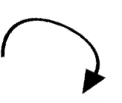






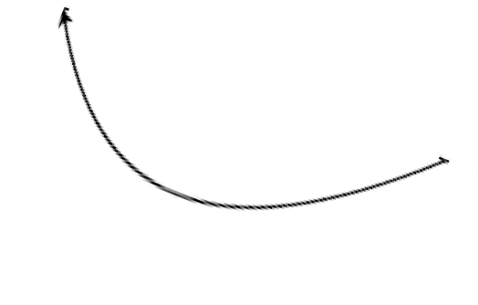
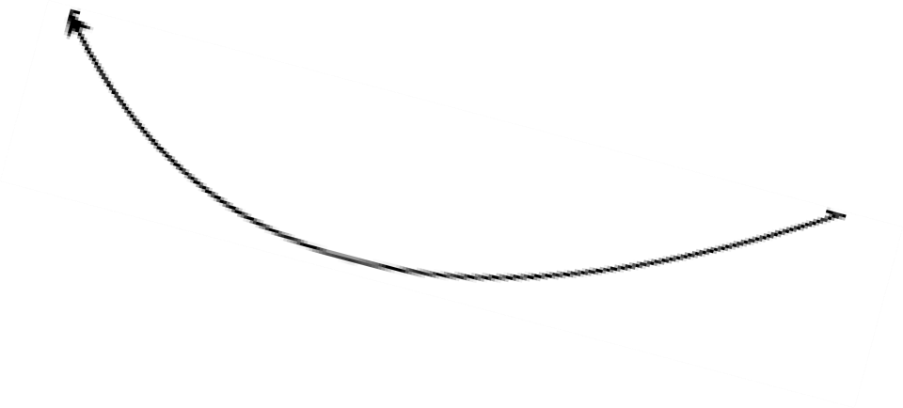
Moore / Mealy Machine Example-7
Ex 7: Design Mealy and Moore machine for the following processes. For input from (0+1)* if input end in 101 output ‘X’ and if input end in 110 output ‘Y’ , otherwise output ‘Z’.
1/z
0/z
1/z
q2
1/z
q0
q1
0/y
0/z
0/z
q3
1/x
Mealy machine
Meaning of various states.
Machine must produce output X on input 101 so q0 to q1, q1 to q3 and q3 to q1 producing string 101 which will produce the output X.
Machine must produce output Y on input 110 so q0 to q1, q1 to q2 and q2 to
q3 producing string 110 which will produce the output Y.
All other transitions will produce output Z.

Slide 121
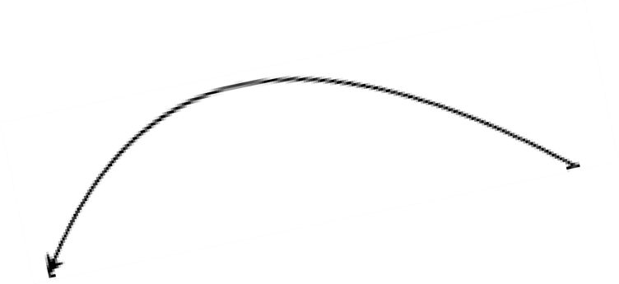
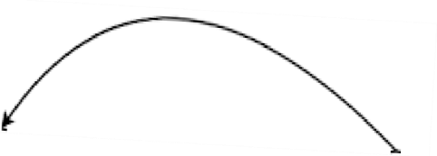







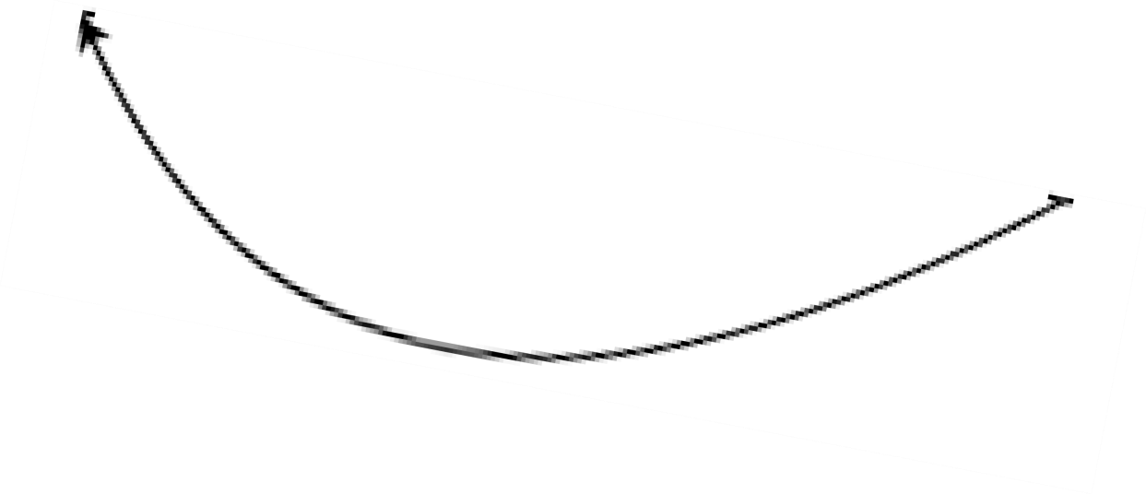



Moore / Mealy Machine Example-7
0
0
1
0
Q2/Z
0
Q3/X
1
Q0/Z
Q1/Z
1
1
0
0
Q4/Z
Q5/Y
1
0,1
Moore machine
Meaning of various states.
Machine must produce output X on input 101 so q0 to q1, q1 to q2 and q2 to q3 producing string 101 which will produce the output X.
Machine must produce output Y on input 110 so q0 to q1, q1 to q4 and q4 to
q5 producing string 110 which will produce the output Y.
• All other transitions will produce output Z.
121

Slide 122







Conversion of Mealy Machine to Moore Machine Example-1 Construct a mealy machine that accept string ending in 00 and 11. Convert the same to moore machine. Solution: Construct Mealy Machine. 0/1 0/0 ^{q1} ^{q0} 0/0 _{1/0} 1/0 q2 1/1
 | Input Symbols | Next State /Output |  | Required Mealy Machine, State transitio and output function as shown here.
 |  | 0 | 1
 | q0 | q1 /0 | q2/ 0
 | q1 | q1 /1 | q2/ 0
 | q2 | q1 /0 | q2/ 1
122
n

Slide 123
Conversion of Mealy Machine to Moore Machine Example-1
Meaning of various states. q0- is a initial state.
q1- has preceding input 0 from q0 next input 0 will complete the sequence 00. q2- has preceding input 1 from q0 next input 1 will complete the sequence 11.
Conversion from Mealy to Moore Machine:
Step 1: Splitting of the states
There is no incoming line associated with q0 so output associated with q0 will be
ε.
There are three incoming lines to state q1
q0 to q1 on input 0 and output 0.
q1 to q1 on input 0 and output 1.
q2 to q1 on input 0 and output 0.
Since there are two different output we will split the state q1 in two sub states namely q1 for output 0 and q1’ for output 1.
Similarly split q2 into q2 for output 0 and q2’ for output 1.
Step 2: Draw equivalent Moore machine after splitting.
123

Slide 124



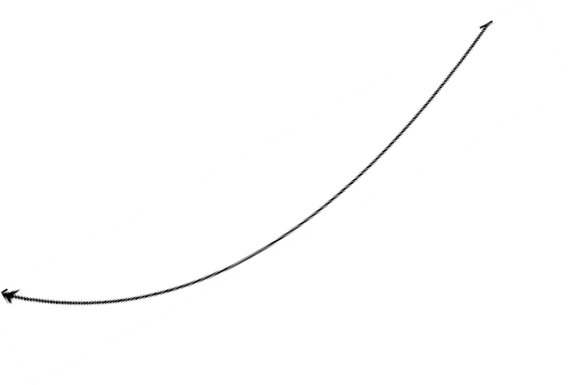





Conversion of Mealy Machine to Moore Machine Example-1 Step 2: Conversion from Mealy to Moore Machine. ₀ 0 q1 /0 q1’ /1 0 0 q0 / ε ⁰ ₁ ¹ ¹ q2 / 0 q2’ / 1 1 1
 | Input Symbols | Next State |  | Output | Required More Machine, State transition and output function as shown here. If mealy machine having m no of states and n output symbols then possible no of states in resultant Moore machine will be mn.
 |  | 0 | 1
 | q0 | q1 | q2 | ε
 | q1 | q1’ | q2 | 0
 | q1’ | q1’ | q2 | 1
 | q2 | q1 | q2’ | 0
 | q2’ | q1 | q2’ | 1
124

Slide 125

Conversion of Mealy Machine to Moore Machine Example-2
Ex 2: Convert the given mealy machine to equivalent more machine.
 | Input Symbols |  | Next State /Output
 |  |  | 0 | 1
 |  | q1 | q1 /1 | q2/ 0
 | q2 |  | q4 /1 | q4/ 1
 | q3 |  | q2 /1 | q3/ 1
 | q4 |  | q3 /0 | q1 /1
Solution:
Step 1: Splitting of the states: Split the states if the incoming arcs are having different
output.
Split the state q1 into q1 with output 0 and q1’ with output 1. Split the state q2 into q2 with output 0 and q2’ with output 1. Split the state q3 into q3 with output 0 and q3’ with output 1.
As all incoming edge to q4 are producing same output so no need to split it will always
produce the output 1.

Slide 126











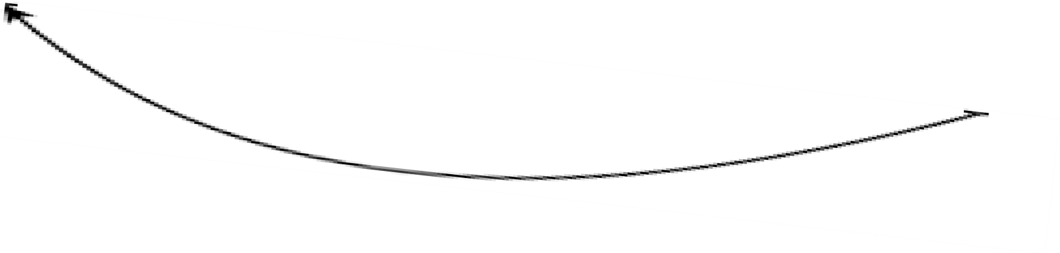
Conversion of Mealy Machine to Moore Machine Example-2
Step 2: Convert to equivalent Moore machine.
1
q1/ε
q2/0
q2’/1
0, 1
1
0
0
0
0, 1
q1’/1
q3/0
1
q3’/1
1
0
1
0
q4/1

Slide 127
Conversion of Mealy Machine to Moore Machine Example-2
Step 2: Construct state transition and output function for Moore machine.
Input Symbols | Next State |  | Output
 | 0 | 1
q1 | q1’ | q2 | ε
q1’ | q1’ | q2 | 1
q2 | q4 | q4 | 0
q2’ | q4 | q4 | 1
q3 | q2’ | q3’ | 0
q3’ | q2’ | q3’ | 1
q4 | q3 | q1’ | 1

Slide 128



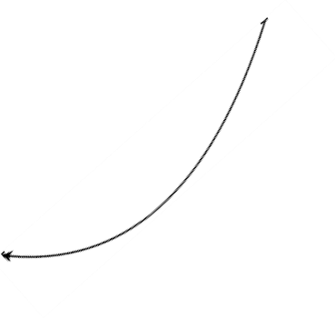








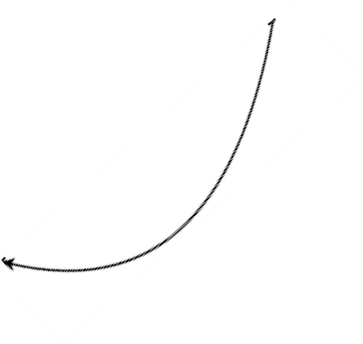


Conversion of Moore Machine to Mealy Machine Example-1
Ex1: Convert the given Moore machine in to mealy machine
q0/1
q1/0
b
a
b
a
b
a
q2/0
q3/1
a
b
q0
q1
b/0
a/0
b/0
Solution:
Construction of trivial
mealy machine by moving output associated with a state to transitions entering that state, we get.
b/1
a/0
a/1
q3
q2
a/0
b/0

Slide 129
Conversion of Moore Machine to Mealy Machine Example-1
Construct state transition and output function for mealy machine.
Input Symbols | Next State /Output
 | 0 | 1
q0 | q2 /0 | q3/ 1
q1 | q3/ 1 | q2 /0
q2 | q1 /0 | q2 /0
q3 | q2 /0 | q1 /0
Step 2: Minimization of mealy machine
1 equivalent participations p1 based on output P1= (q0), (q1), (q2, q3)
2 equivalent participations p2 based on transition:
q2 is mapped with block (q1) on input 0.
q3 is mapped with block (q2, q3) on input 0.
P2= (q0), (q1), (q2) , (q3)

Slide 130





FSM for Vending Machine
A typical vending machine look like as following.
Reset
N
Coin Sensor
 | D
Vending Machine FSM
Release Mechanism
Clock
A vending machine can be designed using FSM model with auto billing. It reduces the hardware. The typical no of steps included in FSM vending machines are:
Selection of product by User.
waiting for Insertion of Coin.
Product delivery and service.
Entire things can be modeled using mealy machine.
Machine can count the value of inserted coin and take the decision regarding
product release.
FSM can also be used for spelling checking.

Slide 131
Mealy Machine Vs Moore Machine.
The following table highlights the points that differentiate a Mealy Machine from a Moore Machine.
Mealy Machine | Moore Machine
Output depends both upon the present state and the present input | Output depends only upon the present state.
Generally, it has fewer states than Moore Machine. | Generally, it has more states than Mealy Machine.
The value of the output function is a function of the transitions and the changes, when the input logic on the present state is done. | The value of the output function is a function of the current state and the changes at the clock edges, whenever state changes occur.
Mealy machines react faster to inputs. They generally react in the same clock cycle. | In Moore machines, more logic is required to decode the outputs resulting in more circuit delays. They generally react one clock cycle later.

Slide 132


