Slide 1
INTRODUCTION
TO
JAVA
DATABASE
CONNECTIVITY

Slide 2

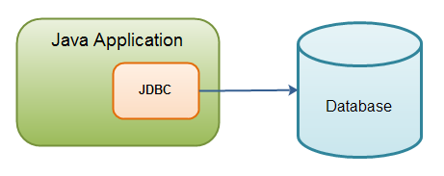
JAVA DATABASE CONNECTIVITY (JDBC)
The Java Database Connectivity (JDBC) API is used to access databases from Java programs.

Slide 3

Tools Required
Java Development kit (JDK)
Database
JDBC Driver for your Database
4. Integrated Development Environment (IDE)

Slide 4
DRIVER
To communicate with your database using JDBC, you will need a JDBC driver. Usually you will get this from the database vendor
JDBC driver must be loaded before you connect to Database
Method : Class.forName( ) ;
Example : Class.forName("sun.jdbc.odbc.JdbcOdbcDriver");

Slide 5
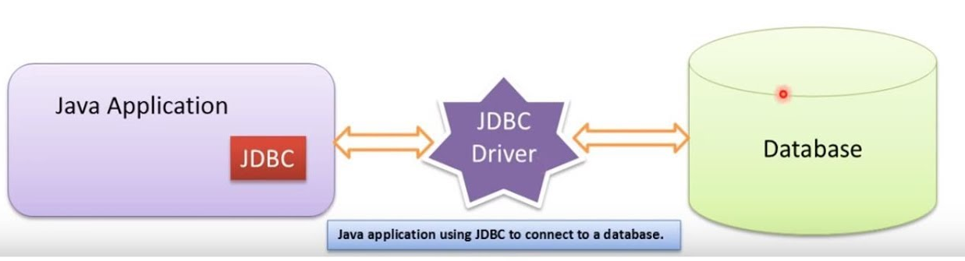

Slide 6
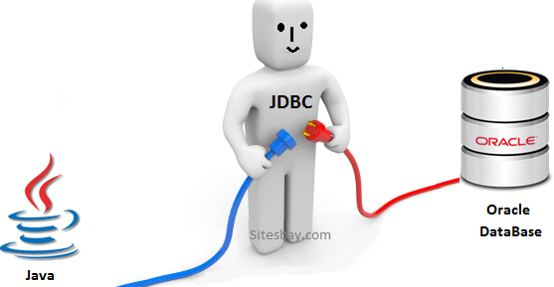
CONNECTION
With the JDBC driver loaded, getting a connection is easy. You import the JDBC classes
(which are in the java.sql package) and call the
getConnection ( );
method of the DriverManager class.
import java.sql.*;
Connection Con = DriverManager.getConnection("jdbc:tinySQL");

Slide 7
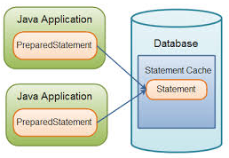
STATEMENTS
Once you have an open connection to a database, you can extract and manipulate data using SQL
(Structured Query Language) via database statements
To create a Database statement
Statement stmt = con. createStatement ();
Then we can use
Stmt.executeQuery( );
to execute the SQL statements.

Slide 8
JDBC Connection Example (MySQL)
Handling a connection requires following steps:
1) Load the driver 2) Open database connection 3) Close database connection

Slide 9
JDBC Connection Example (MySQL)
public class ConnectionDemo {
public static void main(String[ ] args) {
try
{
Class.forName("com.mysql.jdbc.Driver");
System.out.println("MySQL JDBC Driver Registered!");
Connection con = null;
con = DriverManager.getConnection("jdbc:mysql://localhost:3306/jdbcdemo", "root", "password");
System.out.println("SQL Connection to database established!");
con.close();
System.out.println("Connection closed !!");
} catch (SQLException e) {
e.printStackTrace();
}
}

Slide 10
JDBC Connection Example (Oracle)
Handling a connection requires following steps:
1) Load the driver 2) Open database connection 3) Close database connection

Slide 11
JDBC Connection Example (Oracle)
public class ConnectionDemo {
public static void main(String[ ] args) {
try
{
Class.forName(“oracle.jdbc.driver.OracleDriver");
System.out.println("MySQL JDBC Driver Registered!");
Connection con = null;
con=DriverManager.getConnection("jdbc:oracle:thin:@localhost:1521:xe","system","oracle");
System.out.println(“ORACLE Connection to database established!");
con.close();
System.out.println("Connection closed !!");
} catch (Exception e) {
System.out.println(e);
}
}

Slide 12
JDBC RowSet Interface
The instance of RowSet is the java bean component because it has properties and java bean notification mechanism.
It is introduced since JDK 5.
It is the wrapper of ResultSet. It holds tabular data like ResultSet but it is easy and flexible to use.
The implementation classes of RowSet interface are as follows:
1. JdbcRowSet
2. CachedRowSet
3. WebRowSet
4. JoinRowSet
5. FilteredRowSet

Slide 13
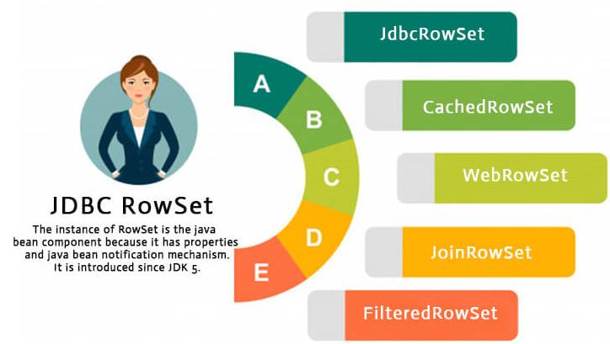

Slide 14

Practice Exercises
Java programs to store & Retrieve Images.
2. Java programs for various Transaction Management .

Slide 15


