Slide 1
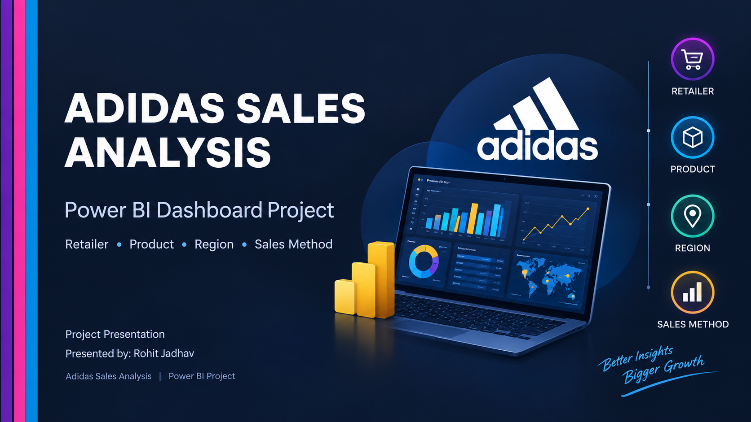
1

Slide 2
1. Project Overview
Business-focused view of Adidas sales performance
Project Goal
Key Analysis Areas
• Analyze Adidas sales performance across products, retailers, regions and sales methods.
• Build an interactive Power BI dashboard for quick comparison and decision-making.
• Use KPI cards and visual analysis to identify high-performing segments.
• Compare 2020 and 2021 performance using the available year filters.
• Overall sales and units sold
• Retailer-wise performance
• Product-wise performance
• Region-wise performance
• Sales-method contribution: In-store, Outlet and Online
• Monthly / yearly comparison indicators
Adidas Sales Analysis | Power BI Project
2

Slide 3
2. Dashboard Structure
The report is organized into four analytical views
01
02
Dashboard
Product Wise Analysis
Executive summary of Dashboard and KPIs
Product and state-level performance
03
04
Retailer Wise Analysis
Region Wise Analysis
Retailer, region and product mix
Regional sales, product mix and state detail
Adidas Sales Analysis | Power BI Project
3

Slide 4
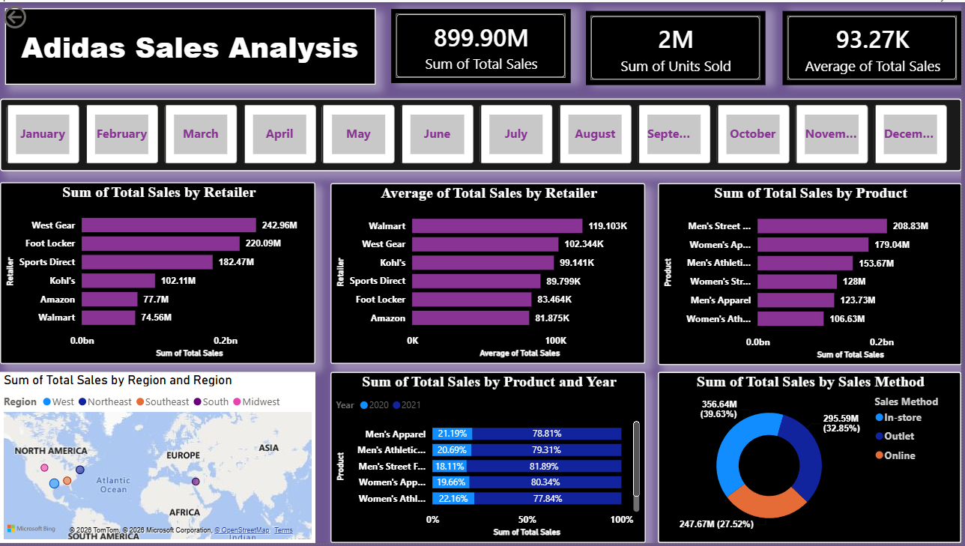
3. Executive Dashboard
Top-level KPIs and Dashboard performance breakdown
TOTAL SALES
UNITS SOLD
AVERAGE SALES
899.90M
2.48M
93.27K
Sum of Total Sales
Sum of Units Sold
Average of Total Sales
What the dashboard shows
• West Gear, Foot Locker and Sports Direct account for about 72% of total sales, so revenue is concentrated in a few key retailers.
• Walmart ranks last in total sales (74.56M) but first in average sale (119.1K), because it places fewer but larger orders.
• Product comparison places Men's Street Footwear at the top.
• In-store sales contribute the largest share ~40% among the three sales methods.
• The map provides a regional view of sales distribution.
• A 20/80 split is exact in your data: 2021 delivered 80% of total sales, about 4x the prior year.
Adidas Sales Analysis | Power BI Projectf
4

Slide 5
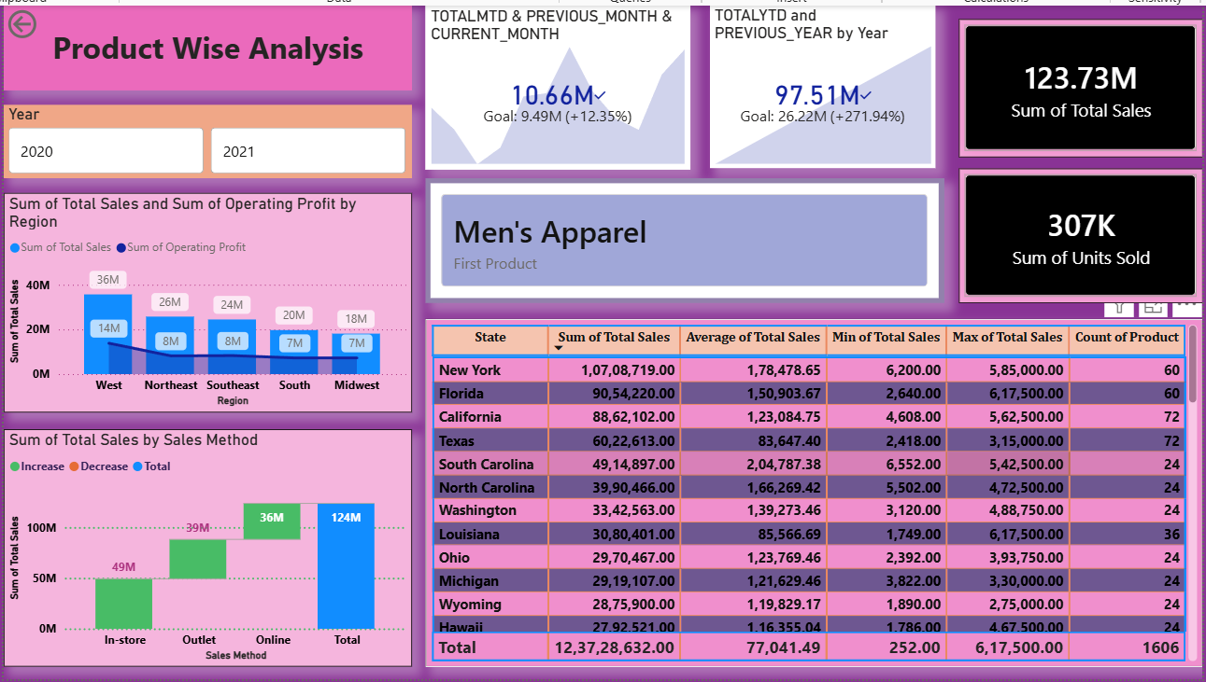
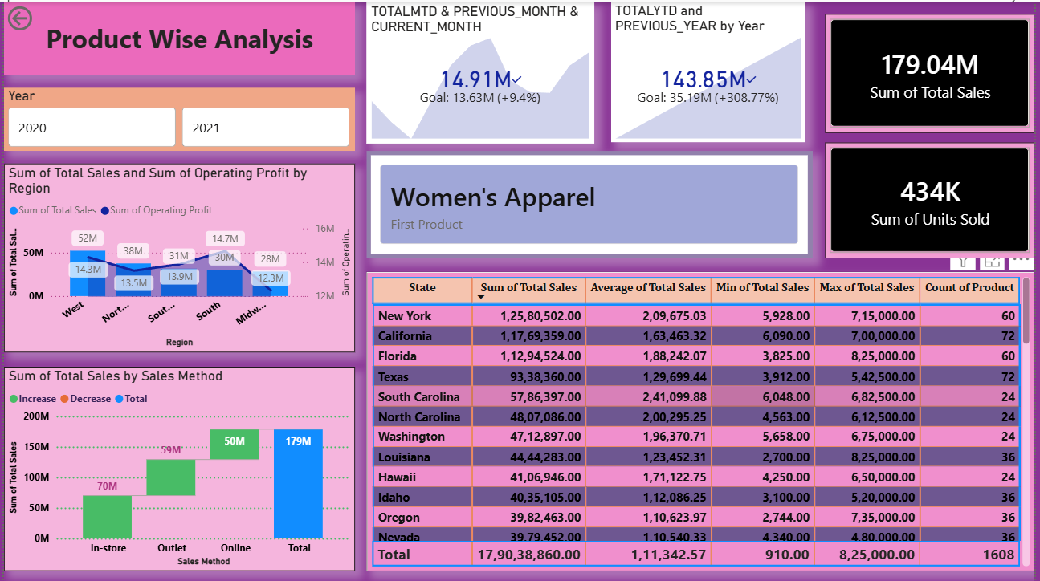
4. Product-Wise Analysis
Men's Apparel VS Women's Apparel
Key observations
• Sales: Women's Apparel earns 179.0M (19.9%) against 123.7M (13.7%) for Men's Apparel, a gap of 55.3M.
• Volume: Women's sells 434K units against 307K (about 41% more).
• Order size: Both have about 1,600 transactions, but Women's average order is 111K vs 77K (44% higher). The sales gap comes from larger orders, not more orders.
• Growth: Both grew about 4x in 2021: Women's +309% and Men's +272%. Women's gained share (19.3% to 20.0%) while Men's lost share (14.4% to 13.6%).
• Latest-month momentum: Both slowed, Women's +9.4% and Men's +12.3%, against about +45% for footwear.
• Channels and states: Both sell about 40% in-store, 32–33% outlet and 28–29% online. New York leads both (12.6M for Women's, 10.7M for Men’s).
Adidas Sales Analysis | Power BI Project
5

Slide 6
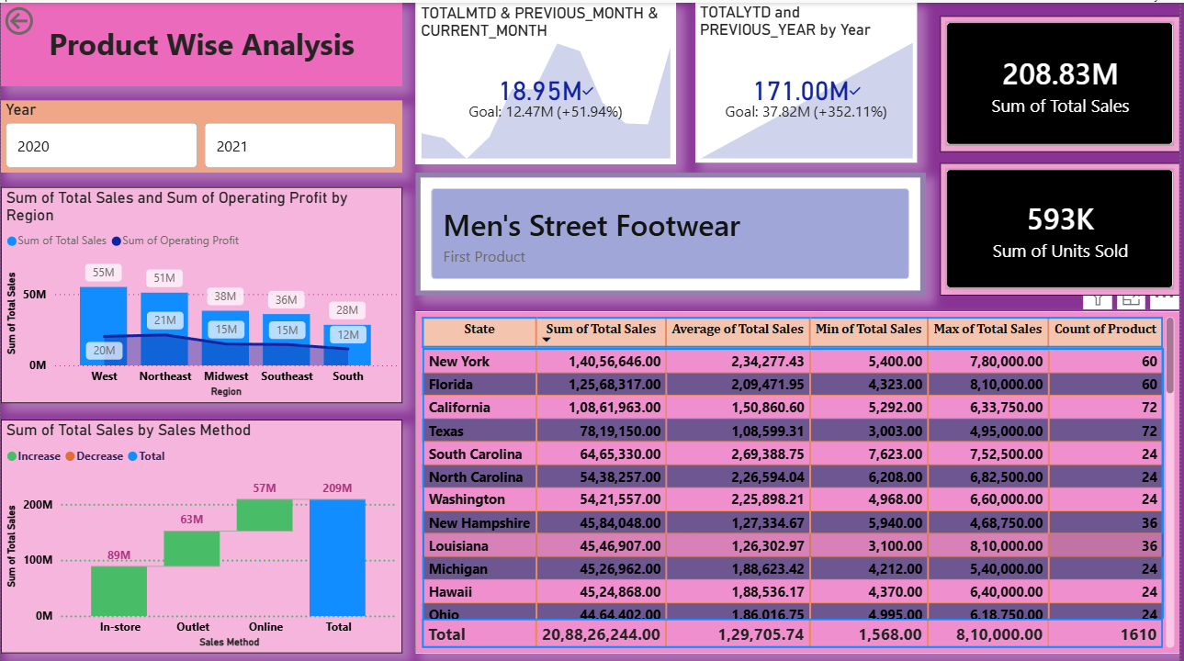
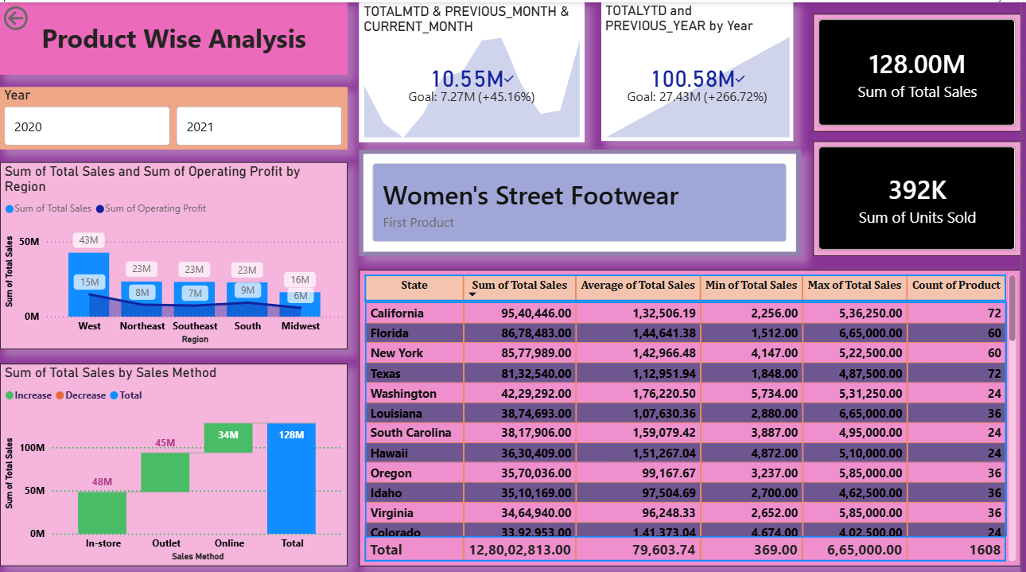
4. Product-Wise Analysis
Men's Street Footwear VS Women's Street Footwear
Key observations
• Sales: Men's earns 208.8M (23.2%) against 128.0M (14.2%) for Women's. That is a gap of 80.8M, and Men's is the #1 product overall.
• Volume: Men's sells 593K units against 392K (about 51% more).
• Growth and share: Men's grew +352% (4.5x) against +267% (3.7x) for Women's. Men's gained about 3 points of share (20.8% to 23.8%), while Women's lost about 1 point (15.1% to 14.0%).
• Profitability: Men's margin is higher at ~39.9% vs ~35.2%. Men's is best in the South and Southeast (about 42–43%) and weakest in the West (about 36%). Women's is best in the South (about 39%) and weakest in the Southeast (about 30%).
• Channels and momentum: Men's relies more on in-store (43% vs 38%), while Women's has a larger outlet share (35% vs 30%). Both have similar online shares (27%). The latest month is strong for both, at +52.0% vs +45.1%.
Adidas Sales Analysis | Power BI Project
6

Slide 7
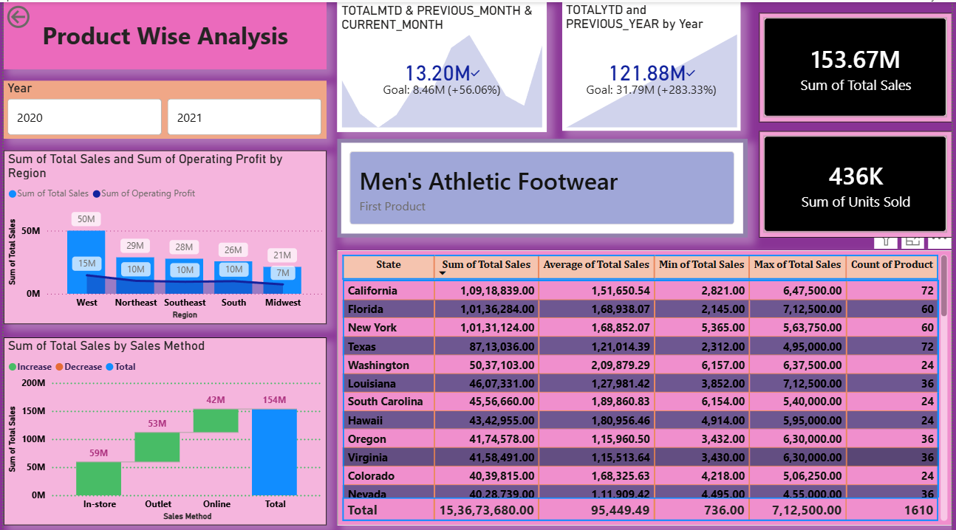
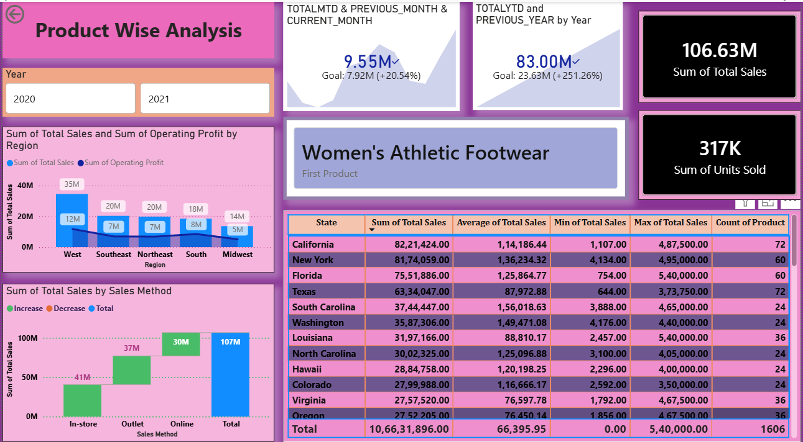
4. Product-Wise Analysis
Men's Athletic Footwear VS Women's Athletic Footwear
Key observations
• Sales: Men's earns 153.7M (17.1%) against 106.6M (11.8%) for Women's. That is a gap of 47.0M, with Men's about 44% bigger. Women's is the smallest of all six products.
• Order size drives the gap: Both have about 1,600 transactions. Men's average order is 95K vs 66K (44% higher), with about 271 vs 197 units per order. Men's also sells 436K units against 317K (about 38% more).
• Growth and share: Men's grew +283% against +251% for Women's. Both lost share in 2021, but Women's lost more (13.0% to 11.6%, against 17.5% to 17.0%). Women's is the product shrinking fastest in the mix.
• Channels and states: Both split almost the same way, with in-store about 38%, outlet 34% and online 27–28%. California leads both products ($10.9M for Men's, $8.2M for Women’s).
Adidas Sales Analysis | Power BI Project
7

Slide 8
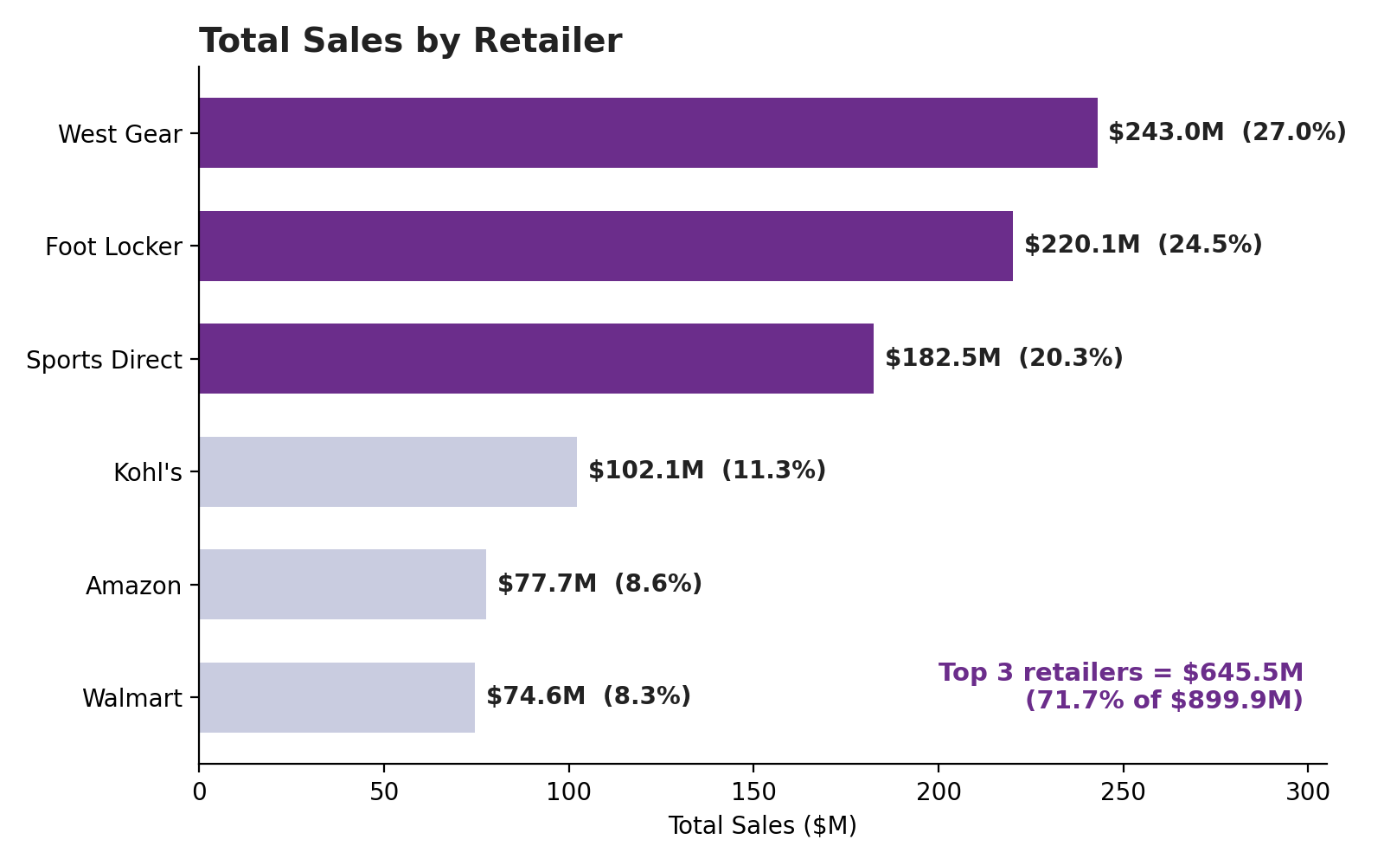
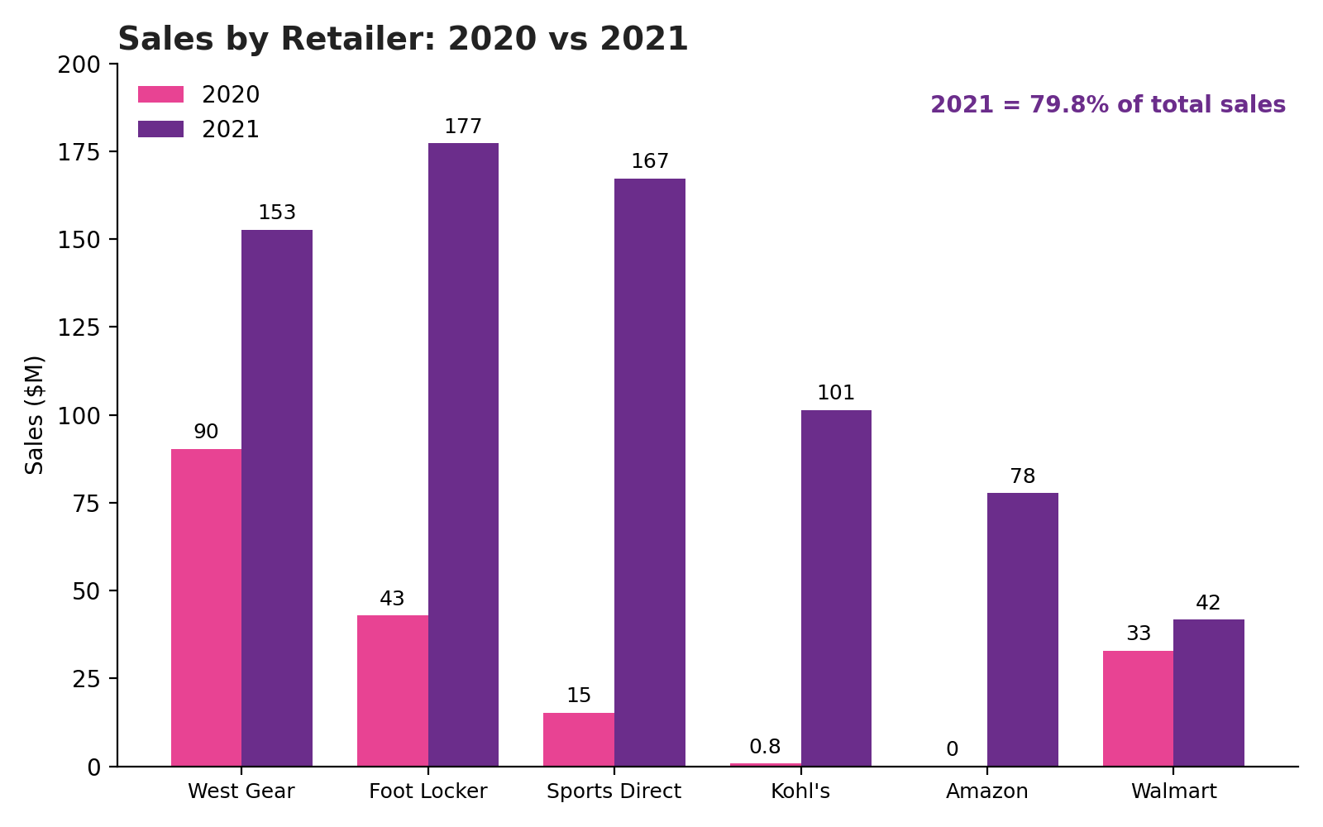
5. Retailer-Wise Analysis
Retailer Wise total Sales Comparison | Year Wise Comparison of Retailers
Retailer insights
• Three retailers drive 72% of sales. West Gear (243.0M), Foot Locker (220.1M) and Sports Direct (182.5M) total 645.5M of 899.9M.
• 2021 was the breakout year. Sports Direct grew about 11x and Foot Locker 4.1x. Amazon and Kohl's had almost no 2020 sales, and Walmart grew only 27%.
• West Gear's share fell from about 50% of 2020 sales to 21% of 2021 sales, because others grew faster.
Adidas Sales Analysis | Power BI Project
8

Slide 9
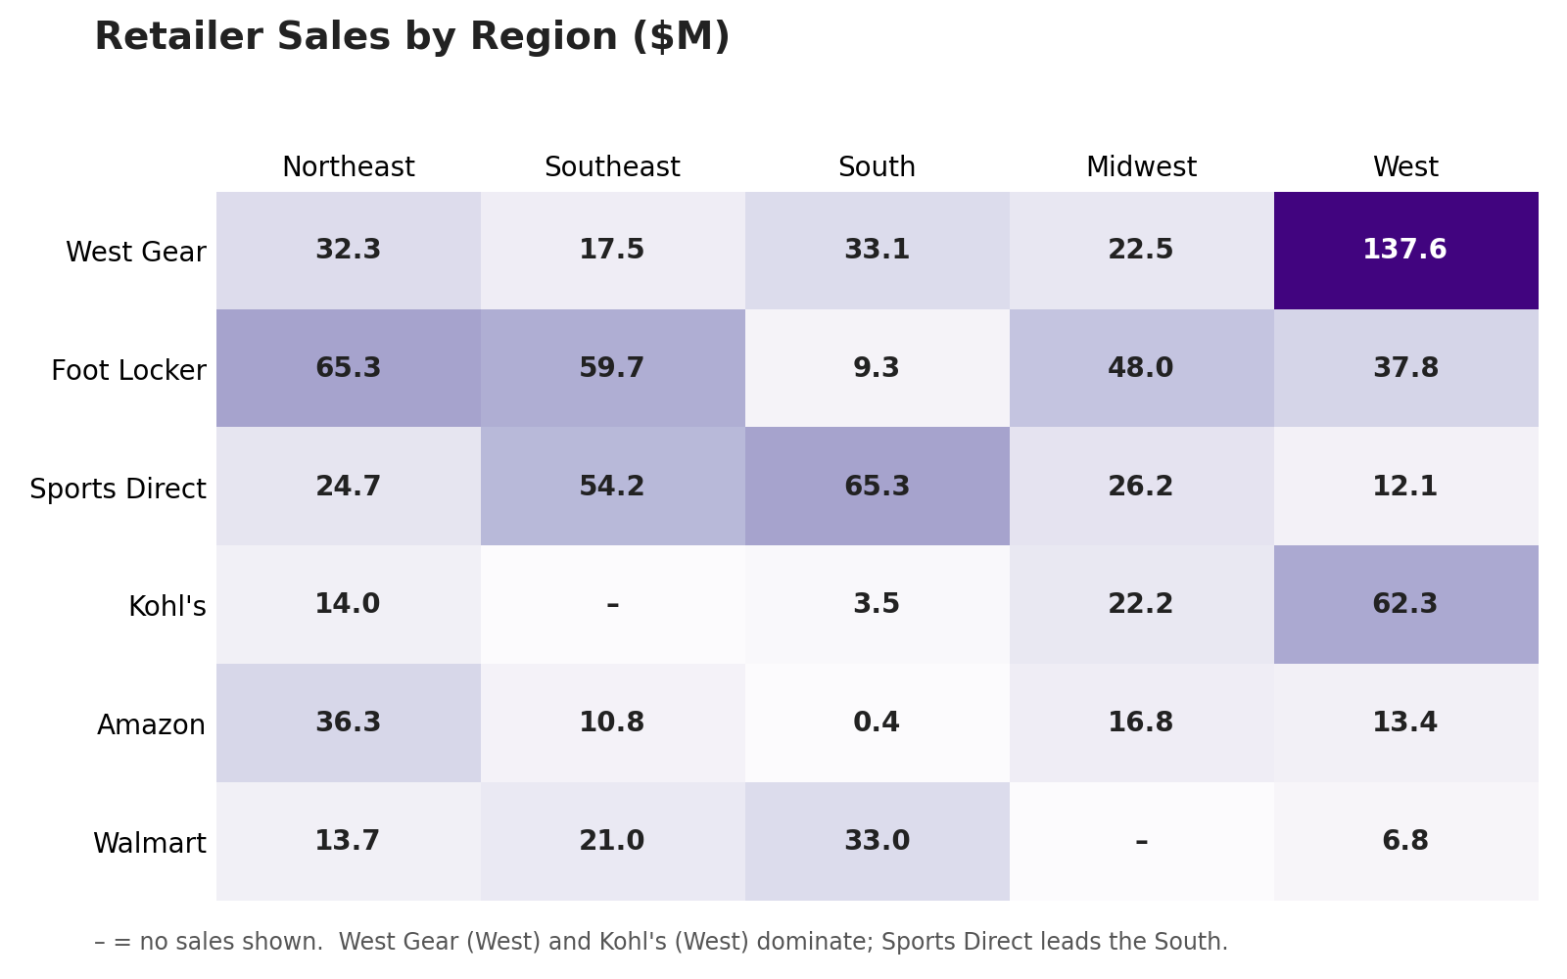
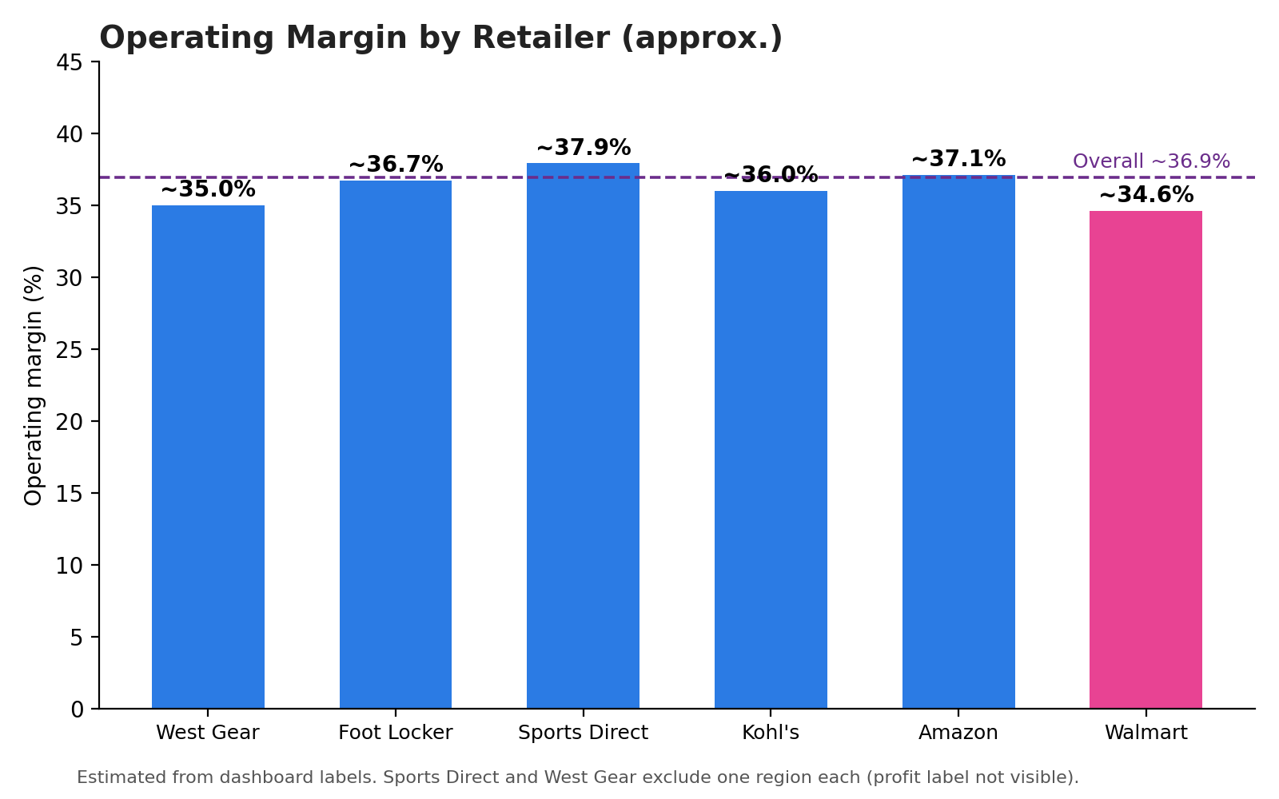
5. Retailer-Wise Analysis
Retailer performance is compared across regions, products and operating profit
Retailer insights
• Each retailer has an anchor region. West Gear and Kohl's depend on the West (57% and 61% of their sales), Sports Direct on the South (36%), Walmart on the South (44%) and Amazon on the Northeast (47%). Foot Locker is the most balanced.•
• Walmart is the weak spot. It has the lowest sales, the lowest margin (34.6%) and the only month-on-month decline (−43.4%). Its average sale is the highest, so it has fewer but larger orders.
• Margins are tightly grouped. All six retailers sit between about 35% and 38%, so growth matters more than margin differences here.
Adidas Sales Analysis | Power BI Project
9

Slide 10
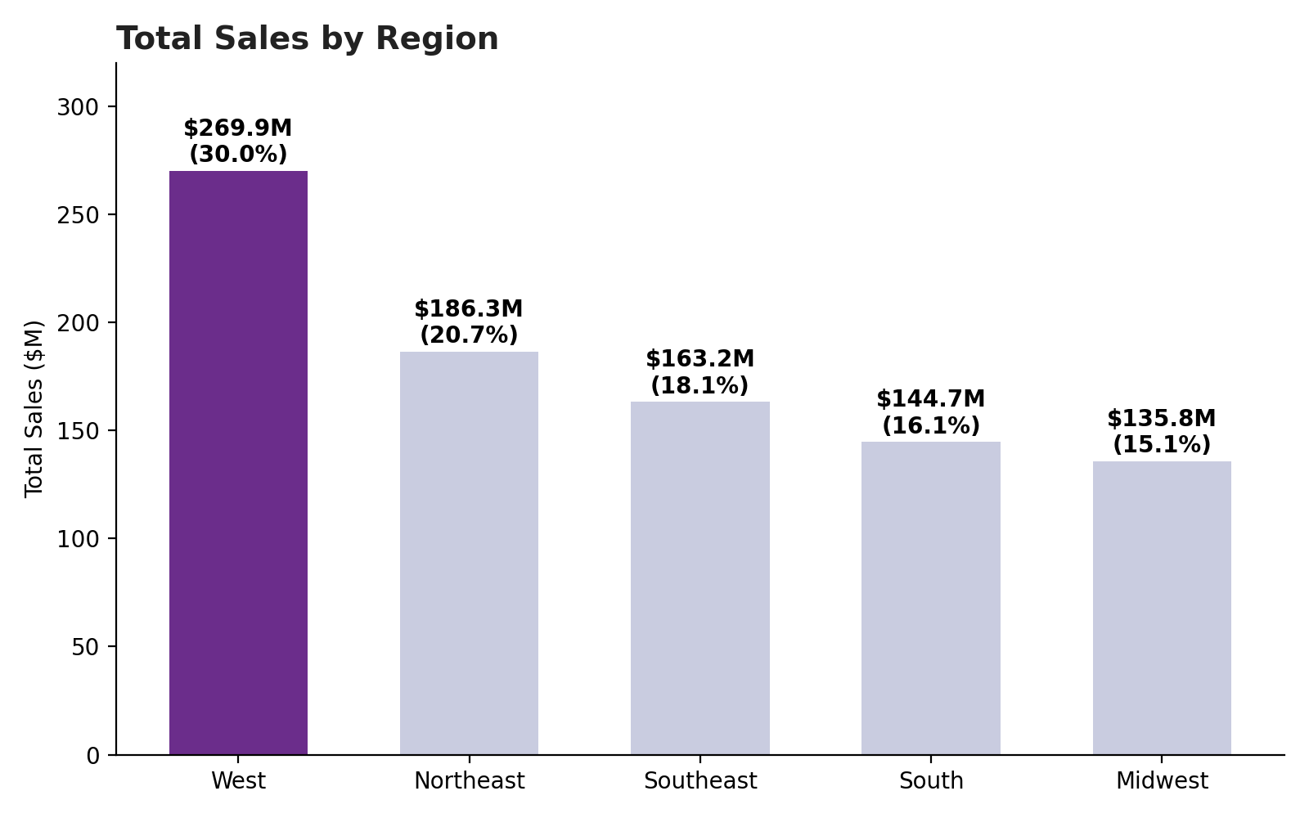
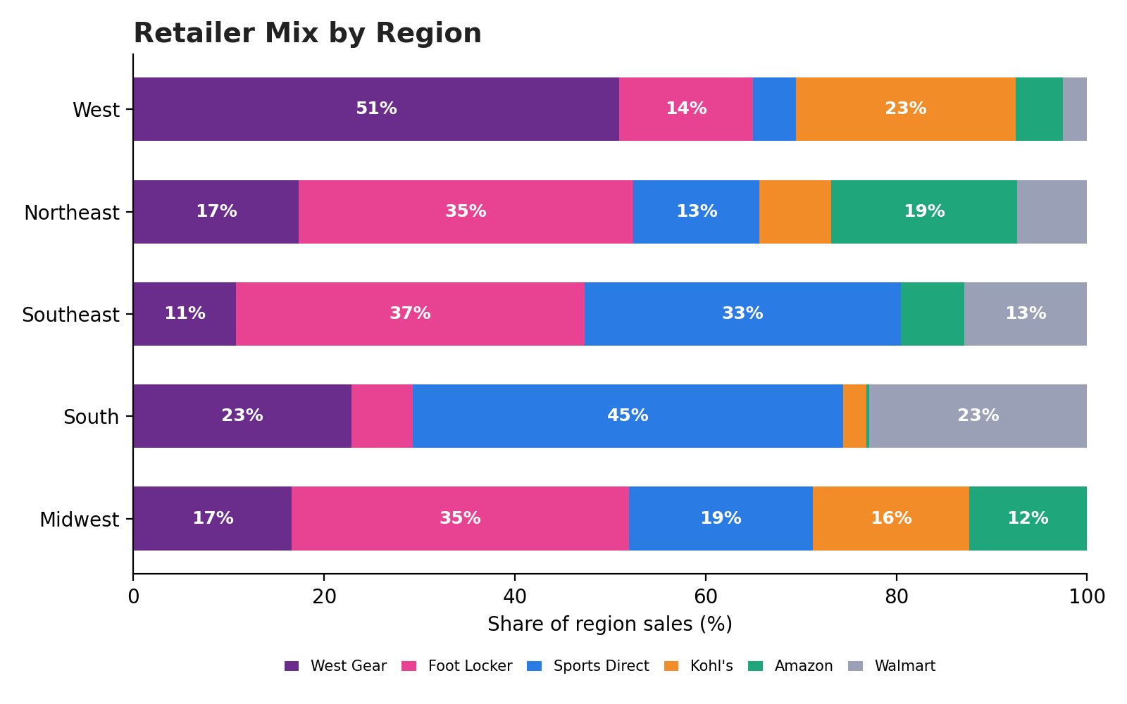
6. Region-Wise Analysis
Regional performance is drilled down to retailer, product and state level
Regional view
• The West leads with 269.9M (30.0%), almost double the Midwest's 135.8M.
• The West and Northeast together make up about half of all sales (50.7%).
• West – California is highest State in Sales 60M Total 12 States
• Northeast – Florida state is highest in Sales 59M
Total 6 States
• West Gear is 51% of West sales, and Sports Direct is 45% of South sales.
• Foot Locker is the top retailer in the Northeast, Southeast and Midwest.
Adidas Sales Analysis | Power BI Project
10

Slide 11
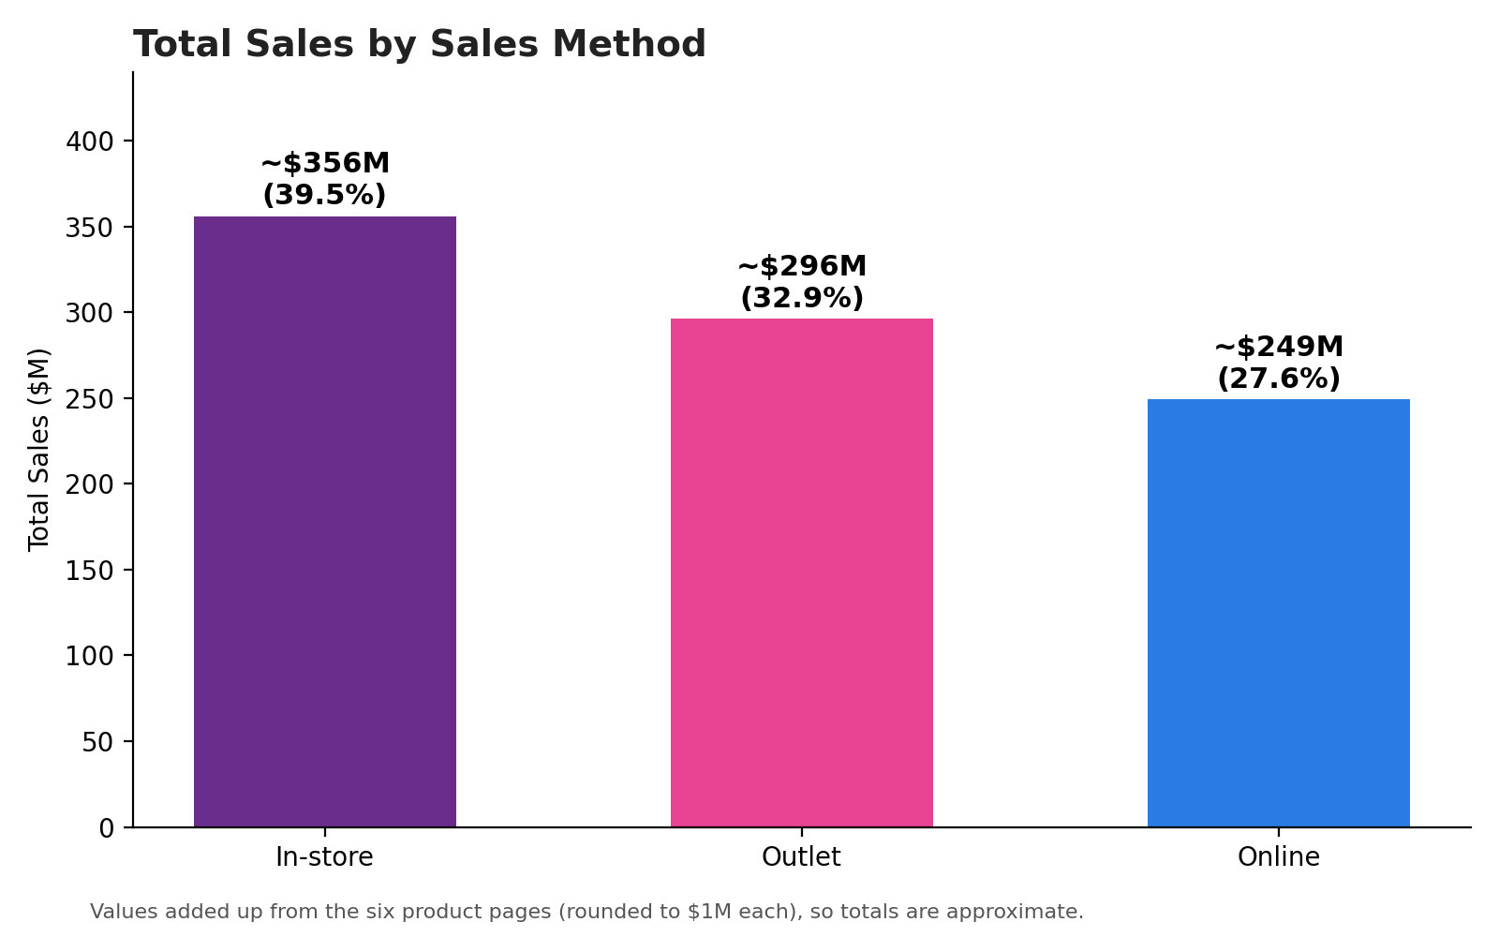
7. Sales Method Analysis
Sales are distributed across In-store, Outlet and Online channels
IN-STORE
OUTLET
ONLINE
356.64M
295.59M
247.67M
39.63% of total sales
32.85% of total sales
27.52% of total sales
Interpretation
• In-store is the largest sales method in the dashboard.
• Outlet is the second-largest contributor.
• Online contributes the smallest of the three channels, while still representing more than one-quarter of total sales.
• This comparison helps evaluate channel mix at an executive level.
Adidas Sales Analysis | Power BI Project
11

Slide 12
8. Key Business Insights
What can be communicated from the dashboard
Overall scale
Top retailer
The dashboard reports 899.90M total sales and 2.48M units sold.
West Gear is the highest retailer in the main sales comparison.
Top product
Top sales method
Men's Street Footwear leads the product comparison.
In-store contributes 39.63%, the largest channel share.
Regional drill-down
Decision support
The report enables comparison of five regions and their states.
Interactive year, retailer, product and region views make the dashboard useful for performance monitoring.
Adidas Sales Analysis | Power BI Project
12

Slide 13
CONCLUSION
A single Power BI report brings together sales, product, retailer and regional analysis.
MEASURE
COMPARE
DECIDE
Track overall sales, units and average sales.
Identify leading products, retailers, regions and channels.
Use drill-down views to support Comparison and performance decisions.
Thank You
Questions & Discussion
Adidas Sales Analysis | Power BI Project
10

