Slide 1
Topic Of the Day ARTICLE
Why are we reading Article ?
What is Article ?
Types of Article
Applications of Article ?
Exercise based on Article ?
A few ADD On’s
Vocabulary – 5 Words (Synonyms & Antonyms)
Sentence Rearrangement

Slide 2
What is Article ?
“ Article is a word which is placed before a noun.”
Eg. A Boy, An Umbrella, The Police
Article belongs to the family of determiners.
What does article determine?
article determine whether the noun is definite or indefinite.
A boy – one boy / some boy (Indefinite)
The School – one specific school (Definite)

Slide 3
Types of Article
Indefinite article Definite article
a or an is called indefinite article
a is used with consonant sounds while an is used with vowel sounds not vowels (a,e,i,o,u)
a and an both are of singular nature hence always precedes a singular noun.
The is definite article
The is used before singular, plural (Countable) and uncountable nouns.
* Singular countable noun does not go without an article.

Slide 4
a cool hack ?
In conversation there are always two persons present
First person – speaker
Second person – listener
When the speaker is introducing a fact or a person for the first time, he will use indefinite article before the noun.
But when the speaker is introducing a fact or a person who is already known to the listener, he will use definite article before the noun.
Let’s understand.
I have a dog (here a fact / info. is introduced)
The dog is black in colour (the info about the dog is already known)
Dogs are loyal to their masters. (article is not used when we are generalizing)

Slide 5
Usage
Indefinite article
a or an are used in two senses
In the sense of “one”
In the sense of “any”
Ravi has a pet (one pet)
Do you have a pet ? (any pet?

Slide 6
Usage
Definite article (The)
Before a proper noun (because there is only one)
The Howrah bridge was built by the British.
The Raisina hills is the official residence of the President of India.
Before a superlative adjective
Ravi is the brightest boy of the class.
The statue of unity is the tallest statue of the world.

Slide 7
Usage
Definite Article (The)
Before an adjective to make it a common noun
Only the brave shall inherit the earth. (Brave people)
Government is preparing budget as per the requirements of the poor. (Poor people)
Before a noun to refer to its community
The cow is a useful animal. (Cows)
The Dog is a loyal animal. (Dogs)

Slide 8
Usage
Definite Article (The)
Before organizations
The UN, The EU, The World Bank
Before Musical instruments
The guitar, the flute etc

Slide 9
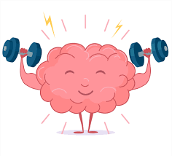
Exercise
Questions based on articles

Slide 10
I purchased __ bag, __ umbrella and __notebook.
If you meet my brother, please pass him __ message.
The CEO has invited everyone to discuss __ policy in detail.
Ravi invited us for __ lunch but __ lunch was horrible.
Mohan is __ ambitious boy.

Slide 11
I purchased a bag, an umbrella and a notebook.
If you meet my brother, please pass him the message.
The CEO has invited everyone to discuss the policy in detail.
Ravi invited us for lunch but the lunch was horrible.
Mohan is an ambitious boy.

Slide 12
Omission of Article
Article is not used before Names (names of persons)
The Rahul is our class head.
The John teaches us English.
But
when the name of a person is used as an adjective or reference the is used before such noun.
Chandigarh is the Paris of India.
Rahul is the Virat kohli of our team.

Slide 13
Omission of Article
We do use article ‘the’ with the name of the countries which include kingdom, states, republic etc.
The United states, The United Kingdom,
Article is not used before languages
The English is our secondary language.
The Punjabi is a sweet language.
Article is not used before Relations
The father is helping his sons.
The wife is cooking dinner.

Slide 14
Omission of Article
Article is not used before the names of meals.
Ravi has invited us for the lunch.
Our maid cooks The dinner for us.

Slide 15
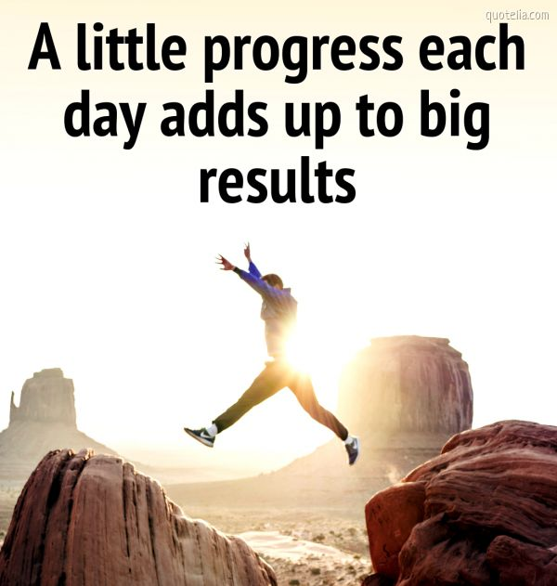
The Add-on’s
Vocabulary

Slide 16
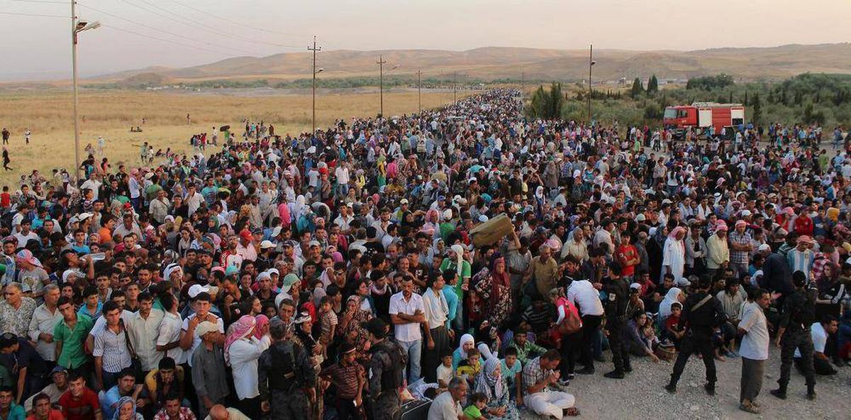
Exodus
Meaning:- a mass departure of people
Synonyms – Migration, exit, withdrawal, retreat, escape,
Antonyms – arrival

Slide 17
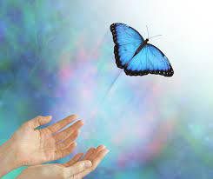
2. Relinquish
Meaning – cease to claim, keep (voluntarily)
Synonyms – give up, renounce, hand over
Antonyms – Keep, retain, continue

Slide 18
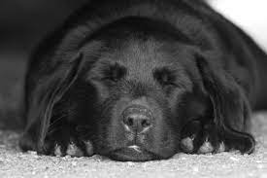
2. Quiescent
Meaning – Period of inactivity
Synonyms – Inactivity, inert, latent, idle, sluggish, dormant, stagnant
Antonyms – active, continuous

Slide 19

2. Fraudulent
Meaning – obtained using deception
Synonyms – deceitful, unscrupulous, illicit, dodgy
Antonyms – honest, fair, above-board

Slide 20
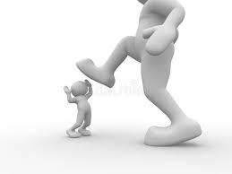
. Belittle
Meaning – to dismiss someone as unimportant
Synonyms – downgrade, run down, ridicule, pick hole in
Antonyms – encourage, appreciate, support

Slide 21
In the question given below select the most logical order to form a meaningful paragraph.
P-But he did not know how to find one at that hour. Q-It was his first visit to the city and he didn't know where to go. R-Mohanlal's train was late and it reached Kolkata a little after midnight. S-He thought he would go to a community centre where he would not have to pay rent.

Slide 22
In the choice(1)/ can’t be(2)/ a man(3)/ Too careful(4)/ of his friends(5).
(A) 3,2,4,1,5
(B) 1,2,3,4,5
(C) 3,2,1,4,5
(D) 3,2,5,4,1

Slide 23
The whole world(1)/ laughs with you(2)/ When you cry(3)/when you laugh(4)/you cry alone(5)
(A) 1,2,3,4,5
(B) 2,1,3,5,4
(C) 4,5,1,2,3
(D) 4,1,2,3,5

Slide 24
(1) our country(2) following greater than some / (3) Salman Khan has a fan(4) of the best paid sports person in
(A) 1, 3, 4, 2
(B) 3, 4, 1, 2
(C) 4, 1, 3, 2
(D) 3, 2, 4, 1

Slide 25
and he who has hope, (1)/ has hope(2)/ has everything(3)/ the person who has health(4).
(A) 1, 4, 3, 2
(B) 3, 2, 4, 1
(C) 3, 4, 1, 2
(D) 4, 2, 1, 3

Slide 26
Covered with (1)/ snow during winter (2)/ the valley remains (3)/ thick blanket of (4).
(A) 2, 4, 1, 3
(B) 4, 1, 3, 2
(C) 1, 3, 2, 4
(D) 3, 1, 4, 2

