Slide 1
VERBAL ABILITY
ENGLISH GRAMMAR
CLASS – 5
VERB

Slide 2
VERBAL ABILITY
What is Verb ?
Verb is an action word.
Ravi plays cricket.
Birds are chirping.
Children are laughing.
Dogs are barking.
I have a car.
Ravi is happy.
Children are excited.

Slide 3
VERBAL ABILITY
So what exactly is a verb ?
Verb is a word which tells about a noun.
The boy killed a snake.
How does verb tell about a noun ???

Slide 4
VERBAL ABILITY
It tells what a noun does.
It tells what is done to a noun.
It tells about a state or having.

Slide 5
VERBAL ABILITY
Types of Verb
Primary Verb Main Verb

Slide 6
VERBAL ABILITY
Subject Verb Agreement
Singular subjects take singular verbs
Plural subjects take plural verbs

Slide 7
VERBAL ABILITY
Let’s try a few more.
One of my friend is a doctor.
Sachin is one of the cricketers who has made India proud.
Some of the work ____ pending. (is/are)
Some of the students ___ absent. (is/are)
All ___ well. (is/are)
All ___ well. (is/are)

Slide 8
VERBAL ABILITY
Two or more subjects connected by ‘and’ usually take a plural verb.
Ravi and Rohit is coming to the party tonight.
Mobile phone and telecommunication has metamorphosed the information technology.
Exception.
If two singular nouns refer to the same person, thing or a common idea, the verb must be singular.
The Principal and teacher is absent.
Rice and curry is my favorite breakfast.

Slide 9
VERBAL ABILITY

Slide 10
VERBAL ABILITY
If the subjects are preceded by each or every, the verb is usually singular.
Every boy of the class ____ contributed to the success of this activity.
Every boy and Every girl ____ participated in the activity.
Two or more singular subjects connected by or, nor, either…or, neither…or , verb agrees with the second subject or subject nearer to it.
Either the teacher or the students _____ absent.(is/are)
Neither the captain nor the crew members ___ got hurt. (has/have)

Slide 11
VERBAL ABILITY
Two subjects joined by with, together with, along with, as well as etc. take verb according to the first subject.
The mother as well as her children ___ going to the market. (is/are)
The captain together with the players ___ objected to the decision. (has/have)

Slide 12
VERBAL ABILITY
1. Everyone (has/have) done his or her homework.
2. Each of the students (is/are) responsible for doing his or her work.
3. Either my father or my brothers (is/are) going to sell the car.
4. Neither my sisters nor my mother (is/are) going to sell the house.
5. The samples on the tray in the lab (need/needs) testing.
6. Mary and John usually (plays/play) together.
7. Both of the dogs (has/have) collars.

Slide 13
VERBAL ABILITY
1. Everyone (has) done his or her homework.
2. Each of the students (is) responsible for doing his or her work.
3. Either my father or my brothers (are) going to sell the car.
4. Neither my sisters nor my mother (is) going to sell the house.
5. The samples on the tray in the lab (need) testing.
6. Mary and John usually (play) together.
7. Both of the dogs (have) collars.

Slide 14
VERBAL ABILITY
8. Neither the dogs nor the cat (is/are) very hungry.
9. Either the girls or the boy (walk/walks) in the evening.
10. Either the boy or the girls (walk/walks) in the evening.
11. At the end of the fall (comes/come) the hard tests.
12. The slaughter of animals for their fur (has/have) caused controversy.
13. The student, as well as his teacher, (was/were) going on the field trip.
14. The hard tests (comes/come) at the end of the fall.
15. Both of my roommates (has/have) decided to live in the dorms.

Slide 15
VERBAL ABILITY
8. Neither the dogs nor the cat (is) very hungry.
9. Either the girls or the boy (walks) in the evening.
10. Either the boy or the girls (walk) in the evening.
11. At the end of the fall (come) the hard tests.
12. The slaughter of animals for their fur (has) caused controversy.
13. The student, as well as his teacher, (was) going on the field trip.
14. The hard tests (come) at the end of the fall.
15. Both of my roommates (have) decided to live in the dorms.

Slide 16
VERBAL ABILITY
John and his brother (is/are) playing football.
Aryan (do not/does not) like to play basketball.
Either of you (have/has) stolen the book.
Your pants (is/are) in the top shelf.
My family (belongs/belong) to the Mahou tribe.

Slide 17
VERBAL ABILITY
John and his brother (are) playing football.
Aryan (does not) like to play basketball.
Either of you (has) stolen the book.
Your pants (are) in the top shelf.
My family (belongs) to the Mahou tribe.

Slide 18
VERBAL ABILITY
Mr, Swamy as well as his family (is/are) quite humble.
Mary (sing/sings) very well.
The novel, including all the essays (take/takes) about two hours to read.
They (eat/eats) lunch together everyday.
The players as well as the coach (want/wants) to win

Slide 19

VERBAL ABILITY
VOCABULARY
In the following question, out of the given four alternatives, select the one which best expresses the meaning of the given word.
Crescendo
1) Dominate
2) Escalation
3) Squander
4) Revere

Slide 20
VERBAL ABILITY
In the following question, out of the given four alternatives, select the one which best expresses the meaning of the given word.
Esoteric
1) Befitting
2) Germane
3) Abstruse
4) Relevant

Slide 21
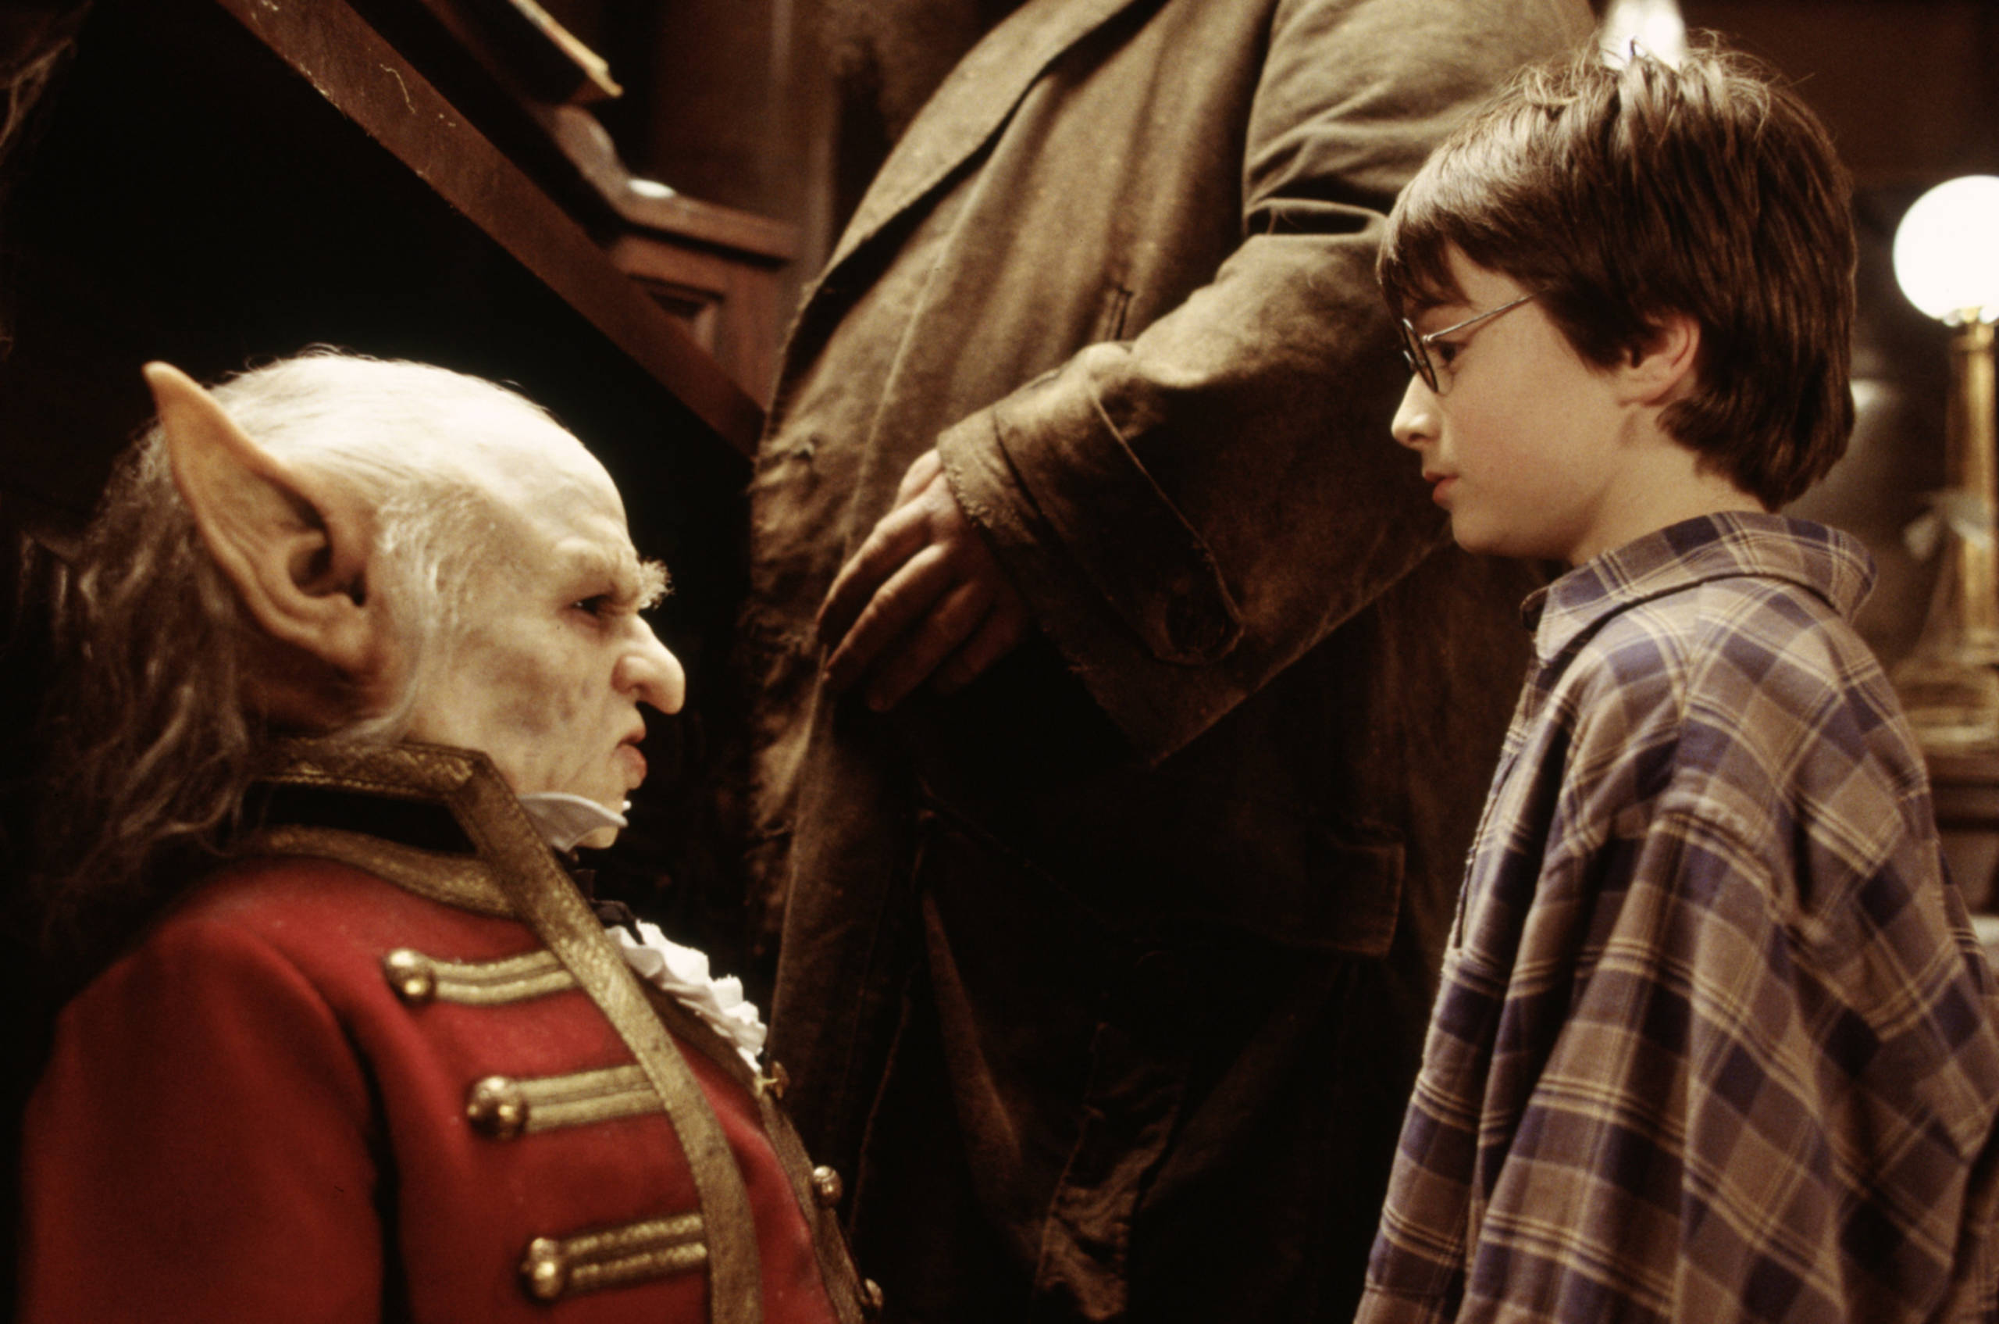
VERBAL ABILITY
In the following question, out of the given four alternatives, select the one which best expresses the meaning of the given word.
Fiendish
1) Apparent
2) Cruel
3) Secure
4) Exemplify

Slide 22
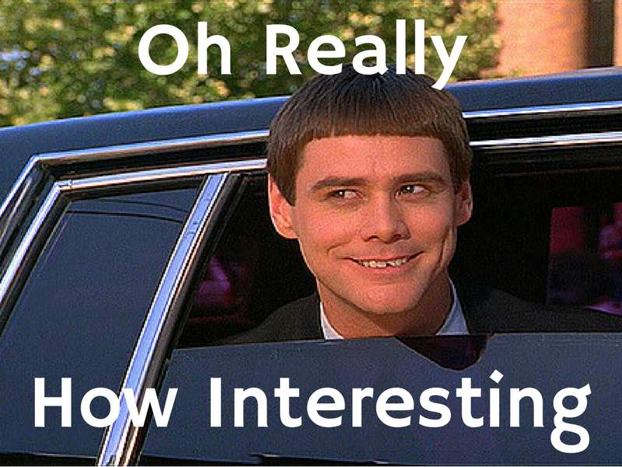
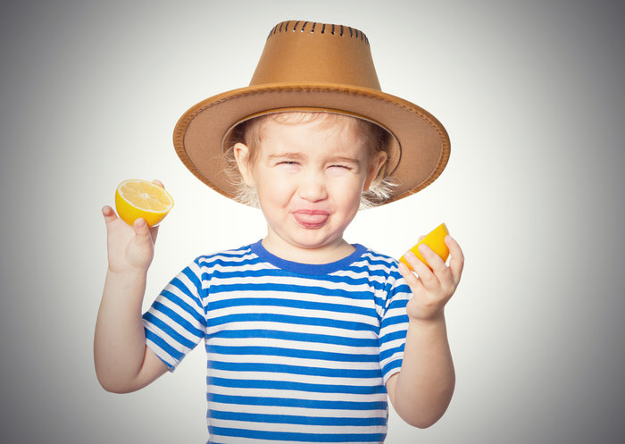
VERBAL ABILITY
In the following question, out of the given four alternatives, select the one which is opposite in the meaning of the given word.
Acerbic
1) Foretell
2) Amazed
3) Harsh
4) Bland

Slide 23

VERBAL ABILITY
In the following question, out of the given four alternatives, select the one which is opposite in the meaning of the given word.
Scurrilous
1) Coarse
2) Sophisticated
3) Insolent
4) Complimentary

Slide 24

VERBAL ABILITY
In the following question, out of the given four alternatives, select the one which best expresses the meaning of the given word.
Guzzle
1) Cheap
2) Imbibe
3) Starve
4) Release

Slide 25
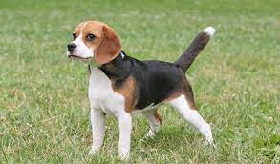
VERBAL ABILITY
In the following question, out of the given four alternatives, select the one which best expresses the meaning of the given word.
Hound
1) Critic
2) Migrate
3) Beagle
4) Variable

Slide 26

VERBAL ABILITY
In the following question, out of the given four alternatives, select the one which best expresses the meaning of the given word.
Embargo
1) Barrier
2) Prescribe
3) Comfort
4) Justify

Slide 27
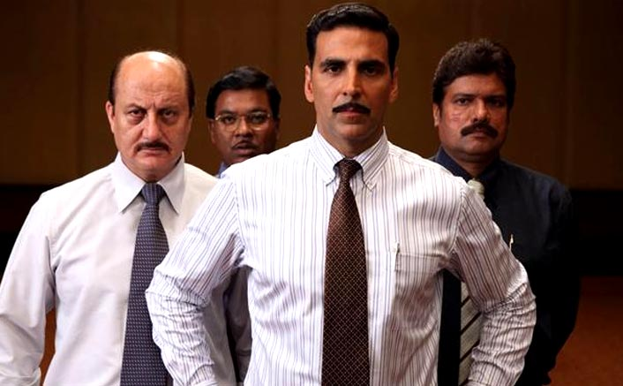
VERBAL ABILITY
In the following question, out of the given four alternatives, select the one which is opposite in the meaning of the given word.
Swindle
1) Insert
2) Dupe
3) Ample
4) Honesty

Slide 28
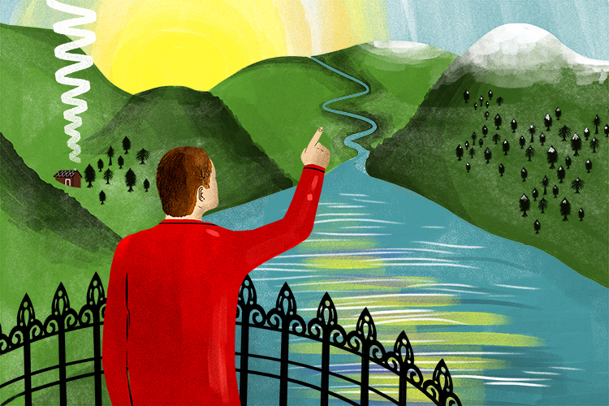
VERBAL ABILITY
In the following question, out of the given four alternatives, select the one which is opposite in the meaning of the given word
Vista
1) Confront
2) Contour
3) Blindness
4) Outlook

