Slide 1

An Introduction to SharePoint

Slide 2


What Is SharePoint?
A Business Solutions Platform
Its Is not specific to a single product or technology→ refers to several aspects of solutions (much like Microsoft Office)
Can serve multiple functions .
Integrates with Microsoft Office
Uses “Sites” to host business solution applications.
SharePoint is available in 3 main ways or “Types of Platforms”:
On Premise (offline; servers are on site )
In the cloud (online, servers are managed by Microsoft)
Hybrid (both On Premise and online)

Slide 3
Which SharePoint is right for you?
 | On Premise (on site) | Online (in the Cloud) | Hybrid (Best of Both Worlds)
Highlights | Full Customization* Robust Security and Confidentiality High Data Integrity | Much Less Management High Availability Less cost Does not Require an IT Team | Pick and Choose what fits your needs.
Use If: | You require customization You are concerned with Compliance and legal restrictions. Data Integrity is a concern | You don’t have dedicated IT personnel Don’t have a large IT budget Using out of box solutions to meet your needs | Pick and Choose what fits your needs.
Do Not Use if: | No dedicated IT Team Have the funds for 3rd party support if no In house IT. Don’t have a very large budget! | You have to adhere to heavy Compliance Regulations or other legal restrictions If you want/need to Customize- customization is not available | You don’t have an IT Team dedicated to managing the server(s).
UW Department | Type of SP
I-School | Online
Radiology | Online
UW School of Law | Online
Records Management | On Premise
School of Medicine | On Premise

Slide 4
Sharepoint platforms…….
On Premise (on site):-
Full Customization*
Robust Security and Confidentiality
High Data Integrity
Online (in the Cloud):-
Much Less Management
High Availability
Less cost
Does not Require an IT Team
Hybrid (Best of Both Worlds)
Pick and Choose what fits your needs

Slide 5
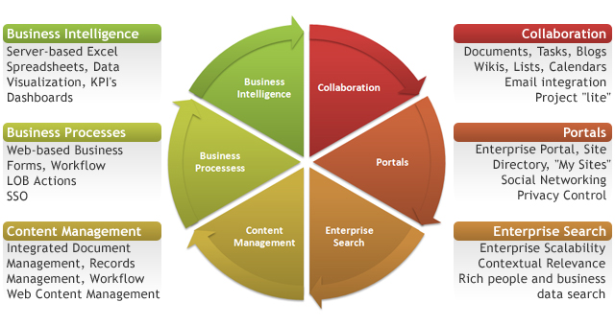
Sharepoint features……
Regardless of whether your organization uses SharePoint Online, On Premise or Hybrid, SharePoint gives you the tools to manage your business processes in one place.
Image Source: http://computertrainingcenters.com/10-ways-sharepoint-can-help-your-business

Slide 6
SharePoint Architecture High Level View
Site Collection
Site
Pages
Apps, Web Parts
Subsite
Pages
Apps, Web Parts
Apps, Web Parts
Apps, Web Parts
Site Collection
Site
Sub site
Apps
Web Parts

Slide 7
SharePoint Content and Management Site Collections, Sites, subsites and pages
Site Collections :-A site collection is a grouping of websites under a common top-level site that have the same owner and share administration settings.
Sites:-Your Main Team Site or Function Site.
This is the first page you will see when you access your SharePoint environment. You could almost say it is your
home.
Sub sites :-A site is a container of objects which can include lists, document libraries, and pages. A site can also contain nested sites called sub sites.
Site Collection
Site
Pages
Apps, Web Parts
Subsite
Pages
Apps, Web Parts
Apps, Web Parts
Apps, Web Parts

Slide 8
SharePoint Content and Management Apps and Web Parts
Pages: Site pages are pages that are created, edited, and customized by end users. They are primarily used for the content in a site. Site pages come in two types—a standard page and a Web Parts page. A standard page contains text, images, Web Parts, and other elements. A Web Parts page contains Web Parts in Web Part zones.
Apps and Web Parts: everything in a SharePoint site is an app. SharePoint app or (App for SharePoint) is mainly a web application, a stand-alone piece of functionality that interacts with SharePoint
Site Collection
Site
Pages
Apps, Web Parts
Subsite
Pages
Apps, Web Parts
Apps, Web Parts
Apps, Web Parts

Slide 9
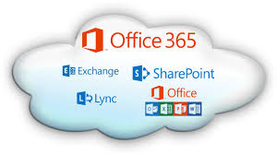
Using an OAW SharePoint Online Site Collection to demonstrate solution capability
OAW’s SharePoint Online is hosted through Microsoft 365
What is Microsoft 365?
In the cloud subscription plan that includes:
Microsoft Office
Skype for Business
Exchange online
OneDrive for Business
+SharePoint (optional)
Since everyone with a UW NetID has a Microsoft 365 license, this makes onboarding to SharePoint seamless
Image source: http://en.community.dell.com/techcenter/sharepoint-for-all/b/blog/archive/2013/07/31/watch-a-video-on-how-to-migrate-sharepoint-to-office365-with-dellsoftware

Slide 10
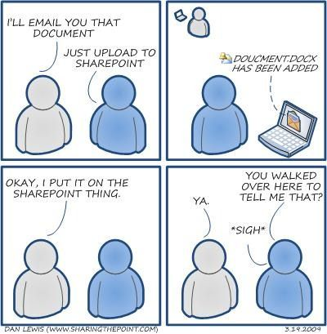
Using an OAW SharePoint Online Site Collection to demonstrate solution capability Continued..
Work Room- Modified Document Library
Streamline Business Process
One comprehensive view
Multi-departmental
Easy tracking
OAW Meetings- Modified List
No more emailing agenda items
Anybody can add agenda items
Easier to search topics and look up decisions
Virtual Filing Cabinet
Increased Transparency for Customers
Filing of Protocols
Records Retention
Automatic Business Process
Reduces Administrative Burdon

Slide 11
Out of Box Solution: The Document Library
Most people use a document library to simply store documents. In SharePoint, you can use it to do so much more! For example, Oaw uses a document library to keep track of the status of our current projects and tasks, as well as to grant visibility to the office of the status of our work.
Ways you can Modify and/or use a Document Library (other than storing documents)
Add Columns to display certain metadata
Add Work Flows for automated Notifications and Approvals
Create different “views” to display certain information (like a dashboard)
Assign tasks and link them outlook for individuals
Assign record policies
Store sets of documents with specific sets of metadata assigned to them (cannot do this with folders)

Slide 12
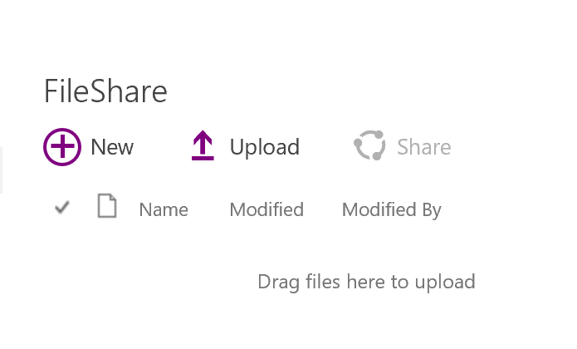
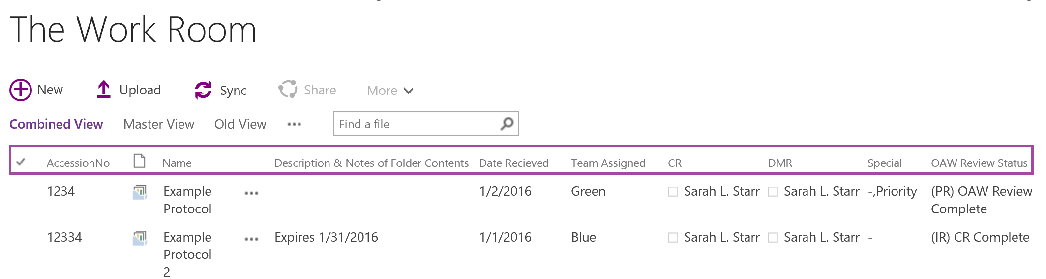
Example of a Modified Document Library
This is What a document library looks like when you add it to a page:
Below is what The Work Room modified Document library looks like. This library has custom metadata, columns, workflows, document sets and custom views.
These are all custom columns.

Slide 13
Out of Box Solution: Modified List
Lists are very similar to document libraries in terms of what you can do with them. The difference is that instead of working with documents or “files” you are working with “data”.
Ways you can Modify and/or use a List
Add Columns to display certain metadata
Add Work Flows for automated Notifications and Approvals
Create different “views” to display certain information (like a dashboard)
Assign tasks and link them outlook for individuals
Attach Files
Use in Business Intelligence

Slide 14
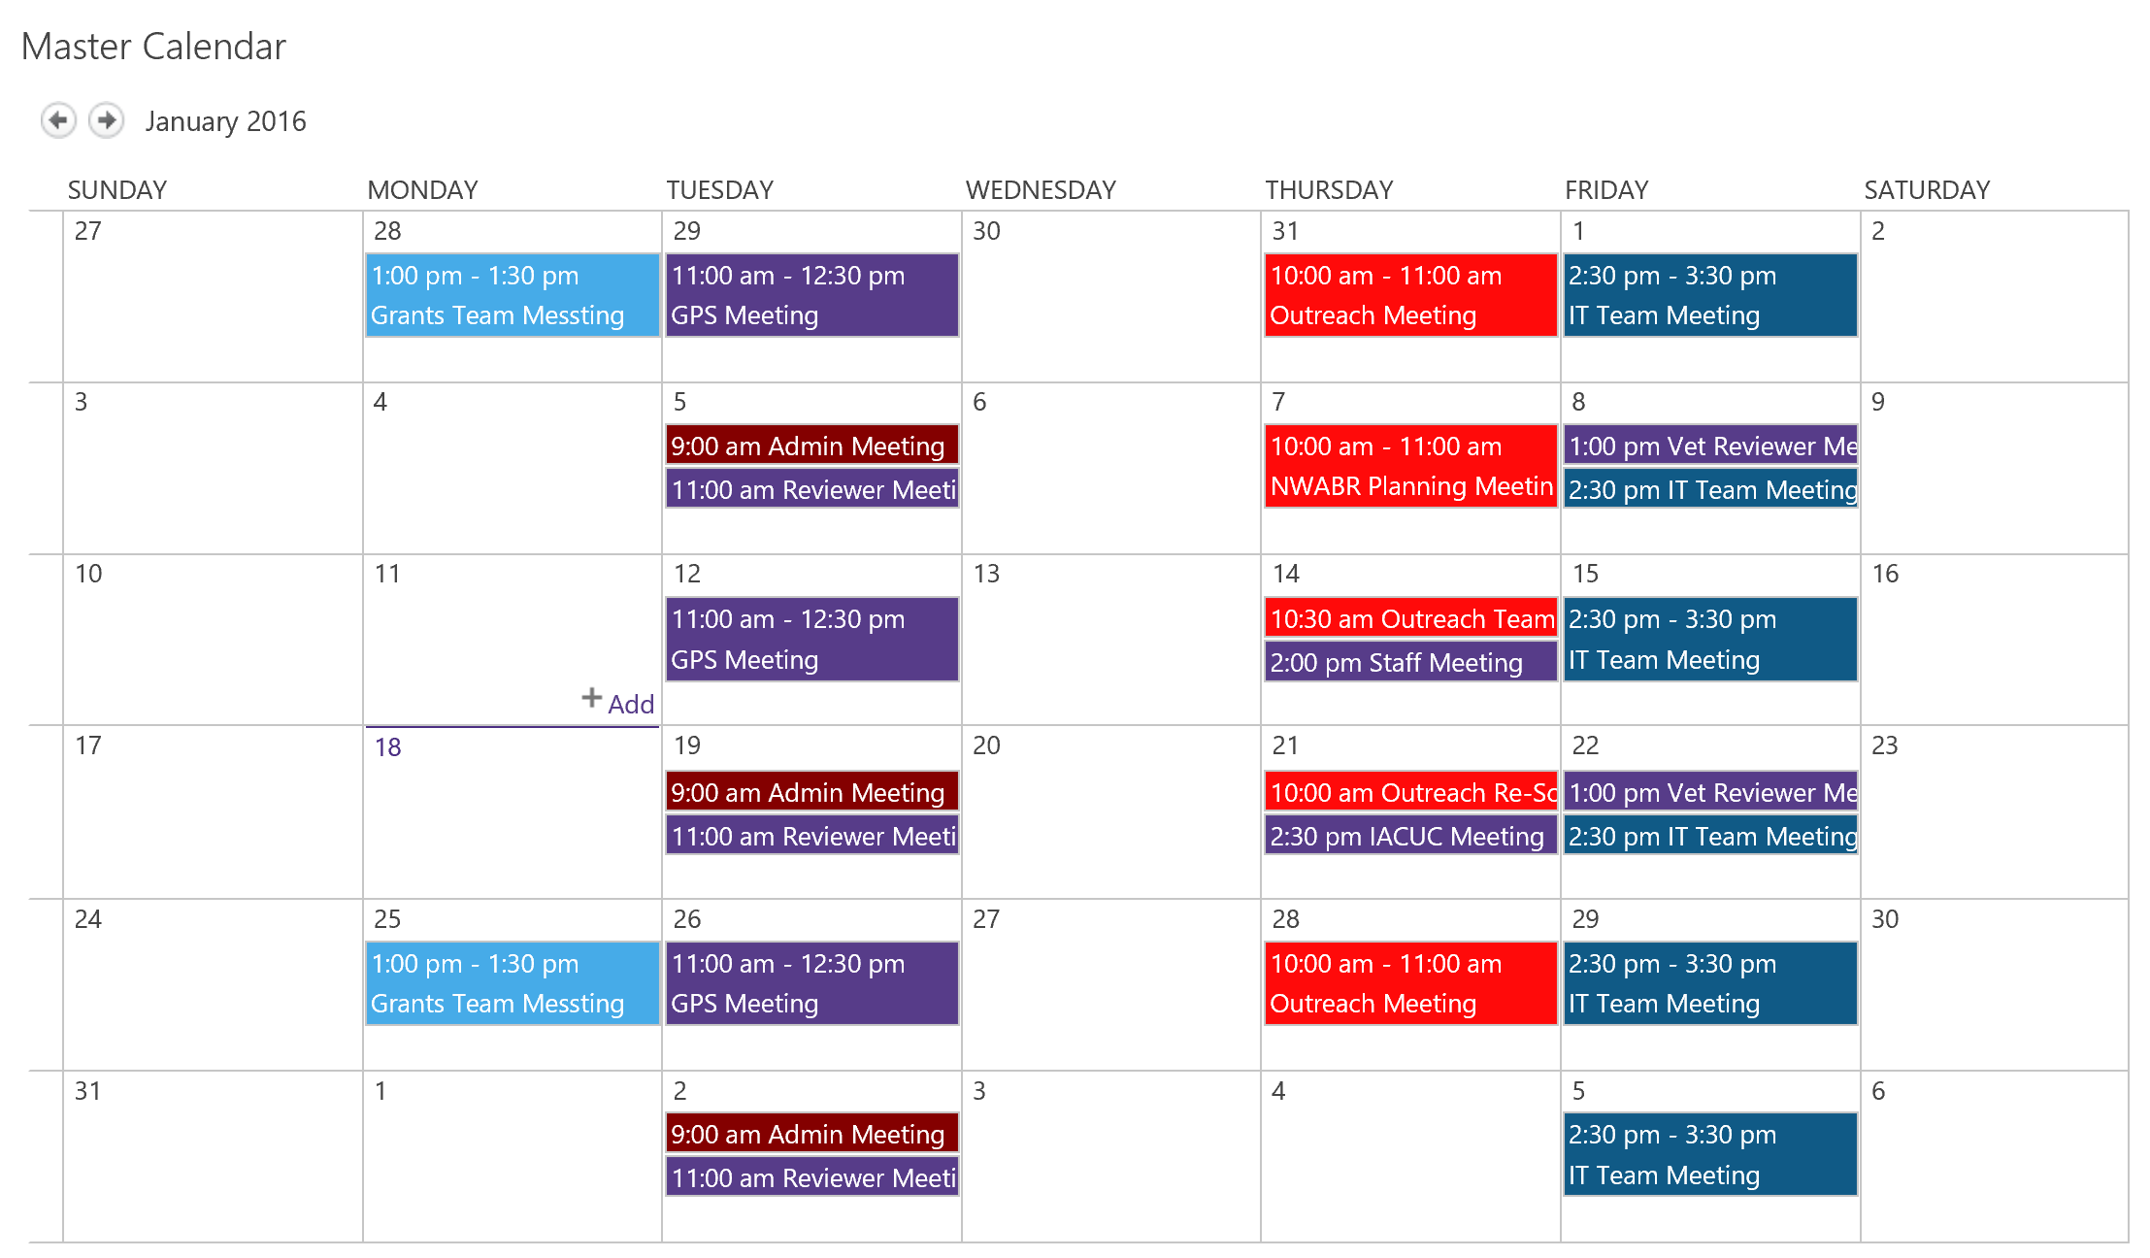
Out of Box Solution: Calendar
Great uses of Calendars in SharePoint include:
Project Calendars
Team Calendars
Out of Office/Leave Calendars
Office/Department Calendars
Features
Overlays- overlay up to 10 calendars in a single calendar view
Integrates with your outlook calendars
Custom views
Integrate with Tasks in Sharepointor in Outlook
Each color on the calendar represents a Team Calendar that has been overlayed on the Master Calendar

Slide 15
Sites: THE Virtual Filing Cabinet Example
Sites can be used countless ways: as teams sites, project sites, document storage, and information pages to name a few. One of the ways OAW uses sites is a combination of all of the above to provide a service to our Researchers .
OAW’s Virtual Filing Cabinet (VFC) contains over 400 sub collections of sites, one collection for each researcher we serve). Each one of these collections include:
A PI and Contact Level Sites that contains
Protocol Approval and Expiration Table
Protocol Tracking for submitted Items
A Protocol level Site for each Protocol that contains:
Approved Protocol Documents
Helpful Link
Researchers and their teams can access their collection of sites at any time to get information on their protocol.

Slide 16
OneDrive for Business
OneDrive for Business is your personal online document library (1 terabyte of storage) , but you can also use it to explore the capabilities of SharePoint to see if SharePoint is right for your business needs:
Open your one Drive for Business
Go to Site Settings
Click on Site Contents
Click on +Subsite
Start playing around!

Slide 17
Thank you!

