Slide 1

NIVORA
Room Search & Analytics Platform
Team
Guide By
Tool Use
Moreshwar Shukla
Prathamesh Kulkarni
Vaishnavi Ambhore
Bhakti Kulkarni
Rohit Adhav
Sachin Sir
Google Forms
Google Sheets
Apps Script
Looker Studio

Slide 2
The Problem
Problems Faced by House Owners
Problems Faced by Tenants
Owner
Owner
Difficult to find rooms in a specific area
Room information is available in different
places
Difficult to compare rent and facilities
Room availability is not always updated
Tenants may need to visit many places
Difficult to find suitable tenants
Limited visibility of available rooms
Need to share the same room information repeatedly
2

Slide 3
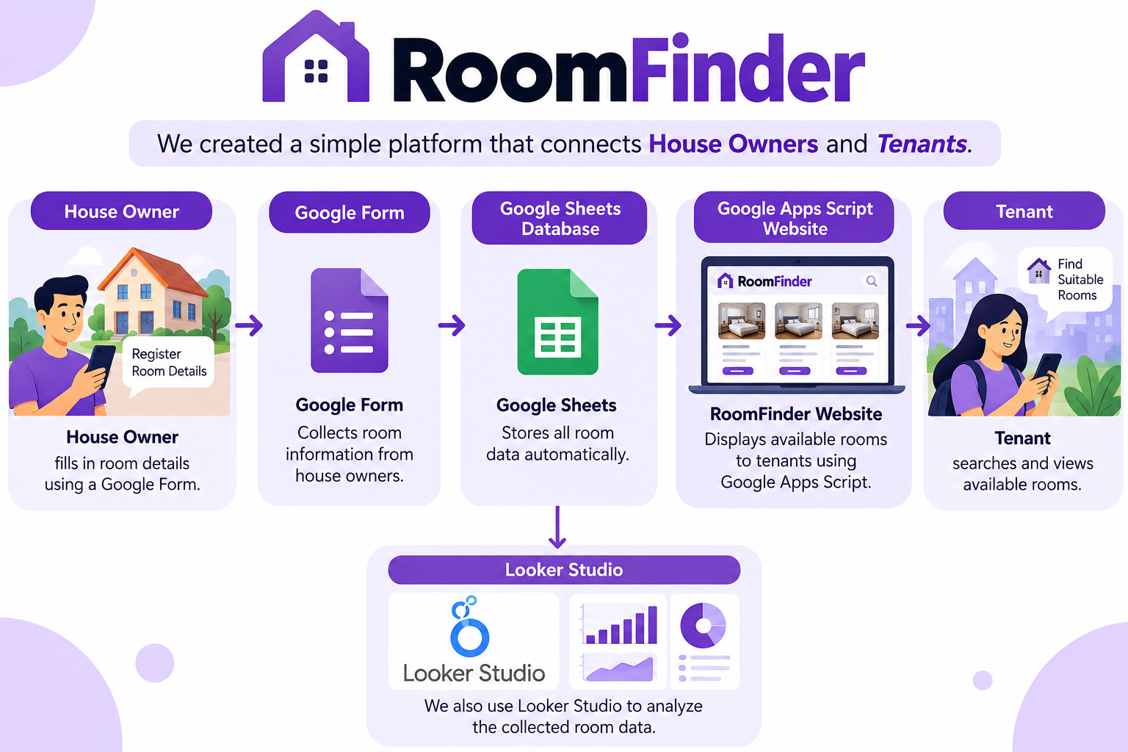
Our Proposed Solution
3

Slide 4
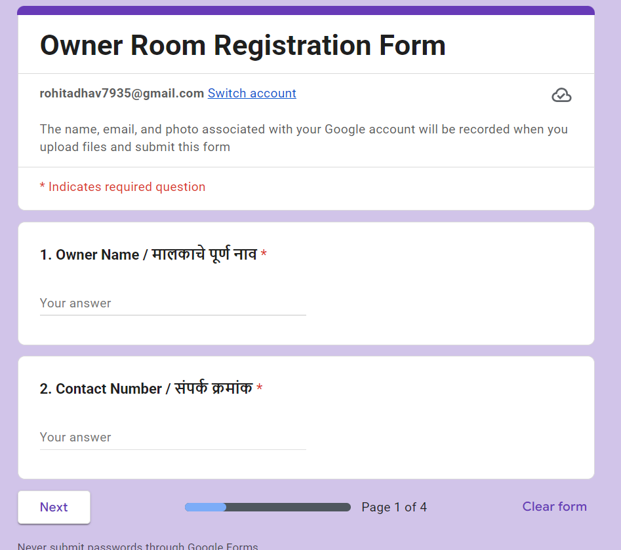
Step 1 — House Owner Registration
• Owner name and contact details
• Property / room location
• Monthly rent
• Room type
• Facilities and description
• Availability status
6

Slide 5
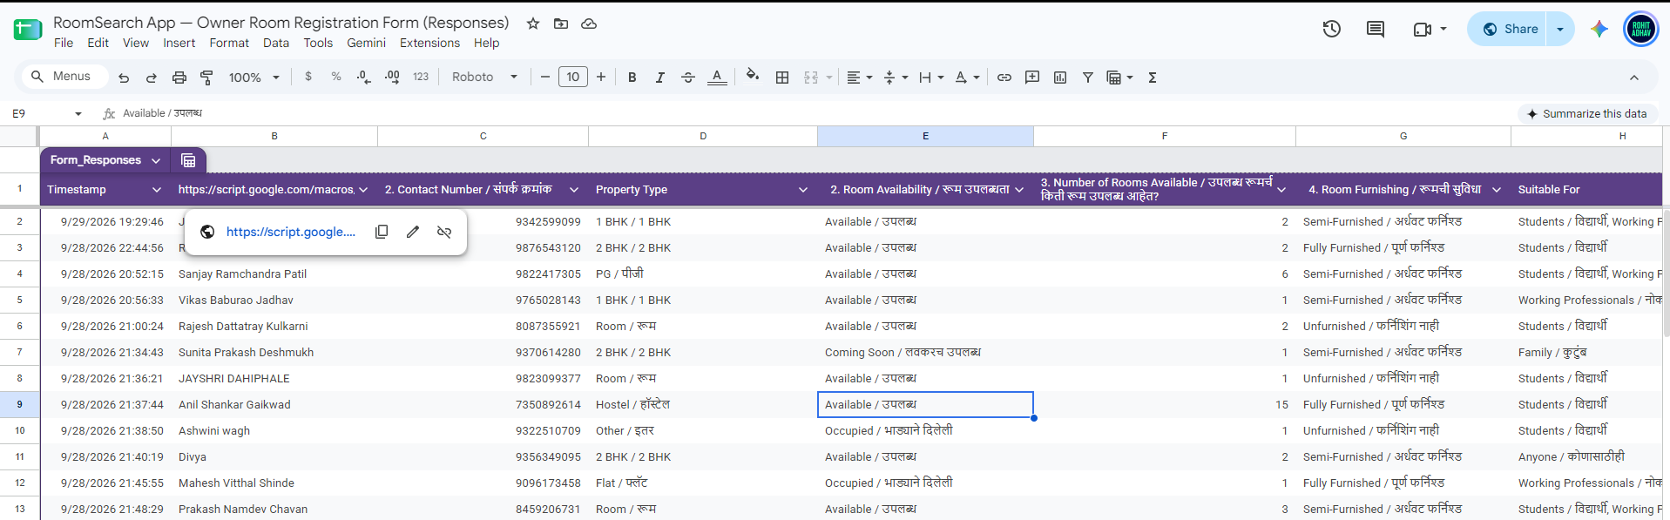
Step 2 — Centralized Database
Cloud Based
Accessible and easy to maintain.
Structured
Consistent columns for room records.
Connected
Feeds both the web app and dashboard.
7

Slide 6
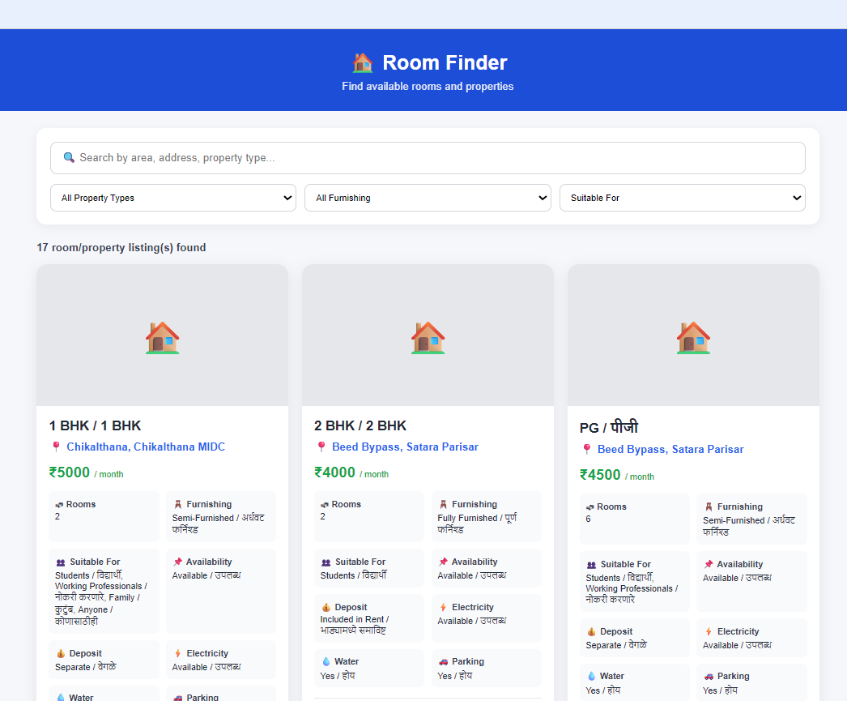
Step 3 — RoomFinder Web Application
• Room listing interface
• Location and rent information
• Room type and facilities
• Owner-provided availability
• Simple tenant-friendly design
8

Slide 7
Tenant Search Process
A simple path from search to contact
1
Open RoomFinder
2
View available rooms
3
Compare rent & location
4
Select a suitable room
5
Contact owner
9

Slide 8
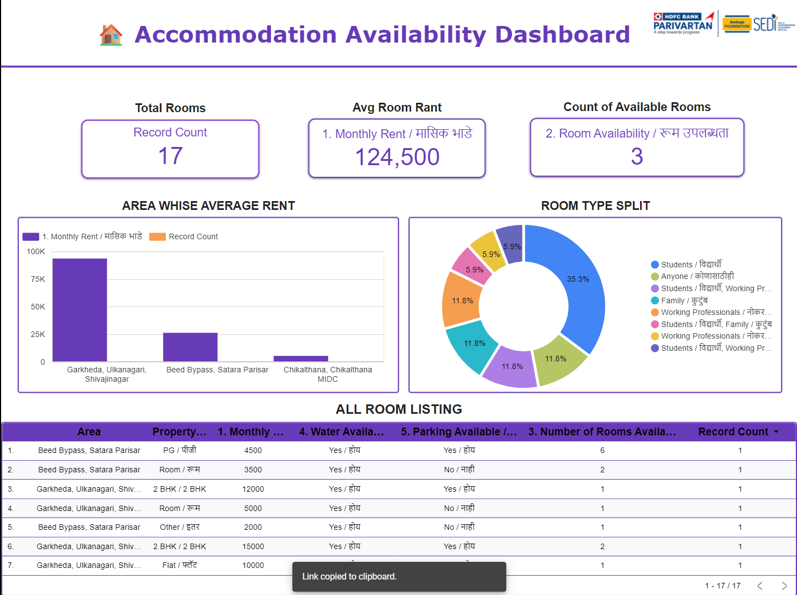
Step 4 — Analytics Dashboard
• Total registered rooms
• Available rooms
• Average monthly rent
• Rooms by area
• Rooms by room type
• Availability analysis
10

Slide 9
What Can We Learn From the Data?
Example analytical questions — replace with your actual values
1
2
3
Location
Rent
Room Type
Which areas have the most room listings?
What is the average monthly rent?
Which room types are most common?
4
5
6
Availability
Supply
Comparison
How many rooms are currently marked available?
Which areas have fewer listed rooms?
How does rent vary by area or room type?
11

Slide 10
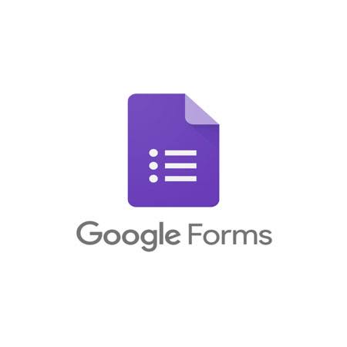


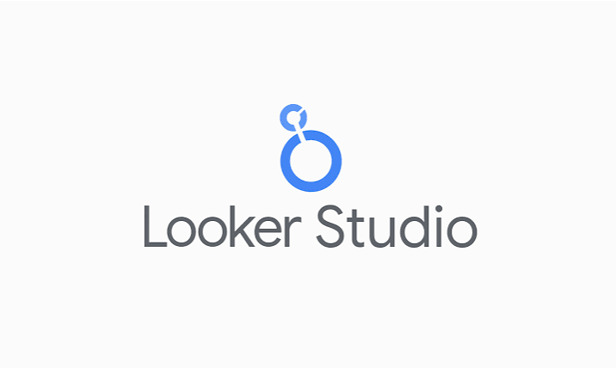
Live Demonstration
19

Slide 11
Thank You
RoomFinder — A Data-Driven Room Discovery System
Questions?

