Slide 1
Introduction to Javascript

Slide 2
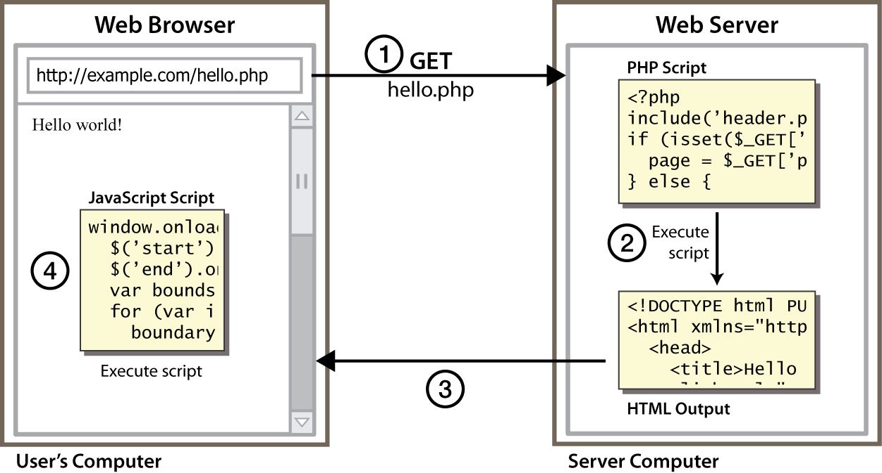
Client Side Scripting
Notes:
client-side script: code runs in browser after page is sent back from server
often this code manipulates the page or responds to user actions

Slide 3
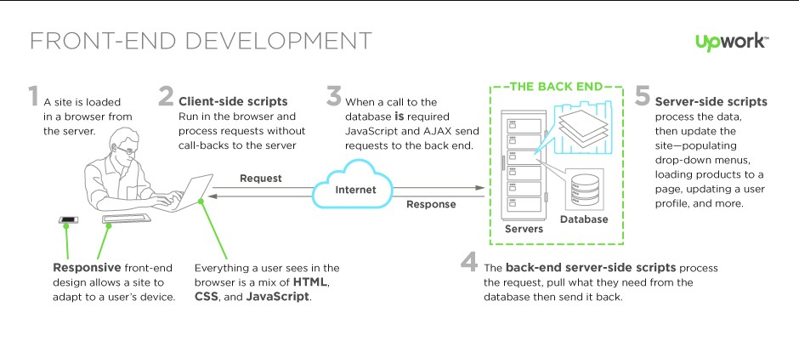
Server Vs Client

Slide 4
Why use client-side programming?
PHP already allows us to create dynamic web pages. Why also use client-side scripting?
client-side scripting (JavaScript) benefits:
usability: can modify a page without having to post back to the server (faster UI)
efficiency: can make small, quick changes to page without waiting for server
event-driven: can respond to user actions like clicks and key presses

Slide 5
Why use client-side programming?
server-side programming (PHP) benefits:
security: has access to server's private data; client can't see source code
compatibility: not subject to browser compatibility issues
power: can write files, open connections to servers, connect to databases, ...

Slide 6
JAVASCRIPT
JavaScript is used in millions of Web pages to improve the design, validate forms, detect browsers, create cookies, and much more.
JavaScript is the most popular scripting language on the internet, and works in all major browsers, such as Internet Explorer, Mozilla, Firefox, Netscape, Opera.

Slide 7
What is Javascript?
a lightweight programming language ("scripting language")
used to make web pages interactive
insert dynamic text into HTML (ex: user name)
react to events (ex: page load user click)
get information about a user's computer (ex: browser type)
perform calculations on user's computer (ex: form validation)

Slide 8
What is Javascript?
JavaScript was designed to add interactivity to HTML pages
JavaScript is a scripting language (a scripting language is a lightweight programming language)
A JavaScript consists of lines of executable computer code
A JavaScript is usually embedded directly into HTML pages
JavaScript is an interpreted language (means that scripts execute without preliminary compilation)
Everyone can use JavaScript without purchasing a license

Slide 9
Are Java and JavaScript the Same?
NO!
Java and JavaScript are two completely different languages in both concept and design!
Java (developed by Sun Microsystems) is a powerful and much more complex programming language - in the same category as C and C++.

Slide 10
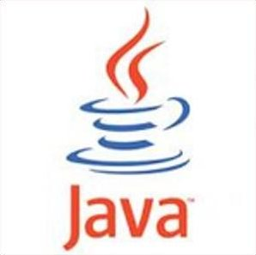
Javascript vs Java
interpreted, not compiled
more relaxed syntax and rules
fewer and "looser" data types
variables don't need to be declared
errors often silent (few exceptions)
key construct is the function rather than the class
"first-class" functions are used in many situations
contained within a web page and integrates with its HTML/CSS content

Slide 11
JavaScript vs. PHP
similarities:
both are interpreted, not compiled
both are relaxed about syntax, rules, and types
both are case-sensitive
both have built-in regular expressions for powerful text processing

Slide 12

JavaScript vs. PHP
differences:
JS is more object-oriented: noun.verb(), less procedural: verb(noun)
JS focuses on user interfaces and interacting with a document; PHP is geared toward HTML output and file/form processing
JS code runs on the client's browser; PHP code runs on the web server
JS <3

Slide 13
Linking to a JavaScript file: script
<script src="filename" type="text/javascript"></script> HTML
script tag should be placed in HTML page's head
script code is stored in a separate .js file
JS code can be placed directly in the HTML file's body or head (like CSS)
but this is bad style (should separate content, presentation, and behavior

Slide 14
How to Put a JavaScript Into an HTML Page?
<html>
<body>
<script type="text/javascript">
document.write("Hello World!")
</script>
</body>
</html>

Slide 15
Ending Statements With a Semicolon?
With traditional programming languages, like C++ and Java, each code statement has to end with a semicolon (;).
Many programmers continue this habit when writing JavaScript, but in general, semicolons are optional! However, semicolons are required if you want to put more than one statement on a single line.

Slide 16
JavaScript Variables
Variables are used to store data.
A variable is a "container" for information you want to store. A variable's value can change during the script. You can refer to a variable by name to see its value or to change its value.
Rules for variable names:
Variable names are case sensitive
They must begin with a letter or the underscore character
strname – STRNAME (not same)

Slide 17
Names should be formed from the 26 upper and lower case letters (A .. Z, a .. z), the 10 digits (0 .. 9), and _ underbar.
Do not use $ dollar sign or \ backslash in names.
Do not use _ underbar as the first or last character of a name.
Most variables and functions should start with a lower case letter.
Global variables in browsers should be in all caps.

Slide 18
JavaScript Operators
Arithmetic Operators
(Operators enable processing on two or more values. JavaScript is used in two types of operators, arithmetic and calculation operators)
Operator | Description | Example | Result
+ | Addition | x=2 | 4
 |  | y=2
 |  | x+y
- | Subtraction | x=5 | 3
 |  | y=2
 |  | x-y
* | Multiplication | x=5 | 20
 |  | y=4
 |  | x*y
/ | Division | 15/5 | 3
 |  | 5/2 | 2,5
% | Modulus (division remainder) | 5%2 | 1
 |  | 10%8 | 2
 |  | 10%2 | 0
++ | Increment | x=5 | x=6
 |  | x++
-- | Decrement | x=5 | x=4
 |  | x--

Slide 19
JavaScript Operators – 2
Assignment Operators
(The assignment statement (=) allows a value to be assigned to a variable. Variables can be assigned any value that is appropriate to their type and definition.)
Operator | Example | Is The Same As
= | x=y | x=y
+= | x+=y | x=x+y
-= | x-=y | x=x-y
*= | x*=y | x=x*y
/= | x/=y | x=x/y
%= | x%=y | x=x%y

Slide 20
JavaScript Operators - 3
Comparison Operators
(The Comparison operator returns a logical value, either True or False, by comparing two or more values ​​with each other.)
Operator | Description | Example
== | is equal to | 5==8 returns false
=== | is equal to (checks for both value and type) | x=5
 |  | y="5"
 |  | x==y returns true
 |  | x===y returns false
!= | is not equal | 5!=8 returns true
> | is greater than | 5>8 returns false
< | is less than | 5<8 returns true
>= | is greater than or equal to | 5>=8 returns false
<= | is less than or equal to | 5<=8 returns true

Slide 21
JavaScript Operators - 4
Logical Operators
(Binary operators combine multiple comparison operations into a single predicate expression.)
Operator | Description | Example
&& | and | x=6
 |  | y=3
 |  | (x < 10 && y > 1) returns true
|| | or | x=6
 |  | y=3
 |  | (x==5 || y==5) returns false
! | not | x=6
 |  | y=3
 |  | !(x==y) returns true

Slide 22
JavaScript Basic Examples
<script>
document.write("Hello World!")
</script> ⇒ format text with HTML code - heading
<script>
alert("Hello World!")
</script>

Slide 23
Example
<script>
x=“Hello World!”
document.write(x)
</script>
<script>
x=“Hello World….”
document.write(“ABC” +x)
</script> ⇒ use line break html code

Slide 24
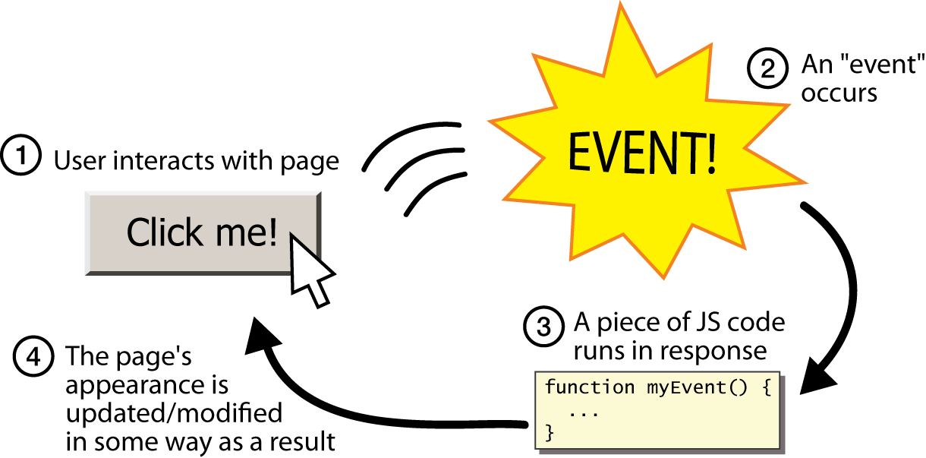
Event-driven programming
split breaks apart a string into an array using a delimiter
can also be used with regular expressions (seen later)
join merges an array into a single string, placing a delimiter between them

Slide 25
Event-driven programming
you are used to programs start with a main method (or implicit main like in PHP)
JavaScript programs instead wait for user actions called events and respond to them
event-driven programming: writing programs driven by user events

Slide 26
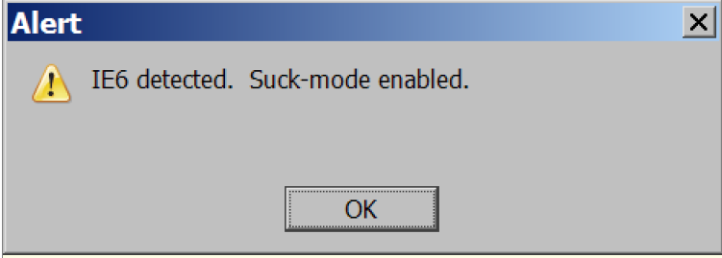
A JavaScript statement: alert
alert("IE6 detected. Suck-mode enabled."); JS
a JS command that pops up a dialog box with a message

Slide 27
JavaScript Popup Boxes
Alert Box
An alert box is often used if you want to make sure information comes through to the user.
When an alert box pops up, the user will have to click "OK" to proceed.
<script>
alert("Hello World!")
</script>

Slide 28
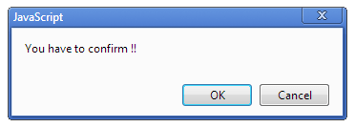
JavaScript Popup Boxes - 2
Confirm Box
A confirm box is often used if you want the user to verify or accept something.
When a confirm box pops up, the user will have to click either "OK" or "Cancel" to proceed.
If the user clicks "OK", the box returns true. If the user clicks "Cancel", the box returns false.

Slide 29
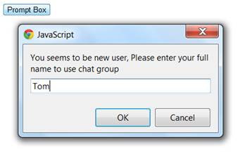
JavaScript Popup Boxes - 3
Prompt Box
A prompt box is often used if you want the user to input a value before entering a page.
When a prompt box pops up, the user will have to click either "OK" or "Cancel" to proceed after entering an input value.
If the user clicks "OK“, the box returns the input value. If the user clicks "Cancel“, the box returns null.

Slide 30
Prompt Box Example
<script>
x=prompt (“Hello World”, “ ”)
document.write(“ABC <br>”,+x)
</script>

Slide 31
JS Examples -1
Y=20x+12 ve x=3 how to write the result code?
<script>
x=3
y=20*x+12
alert(y)
</script>

Slide 32
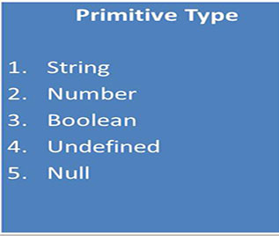
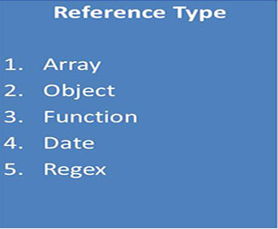
Data Types
Javascript is a loosely typed, prototype based scripting language. We can create any type of data using a single variable var.
"var" means a variable which can store any type of data. Data type of variable is not declared
Primitive are very basic or common data types in javascript. Like string, numbers, boolean, undefined and null
Reference are datatypes based on primitive. Like Array, Object, Functions, Date and regex.

Slide 33
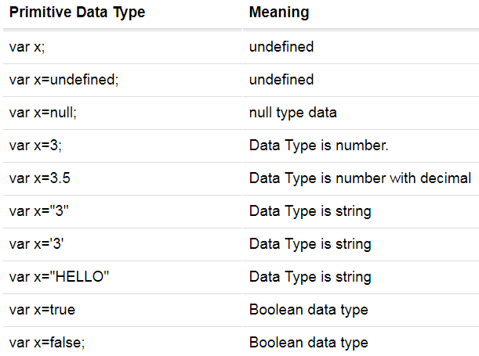
Primitive Data Types

Slide 34
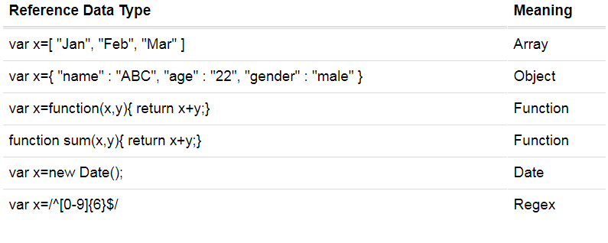
Reference Data Type

Slide 35
JavaScript Data Types Conversion
5data types
contain values:
string
number
Boolean
object
function
3 types of objects
Object
Date
Array
2 data types cannot contain values:
null
undefined
Use typeof operator to know data type of variable.
JavaScript variables can be converted to a new variable and another data type:
By the use of a JavaScript function
Automatically by JavaScript itself

Slide 36
JavaScript Data Types Conversion
Converting Numbers to Strings
String(variable); // returns a string from a number variable x
variable.toString();
String(X))
X.toString()
String(false) // returns "false“
false.toString() // returns "false“
String(Date()) // returns Current Date
Date().toString()
Converting Strings to Numbers
Number("3.14") // returns 3.14
Number(false) // returns 0
Automatic String Conversion
JavaScript automatically calls the variable's toString() function when you try to "output" an object or a variable:

Slide 37
Array
An array is a special variable, which can hold more than one value at a time.
var car1 = "Saab"; var car2 = "Volvo"; var car3 = "BMW";
var cars = ["Saab", "Volvo", "BMW"];
Creating an Array
var array_name = [item1, item2, ...];
var cars = new Array("Saab", "Volvo", "BMW");

Slide 38
Array
Access the Elements of an Array
You access an array element by referring to the index number
var name = cars[0];
document.getElementById("demo").innerHTML = cars[0];
Changing an Array Element
cars[0] = "Opel";
Access the Full Array
var cars = ["Saab", "Volvo", "BMW"];
document.getElementById("demo").innerHTML = cars;

Slide 39
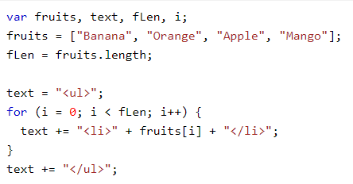
Array
Looping an Array

Slide 40
Conditional Statements
Very often when you write code, you want to perform different actions for different decisions. You can use conditional statements in your code to do this.
In JavaScript we have the following conditional statements:
if statement - use this statement if you want to execute some code only if a specified condition is true
if...else statement - use this statement if you want to execute some code if the condition is true and another code if the condition is false
if...else if....else statement - use this statement if you want to select one of many blocks of code to be executed
switch statement - use this statement if you want to select one of many blocks of code to be executed

Slide 41
Conditional Statements Examples
<script>
x=3
if(x<0)
{
alert (“negatif”)
}
else
{
alert (“pozitif”)
}
</script>

Slide 42
Buttons
<button>Click me!</button> HTML
button's text appears inside tag; can also contain images
To make a responsive button or other UI control:
choose the control (e.g. button) and event (e.g. mouse 1. click) of interest
write a JavaScript function to run when the event occurs
attach the function to the event on the control
Notes:
Reset is not working here! Debug! test1.html

Slide 43
JavaScript functions
function name() {
statement ;
statement ;
...
statement ;
} JS
function myFunction() {
alert("Hello!");
alert("How are you?");
} JS
the above could be the contents of example.js linked to our HTML page
statements placed into functions can be evaluated in response to user events

Slide 44
Event handlers
<element attributes onclick="function();">... HTML
<button onclick="myFunction();">Click me!</button> HTML
JavaScript functions can be set as event handlers
when you interact with the element, the function will execute
onclick is just one of many event HTML attributes we'll use
but popping up an alert window is disruptive and annoying
A better user experience would be to have the message appear on the page...

Slide 45
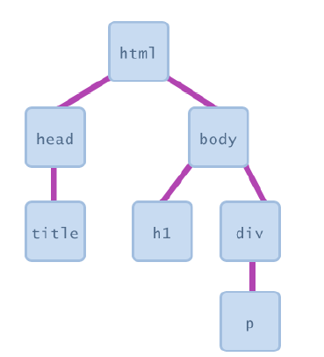
Document Object Model (DOM)
most JS code manipulates elements on an HTML page
we can examine elements' state
e.g. see whether a box is checked
we can change state
e.g. insert some new text into a div
we can change styles
e.g. make a paragraph red

Slide 46
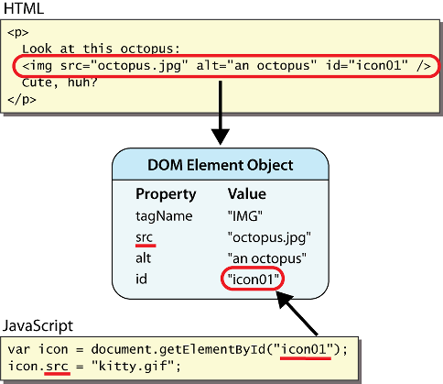
DOM element objects
Notes:
every element on the page has a corresponding DOM object access/modify the attributes of the DOM object with objectName.attributeName

Slide 47
Accessing elements: document.getElementById
var name = document.getElementById("id");
JS
<button onclick="changeText();">Click me!</button>
<span id="output">replace me</span>
<input id="textbox" type="text" /> HTML
function changeText() {
var span = document.getElementById("output");
var textBox = document.getElementById("textbox");
textbox.style.color = "red";
} JS
Notes:
span.innerHTML = textBox.value;

Slide 48
Accessing elements: document.getElementById
document.getElementById returns the DOM object for an element with a given id
can change the text inside most elements by setting the innerHTML property
can change the text in form controls by setting the value property

Slide 49
Changing element style: element.style
Attribute | Property or style object
color | color
padding | padding
background-color | backgroundColor
border-top-width | borderTopWidth
Font size | fontSize
Font famiy | fontFamily

Slide 50
Preetify
function changeText() {
//grab or initialize text here
// font styles added by JS:
text.style.fontSize = "13pt";
text.style.fontFamily = "Comic Sans MS";
text.style.color = "red"; // or pink?
} JS

Slide 51
More Javascript Syntax

Slide 52
Variables
var name = expression; JS
var clientName = "Connie Client";
var age = 32;
var weight = 127.4; JS
variables are declared with the var keyword (case sensitive)
types are not specified, but JS does have types ("loosely typed")
Number, Boolean, String, Array, Object, Function, Null, Undefined
can find out a variable's type by calling typeof

Slide 53
Number type
var enrollment = 99;
var medianGrade = 2.8;
var credits = 5 + 4 + (2 * 3); JS
integers and real numbers are the same type (no int vs. double)
same operators: + - * / % ++ -- = += -= *= /= %=
similar precedence to Java
many operators auto-convert types: "2" * 3 is 6

Slide 54
Comments (same as Java)
// single-line comment
/* multi-line comment */ JS
identical to Java's comment syntax
recall: 4 comment syntaxes
HTML: <!-- comment -->
CSS/JS/PHP: /* comment */
Java/JS/PHP: // comment
PHP: # comment

Slide 55
Math object
var rand1to10 = Math.floor(Math.random() * 10 + 1);
var three = Math.floor(Math.PI); JS
methods: abs, ceil, cos, floor, log, max, min, pow, random, round, sin, sqrt, tan
properties: E, PI

Slide 56
Special values: null and undefined
var ned = null;
var benson = 9;
// at this point in the code,
// ned is null
// benson's 9
// caroline is undefined JS
undefined : has not been declared, does not exist
null : exists, but was specifically assigned an empty or null value
Why does JavaScript have both of these?

Slide 57
Logical operators
> < >= <= && || ! == != === !==
most logical operators automatically convert types:
5 < "7" is true
42 == 42.0 is true
"5.0" == 5 is true
=== and !== are strict equality tests; checks both type and value
"5.0" === 5 is false

Slide 58
if/else statement (same as Java)
if (condition) {
statements;
} else if (condition) {
statements;
} else {
statements;
}
JS
identical structure to Java's if/else statement
JavaScript allows almost anything as a condition

Slide 59
Boolean type
var iLike190M = true;
var ieIsGood = "IE6" > 0; // false
if ("web devevelopment is great") { /* true */ }
if (0) { /* false */ } JS
any value can be used as a Boolean
"falsey" values: 0, 0.0, NaN, "", null, and undefined
"truthy" values: anything else
converting a value into a Boolean explicitly:
var boolValue = Boolean(otherValue);
var boolValue = !!(otherValue);

Slide 60
for loop (same as Java)
var sum = 0;
for (var i = 0; i < 100; i++) {
sum = sum + i;
} JS
var s1 = "hello";
var s2 = "";
for (var i = 0; i < s.length; i++) {
s2 += s1.charAt(i) + s1.charAt(i);
}
// s2 stores "hheelllloo" JS

Slide 61
while loops (same as Java)
while (condition) {
statements;
} JS
do {
statements;
} while (condition); JS
break and continue keywords also behave as in Java

Slide 62
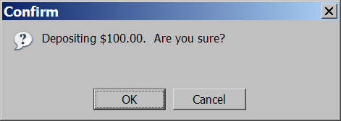
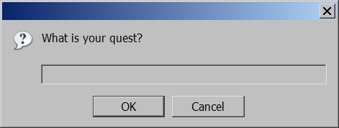
Popup boxes
alert("message"); // message
confirm("message"); // returns true or false
prompt("message"); // returns user input string JS

Slide 63
Arrays
var name = []; // empty array
var name = [value, value, ..., value]; // pre-filled
name[index] = value; // store element JS
var ducks = ["Huey", "Dewey", "Louie"];
var stooges = []; // stooges.length is 0
stooges[0] = "Larry"; // stooges.length is 1
stooges[1] = "Moe"; // stooges.length is 2
stooges[4] = "Curly"; // stooges.length is 5
stooges[4] = "Shemp"; // stooges.length is 5 JS
Notes:
two ways to initialize an array
length property (grows as needed when elements are added)

Slide 64
Array methods
var a = ["Stef", "Jason"]; // Stef, Jason
a.push("Brian"); // Stef, Jason, Brian
a.unshift("Kelly"); // Kelly, Stef, Jason, Brian
a.pop(); // Kelly, Stef, Jason
a.shift(); // Stef, Jason
a.sort(); // Jason, Stef JS
array serves as many data structures: list, queue, stack, ...
methods: concat, join, pop, push, reverse, shift, slice, sort, splice, toString, unshift
push and pop add / remove from back
unshift and shift add / remove from front
shift and pop return the element that is removed

Slide 65
String type
var s = "Connie Client";
var fName = s.substring(0, s.indexOf(" ")); // "Connie"
var len = s.length; // 13
var s2 = 'Melvin Merchant'; JS
methods: charAt, charCodeAt, fromCharCode, indexOf, lastIndexOf, replace, split, substring, toLowerCase, toUpperCase
charAt returns a one-letter String (there is no char type)
length property (not a method as in Java)
Strings can be specified with "" or ''
concatenation with + :
1 + 1 is 2, but "1" + 1 is "11"

Slide 66
More about String
escape sequences behave as in Java: \' \" \& \n \t \\
converting between numbers and Strings:
var count = 10;
var s1 = "" + count; // "10"
var s2 = count + " bananas, ah ah ah!"; // "10 bananas, ah ah ah!"
var n1 = parseInt("42 is the answer"); // 42
var n2 = parseFloat("booyah"); // NaN JS
accessing the letters of a String:
var firstLetter = s[0]; // fails in IE
var firstLetter = s.charAt(0); // does work in IE
var lastLetter = s.charAt(s.length - 1); JS

Slide 67
Splitting strings: split and join
var s = "the quick brown fox";
var a = s.split(" "); // ["the", "quick", "brown", "fox"]
a.reverse(); // ["fox", "brown", "quick", "the"]
s = a.join("!"); // "fox!brown!quick!the" JS
split breaks apart a string into an array using a delimiter
can also be used with regular expressions (seen later)
join merges an array into a single string, placing a delimiter between them

