Slide 2
What are key uses of JavaScript

Slide 3
Features of JavaScript
No Need of special Plugin , All browsers are currently support JavaScript.
Support commonly structured language type syntax.
It automatically insert semicolon , hence no need to add semicolon.
Data type is bound to the value and not to variable
We can assign integer to value to variable “a”
Later on we can change value to string .
4. Using eval function expression can be evaluated at run time
5. Support object, but handling is totally different from OOPL
6. Support regular expression ( [abc] , [^abc] ,[0-9] ,[^0-9] ,(x|y))
6.1 which is used to matching text-pattern.
6.2 used for validation.
7. Function can be used
Browser Support
Structure Programming Syntax
Dynamic Typing
Run Time Evaluation
Support of Object
Regular Expression
Function Programming

Slide 4
Can JavaScript be in separate file ? Discuss in details How to call JavaScript from HTML Page.

Slide 5
External JavaScript
<script type=”text/javascript src=”myjavascript.js> </script>
<!DOCTYPE html> <html> <body> <h2>External JavaScript</h2> <p id="demo">A Paragraph.</p> <button type="button" onclick="myFunction()">Try it</button> <p>(myFunction is stored in an external file called "myScript.js")</p> <script src="myScript.js"></script> </body> </html>
function myFunction() { document.getElementById("demo").innerHTML = "Paragraph changed."; }
JavaScript in Body Paragraph changed. Try it

Slide 6
What are different data types in JavaScript ?

Slide 7
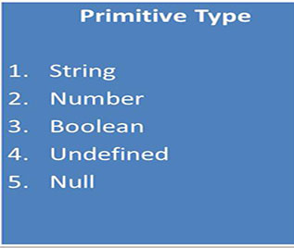
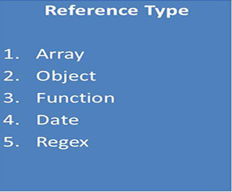
Data Types
Javascript is a loosely typed, prototype based scripting language. We can create any type of data using a single variable var.
"var" means a variable which can store any type of data. Data type of variable is not declared
Primitive are very basic or common data types in javascript. Like string, numbers, boolean, undefined and null
Reference are datatypes based on primitive. Like Array, Object, Functions, Date and regex.

Slide 8
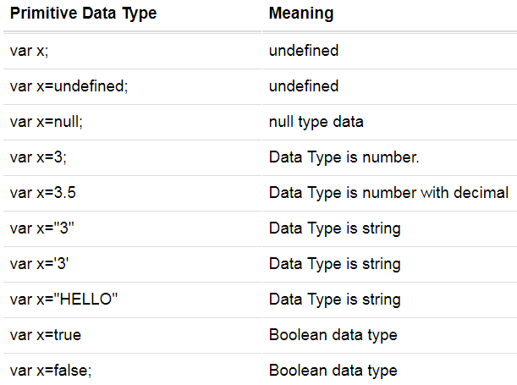
Primitive Data Types

Slide 9
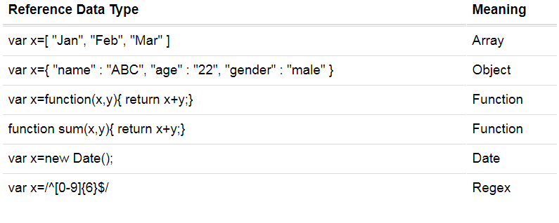
Reference Data Type

Slide 10
How to create array and read element in JavaScript

Slide 11
Array
An array is a special variable, which can hold more than one value at a time.
var car1 = "Saab"; var car2 = "Volvo"; var car3 = "BMW";
var cars = ["Saab", "Volvo", "BMW"];
Creating an Array
var array_name = [item1, item2, ...];
var cars = new Array("Saab", "Volvo", "BMW");

Slide 12
Array
Access the Elements of an Array
You access an array element by referring to the index number
var name = cars[0];
document.getElementById("demo").innerHTML = cars[0];
Changing an Array Element
cars[0] = "Opel";
Access the Full Array
var cars = ["Saab", "Volvo", "BMW"];
document.getElementById("demo").innerHTML = cars;

Slide 13
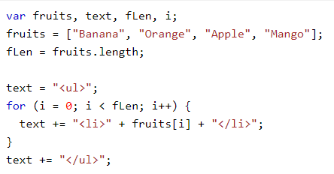
Array
Looping an Array

Slide 14
How to create object in JavaScript with example
JavaScript is designed on a simple object-based paradigm.
An object is a collection of properties, and a property is an association between a name (or key) and a value.
A property's value can be a function, in which case the property is known as a method.
In addition to objects that are predefined in the browser, you can define your own objects.

Slide 15
Data type : Objects
var sabine = { };
sabine.name = 'Sabine';
sabine.type = 'cat';
sabine.gender = 'female';
sabine.age = 14;
sabine.fixed = true;
sabine; // Object
sabine['name']; // 'Sabine'
sabine.name; // 'Sabine'

Slide 16
Variable conventions for Java Script

Slide 17
JavaScript Variables
Variables are used to store data.
A variable is a "container" for information you want to store. A variable's value can change during the script. You can refer to a variable by name to see its value or to change its value.
Rules for variable names:
Variable names are case sensitive
They must begin with a letter or the underscore character
strname – STRNAME (not same)

Slide 18
Names should be formed from the 26 upper and lower case letters (A .. Z, a .. z), the 10 digits (0 .. 9), and _ underbar.
Do not use $ dollar sign or \ backslash in names.
Do not use _ underbar as the first or last character of a name.
Most variables and functions should start with a lower case letter.
Global variables in browsers should be in all caps.

Slide 19
List and brief any five functions in JavaScript
eval() | Evaluates a string and executes it as if it was script code
isFinite() | Determines whether a value is a finite, legal number
isNaN() | Determines whether a value is an illegal number
Number() | Converts an object's value to a number
parseFloat() | Parses a string and returns a floating point number
parseInt() | Parses a string and returns an integer
String() | Converts an object's value to a string
unescape() | Deprecated in version 1.5. Use decodeURI() or decodeURIComponent()instead

Slide 20
Eval()
The eval() function evaluates or executes an argument.
If the argument is an expression, eval() evaluates the expression. If the argument is one or more JavaScript statements, eval() executes the statements
var x = 10; var y = 20; var a = eval("x * y") + "<br>"; var b = eval("2 + 2") + "<br>"; var c = eval("x + 17") + "<br>"; var res = a + b + c;

Slide 21
isFinite()
The isFinite() function determines whether a number is a finite, legal number.
This function returns false if the value is +infinity, -infinity, or NaN (Not-a-Number), otherwise it returns true.
var a = isFinite(123) + "<br>"; true var b = isFinite(-1.23) + "<br>"; true var c = isFinite(5-2) + "<br>"; true var d = isFinite(0) + "<br>"; true var e = isFinite("123") + "<br>"; true var f = isFinite("Hello") + "<br>"; false var g = isFinite("2005/12/12"); false var res = a + b + c + d + e + f + g;
true<br>true<br>true<br>true<br>true<br>false<br>false

Slide 22
The isNaN() function determines whether a value is an illegal number (Not-a-Number).
This function returns true if the value equates to NaN. Otherwise it returns false.
isNaN(123) //false isNaN(-1.23) //false isNaN(5-2) //false isNaN(0) //false isNaN('123') //false isNaN('Hello') //true isNaN('') //false isNaN(true) //false isNaN(NaN) //true isNaN(undefined) //true
isNaN('NaN') //true
isNaN(0 / 0) //true
isNaN('2005/12/12') //true

Slide 23
The Number() function converts the object argument to a number that represents the object's value.
If the value cannot be converted to a legal number, NaN is returned.
var x1 = true; var x2 = false; var x3 = new Date(); var x4 = "999"; var x5 = "999 888"; var n = Number(x1) + "<br>" + Number(x2) + "<br>" + Number(x3) + "<br>" + Number(x4) + "<br>" + Number(x5);
1 0 1550645324238 999 NaN

Slide 24
parseFloat()
The parseFloat() function parses a string and returns a floating point number.
This function determines if the first character in the specified string is a number. If it is, it parses the string until it reaches the end of the number, and returns the number as a number, not as a string.
var a = parseFloat("10") + "<br>"; var b = parseFloat("10.00") + "<br>"; var c = parseFloat("10.33") + "<br>"; var d = parseFloat("34 45 66") + "<br>"; var e = parseFloat(" 60 ") + "<br>"; var f = parseFloat("40 years") + "<br>"; var g = parseFloat("He was 40") + "<br>"; var n = a + b + c + d + e + f + g; 10 10 10.33 34 60 40 NaN

Slide 25
parseInt()
The parseInt() function parses a string and returns an integer.
var a = parseInt("10") + "<br>"; var b = parseInt("10.00") + "<br>"; var c = parseInt("10.33") + "<br>"; var d = parseInt("34 45 66") + "<br>"; var f = parseInt("40 years") + "<br>"; var g = parseInt("He was 40") + "<br>"; var h = parseInt("10", 10)+ "<br>"; var k = parseInt("0x10")+ "<br>"; var n = a + b + c + d + f + g + h + k;
10 10 10 34 40 NaN 10 16

Slide 26
String()
The String() function converts the value of an object to a string.
var x1 = Boolean(0); var x2 = Boolean(1); var x3 = new Date(); var x4 = "12345"; var x5 = 12345; var res = String(x1) + "<br>" + false String(x2) + "<br>" + true String(x3) + "<br>" + Wed Feb 20 2019 12:33:23 GMT+0530 (India Standard Time) String(x4) + "<br>" + 12345 String(x5); 12345

Slide 27
Explain Document Object Model with example

Slide 28
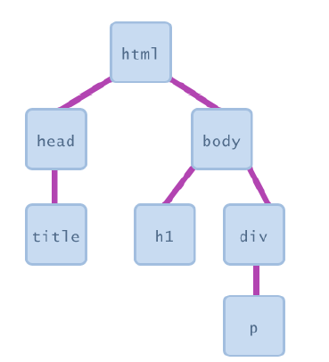
Document Object Model (DOM)
most JS code manipulates elements on an HTML page
we can examine elements' state
e.g. see whether a box is checked
we can change state
e.g. insert some new text into a div
we can change styles
e.g. make a paragraph red

Slide 29
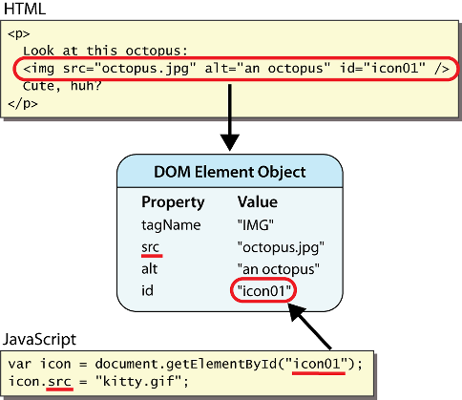
DOM element objects
Notes:
every element on the page has a corresponding DOM object access/modify the attributes of the DOM object with objectName.attributeName

Slide 30
Accessing elements: document.getElementById
var name = document.getElementById("id");
JS
<button onclick="changeText();">Click me!</button>
<span id="output">replace me</span>
<input id="textbox" type="text" /> HTML
function changeText() {
var span = document.getElementById("output");
var textBox = document.getElementById("textbox");
textbox.style.color = "red";
} JS
Notes:
span.innerHTML = textBox.value;

Slide 31
Accessing elements: document.getElementById
document.getElementById returns the DOM object for an element with a given id
can change the text inside most elements by setting the innerHTML property
can change the text in form controls by setting the value property

Slide 32
Changing element style: element.style
Attribute | Property or style object
color | color
padding | padding
background-color | backgroundColor
border-top-width | borderTopWidth
Font size | fontSize
Font famiy | fontFamily

Slide 33
Power of JavaScript Using DOM
JavaScript can change all the HTML elements in the page
JavaScript can change all the HTML attributes in the page
JavaScript can change all the CSS styles in the page
JavaScript can remove existing HTML elements and attributes
JavaScript can add new HTML elements and attributes
JavaScript can react to all existing HTML events in the page
JavaScript can create new HTML events in the page

Slide 34
Dom Methods
Method | Description
document.body | Returns documents body
document.createElement() | Create the element node
document.forms | Returns collection of all form element in document
document.elementById() | Returns element has ID attributes with specific value
document.getElementByName() | Returns node list containing all element with specific value
document.open() | Open HTML output stream to collect output from document.write
document.write() | It writes the specified string on document.

