Slide 2
Revision Unit I
Introduction to web technology, internet and www
Web site planning and design
HTML: structure of html document , HTML elements: headings, paragraphs, line break, colors & fonts
links, frames, lists, tables, images and forms, Difference between HTML and HTML5
CSS: Introduction to Style Sheet, Inserting CSS in an HTML page, CSS selectors
XML: Introduction to XML, XML key component, Transforming XML into XSLT
DTD: Schema, elements, attributes, Introduction to JSON

Slide 3
What do you mean by CSS?
CSS stands for Cascading Style Sheet.
Typical CSS file is a text file with an extention.css and contains a series of commands or rules.
These rules tell the HTML how to display.
CSS are like a dress code
It describe how web pages should look
CSS can be easily separated from HTML file so it is easy to find and easy to modify.
Cascading Style Sheet(CSS) is used to set the style in web pages which contain HTML elements. It sets the background color, font-size, font-family, color, … etc property of elements in a web pages.

Slide 4
What are the different ways to create CSS?
There are three types of CSS which are given below:
Inline CSS
Internal or Embedded CSS
External CSS
Inline CSS: Inline CSS contains the CSS property in the body section attached with element is known as inline CSS. This kind of style is specified within an HTML tag using style attribute

Slide 5
<!DOCTYPE html>
<html>
<head>
<title>Inline CSS</title>
</head>
<body>
<p style = "color:#009900; font-size:50px;font-style:italic; text-align:center;">
Hello CSS</p>
</body>
</html>
Hello CSS

Slide 6
Internal or Embedded CSS: This can be used when a single HTML document must be styled uniquely. The CSS rule set should be within the HTML file in the head section i.e the CSS is embedded within the HTML file.

Slide 7
<!DOCTYPE html>
<html>
<head>
<title>Internal CSS</title>
<style>
.main {
text-align:center;
}
.GFG {
color:#009900;
font-size:50px;
font-weight:bold;
}
.geeks {
font-style:bold;
font-size:20px;
}
</style>
</head>
<body>
<div class = "main">
<div class ="GFG">CSS</div>
<div class ="geeks">A Cascading Style Sheet</p>
</div>
</body>
</html>
CSS
A Cascading Style Sheet

Slide 8
External CSS: External CSS contains separate CSS file which contains only style property with the help of tag attributes (For example class, id, heading, … etc).
CSS property written in a separate file with .css extension and should be linked to the HTML document using link tag.
This means that for each element, style can be set only once and that will be applied across web pages.
link tag is used to link the external style sheet with the html webpage.
href attribute is used to specify the location of the external style sheet file.

Slide 9
Style.css
body {
background-color:powderblue;
}
.main {
text-align:center;
}
.GFG {
color:#009900;
font-size:50px;
font-weight:bold;
}
#geeks {
font-style:bold;
font-size:20px;
}
<!DOCTYPE html>
<html>
<head>
<link rel="stylesheet" href="geeks.css"/>
</head>
<body>
<div class = "main">
<div class ="GFG">CSS</div>
<div id ="geeks">
A Cascading Style sheet
</p>
</div>
</body>
</html>
CSS
A Cascading Style Sheet

Slide 10
What is JSON? Why to use JSON over XML?
JSON stands for JavaScript Object Notation
JSON is a lightweight format for storing and transporting data
JSON is often used when data is sent from a server to a web page
JSON is "self-describing" and easy to understand
This example defines an Students object: an array of 3 student records (objects):
{ “Students":[ {"firstName":"John", "lastName":"Doe"},
{"firstName":"Anna", "lastName":"Smith"},
{"firstName":"Peter", "lastName":"Jones"} ] }
JSON Syntax Rules
Data is in name/value pairs
Data is separated by commas
Curly braces hold objects
Square brackets hold arrays

Slide 11
Less Verbose: JSON has a more compact style than XML, and it is often more readable. The lightweight approach of JSON can make significant improvements in RESTful APIs working with complex systems.
Faster: The XML software parsing process can take a long time. One reason for this problem is the DOM manipulation libraries that require more memory to handle large XML files. JSON uses less data overall, so you reduce the cost and increase the parsing speed.
Readable: The JSON structure is straightforward and readable. You have an easier time mapping to domain objects, no matter what programming language you're working with.
Structure Matches the Data: JSON uses a map data structure rather than XML's tree. In some situations, key/value pairs can limit what you can do, but you get a predictable and easy-to-understand data model.
Objects Align in Code: JSON objects and code objects match, which is beneficial when quickly creating domain objects in dynamic languages.
JSON Limitations: The limitations in JSON actually end up being one of its biggest benefits. A common line of thought among developers is that XML comes out on top because it supports modeling more objects. However, JSON's limitations simplify the code, add predictability and increase readability.

Slide 12
Write at least any five Differences between HTML and HTML5.

Slide 13
Difference Between HTML4 &HTML5
Sr.No | HTML4 | HTML5
1 | Doctype declaration in Html is too longer <!DOCTYPE HTML PUBLIC "-//W3C//DTD HTML 4.01//EN" "http://www.w3.org/TR/html4/strict.dtd"> | DOCTYPE declaration in Html5 is very simple "<!DOCTYPE html>
2 | character encoding in Html is also longer <!DOCTYPE HTML PUBLIC "-//W3C//DTD HTML 4.0 Transitional//EN"> | character encoding (charset) declaration is also very simple <meta charset="UTF-8">
3 | Audio and Video are not part of HTML4 | Audio and Videos are integral part of HTML5 e.g. <audio> and <video> tags.
4 | Vector Graphics is possible with the help of technologies such as VML, Silverlight, Flash etc | Vector graphics is integral part of HTML5 e.g. SVG and canvas
5 | Html5 use cookies. | It provides local storage in place of cookies.

Slide 14
Difference Between HTML4 &HTML5
Sr.No | HTML4 | HTML5
6 | It is almost impossible to get true GeoLocation of user browsing any website especially if it comes to mobile devices. | JS GeoLocation API in HTML5 helps identify location of user browsing any website (provided user allows it)
7 | to possible to draw shapes like circle, rectangle, triangle. | Using Html5 you can draw shapes like circle, rectangle, triangle.
8 | Does not allow JavaScript to run in browser. JS runs in same thread as browser interface. | Allows JavaScript to run in background. This is possible due to JS Web worker API in HTML5
9 | Works with all old browsers | Supported by all new browser.
10 | to possible to draw shapes like circle, rectangle, triangle. | Using Html5 you can draw shapes like circle, rectangle, triangle.

Slide 15
What are the different design issues in web development?

Slide 16
Website Planning and Design Issue
Website accessibility (Simplicity)
Compatibility with browsers (Compatibility)
Navigational structure (Navigability)
Positioning of content(Consistency)
Scalability
Performance
Security
Robustness
Visual appeal

Slide 17
What is purpose of HTTP? What are different commands of HTTP
HTTP means HyperText Transfer Protocol.
HTTP is the underlying protocol used by the World Wide Web and this protocol defines how messages are formatted and transmitted, and what actions Web servers and browsers should take in response to various commands.

Slide 18
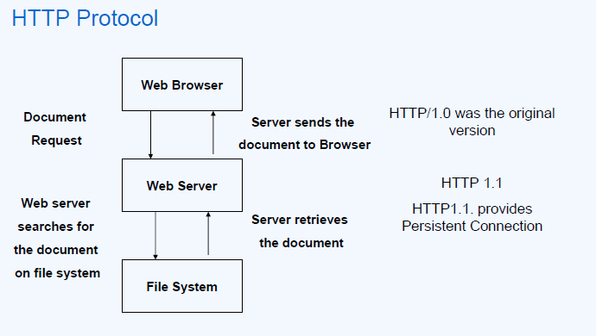
Describe the steps involved when a web browser requests for and obtains a web page from a web server.

Slide 19
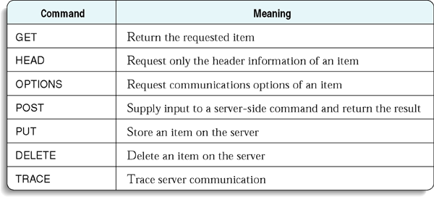
HTTP Commands
HTTP/1.1 200 OK
Allow: OPTIONS, GET, HEAD, POST
Cache-Control: max-age=604800
Date: Thu, 13 Oct 2016 11:45:00 GMT
Expires: Thu, 20 Oct 2016 11:45:00 GMT
Server: EOS (lax004/2813)
x-ec-custom-error: 1
Content-Length: 0
curl -X OPTIONS http://example.org -i

Slide 20
Why is HTTP called a stateless protocol? Why is it so?

Slide 21
HTTP GET Request
Method
URL
Protocol Version
GET http://www.google.com/ HTTP/1.1
Host: www.google.com
User-Agent: Mozilla/5.0 (Windows NT 6.2) Gecko/20100101 Firefox/35.0
Accept: text/html, image/png, */*
Accept-Language: en-us,en;q=0.5
Cookie: rememberme=true; PREF=ID=21039ab4bbc49153:FF=4
Headers
Blank Line
No Data for GET method

Slide 22
HTTP POST Request
Method
URL
Protocol Version
POST http://www.example.com/ HTTP/1.1
Host: www.example.com
User-Agent: Mozilla/5.0 (Windows NT 6.2) Gecko/20100101 Firefox/35.0
Accept: text/html, image/png, */*
Accept-Language: en-us,en;q=0.5
Headers
Blank Line
name=Jane+Doe&sex=female&color=green&over6feet=true&over200pounds=false&athleticability=NA
POST data

Slide 23
HTTP Response
Protocol Version
HTTP Response Code
HTTP/1.1 200 OK
Cache-Control: private
Content-Type: text/html
Server: GWS/2.1
Date: Fri, 13 Oct 2006 03:16:30 GMT
<HTML> ... (page data) ... </HTML>
Headers
Blank
Line
Web Page Data

Slide 24
Common HTTP Response Codes
Response Code | Meaning
200 OK | Resource is available in the body of the response. No errors.
400 BAD REQUEST | Client sent a request with an error. If there is a response body, it contains an error message.
500 INTERNAL SERVER ERROR | Server error. If there is a response body, it contains an error message.
301 MOVED PERMANENTLY | Client triggered action that caused URI to change or attempted to access old URI.
404 NOT FOUND | No resource is available at the specified URI.
410 GONE | Resource is no longer available at the specified URI.
409 CONFLICT | Client requested action that would put resources in an inconsistent state.
http://httpstatus.es/

Slide 25
HTTP Standards
Historical Standards
HTTP 0.9 (1991) 1st documented version.
HTTP 1.0 (1996) defined in RFC 1945.
HTTP 1.1 (1999) defined in RFC 2616.
Current Standard (well specified HTTP/1.1, 2014)
RFC 7230: Message Syntax and Routing
RFC 7231: Semantics and Content
RFC 7232: Conditional Requests
RFC 7233: Range Requests
RFC 7234: Caching
RFC 7235: Authentication
Notes:
https://www.mnot.net/blog/2014/06/07/rfc2616_is_dead
https://http2.github.io/

Slide 26
HTTP is a stateless protocol
A stateful protocol allows requests to move the server into a different state, in which a request may produce a different result.
Example protocols: FTP, SMTP, TCP
FTP command “get rest.txt” will return a different file when cwd is /public rather than /private.
A stateless protocol treats each request as an independent transaction that is unrelated to any previous request so that communication consists of independent pairs of requests and responses.
Examples: HTTP, IP

Slide 27
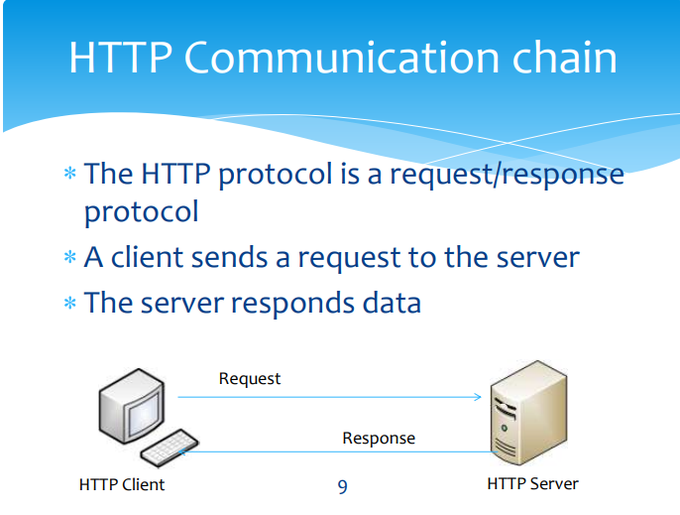

Slide 28
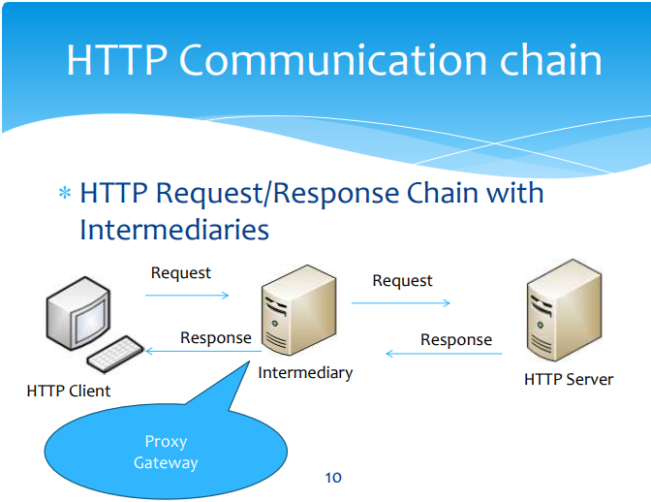

Slide 29
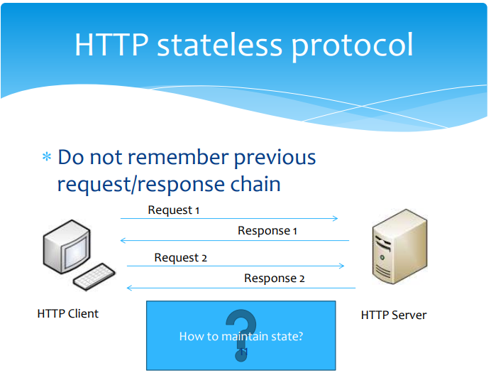

Slide 30
Define the terms i. Website, ii. Web Page, iii. Web Server, iv. URL and v. Home Page.
Website :A website is a collection of related web pages, including multimedia content, typically identified with a common domain name, and published on at least one web server.
Web Page:A web page is a document that is suitable for the World Wide Web and web browsers. A web browser displays a web page on a monitor or mobile device.
Web Server: A Web server is a program that uses HTTP (Hypertext Transfer Protocol) to serve the files that form Web pages to users, in response to their requests, which are forwarded by their computers' HTTP clients. Dedicated computers and appliances may be referred to as Web servers as well.

Slide 31
URL:URL is the abbreviation of Uniform Resource Locator and is defined as the global address of documents and other resources on the World Wide Web. ... The term "web address" is a synonym for a URL that uses the HTTP or HTTPS protocol.
Home Page:A home page or a start page is the initial or main web page of a website or a browser

Slide 32
Explain the need for XML in detail.
The purpose of XML is to support dependable, long-term storage, transmission, conversion, and consumption of data.
XML is an international standard :XML is a document standard that is maintained by the W3C, an organization that is responsible for Web standards. XML documents are vendor-neutral, and they are not tied to one application or one company.

Slide 33
The trouble with HTML is that it was designed with humans in mind. Even without viewing the above HTML document in a browser, you and I can figure out that it is someone's postal address.
While the tags in this document tell a browser how to display this information, the tags don't tell the browser what the information is.
You and I know it's an address, but a machine doesn't.
<p><b>Mrs. Mary McGoon</b>
<br>
1401 Main Street
<br>
Anytown, NC 34829</p>

Slide 34
Need of XML
XML is used for, is to outsource data.
Rather than integrating them into the HTML document, they are stored in separate XML files.
XML stores data in plain text format, the storage is independent of your platform and your data can be exported

Slide 35
What is XML Used For?
XML documents are used to transfer data from one place to another often over the Internet.
XML subsets are designed for particular applications.
Example : One is RSS (Rich Site Summary or Really Simple Syndication ). It is used to send breaking news bulletins from one web site to another.
A number of fields have their own subsets. These include chemistry, mathematics, and books publishing.
Most of these subsets are registered with the W3Consortium and are available for anyone’s use.

Slide 36
Advantages of XML
XML is text (Unicode) based.
Takes up less space.
Can be transmitted efficiently.
One XML document can be displayed differently in different media.
Html, video, CD, DVD,
You only have to change the XML document in order to change all the rest.
XML documents can be modularized. Parts can be reused.
XML documents are used to transfer data from one place to another often over the Internet
XML stores data in plain text format, the storage is independent of your platform and your data can be exported

Slide 37
What are DTDs? How do they work?
DTDs check vocabulary and validity of the structure of XML documents against grammatical rules of appropriate XML language.
An XML DTD can be either specified inside the document, or it can be kept in a separate document and then liked separately.
DTD’s are of two types
Internal DTD
External DTD
Basic syntax of a DTD is as follows −
<!DOCTYPE element DTD identifier
[
declaration1
declaration2 ........
]
>

Slide 38
Internal DTD
A DTD is referred to as an internal DTD if elements are declared within the XML files.
To refer it as internal DTD, standalone attribute in XML declaration must be set to yes. This means, the declaration works independent of an external source.
<?xml version = "1.0" encoding = "UTF-8" standalone = "yes" ?>
<!DOCTYPE address [
<!ELEMENT address (name,company,phone)>
<!ELEMENT name (#PCDATA)> <!ELEMENT company (#PCDATA)>
<!ELEMENT phone (#PCDATA)>
]>
<address>
<name>Tanmay Patil</name>
<company>TutorialsPoint</company>
<phone>(011) 123-4567</phone>
</address>

Slide 39
External DTD
In external DTD elements are declared outside the XML file. They are accessed by specifying the system attributes which may be either the legal .dtd file or a valid URL.
To refer it as external DTD, standalone attribute in the XML declaration must be set as no. This means, declaration includes information from the external source.
<!ELEMENT address (name,company,phone)>
<!ELEMENT name (#PCDATA)>
<!ELEMENT company (#PCDATA)>
<!ELEMENT phone (#PCDATA)>
address.dtd
<?xml version = "1.0" encoding = "UTF-8" standalone = "no" ?>
<!DOCTYPE address SYSTEM "address.dtd">
<address>
<name>Tanmay Patil</name>
<company>TutorialsPoint</company>
<phone>(011) 123-4567</phone>
</address>

Slide 40
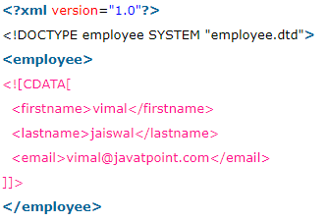
CDATA vs PCDATA
CDATA: (Unparsed Character data): CDATA contains the text which is not parsed further in an XML document. Tags inside the CDATA text are not treated as markup and entities will not be expanded.
<firstname>vimal</firstname>
<lastname>jaiswal</lastname>
<email>vimal@javatpoint.com</email>

Slide 41
PCDATA: (Parsed Character Data): XML parsers are used to parse all the text in an XML document. PCDATA stands for Parsed Character data. PCDATA is the text that will be parsed by a parser. Tags inside the PCDATA will be treated as markup and entities will be expanded.
In other words you can say that a parsed character data means the XML parser examine the data and ensure that it doesn't content entity if it contains that will be replaced
vimal
jaiswal
vimal@javatpoint.com

Slide 42
What are XML schemas?
An XML Schema is a language for expressing constraints about XML documents.
There are several different schema languages in widespread use, but the main ones are Document Type Definitions (DTDs), Relax-NG, Schematron and W3C XSD (XML Schema Definitions).
A Schema can be used:
to provide a list of elements and attributes in a vocabulary;
to associate types, such as integer, string, etc., or more specifically such as hatsize, sock_colour, etc., with values found in documents;
to constrain where elements and attributes can appear, and what can appear inside those elements, such as saying that a chapter title occurs inside a chapter, and that a chapter must consist of a chapter title followed by one or more paragraphs of text;
to provide documentation that is both human-readable and machine-processable;
to give a formal description of one or more documents.

Slide 43
How are they better than DTDs?
XML schemas are written in XML while DTD are derived from SGML syntax.
XML schemas define datatypes for elements and attributes while DTD doesn't support datatypes.
XML schemas allow support for namespaces while DTD does not.
XML schemas define number and order of child elements, while DTD does not.
XML schemas can be manipulated on your own with XML DOM but it is not possible in case of DTD.
using XML schema user need not to learn a new language but working with DTD is difficult for a user.
XML schema provides secure data communication i.e sender can describe the data in a way that receiver will understand, but in case of DTD data can be misunderstood by the receiver.
XML schemas are extensible while DTD is not extensible
DTD lets you define new ENTITY values for use in your XML file.
DTD lets you extend it local to an individual XML file.

Slide 44
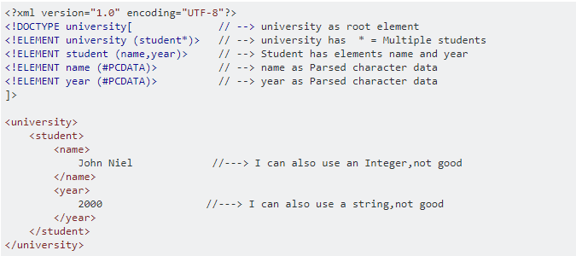

Slide 45
