Slide 1
Implementation of firmware for NEP on ESP32
Sample rest POST call
Sample rest GET call
Algo design
Security issues

Slide 2
MQTT Broker
Sub
Topic: xyz
Username: xyz
Password : xxxx
Pub
Topic: xyz
Username: xyz
Password : xxxx
Customers
req
REST Server
Manufacturer
HTTP
req
SmartPens

Slide 3
IoT & Security

Slide 4
We are learning...
(re)Intro to IoT
Before Internet and After Internet
Transform normal to smart
IoT Use cases
Why security??

Slide 5

(re) Introduction to IoT
Bringing things into the internet

Slide 6
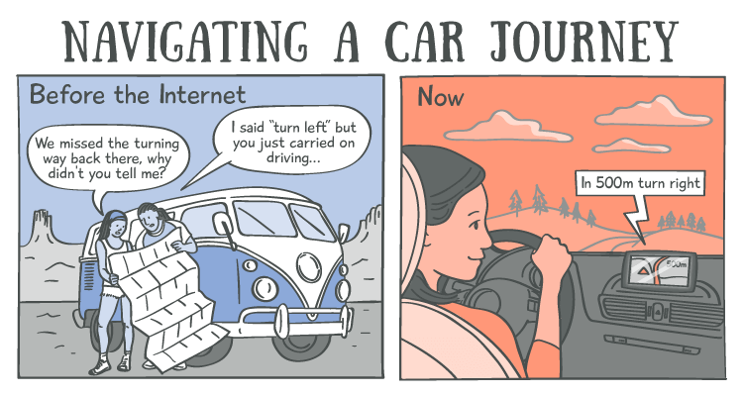
Before vs After internet

Slide 7







Before vs After internet
Letters |  | emails
Maps |  | Navigation apps
Banks |  | Payment apps
Picnics and Get togethers |  | Social networking apps
Pens, Pocket calendar,diary |  | Smart phones
Meetings and Classes |  | Video conferences

Slide 8
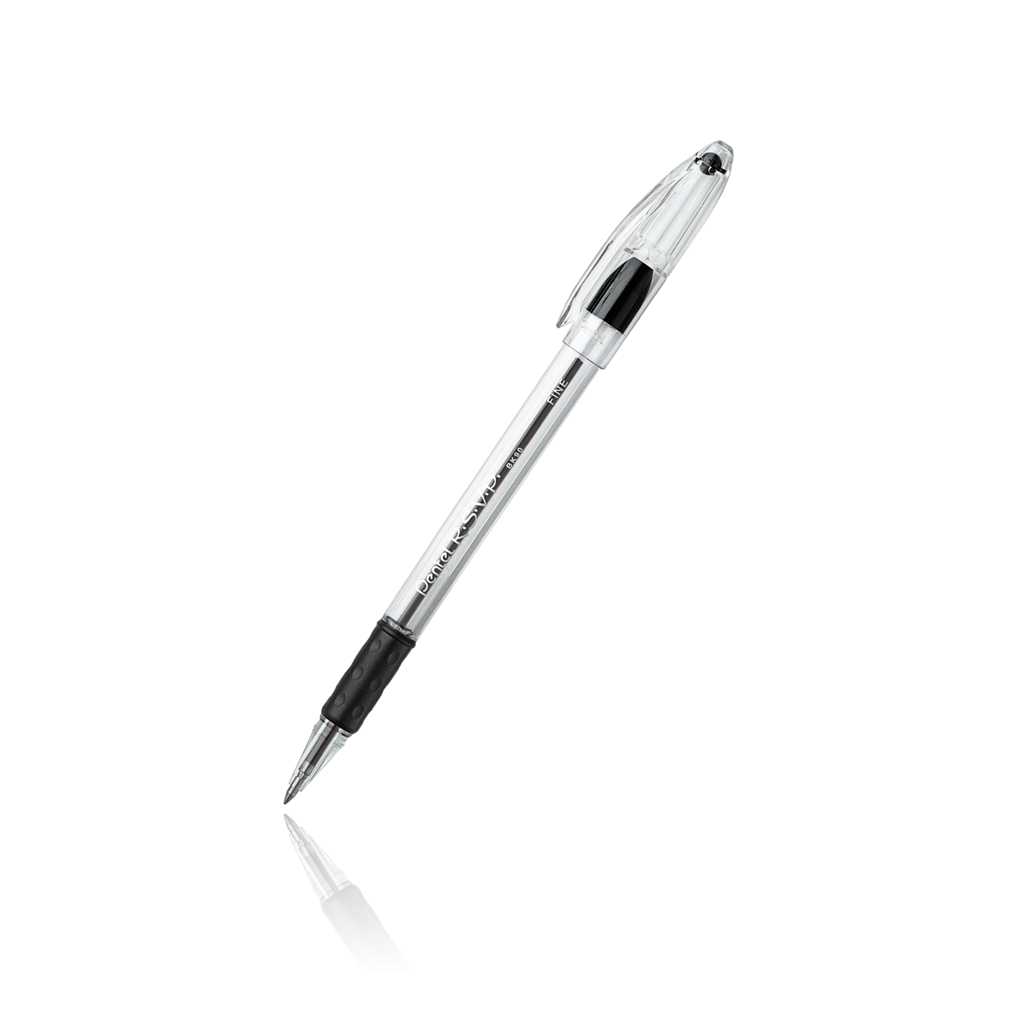
Transform normal to smart
Pen Color
Height
Width
Ink color
Date of Manufacturing
.
.
% of ink
Cap status(open/close)
Working status(writing/off)
Direction of Movement
Temp around the pen
.
.
Bringing things into the internet
Smart Pen = Pen + Sensor/Actuator + Controller + Communication Module

Slide 9
Use case - 1
Pen Color
Height
Width
Ink color
Date of Manufacturing
.
.
% of ink
Cap status(open/close)
Working status(writing/off)
Direction of movement
Temp around the pen
Location of Pen
.
.
Product Name : Ringing pen
USP : It will ring, when you forgets to close the pen cap.

Slide 10
Use case - 2
Pen Color
Height
Width
Ink color
Date of Manufacturing
.
.
% of ink
Cap status(open/close)
Working status(writing/off)
Direction of movement
Temp around the pen
Location of Pen
.
.
Product Name : Digital Pen
USP : It will make a soft copy of what you have written.

Slide 11
Use case - 3
Pen Color
Height
Width
Ink color
Date of Manufacturing
.
.
% of ink
Cap status(open/close)
Working status(writing/off)
Direction of movement
Temp around the pen
Location of Pen
.
.
Product Name : Tracking Pen
USP : You can track your phone from your mobile.

Slide 12
Use case - 4
Pen Color
Height
Width
Ink color
Date of Manufacturing
.
.
% of ink
Cap status(open/close)
Working status(writing/off)
Direction of movement
Temp around the pen
Location of Pen
.
.
Product Name : Never Ending Pen
USP : We will deliver you a new pen to doorstep, before running out of juice.

Slide 13
Use case - The Never Ending Pen
Aim : Have to build a software, to which the “The Never Ending Pen” sends a request when its ink status is below 10% to replace it.
Design a solution : (Home work)

Slide 14
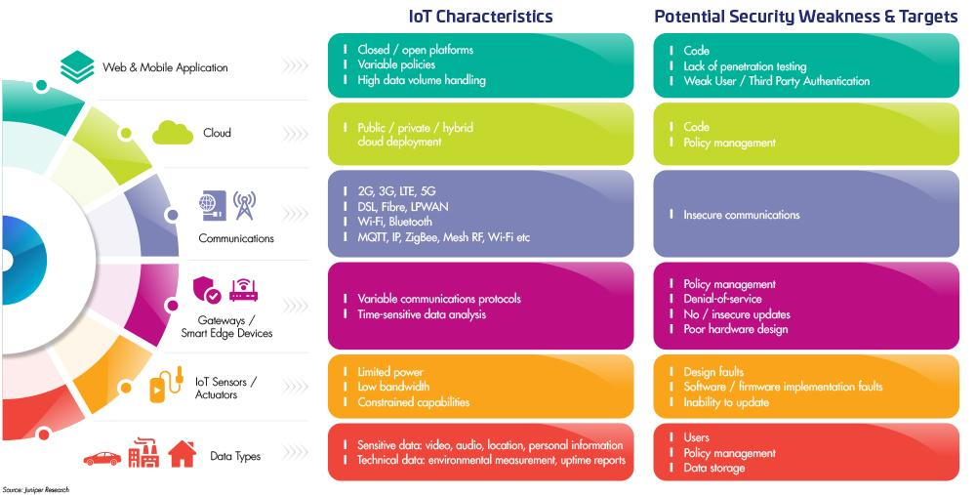

Slide 15


Slide 16
Cryptography
Cryptography : The field of study related to encoded information (comes from Greek word for "secret writing")
Encryption : The process of converting plaintext into ciphertext
Decryption : The process of converting ciphertext into plaintext
Encrypted(Information) cannot be read
Decrypted(Encrypted(Information)) can be

Slide 17
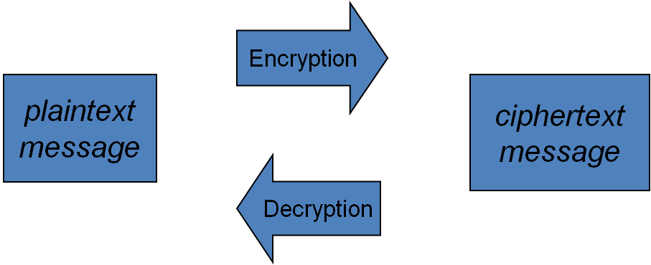
Cryptography

Slide 18
Cryptography
Cipher : An algorithm used to encrypt and decrypt text
Key : The set of parameters that guide a cipher
Neither is any good without the other

Slide 19
Substitution Ciphers
•A cipher that substitutes one character with another.
•These can be as simple as swapping a list, or can be based on more complex rules.
•These are NOT secure anymore, but they used to be quite common. What has changed?

Slide 20
Caesar Ciphers
A B C D E F G H I J K L M N O P Q R S T U V W X Y Z
D E F G H I J K L M N O P Q R S T U V W X Y Z A B C
Substitute the letters in the second row for the letters in the top row to encrypt a message
Encrypt(COMPUTER) gives FRPSXWHU
Substitute the letters in the first row for the letters in the second row to decrypt a message
Decrypt(Encrypt(COMPUTER)) = Decrypt(FRPSXWHU) = COMPUTER

Slide 21
Transposition Ciphers
T O D A Y
+ I S + M
O N D A Y
Write the letters in a row of five, using '+' as a blank. Encrypt by starting spiraling inward from the top left moving counter clockwise
Encrypt(TODAY IS MONDAY) gives T+ONDAYMYADOIS+
Decrypt by recreating the grid and reading the letters across the row
The key are the dimension of the grid and the route used to encrypt the data

Slide 23
Identity and Access Management design constraints
Create a flexible identity lifecycle for each entity/resource.
Determine a process for registering each entity/resource.
Set up security safeguards.
Outline policies for protecting personally identifiable information (PII).
Establish company procedures for access control.
Create a well-defined authentication and authorization process for connected devices.

Slide 24
Identity and Access Management in IoT
Class-2

Slide 25
Identity and Entity
According to ISO/IEC 24760-1:2011, an identity is “a set of attributes related to an entity”, and an entity is defined as “an item... that has a recognizably distinct existence”. These definitions are very broad, and clearly cover more than just devices and people. For example, not only is an IoT device an entity according to this definition; all of its physical and virtual components are also entities, as are all of the actors that interact with them. The definition also covers parts and groups of such items, as long as they have a recognizably distinct existence.
getAttributes(identity){
return attributes;
}

Slide 26
Never Ending Pen Entities
Pen:
Name
MAC
Version
Color
Type
Brand
Ink status
Location
User
Company
Location:
Latitude
Longitude
User:
Name
Pen(s)
Address
UPI
Balance
Last purchase
Company:
Name
Colors
Sold
Stock
Returned
BankDetails

Slide 27
Definitions of Identity Management
The term identity management is defined in ISO/IEC 24760–1:2011 as “the processes and policies involved in managing the lifecycle and values, type and optional metadata of attributes in identities known in a particular domain”.
For developers, identity management involves nothing more than giving a thing a traceable name or number, and perhaps adding a password or a public key certificate.
For designers, it means applying a consistent naming scheme or using a particular protocol to provide a computer with a host name, or a system user with a convenient sign-in experience.

Slide 28
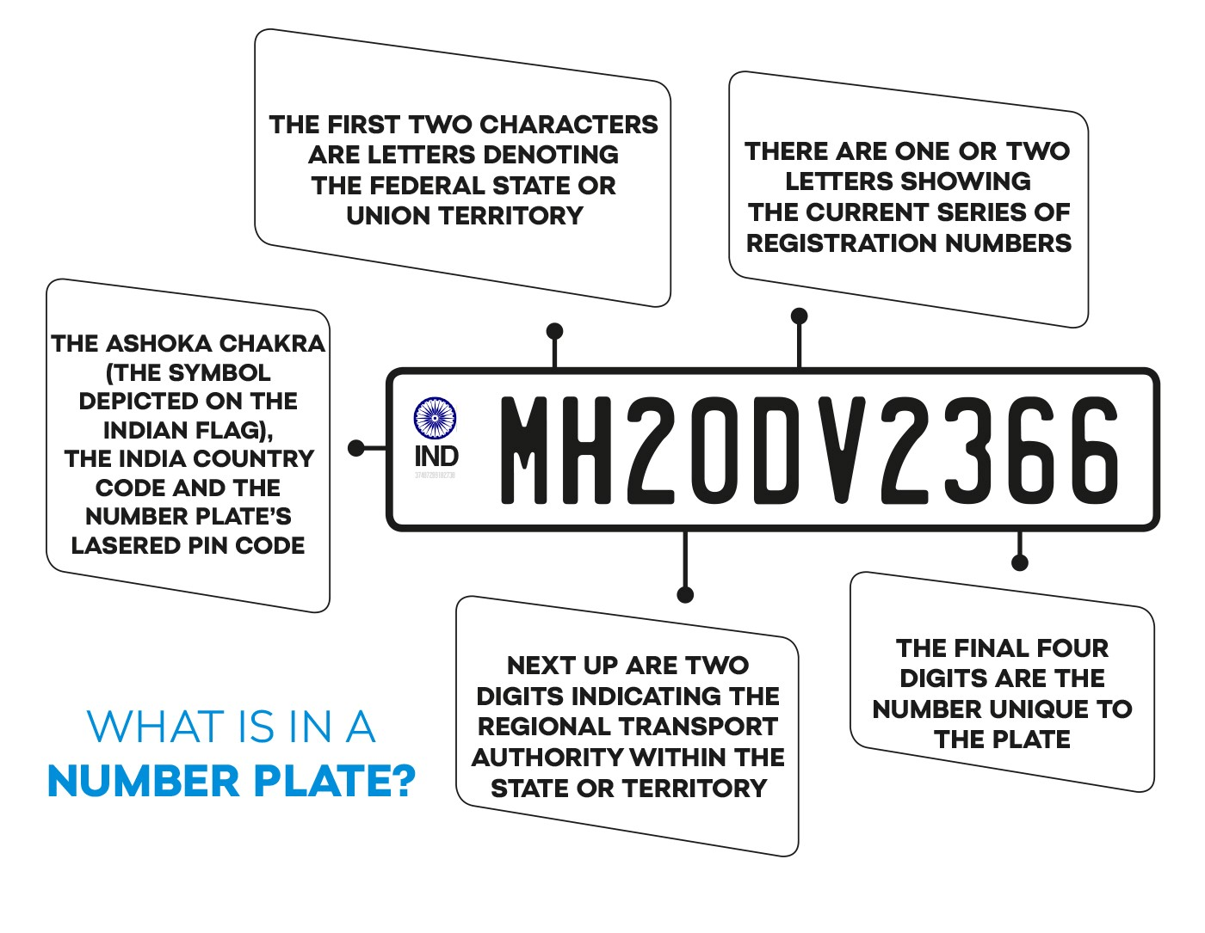
Identity decoding
getAttributes(identity){
return attributes;
}

Slide 29
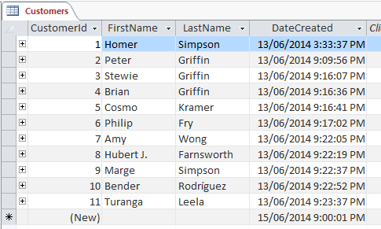
Identity mapping
getAttributes(identity){
return attributes;
}

Slide 30
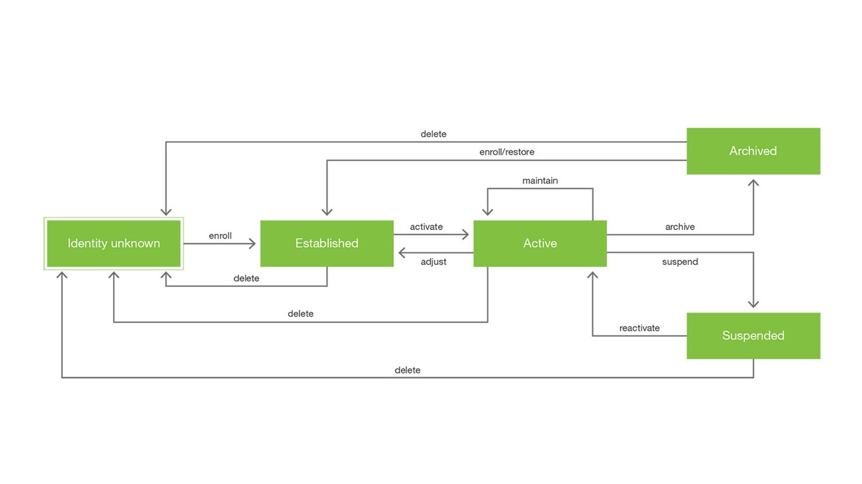

Slide 31
Registration methods
Key (System generated)
Credentials (User given)

Slide 32
User registration
User:
Name
Pen(s)
Address
UPI
Balance
Last purchase
Key (System generated)
Credentials (User given)
URL : host:port/api/v1/user
Method : POST
registerUser(Name,Address){
return key;
}

Slide 33
Pen registration
Pen:
Name
MAC
Version
Color
Type
Brand
Ink status
Location
User
Company
Key (System generated)
Credentials (User given)
URL : host:port/api/v1/pen
Method : POST
registerPen( Color, Type, Brand, Company){
return key;
}

Slide 34
Pen activation
Pen:
Name
MAC
Version
Color
Type
Brand
Ink status
Location
User
Company
Key (System generated)
Credentials (User given)
URL : host:port/api/v1/pen
Method : PUT
activatePen( key, MAC, Version){
return key;
}

Slide 35
Pen’s notification
Pen:
Name
MAC
Version
Color
Type
Brand
Ink status
Location
User
Company
Key (System generated)
Credentials (User given)
URL : host:port/api/v1/pen
Method : PUT
registerPen( Key, InkStatus){
//update ink status and notify user and company
}

Slide 36
User registration
User:
Name
UserName
Password
Pen(s)
Address
UPI
Balance
Last purchase
Key (System generated)
Credentials (User given)
URL : host:port/api/v1/user
Method : POST
registerUser(username, password, Name,Address){
//create user
}

Slide 37
User login
User:
Name
UserName
Password
Pen(s)
Address
UPI
Balance
Last purchase
Key (System generated)
Credentials (User given)
URL : host:port/api/v1/user
Method : POST
authUser(username, password){
//validate user
//create a session
//return session id
}

Slide 38
User Activation
User:
Name
Pen(s)
Address
UPI
Balance
Last purchase
State
Key (System generated)
Credentials (User given)
URL : host:port/api/v1/user
Method : UPDATE
activateUser(sessionID, Pen, UPI, Amount){
//activate user
//addPen
}

Slide 39
User registration
Start
Read username and password
Is username unique?
Store username and password
Stop

Slide 40
User login
Start
Start
Read username and password
Read username and password
Is username unique?
Username
password
matching?
Store username and password
Create session id
Stop
Stop

Slide 41

User forgot password
Start
Start
Read username and password
Read username and password
Is username unique?
Username
password
matching?
Store username and password
Create session id
Stop
Stop

Slide 42
User registration( with security question)
Start
Read username and password
Is username unique?
Let user to choose a security question.
Store username, password,question & answer
Read answer
Stop

Slide 43
User login ( with security question)
Start
Start
Read username and password
Read username and password
Is username unique?
Username
password
matching?
Let user to choose a security question.
Store username, password,question & answer
Create session id
Read answer
Stop
Stop

Slide 44
User forgot password( with security question)
Start
Start
Read username and password
Let user to answer the security question.
Is username unique?
Is answer matching?
Let user to choose a security question.
Store username, password,question & answer
Share password
Read answer
Stop
Stop

Slide 45
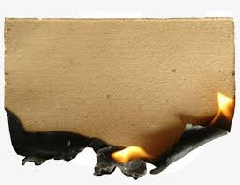
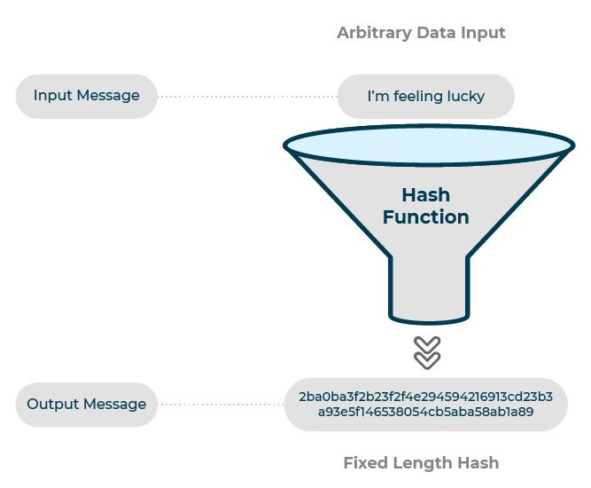
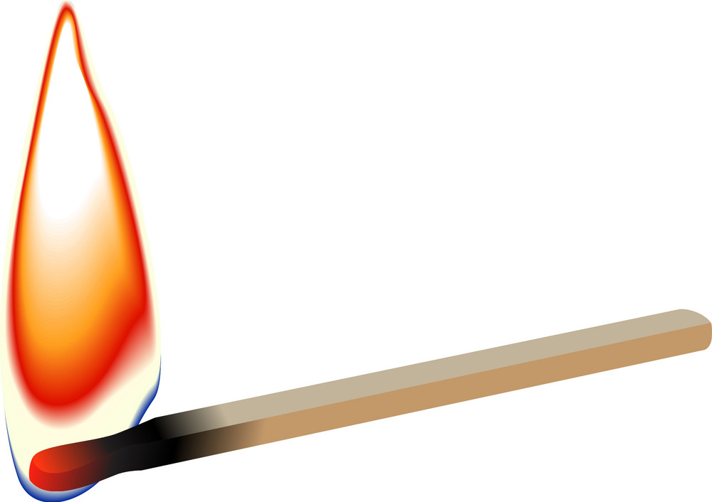
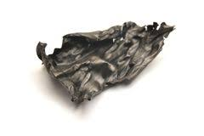
Hashing

Slide 46
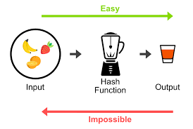


One way functions
y = f(x)
x = g(y)
c = multiply(a,b)
{a,b} = factorize(c)
235687 x 46893 =
11052070491
__ x __ =
__ x __ =
11052070493
2079187390200688629690455668267582131119887511714297283478746174992824760425998051439058443348655490294845767647382356173536961559117641500969666943603234

Slide 47
User registration( with encrypted password)
Start
Read email id and password
Is email id already registered?
Encrypt password
Store username & hash
Stop

Slide 48
User login ( with encrypted password)
Start
Start
Read email id and password
Read username and password
Is email id already registered?
Encrypt password
Username
hash
matching?
Encrypt password
Store username & hash
Create session id
Stop
Stop

Slide 49
User forgot password ( with encrypted password)
Start
Start
Start
Read email id and password
Read username and password
Send reset link to email id
Is email id already registered?
Encrypt password
Let user to enter new password
Username
hash
matching?
Encrypt password
Encrypt password
Store username & hash
Create session id
Store username & hash
Stop
Stop
Stop

Slide 50
Encrypted password and email auth
Start
Read email id and password
Is email id already registered?
Generate & send OTP to the email
Encrypt password
Let user to enter OPT
Store email id & hash
Is OTP matching?
Stop

Slide 51
/user/v1/register
/user/v1/authenticate
/user/v2/register
/user/v2/auth
/user/v2/forgotpasswrod
/user/v3/register
/user/v3/authenticate
/user/v3/forgotpassword
/user/v4/register
/user/v4/authenticate

Slide 52
Establishing naming conventions and uniqueness requirements
Uniqueness is a feature that can be randomized or deterministic (for example, algorithmically sequenced); its only requirement is that there are no others identical to it. The simplest unique identifier is a counter. Each value is assigned and never repeats itself. The other is a static value in concert with a counter, for example, a device manufacturer ID plus a product line ID plus a counter. In many cases, a random value is used in concert with static and counter fields. Non Repetition is generally not enough from the manufacturer’s perspective. Usually, something needs a name that provides some context. To this end, manufacturer-unique fields may be added in a variety of ways unique to the manufacturer or in conformance with an industry convention. Uniqueness may also be fulfilled by using a globally unique identifier (UUID) for which the UUID standard specified in RFC 4122 applies. No matter the mechanism, so long as a device is able to be provisioned, an identifier that is non repeating, unique to its manufacturer, use, application, or a hybrid of all these should be acceptable for use in identity management. Beyond the mechanisms, the only thing to be careful about is that the combination of all possible identifiers within a statically specified ID length should not be exhausted prematurely if at all possible.
Once a method for assigning uniqueness to your IoT devices is established, the next step is to be able to logically identify the assets within their area of operation in order to support authentication and access-control functions.

Slide 53
Naming a device
Every time you access a restricted computing resource, your identity is checked to ensure that you are authorized to access that specific resource. There are many ways in whichthis can occur, but the endresult of a successful implementation is that someone who does not have the right credentials is not allowed access. Although the process sounds simple, there are a number of difficult challenges that must be overcome when discussing identity and access management for the constrained and numerous devices that comprise the IoT.
One of the first challenges is related to the identity itself. Although identity may seem straightforward to you—your name, for example—that identity must be translated into a piece of information that the computing resource (or access-management system) understands. The identity must also not be duplicated across the information domain. Many computer systems today rely on a username, where each username within a domain is distinct. The username could be something as simple as <lastname_firstname_middleiniital>.

Slide 54
In the case of the IoT, understanding what identities, or names, to provision to a device can cause confusion. As discussed, in some systems, devices use unique identifiers such as UUIDs or Electronic Serial Numbers (ESNs).
We can see a good illustration by looking at how Amazon’s first implementation of its IoT service makes use of the IoT device serial numbers of IoT devices. Amazon IoT includes a thing registry service that allows an administrator to register IoT devices, capturing for each the name of the thing and various attributes of it. The attributes can include data items such as:
manufacturer
type
serial number
deployment_date
location
Note that such attributes can be used in what is called attribute-based access control(ABAC). ABAC access approaches allow access decision policies to be defined not just by the identity of the device but also its properties (attributes). Rich, potentially complex rules can be defined for the needs at hand.

Slide 55
Even when identifiers such as UUIDs or ESNs are available for an IoT device, these are generally not sufficient for securing authentication and access-control decisions; an identifier can easily be spoofed without enhancement through cryptographic controls. In these instances, administrators must bind another type of identifier to a device. This binding can be as simple as associating a password with the identifier or, more appropriately, using credentials such as digital certificates.
IoT messaging protocols frequently include the ability to transmit a unique identifier. For example, MQTT includes a ClientID field that can transmit a broker-unique client identifier. In the case of MQTT, the ClientID value is used to maintain state within a unique broker-client communication session.

Slide 56
Secure bootstrap
Gh Nothing is worse for security than an IoT-enabled system or network replete with false identities used in acts of identity theft, loss of private information, spoofing, and general mayhem. However, a difficult task in the identity lifecycle is to establish the initial trust in the device that allows it to bootstrap itself into the system. Among the greatest vulnerabilities to secure identity and access management is insecure bootstrapping.
Bootstrapping represents the beginning of the process of provisioning a trusted identity to a device within a given system. Bootstrapping may begin in the manufacturing process (for example, in the foundry manufacturing a chip) and be completed once delivered to the end operator. It may also be completely performed in the hands of the end user or some intermediary (for example, the depot or supplier) once delivered. The most secure bootstrapping methods start in the manufacturing processes and implement discrete security associations throughout the supply chain.

Slide 57
They uniquely identify a device through:
Unique serial numbers printed on the device.
Unique and unalterable identifiers stored and fused in device read-only memory(ROM).
Manufacturer-specific cryptographic keys used only through specific lifecycle states to securely handoff the bootstrapping process to follow-on lifecycle states (for example, shipping, distribution, and handoff to an enrollment center). Such keys (frequently delivered outofband) are used for loading subsequent components by specific entities responsible for preparing the device.

Slide 58
PKIs are often used to aid in the bootstrap process. Bootstrapping from a PKI perspective should generally involve the following processes:
Devices shouldbe securely shipped from the manufacturer (via secureshipping servicescapable of tamperdetection) to a trusted facility or depot. The facility should have robust physical security access controls, record-keeping, and audit processes in addition to highly vetted staff.
Device counts and batches should bematched against the shipping manifest.
Once they have been received, the steps for each device include:
Authenticating the device uniquely,using a customer-specific, default manufacturer authenticator (password or key).
Installing PKI trust anchors and any intermediate public key certificates (for example, those of the registration authority, enrollment certificate authority, or other roots).
Installing minimal network reachability information such that the device knows where to check certificate revocation lists, perform OCSP lookups, or perform other security-related functions.
Provisioning the device PKI credentials (public key signed by CA) and private key(s) such that other entities possessing the signing CA keys can trust the new device.

Slide 59
A secure bootstrapping process may not be identical to that described in the preceding list but should be one that mitigates the following types of threats and vulnerabilities when provisioning devices:
Insider threats designed to introduce new, rogue, or compromised devices (whichshould not be trusted)
Duplication (cloning) of devices no matter where in the lifecycle
Introduction of public key trust anchors or other key material into a device that should notbe trusted (rogue trust anchors and other keys)
Compromising (including replication) of a new IoT device’s private keys during key generation or import into the device
Gaps in device possession during the supply chain and enrollment processes
Protection of the device when re-keying and assigning new identification material needed for normal use (re-bootstrapping as needed)

Slide 60
Given the security-critical features of smart chip cards and their use in sensitive financial operations, the smartcard industry adopted rigid enrollment process controls not unlike those described above. Without them, severe attacks would have the potential of crippling the financial industry. Granted, many consumer-level IoT devices are unlikely to have secure bootstrap processes, but over time,the authorsbelieve that this will change, depending on the deployment environment and the stakeholders’ appreciation of the threats. The more connected devices become, the more their potential to do harm.
In practice, secure bootstrapping processes need to be tailored to the threat environment of the particular IoT device, its capabilities, and the network environment in question. The greater the potential risks, the more strict and thorough the bootstrapping process needs to be.

Slide 61
/user/register
/user/auth
/user/showPens
/user/buyPen/:id
/user/showMyPens
/user/pen/:id

Slide 62
/user/register
Method : POST
Input : username, password,firstname,lastname
Output: emptyJson or errorMessage

Slide 63
/user/auth
Method : POST
Inputs : username,password
Outputs : JWT (encode userid and set experiy time of 1 day) or errorMessage

Slide 64
/user/showPens
Method : GET

Slide 65
What Are the Key Requirements of IoT Security?
The key requirements for any IoT security solution are:
IoT Device and data security, including authentication of devices and confidentiality and integrity of data
Implementing and running security operations at IoT scale
Meeting compliance requirements and requests
Meeting performance requirements as per the use case

Slide 66
Key Functional Blocks
IoT security solutions need to implement the functional blocks listed below as interconnected modules, not in isolation, to meet the IoT scale, data security, device trust and compliance requirements.
IoT Device Trust: Establishing and managing Device Identity and Integrity
IoT Data Trust: Policy driven end-to-end data security, privacy from creation to consumption
Operationalizing the Trust: Automating and interfacing to the standards based, proven technologies/products. E.g. PKI products.

Slide 67
What Do Connected Devices Require to Participate in the IoT Securely?
To securely participate in the IoT, each connected device needs a unique identification – even before it has an IP address. This digital credential establishes the root of trust for the device’s entire lifecycle, from initial design to deployment to retirement.
nCipher Security uses nShield hardware security modules (HSMs), combined with supporting security applications from nCipher technology partners, to enable manufacturers to provide each device a unique ID using the strongest cryptographic processing, key protection, and key management available. A digital certificate is injected into each device to enable:
Authentication of each device introduced to the organization’s architecture
Verification of the integrity of the operating system and applications on the device
Secure communications between devices, gateway, and cloud
Authorized software and firmware updates, based on approved code

Slide 68
Are There Security Guidelines for the IoT?
A number of organizations have developed security guidelines for the IoT. These include:
The IoT Security Foundation’s “Best Practice Guidelines”
The Open Web Application Security Project’s (OWASP) “Security Guidance”
Groupe Spéciale Mobile Association’s (GSMA) “GSMA IoT Security Guidelines & Assessment”
The U.S. Department of Commerce National Institute of Standards and Technology’s (NIST) Special Publication 800-160 (the “Guidance”) on implementing security in Internet-of-Things (“IoT”) devices
The Cloud Security Alliance’s (CSA) “Future Proofing the Connected World: 13 Step to Developing Secure IoT Products”

Slide 69
Why Is Device Authentication Necessary for the IoT?
Strong IoT device authentication is required to ensure connected devices on the IoT can be trusted to be what they purport to be. Consequently, each IoT device needs a unique identity that can be authenticated when the device attempts to connect to a gateway or central server. With this unique ID in place, IT system administrators can track each device throughout its lifecycle, communicate securely with it, and prevent it from executing harmful processes. If a device exhibits unexpected behavior, administrators can simply revoke its privileges.

Slide 70
Why Is Secure Manufacturing Necessary for IoT Devices?
IoT devices produced through unsecured manufacturing processes provide criminals opportunities to change production runs to introduce unauthorized code or produce additional units that are subsequently sold on the black market.
One way to secure manufacturing processes is to use hardware security modules (HSMs) and supporting security software to inject cryptographic keys and digital certificates and to control the number of units built and the code incorporated into each.

Slide 71
Why Is Code Signing Necessary for IoT Devices?
To protect businesses, brands, partners, and users from software that has been infected by malware, software developers have adopted code signing. In the IoT, code signing in the software release process ensures the integrity of IoT device software and firmware updates, and defends against the risks associated with IoT software code tampering or code that deviates from organizational policies.
In public key cryptography, code signing is a specific use of certificate-based digital signatures that enables an organization to verify the identity of the software publisher and certify the software has not been changed since it was published.

Slide 72
What is IoT PKI?
Today there are more things (devices) online than there are people on the planet! Devices are the number one users of the Internet and need digital identities for secure operation. As enterprises seek to transform their business models to stay competitive, rapid adoption of IoT technologies is creating increasing demand for internet of things public key infrastructure (IoT PKI). PKIs provide digital certificates for the growing number of devices and the software and firmware they run.
Safe IoT deployments require not only trusting the devices to be authentic and to be who they say they are, but also trusting that the data they collect is real and not altered. If one cannot trust the IoT devices and the data, there is no point in collecting, running analytics, and executing decisions based on the information collected.
Secure adoption of IoT requires:
Enabling mutual authentication between connected devices and applications
Maintaining the integrity and confidentiality of the data collected by devices
Ensuring the legitimacy and integrity of the software downloaded to devices
Preserving the privacy of sensitive data in light of stricter security regulations

