Slide 1

Asymmetric-Key
Cryptography
Copyright © The McGraw-Hill Companies, Inc. Permission required for reproduction or display.
10.<number>

Slide 2
Objectives
To distinguish between two cryptosystems:
symmetric-key and asymmetric-key
To introduce trapdoor one-way functions and their
use in asymmetric-key cryptosystems
10.<number>

Slide 3
10-1 INTRODUCTION
Symmetric and asymmetric-key cryptography will exist in parallel and continue to serve the community. We actually believe that they are complements of each other; the advantages of one can compensate for the disadvantages of the other.
Topics discussed in this section:
10.1.1 Keys
10.1.2 General Idea
10.1.3 Need for Both
10.<number>

Slide 4

10-1 INTRODUCTION
Symmetric and asymmetric-key cryptography will exist in parallel and continue to serve the community. We actually believe that they are complements of each other; the advantages of one can compensate for the disadvantages of the other.
Note
Symmetric-key cryptography is based on sharing secrecy;
asymmetric-key cryptography is based on personal secrecy.
10.<number>

Slide 5
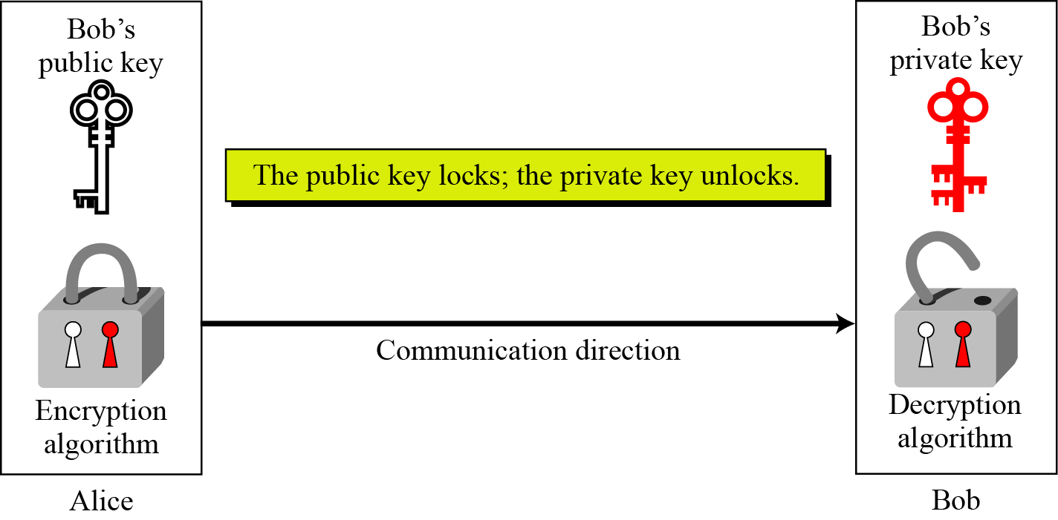
10.1.1 Keys
Asymmetric key cryptography uses two separate keys: one private and one public.
Figure 10.1 Locking and unlocking in asymmetric-key cryptosystem
10.<number>

Slide 6
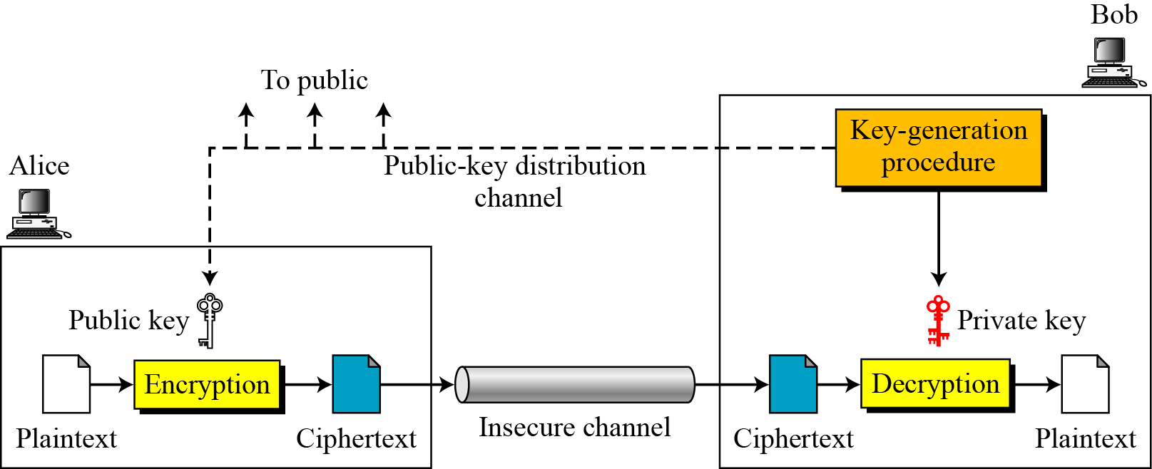
10.1.2 General Idea
Figure 10.2 General idea of asymmetric-key cryptosystem
10.<number>

Slide 7
10.1.3 Need for Both
There is a very important fact that is sometimes misunderstood: The advent of asymmetric-key cryptography DOES NOT eliminate the need for symmetric-key cryptography.
10.<number>

Slide 8
Symmetric Key
Symmetric-key encryption the message is encrypted by using a key and the same key is used to decrypt the message which makes it easy to use but less secure.
It also requires a safe method to transfer the key from one party to another.
10.<number>

Slide 9
Asymmetric Key
Asymmetric Key Encryption is based on public and private key encryption techniques.
It uses two different key to encrypt and decrypt the message.
It is more secure than the symmetric key encryption technique but is much slower.
10.<number>

