Slide 1
IEEE 802.11 WLAN

Slide 2
History
FCC decided to authorize public use of ISM band in
mid-80s
No need to obtain FCC licenses
This resulted in substantial growth of WLAN products
Due to lack of standards proprietary products appeared
Divided the market
Parts were incompatible
Working group IEEE 802.11 was established
Defined physical and MAC sub-layer standards in
June 1997

Slide 3
802.11 Family
 | 802.11 | 802.11a | 802.11b | 802.11g | 802.11n
Freq. Band | 2.4GHz | 5 GHz | 2.4 GHz | 2.4 GHz | 2.4GHz
Max. data rate | 2Mbps | 54Mbps | 11Mbps | 54 Mbps | 248Mbps
Another standard HIPERLAN was developed in Europe
It offered rates between 2 and 25Mbps in 5.2 GHz

Slide 4
Benefits of Wireless LANs
Some jobs require people to physically move while using an appliance, which exchanges information with another appliance or central computer
Wired LANs poses difficulty in implementation
WLAN is technology of choice
Reduction in infrastructure and operating cost
Useful where wiring is not possible
Fast deployment
No cable faults: reduced downtime

Slide 5
WLAN applications
LAN Extension
WLAN cannot substitute existing wired network
Suitable for flexible extension of wired networks
Cross-building interconnection
Connecting wired LANs located in nearby buildings
Point-to-point link controlled by a device that incorporates a router functionality

Slide 6
WLAN applications
Nomadic access
Employee transferring data on return from a tour,
from his laptop to the server
Students accessing information offered by university server from anywhere in the campus
Ad hoc networking
A peer-to-peer network, setup to satisfy a temporary need
Conference room or business meetings where participants use portable computers to form a network in order to share information

Slide 7
802.11 Network Architecture
802.11 defines a hierarchical Network architecture
Allows WLAN equipment to be configured in a
variety of ways
End-points are called stations, have a NIC
Simplest configuration is called as BSS
Supports direct communication between
members
Using BSS, we can build
Independent BSS, Infrastructure BSS, Extended service set

Slide 8
WLAN Components
Wireless LAN Station
The station (STA) is the most basic component of the
wireless network.
A station is any device that contains the functionality of the
802.11 protocol, that being MAC, PHY, and a connection to the wireless media.
Typically the 802.11 functions are implemented in the
hardware and software of a network interface card (NIC)
A station could be a laptop PC, handheld device, or an Access Point.
Stations may be mobile, portable, or stationary
Basic Service Set (BSS)
basic building block of an 802.11 wireless LAN.
The BSS consists of a group of any number of stations.

Slide 9
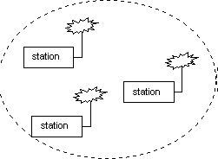
Independent Basic Service Set

Slide 10
IBSS
A set of stations, which have recognized each other and are connected via the wireless media in a peer- to-peer fashion.
Also called an Ad-hoc network.
The mobile stations communicate directly with each
other.
There are no relay functions in an IBSS therefore all stations need to be within range of each other and communicate directly.
Effective for a temporary need
No provision to access wired network

Slide 11
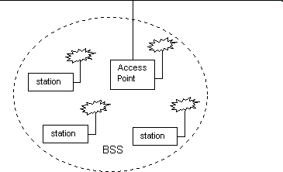
Infrastructure BSS
Backbone

Slide 12
Infrastructure BSS
BSS with a component called an Access Point (AP).
The access point provides a local relay function for
the BSS.
All stations in the BSS communicate with the access point and do not communicate directly.
All frames are relayed between stations by the
access point.
This local relay function effectively doubles the range of the IBSS.
The access point may also provide connection to a
distribution system.

Slide 13
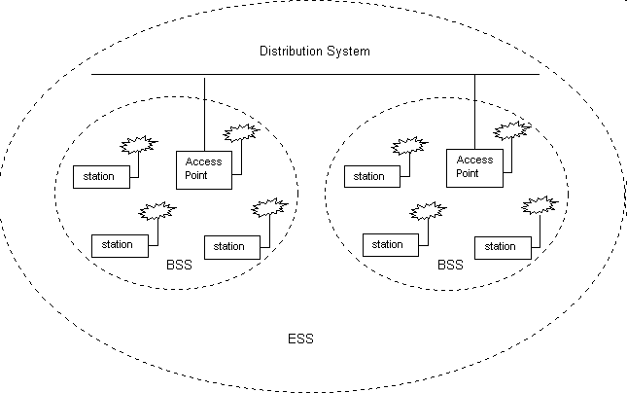
Extended Service Set

Slide 14
ESS
Extends the range of mobility to an arbitrary range
Set of infrastructure BSS’s, where the access points communicate amongst themselves to forward traffic from one BSS to another
The access point performs this communication through the distribution system, which may be constructed of either a wired LAN or wireless network.
The distribution system is a thin layer in each access point that
determines the destination for traffic received from a BSS.
relayed back to a destination in the same BSS
forwarded on the distribution system to another access point
sent into the wired network to a destination not in the extended service set.

Slide 15
ESS
Communications received by an access point from the distribution system are transmitted to the BSS to be received by the destination mobile station.
Network equipment outside of the extended service set views the ESS and all of its mobile stations as a single MAC-layer network where all stations are physically stationary.
ESS hides the mobility of the mobile stations from everything outside the ESS.
This level of indirection provided by the 802.11 architecture allows existing network protocols that have no concept of mobility to operate correctly with a wireless LAN where there is mobility.

Slide 16
Network Services
Distribution
Used by mobile stations in Infrastructure BSS,
every time they send data.
Once a frame has been access by access point, it uses distribution service to deliver the frame
This is true even for two mobile stations
associated with same access point
Integration
Service provided by the distribution system
It allows connection of the distribution system to the non-IEEE 802.11 network

Slide 17
Network Services
Association
Request from client and response from AP.
Finalizes security options
Finalizes bit rate options
Sets up data link
Client learns the access point MAC address (BSSID)
Delivery of frames to mobile stations is possible because they register or associate with access point
The distribution system uses the registration information to determine which access point to use for a mobile station
– Unassociated stations are not “on the network”
58

Slide 18
Network Services
Reassociation
When a mobile station moves between BSS areas, within a single ESS, it evaluates signal strength and may switch the access point with which it is associated.
Reassociations are initiated by STA, when signal conditions indicate that a association with a different AP is beneficial
After Reassociation is complete, distribution system
updates it location records

Slide 19
Network Services
Disassociation
Used for terminating an existing association
Mobility data stored in the distribution system is revoked
A polite task to do during STA shutdown
MAC is designed to handle STA that leave network
without disassociating

Slide 20
Network Services
Authentication
Wireless networks cannot offer same level of
physical security as wired LAN
Network attachment points in wired LAN can be secured in locked closets
Additional authentication routines are required to
ensure only authorised users are allowed
In practice, many access points are configured for “open system” authentication

Slide 21
Network Services
Privacy
Eavesdropping on wireless network can be comparatively simpler by using correct antenna and modulation methods
Optional privacy service Wired Equivalent Privacy
(WEP) is available.
Uses encryption techniques
WEP is not iron clad securtiy

Slide 22
802.11b Security Features
Wired Equivalent Privacy (WEP) – A protocol to protect link-level data during wireless transmission between clients and access points.
Services:
Authentication: provides access control to the network by denying access to client stations that fail to authenticate properly.
Confidentiality: intends to prevent information compromise from casual eavesdropping
Integrity: prevents messages from being modified while in transit between the wireless client and the access point.

Slide 23
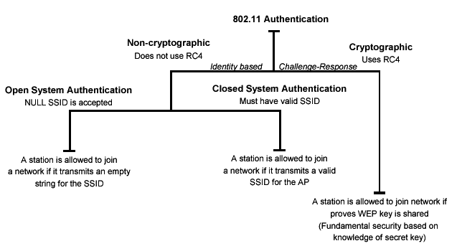
Authentication
Authentication techniques

Slide 24
Privacy
Cryptographic techniques
WEP Uses RC4 symmetric key, stream cipher algorithm to generate a pseudo random data sequence. The stream is XORed with the data to be transmitted
Key sizes: 40bits to 128bits
Unfortunately, recent attacks have shown that the WEP approach for privacy is vulnerable to certain attack regardless of key size

Slide 25
Data Integrity
Data integrity is ensured by a simple encrypted
version of CRC (Cyclic Redundant Check)
Also vulnerable to some attacks

Slide 26
Security Problems
Security features in Wireless products are frequently
not enabled.
Use of static WEP keys (keys are in use for a very long time). WEP does not provide key management.
Cryptographic keys are short.
No user authentication occurs – only devices are authenticated. A stolen device can access the network.
Identity based systems are vulnerable.
Packet integrity is poor.

Slide 27
Mobility Support
BSS transition
Stations continuously monitor the signal strength
from all APs in a ESS area
Within an ESS, 802.11 provides MAC layer mobility
STAs use reassociation service to associate with a
new AP
New access point needs to inform old access point about the association
Not standardized as a protocol

Slide 28
Mobility Support
ESS transition
802.11 does not support this type of transitions
It allows STA to associate with an AP in new ESS
Higher layer connections are guaranteed to be distributed
Maintaining high level connection requires support
from protocol
In case of TCP/IP, mobile IP is required to seamlessly support ESS transitions

Slide 29
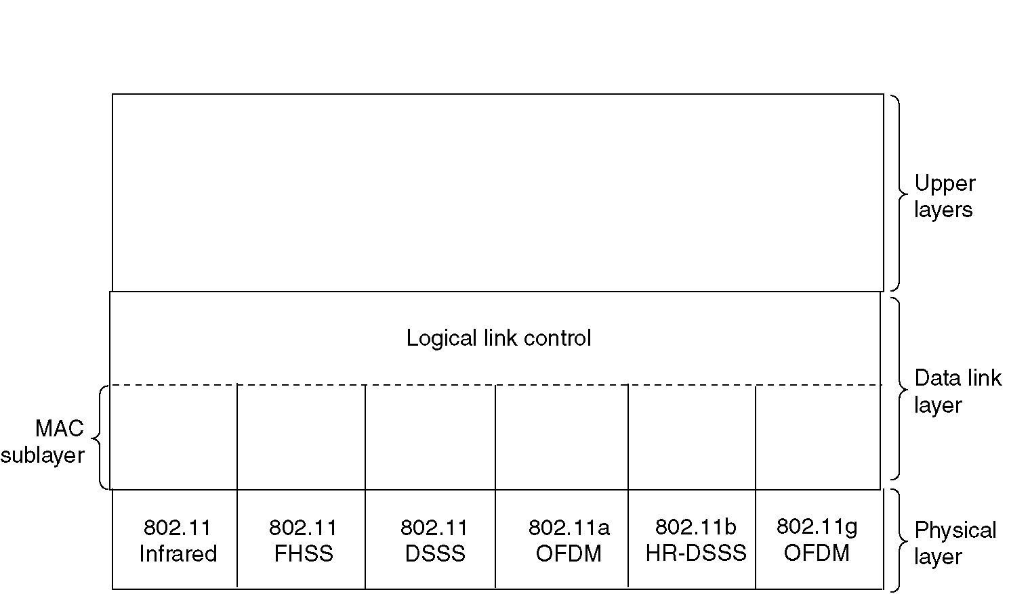
Part of the 802.11 Protocol Stack

Slide 30
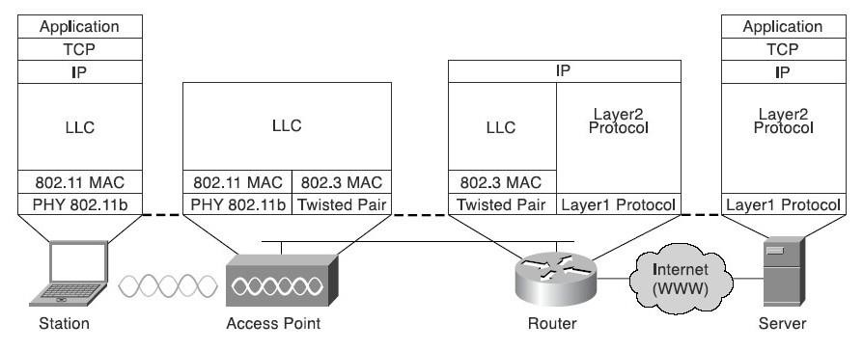
Protocol Stack across Network

Slide 31
Thank You
491

