Slide 1
Ethernet

Slide 2
Some members of 802 family
Name | Protocol
IEEE 802.1 | Bridging and Network Management
IEEE 802.2 | Logical link control
IEEE 802.3 | Ethernet
IEEE 802.4 | Token bus
IEEE 802.5 | MAC layer for a Token Ring
IEEE 802.6 | Metropolitan Area Networks
IEEE 802.15 | Wireless PAN
IEEE 802.15.1 | Bluetooth
IEEE 802.15.4 | ZigBee
IEEE 802.16 | Broadband Wireless Access (WiMAX )

Slide 3
Ethernet standards over years
Standard | Year | Description
802.3 | 1982 | CSMA/CD based Ethernet (Thick Ethernet)
802.3a | 1985 | 10Base-2 (Thin Ethernet)
802.3i | 1990 | 10Base-T (Twisted pair)
802.3u | 1995 | 100Base-T (Fast Ethernet and auto negotiation)
802.3z | 1998 | 1000Base-X (Gigabit Ethernet)
802.3ae | 2002 | 10-Gigabit Ethernet

Slide 4
Ethernet
Ethernet uses CSMA/CD protocol to transfer data over the shared medium
Transmission
Wait until the Frame is ready for transmission and the medium becomes idle
Start transmitting.
Did a collision occur? If so, go to the collision handling procedure.
Reset retransmission counters and end-frame transmission

Slide 5
Ethernet
Collision handling procedure
Continue transmission until minimum packet time is reached (jam signal) to ensure that all receivers detect the collision
Increment retransmission counter
If the maximum number of transmission attempts is reached, abort transmission.
Calculate and wait for a random backoff period based on the number of collisions and Go to the Transmission procedure

Slide 6
Fast Ethernet
The need for faster speed resulted in a 1995 standard for 100 Mb/s
Although the 100Base-T standard was close to 10Base-T, network designers had to determine which customers needed the extra bandwidth.
Ethernet networks than could be 10 Mb/s or 100 Mb/s (Fast Ethernet) and connected with 10/100 Mb/s Ethernet devices that automatically switched network speeds.

Slide 7
Fast Ethernet
Because there was a choice of bandwidths, the standard also allowed for equipment that could auto-negotiate the two speeds.
If an Ethernet device was transmitting or receiving from a 10 Mb/s network, it could support that network.
If the network operates at 100 Mb/s, the same device could switch automatically to the higher rate.

Slide 8
Gigabit Ethernet
Gigabit Ethernet takes advantage of jumbo frames to reduce the frame rate
Standard Ethernet frame size is 64 to 1518 bytes.
Jumbo frames are between 64 to 9215 bytes.
Using jumbo frames on Gigabit Ethernet links greatly reduces the number of packets (from more than 80,000 to less than 15,000 per second)
Gigabit Ethernet can be transmitted over CAT 5 cable and optical fiber

Slide 9
10Gigabit Ethernet
The operation of 10 Gigabit Ethernet is similar to that of lower-speed Ethernets.
It maintains the IEEE 802.3 Ethernet frame size and format that preserves layer 3 and higher protocols.
However, 10 Gigabit Ethernet only operates over point-to-point links in full-duplex mode.
It uses fiber as well as copper as a medium for transporting Ethernet frames.
There are seven media types, which are designed for use in either local or wide-area networking.

Slide 10
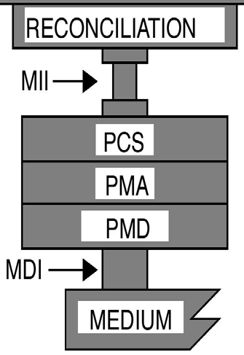
802.3 Layers ( For 100 Mbps )
Application
Presentation
Session
Transport
Network
Data Link
Physical
Logical Link Control Media Access Control
Phy
MII: Media Independent Interface PCS: Physical Coding Sublayer PMA: Physical Medium Attachment PMD: Physical Medium Dependent
MDI : Media Dependent Interface

Slide 11
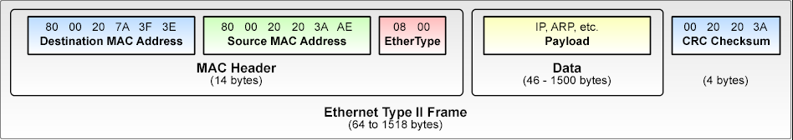
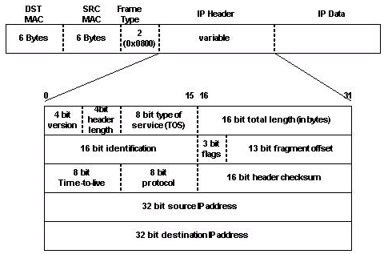
Ethernet Frame

Slide 12
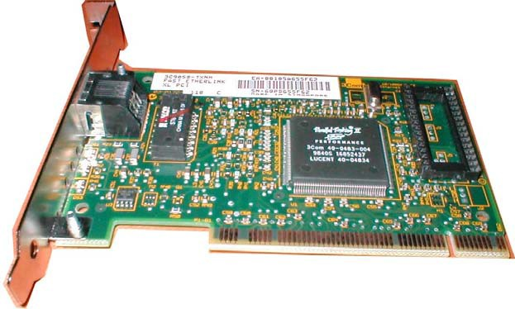
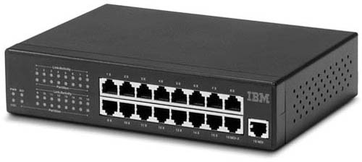
Ethernet Products
Network Interface Card
Connects a computer to the network
PCI bus
10/100 Mbps Auto negotiated, full duplex
Plug-n-play
Hubs/repeaters Connects two or more
segments together

