Slide 1

Chapter 9
Internet Control Message
Protocol
Objectives
Upon completion you will be able to:
Be familiar with the ICMP message format
Know the types of error reporting messages
Know the types of query messages
Be able to calculate the ICMP checksum
Know how to use the ping and traceroute commands
Understand the modules and interactions of an ICMP package
TCP/IP Protocol Suite

Slide 2
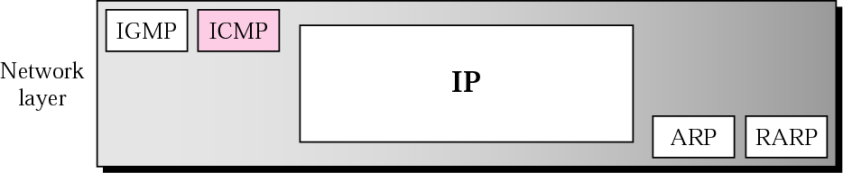
Figure 9.1 Position of ICMP in the network layer
TCP/IP Protocol Suite

Slide 3
9.1 TYPES OF MESSAGES
ICMP messages are divided into error-reporting messages and query messages. The error-reporting messages report problems that a router or a host (destination) may encounter. The query messages get specific information from a router or another host.
TCP/IP Protocol Suite

Slide 4
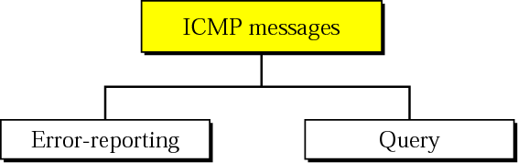
Figure 9.3 ICMP messages
TCP/IP Protocol Suite

Slide 5
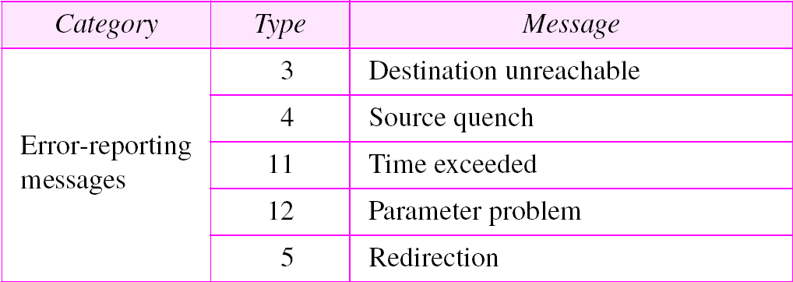
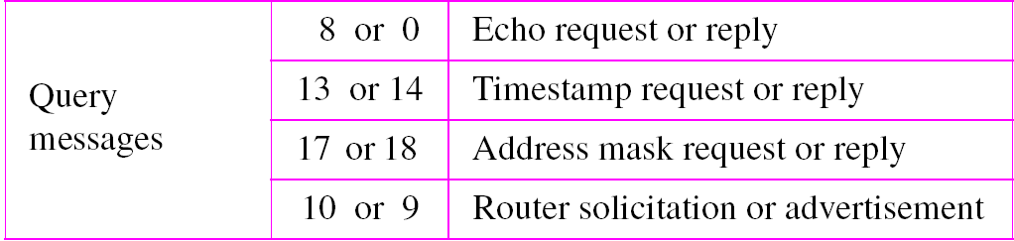
Table 9.1 ICMP messages
TCP/IP Protocol Suite

Slide 6
9.3 ERROR REPORTING
IP, as an unreliable protocol, is not concerned with error checking and error control. ICMP was designed, in part, to compensate for this shortcoming. ICMP does not correct errors, it simply reports them.
The topics discussed in this section include:
Destination Unreachable
Source Quench
Time Exceeded
Parameter Problem
Redirection
TCP/IP Protocol Suite

Slide 7

Note:
ICMP always reports error messages to the original source.
TCP/IP Protocol Suite

Slide 8
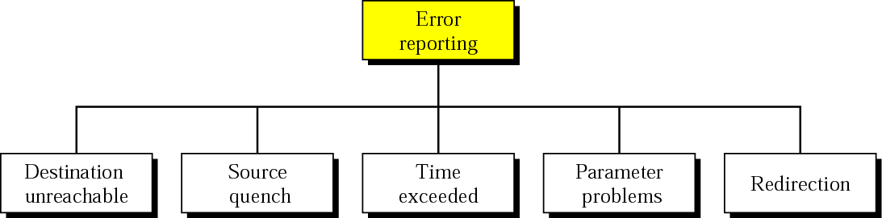
Figure 9.5 Error-reporting messages
TCP/IP Protocol Suite

Slide 9
Note:
The following are important points about ICMP error messages:
❏ No ICMP error message will be generated in response
to a datagram carrying an ICMP error message.
❏ No ICMP error message will be generated for a
fragmented datagram that is not the first fragment.
❏ No ICMP error message will be generated for a
datagram having a multicast address.
❏ No ICMP error message will be generated for a
datagram having a special address such as 127.0.0.0 or
0.0.0.0.
TCP/IP Protocol Suite

Slide 10
Note:
Destination-unreachable messages with codes 2 or 3 can be created only by the destination host.
Other destination-unreachable messages can be created only by routers.
TCP/IP Protocol Suite

Slide 11
Note:
A router cannot detect all problems that prevent the delivery of a packet.
TCP/IP Protocol Suite

Slide 12
Note:
There is no flow-control mechanism in the IP protocol.
TCP/IP Protocol Suite

Slide 13
Note:
A source-quench message informs the source that a datagram has been discarded due to congestion in a router or the destination host.
The source must slow down the sending of datagrams until the congestion is relieved.
TCP/IP Protocol Suite

Slide 14
Note:
One source-quench message is sent for each datagram that is discarded due to congestion.
TCP/IP Protocol Suite

Slide 15
Note:
Whenever a router decrements a datagram with a time-to-live value to zero, it discards the datagram and sends a time-exceeded message to the original source.
TCP/IP Protocol Suite

Slide 16
Note:
When the final destination does not receive all of the fragments in a set time, it discards the received fragments and sends a time-exceeded message to the original source.
TCP/IP Protocol Suite

Slide 17
Note:
In a time-exceeded message, code 0 is used only by routers to show that the value of the time-to-live field is zero. Code 1 is used only by the destination host to show that not all of the fragments have arrived within a set time.
TCP/IP Protocol Suite

Slide 18
Note:
A parameter-problem message can be created by a router or the destination host.
TCP/IP Protocol Suite

Slide 19
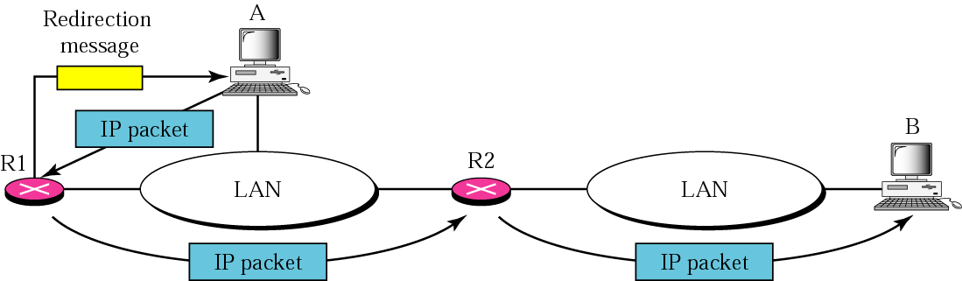
Figure 9.11 Redirection concept
TCP/IP Protocol Suite

Slide 20
Note:
A host usually starts with a small routing table that is gradually augmented and updated. One of the tools to accomplish this is the redirection message.
TCP/IP Protocol Suite

Slide 21
Note:
A redirection message is sent from a router to a host on the same local network.
TCP/IP Protocol Suite

Slide 22
9.4 QUERY
ICMP can also diagnose some network problems through the query messages, a group of four different pairs of messages. In this type of ICMP message, a node sends a message that is answered in a specific format by the destination node.
The topics discussed in this section include:
Echo Request and Reply
Timestamp Request and Reply
Address-Mask Request and Reply
Router Solicitation and Advertisement
TCP/IP Protocol Suite

Slide 23
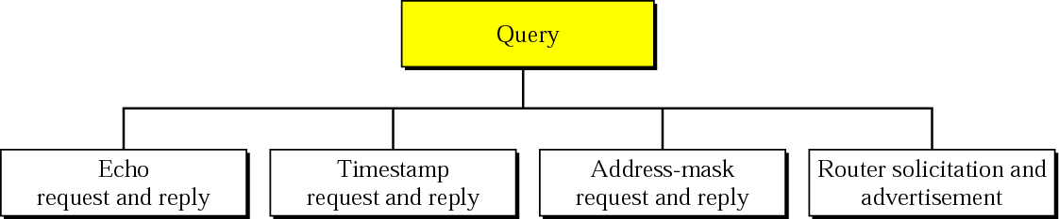
Figure 9.13 Query messages
TCP/IP Protocol Suite

Slide 24
Note:
An echo-request message can be sent by a host or router. An echo-reply message is sent by the host or router which receives an echo-request message.
TCP/IP Protocol Suite

Slide 25
Note:
Echo-request and echo-reply messages can be used by network managers to check the operation of the IP protocol.
TCP/IP Protocol Suite

Slide 26
Note:
Echo-request and echo-reply messages can test the reachability of a host. This is usually done by invoking the ping command.
TCP/IP Protocol Suite

Slide 27
Note:
Timestamp-request and timestamp-reply messages can be used to calculate the round-trip time between a source and a destination machine even if their clocks are not synchronized.
TCP/IP Protocol Suite

Slide 28
Note:
The timestamp-request and timestamp-reply messages can be used to synchronize two clocks in two machines if the exact one-way time duration is known.
TCP/IP Protocol Suite

Slide 29
9.6 DEBUGGING TOOLS
We introduce two tools that use ICMP for debugging: ping and traceroute.
The topics discussed in this section include:
Ping
Traceroute
TCP/IP Protocol Suite

Slide 30
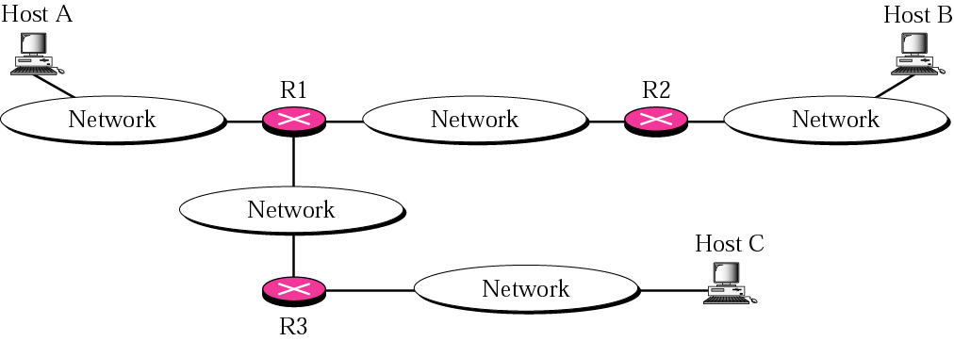
Figure 9.20 The traceroute program operation
TCP/IP Protocol Suite

Slide 31
Example 4
We use the traceroute program to find the route from the computer voyager.deanza.edu to the server fhda.edu. The following shows the result:
$ traceroute fhda.edu
traceroute to fhda.edu (153.18.8.1), 30 hops max, 38 byte packets
1 Dcore.fhda.edu (153.18.31.254) 0.995 ms 0.899 ms 0.878 ms
2 Dbackup.fhda.edu (153.18.251.4) 1.039 ms 1.064 ms 1.083 ms
3 tiptoe.fhda.edu (153.18.8.1) 1.797 ms 1.642 ms 1.757 ms
See Next Slide
TCP/IP Protocol Suite

