Slide 1
802.11AC
Matthew Gast, Director of Advanced Technology & chair of the 802.11-2012 revision
SURFnet WLPC, June 2, 2014

Slide 2
Agenda
802.11ac history & key features
Wider channels
› Dynamic bandwidth sharing
› Channel planning
Spatial stream expansion
• 256-QAM
Beamforming & MU-MIMO

Slide 3
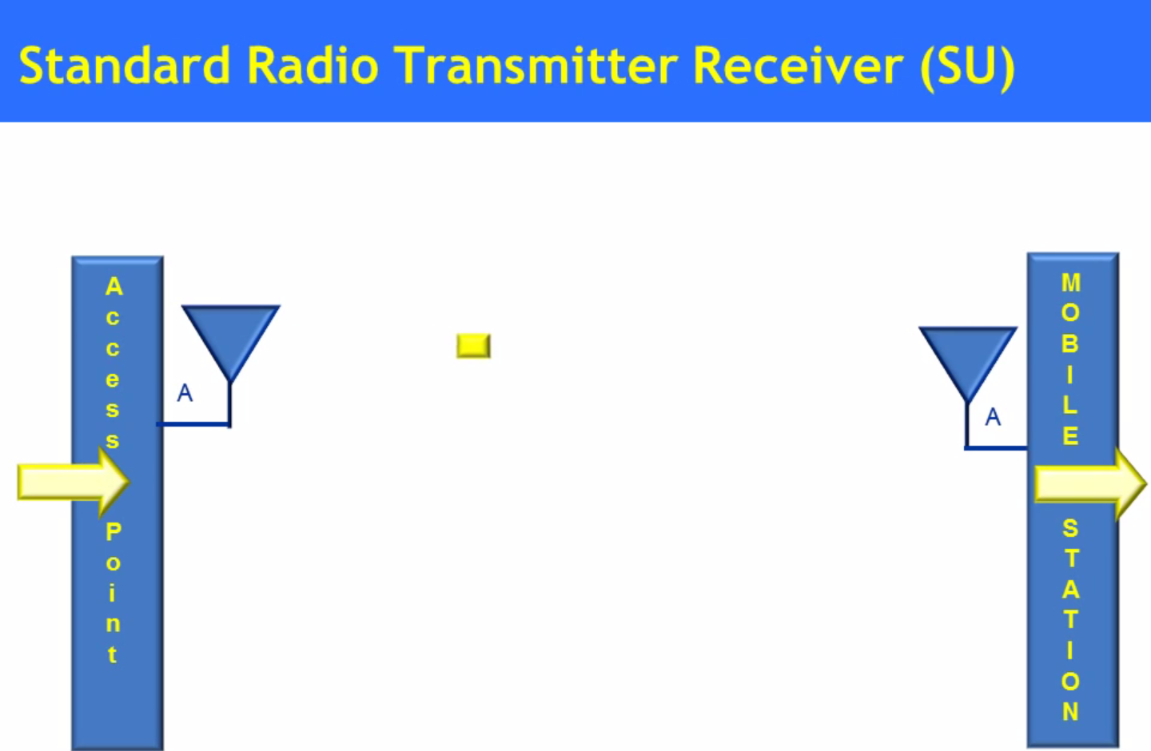

Slide 4
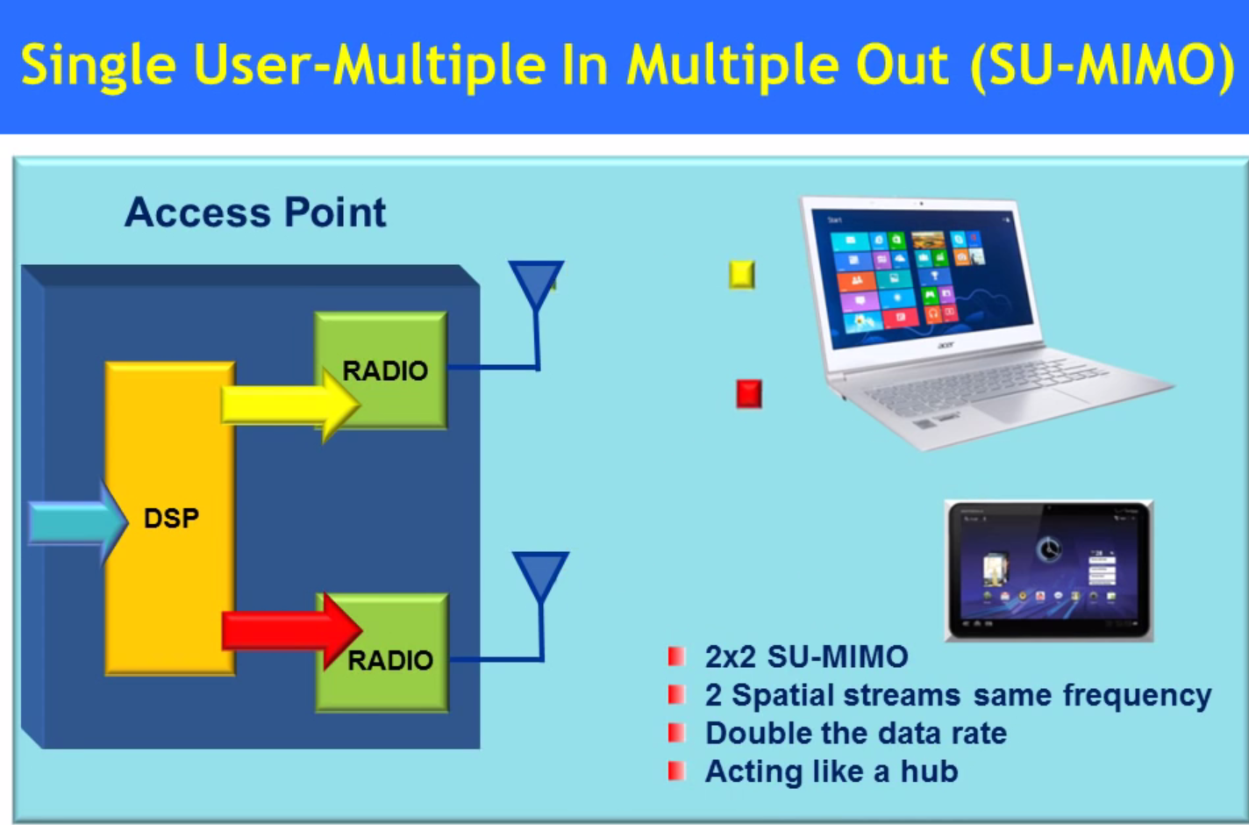

Slide 5


Slide 6
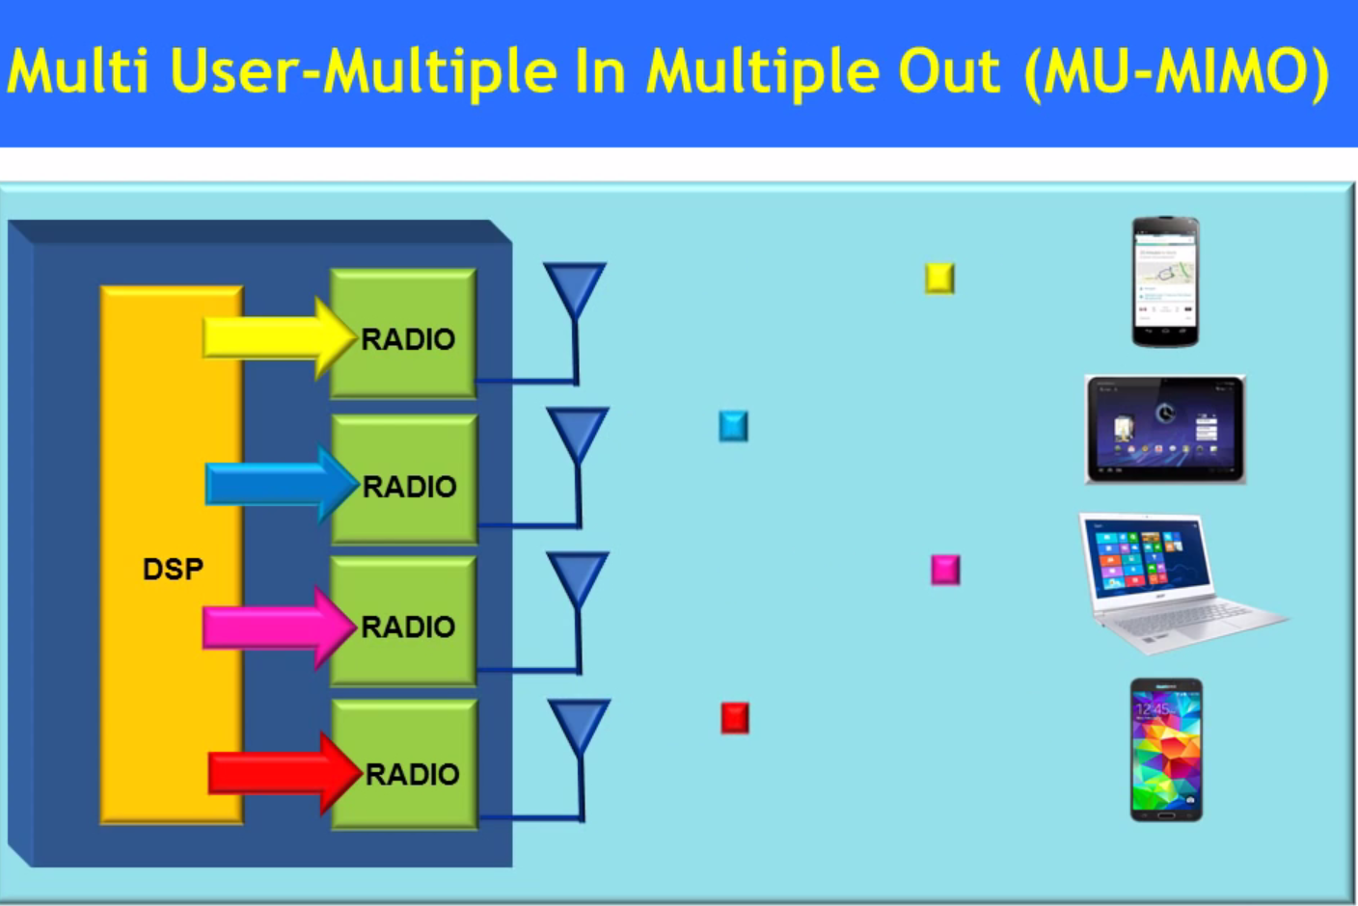

Slide 7
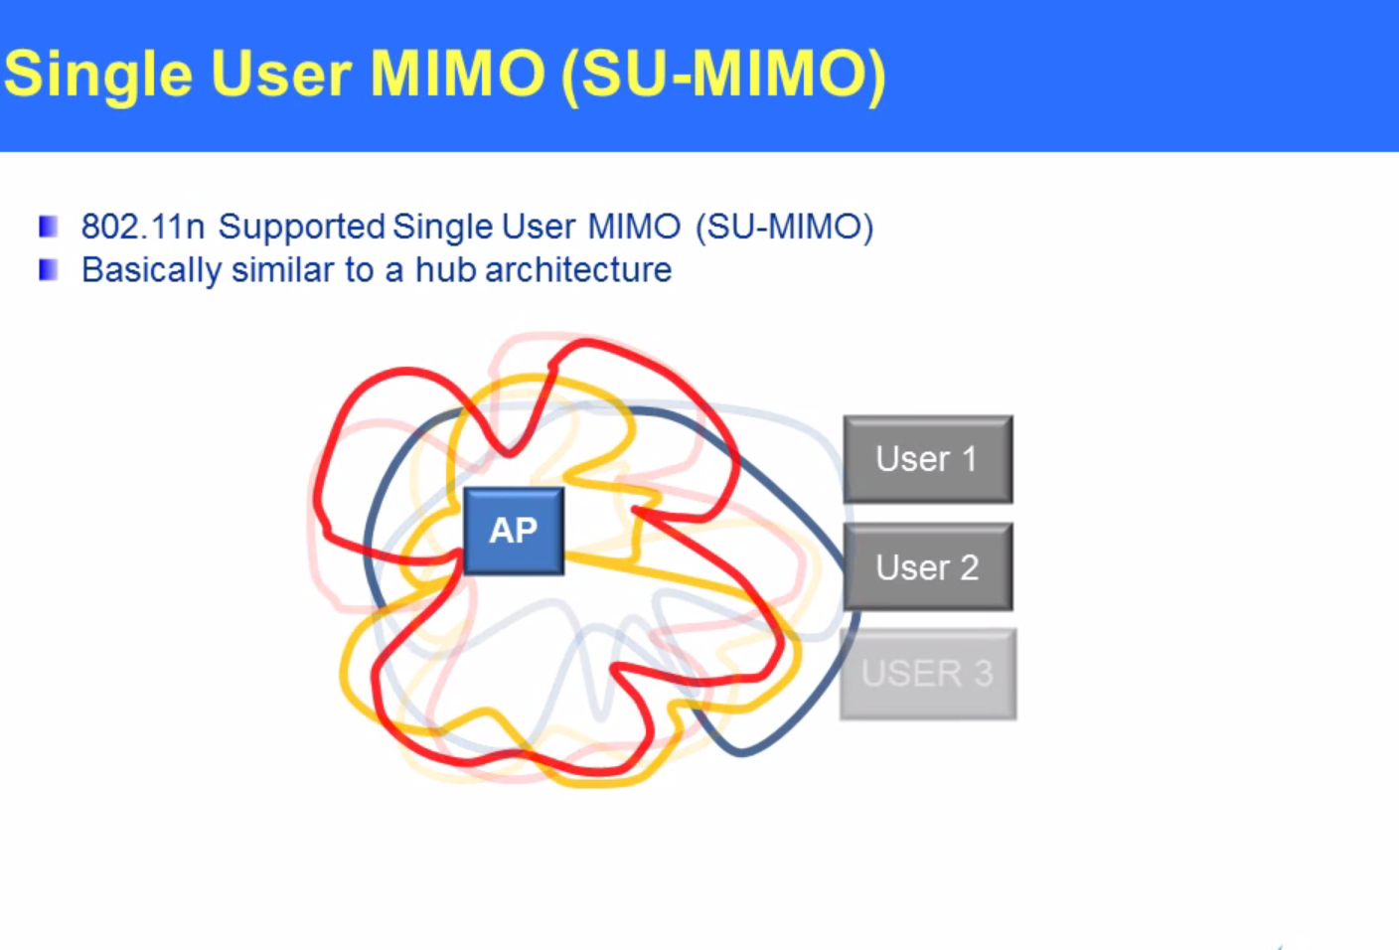

Slide 8
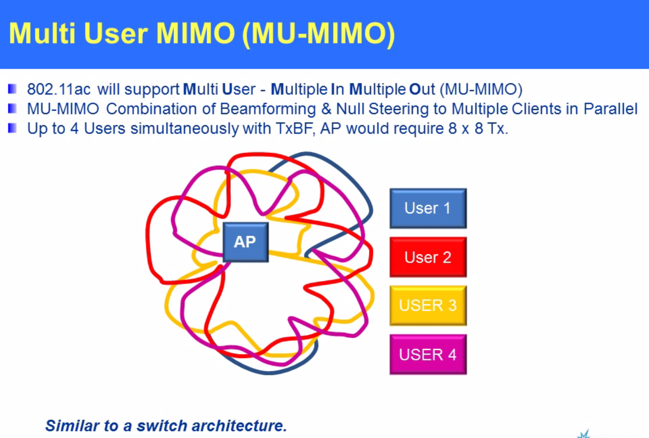

Slide 9
Key 802.11ac features
80 & 160 MHz channels
› Higher throughput than with today’s 802.11n channels
› 802.11ac will require more spectrum than 802.11n
Up to 8 spatial streams
› It may take some time before products are available with more than 4
3. 256-QAM
› Adds additional speed at short ranges where RF interference is low
› High-performance radios are required to take maximum advantage, and benefits of 256-QAM will not cross a building’s wall
4. Transmit beamforming & multi-user MIMO (MU-MIMO)
› MU-MIMO is the driving feature of 802.11ac, but is not yet present in shipping products (or even chips)

Slide 10
Major features of 802.11ac
802.11ac protocol feature | Description | First-wave gain over 802.11n | Second- wave gain over 802.11n
80 & 160 MHz channels | 802.11n supports only 40 MHz channels; wider channels support higher data rates | ~2x (80 MHz) | ~4x (160 MHz)
Up to 8 spatial streams | 802.11n is largely 3 SS; currently planned 802.11ac chips only support up to 4 SS | ~1x (3 SS) | ~1.33x (4 SS)
256-QAM | 64-QAM is the maximum in 802.11n | ~1.33x | ~1.33x
Multi-user MIMO | Beamforming was not widely supported in 802.11n | n/a | ~2x?
Total |  | ~2.5x | ~15x

Slide 11
The short version: 802.11ac speeds
 |  | 802.11n (2-stream) | 802.11n (3-stream) | 802.11ac (3-stream)
Single-stream mobile device (e.g. smartphone) | 20 MHz | 75 | 75 | 87
 | 40 MHz | 150 | 150 | 200
 | 80 MHz | - | - | 433
Two-stream device (e.g. tablet or low-end notebook) | 20 MHz | 150 | 150 | 173
 | 40 MHz | 300 | 300 | 400
 | 80 MHz | - | - | 867
Three-stream device (e.g. high-end notebook) | 20 MHz | 150 | 225 | 289
 | 40 MHz | 300 | 450 | 600
 | 80 MHz | - | - | 1300
Note: These are the data rates for individual frames; maximum throughput will likely be at least 33% lower (as measured by TCP throughput)

Slide 12
80 & 160 MHz channels
Wider channels support higher data rates
› Double the channel width from 40 MHz to 80 MHz and the data rate doubles
› 160 MHz channels may be contiguous (one block) or non- contiguous (two 80 MHz channels)
First-wave products support 80 MHz channels
› Required by 802.11ac standard
› Five available channels (3 require DFS) will provide coverage throughout most buildings
Channel plan now fixes channels so wide channels do not overlap with each other
› Improvement from 802.11n’s “40-above” and “40-below” modes that allowed unintentional overlap

Slide 13
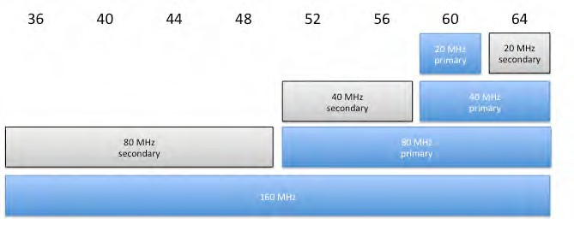

Bandwidth sharing
Networks have primary channels and secondary channels
› Primary is the half of the channel you use, secondary is the half you don’t
Channel size is allowed to switch per-frame
© 2011 Aerohive Networks CONFIDENTIAL 9
Figure from 802.11ac:
A Survival Guide
by Matthew Gast

Slide 14
































Channel Planning
36 | 40 | 44 | 48 | 52 | 56 | 60 | 64
Figure from 802.11ac:
A Survival Guide
by Matthew Gast
First AP chooses channel 40
Second AP chooses different 80 MHz channel
Third AP chooses unoccupied 40 MHz channel
Fourth AP chooses unoccupied 40 MHz channel
Fifth AP chooses unoccupied 20 MHz channel

Slide 15
Spatial streams
802.11ac defines up to 8 spatial streams (SS)
› Compares to a maximum of 4 in 802.11n (and only 3 SS was widely implemented)
› Each SS requires an antenna, so 8 SS modes require both AP and device to have 8 antennas
Additional streams increase throughput
› All streams use the same data rate, so throughput scales linearly with each SS
Multi-user MIMO (MU-MIMO) enables 8 SS to be divided among four devices
› Can transmit to multiple single-stream devices (e.g. phone, tablet) at the same instant

Slide 16
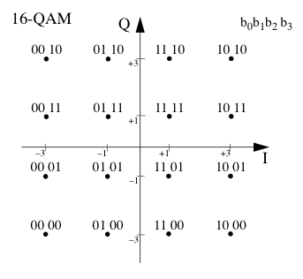
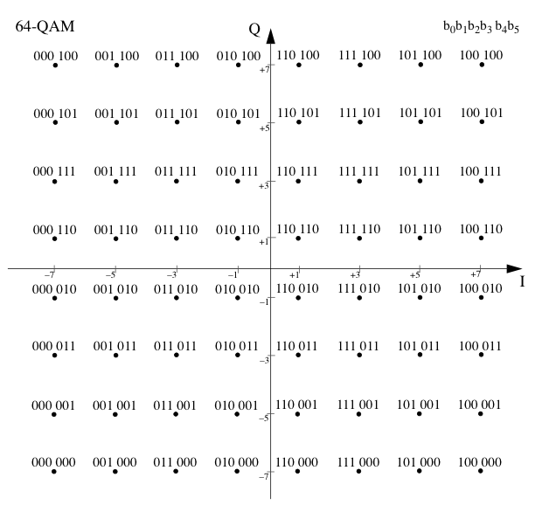
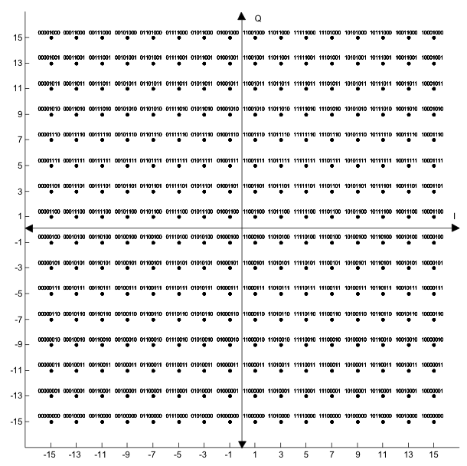
256-QAM
A constellation point encodes an amplitude/phase shift combination
› Pack more points into the constellation to transmit more bits
Additionally, more aggressive error code means more of the bits are data and fewer are overhead
802.11ac devices can still fall back to 802.11n rates if radio link is not good enough

Slide 17
And on to that fourth feature
The first three features are pretty easy, and are widely available in shipping products
› Well, not 160 MHz yet
That leaves beamforming and (downlink) multi-user MIMO
› AP-to-device direction only
Three out of four ain’t bad, but that last one is a Duesy
doozy

Slide 18
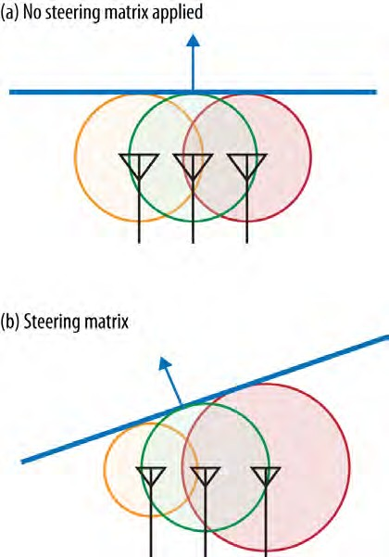
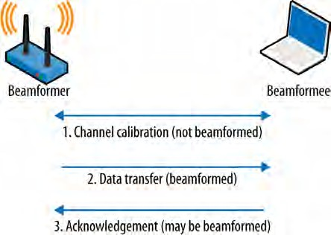

Beamforming in 802.11ac
Objective of beamforming is to steer the energy towards particular receivers
› By increasing SNR, we can increase data rates
Beamforming may be explicit or implicit
› Implicit measures by inference
› Explicit is an actual channel measurement
All figures from 802.11ac: A Survival Guide (and used with permission!)

Slide 19


What does this all mean? Designing for 802.11ac Today
Lots of things are the same as 802.11n
› One wire to the AP is ok today
› Multipath is your friend
› Nope, WEP is really dead
802.11ac is about capacity, not coverage
› New installs should use a second (cat 6) cable for future capacity
› Improved capacity reduces average latency
Changes in capacity change the way we build networks
› Track application demands

Slide 20

More Details

