Slide 1

Internet of Things: 802.15.4, 6LoWPAN, RPL

Slide 2
IEEE 802.15.4
1
IEEE 802.15.4
Radio Characteristics and Topologies
Frame Formats, Media Access Control, Security
2
IPv6 over IEEE 802.15.4 (6LoWPAN)
Header Compression Fragmentation and Reassembly
4

Slide 3
IEEE 802.15.4
IEEE 802.15.4
The IEEE standard 802.15.4 offers physical and media access control layers for low-cost, low-speed, low-power wireless personal area networks (WPANs)
Application Scenarios Home Networking Automotive Networks Industrial Networks Interactive Toys Remote Metering
. . .

Slide 4
IEEE 802.15.4 Standard Versions
802.15.4-2003
Original version using Direct Sequence Spread Spectrum (DSSS) with data transfer rates of 20 and 40 kbit/s
802.15.4-2006
Revised version using Direct Sequence Spread Spectrum (DSSS) with higher data rates and adding Parallel Sequence Spread Spectrum (PSSS)
802.15.4a-2007
Adding Direct Sequence Ultra-wideband (UWB) and Chirp Spread Spectrum (CSS) physical layers to the 2006 version of the standard (ranging support)

Slide 5
Radio Characteristics (802.15.4-2003)
Frequencies and Data Rates
0 Channel 1 2 3 4
5 6 7 8 9 10
868.3 MHz
902 MHz
2 MHz
928 MHz
11 12
13 14 15 16 17 18 19
20 21 22 23 24 25 26
2.4 GHz
5 MHz
2.4835 GHz
Frequency | Channels | Region | Data Rate | Baud Rate
868-868.6 MHz | 0 | Europe | 20 kbit/s | 20 kBaud
902-928 MHz | 1-10 | USA | 40 kbit/s | 40 kBaud
2400-2483.5 MHz | 11-26 | global | 250 kbit/s | 62.5 kBaud

Slide 6
IEEE 802.15.4 Device Classes
Full Function Device (FFD)
Any topology
PAN coordinator capable Talks to any other device
Implements complete protocol set
Reduced Function Device (RFD) Reduced protocol set
Very simple implementation Cannot become a PAN coordinator
Limited to leafs in more complex topologies

Slide 7
IEEE 802.15.4 Definitions
Network Device
An RFD or FFD implementation containing an IEEE 802.15.4 medium access control and physical interface to the wireless medium.
Coordinator
An FFD with network device functionality that provides coordination and other services to the network.
PAN Coordinator
A coordinator that is the principal controller of the PAN. A network has exactly one PAN coordinator.

Slide 8
IEEE 802.15.4 Star Topology
Star Topology
All nodes communicate via the central PAN coordinator Leafs may be any combination of FFD and RFD devices PAN coordinator is usually having a reliable power source

Slide 9
IEEE 802.15.4 Peer-to-Peer Topology
Peer-to-Peer Topology
Nodes can communicate via the centeral PAN coordinator and via additional point-to-point links
Extension of the pure star topology

Slide 10
IEEE 802.15.4 Cluster Tree Topology
Cluster Tree Topology
Leafs connect to a network of coordinators (FFDs) One of the coordinators serves as the PAN coordinator Clustered star topologies are an important case
(e.g., each hotel room forms a star in a HVAC system)
10 / 52

Slide 11
IEEE 802.15.4 Frame Formats
General Frame Format
octets: 2 | 1 |  | 0/2 |  | 0/2/8 |  | 0/2 |  | 0/2/8 |  | variable | 2
Frame control | Sequence number |  | Destination PAN identifier |  | Destination address |  | Source PAN identifier |  | Source address |  | Frame payload | Frame sequence check
bits: 0−2 | 3 | 4 |  | 5 |  | 6 |  | 7−9 |  | 10−11 | 12−13 | 14−15
Frame type | Security enabled | Frame pending |  | Ack. requested |  | Intra PAN |  | Reserved |  | Dst addr mode | Reserved | Src addr mode
IEEE 64-bit extended addresses (globally unique) 16-bit “short” addresses (unique within a PAN)
Optional 16-bit source / destination PAN identifiers max. frame size 127 octets; max. frame header 25 octets

Slide 12
IEEE 802.15.4 Frame Formats
Beacon Frames
Broadcasted by the coordinator to organize the network
Command Frames
Used for association, disassociation, data and beacon requests, conflict notification, . . .
Data Frames
Carrying user data — this is what we are interested in
Acknowledgement Frames
Acknowledges successful data transmission (if requested)

Slide 13
IEEE 802.15.4 Media Access Control
Carrier Sense Multiple Access / Collision Avoidance
Basic idea of the CSMA/CA algorithm: First wait until the channel is idle.
Once the channel is free, start sending the data frame after some random backoff interval.
Receiver acknowledges the correct reception of a data frame.
If the sender does not receive an acknowledgement, retry the data transmission.

Slide 14
IEEE 802.15.4 Unslotted Mode
Node → PAN, Node → Node
The sender uses CSMA/CA and the receiver sends an ACK if requested by the sender.
Receiver needs to listen continuously and can’t sleep.
PAN → Node
The receiver polls the PAN whether data is available.
The PAN sends an ACK followed by a data frame. Receiving node sends an ACK if requested by the sender. Coordinator needs to listen continuously and can’t sleep.

Slide 15
IEEE 802.15.4 Slotted Mode
Superframes
CSMA/CA
GTS1 GTS2
GTS3
SLEEP
B |  | CAP | CFP | INACTIVE | B
A superframe consists of three periods:
1
During the Contention-Access-Period (CAP), the channel can be accessed using normal CSMA/CA. The Contention-Free-Period (CFP) has Guaranteed Time Slots (GTS) assigned by the PAN to each node.
During the Inactive-Period (IP), the channel is not used and all nodes including the coordinator can sleep.
2
3
The PAN delimits superframes using beacons.

Slide 16
IEEE 802.15.4 Security
Security Services
Security Suite | Description
Null | No security (default)
AES-CTR | Encryption only, CTR Mode
AES-CBC-MAC-128 AES-CBC-MAC-64 AES-CBC-MAC-32 | 128 bit MAC 64 bit MAC 32 bit MAC
AES-CCM-128 AES-CCM-64 AES-CCM-32 | Encryption and 128 bit MAC Encryption and 64 bit MAC Encryption and 32 bit MAC
Key management must be provided by higher layers Implementations must support AES-CCM-64 and Null

Slide 17
IPv6 over IEEE 802.15.4 (6LoWPAN)
1
IEEE 802.15.4
Radio Characteristics and Topologies
Frame Formats, Media Access Control, Security
2
IPv6 over IEEE 802.15.4 (6LoWPAN)
Header Compression Fragmentation and Reassembly
4

Slide 18
6LowPAN Motivation
Benefits of IP over 802.15.4 (RFC 4919)
1
The pervasive nature of IP networks allows use of existing infrastructure.
IP-based technologies already exist, are well-known, and proven to be working.
Open and freely available specifications vs. closed proprietary solutions.
Tools for diagnostics, management, and commissioning of IP networks already exist.
IP-based devices can be connected readily to other IP-based networks, without the need for intermediate entities like translation gateways or proxies.
2
3
4
5
20 / 52

Slide 19
6LowPAN Challenge
Header Size Calculation. . .
IPv6 header is 40 octets, UDP header is 8 octets
802.15.4 MAC header can be up to 25 octets (null security) or 25+21=46 octets (AES-CCM-128) With the 802.15.4 frame size of 127 octets, we have
127-25-40-8 = 54 octets (null security)
127-46-40-8 = 33 octets (AES-CCM-128)
of space left for application data!
IPv6 MTU(maximum transmission unit) Requirements
IPv6 requires that links support an MTU of 1280 octets Link-layer fragmentation / reassembly is needed

Slide 20
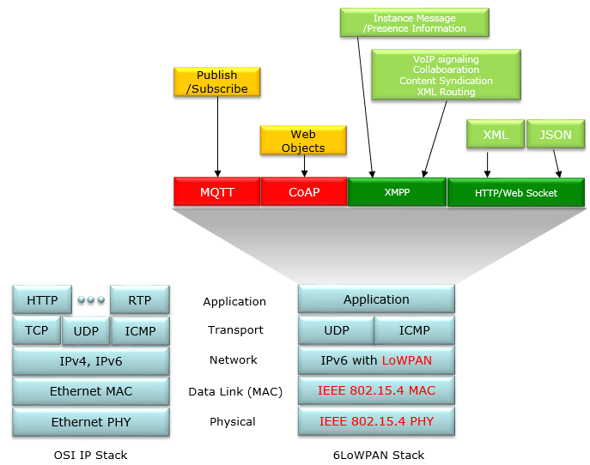
6LoWPAN in Full Stack Architecture

Slide 21
6LowPAN Overview (RFC 4944)
Overview
The 6LowPAN protocol is an adaptation layer allowing to transport IPv6 packets over 802.15.4 links
Uses 802.15.4 in unslotted CSMA/CA mode (strongly suggests beacons for link-layer device discovery)
Based on IEEE standard 802.15.4-2003 Fragmentation / reassembly of IPv6 packets Compression of IPv6 and UDP/ICMP headers Mesh routing support (mesh under)
Low processing / storage costs

Slide 22
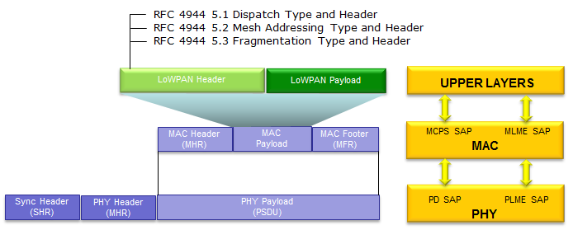
Relationship between 802.15.4 and 6LoWPAN

Slide 23
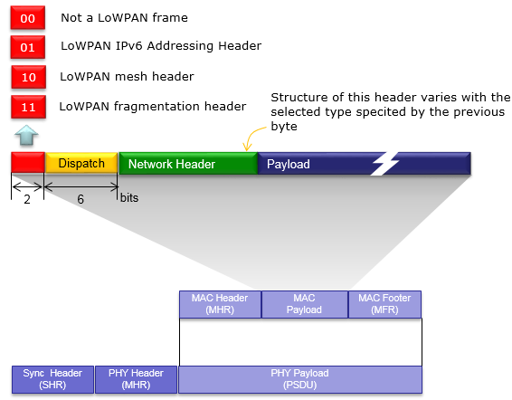
Header Stack

Slide 24
6LowPAN Dispatch Codes
All LoWPAN encapsulated datagrams are prefixed by an encapsulation header stack.
Each header in the stack starts with a header type field followed by zero or more header fields.
Bit Pattern | Short Code | Description
00 xxxxxx | NALP | Not A LoWPAN Packet
01 000001 | IPv6 | uncompressed IPv6 addresses
01 000010 | LOWPAN HC1 | HC1 Compressed IPv6 header
01 010000 | LOWPAN BC0 | BC0 Broadcast header
01 111111 | ESC | Additional Dispatch octet follows
10 xxxxxx | MESH | Mesh routing header
11 000xxx | FRAG1 | Fragmentation header (first)
11 100xxx | FRAGN | Fragmentation header (subsequent)

Slide 25
6LowPAN Frame Formats
Uncompressed IPv6/UDP (worst case scenario)
max. 127 octets
DSP
FCS
preamble | 802.15.4 MAC header |  | uncompressed IPv6 header | UDP | payload
max. 23 / 44
1
40
8
up to 54 / 33
2
Dispatch code (01000001₂) indicates no compression
Up to 54 / 33 octets left for payload with a max. size MAC header with null / AES-CCM-128 security
The relationship of header information to application payload is obviously really bad

Slide 26
6LowPAN Frame Formats
Compressed Link-local IPv6/UDP (best case scenario)
max. 127 octets
DSP HC1 IPv6
FCS
preamble | 802.15.4 MAC header |  |  |  | UDP | payload
max. 23 / 44
1 1 1 8
up to 92 / 71
2
max. 127 octets
preamble
802.15.4 MAC header
DSP HC1 HC2 IPv6 UDP
payload
FCS
max. 23 / 44
1 1 1 1 3
up to 97 / 76
2
Dispatch code (01000010₂) indicates HC1 compression HC1 compression may indicate HC2 compression follows
This shows the maximum compression achievable for link-local addresses (does not work for global addresses)
Any non-compressable header fields are carried after the HC1 or HC1/HC2 tags (partial compression)

Slide 27
Header Compression
Compression Principles (RFC 4944)
Omit any header fields that can be calculated from the context, send the remaining fields unmodified
Nodes do not have to maintain compression state (stateless compression)
Support (almost) arbitrary combinations of compressed / uncompressed header fields
Ongoing Work
Compression for globally routable addresses (HC1G) Stateful compression (IPHC, NHC)

Slide 28
Fragmentation and Reassembly
Fragmentation Principles (RFC 4944)
IPv6 packets to large to fit into a single 802.15.4 frame are fragmented.
A first fragment carries a header that includes the datagram size (11 bits) and a datagram tag (16 bits).
Subsequent fragments carry a header that includes the datagram size, the datagram tag, and the offset (8 bits).
Time limit for reassembly is 60 seconds.
Ongoing Work
Recovery protocol for lost fragments (RFC 4944 requires to resend the whole set of fragments)

