Slide 1
An introduction

Slide 2
Contents
Introduction to Thread Details on the Thread Group Technical overview
Wrap-up and recap Founder intro

Slide 3
The need for a new wireless network
A new era of connected products
Existing wireless mesh protocol didn’t meet requirements

Slide 4

The need for a new wireless network
Requirements:
New wireless home network
✔ Low power
✔ Resilient (mesh)
✔ IP-based
✔ Open protocol
✔ Secure and user friendly
✔ Fast time to market
✔ Existing radio silicon

Slide 5
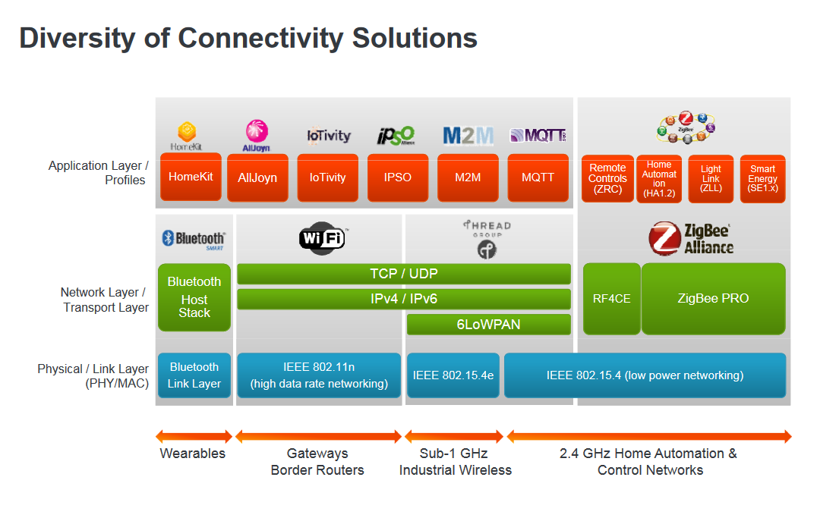

Slide 6
The need for a new wireless network
Requirements:
New wireless home network
✔ No single point of failure
✔ Low power
✔ Self-healing
✔ Resilient (mesh)
✔ Interference robustness
✔ IP-based
✔ Self-extending
✔ Open protocol
✔ Reliable enough for critical infrastructure
✔ Secure and user friendly
✔ Fast time to market
✔ Existing radio silicon

Slide 7



Why IP
Application 0
Application n
Application Protocol
Application Protocol
IPv6 - A unified ConveIPrgv6ence Layer for the home
802.15.4
802.11
Bluetooth 4.x

Slide 8

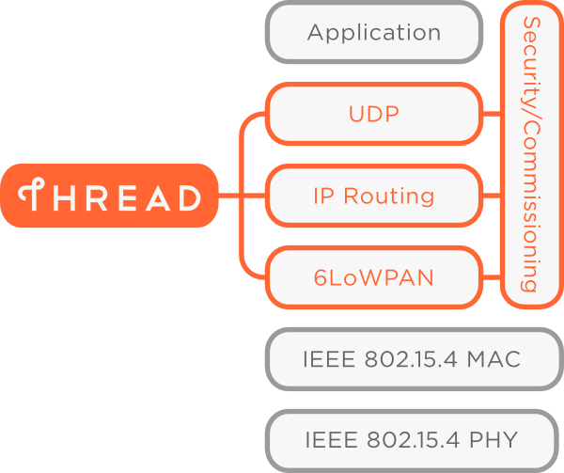
What it delivers
A secure wireless mesh network for your home and its connected products
Built on well-proven, existing technologies Uses 6LoWPAN and carries IPv6 natively Runs on existing 802.15.4 silicon
New security architecture to make it simple and secure to add / remove products
250+ products per network
Designed for very low power operation Reliable for critical infrastructure
Can support many popular application layer protocols and platforms
A software upgrade can add Thread to currently shipping 802.15.4 products

Slide 9

What can run over it
Support for many application layers
Any low bandwidth application layer that can run over IPv6
Some existing examples are CoAP and Smart Objects ZigBee Smart Energy 2.0 ECHONET Lite

Slide 10

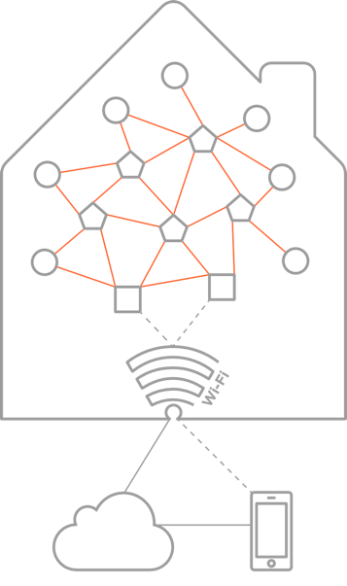
Target applications
Thread is designed for all sorts of products in the home
Appliances Access control Climate control
Energy management Lighting
Safety Security
Devices working together to form a cohesive mesh network

Slide 11


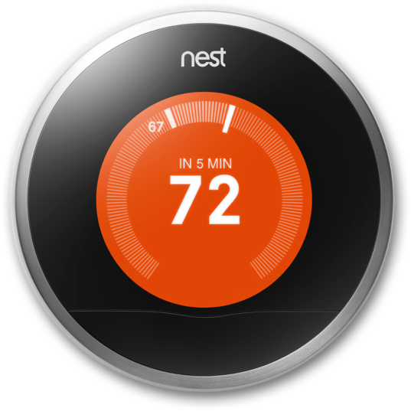
A version of Thread is shipping today in Nest products Millions of Thread devices

Slide 12
Organization overview

Slide 13








7 companies founded the Thread Group
Board of Directors
President: Chris Boross - Nest Labs
VP of Marketing: Sujata Neidig - Freescale VP of Technology: Skip Ashton - Silicon Labs Secretary: Bill Curtis - ARM
Treasurer: Kevin Kraus - Yale Security
Director: Landon Borders - Big Ass Fans Director: Benny Getz - Samsung Electronics
Not another standards body
A market education group offering product certification
Promoting Thread’s use in connected products for the home
Thread will offer rigorous product certification to ensure security and interoperability

Slide 14
















Organization Status
Thread launched on July, 15th 2014
Tremendous press and interest generated Over 100 articles within a day of launch Top-tier mainstream and industry press

Slide 15
Technical overview
Skip Ashton - Silicon Labs

Slide 16
Connected home requirements
Direct addressability to all devices – device to device or device to cloud
Simplified forming and joining of network
Limit special devices or customer knowledge of concepts like coordinator vs. router vs. end device Scalable to 250-300 devices in a home
Latency less than 100 milliseconds for typical interactions Allow the use of multiple border routers
Seamless connectivity to user interaction on device of choice in the home (dedicated display, smart phone, tablet, etc.)
Battery operated devices with years of expected life – door locks, security sensors etc

Slide 17
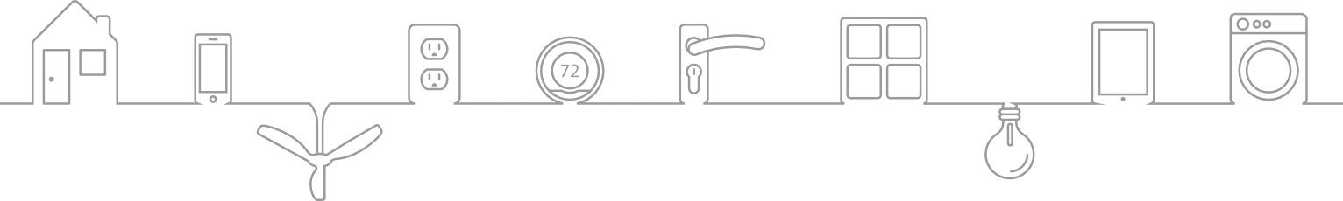
Connected home requirements
HVAC
Energy Saving
Security
Sensors
Lighting
Appliances
Normally Powered
Gateway Lighting Appliances Smart Meter
Garage door opener HVAC equipment Smart Plugs
Fans
Powered or battery
Thermostat Light switches Smoke Detectors CO detectors
In home display Shade or blinds control
Door bell Glass break sensors
Robots/cleaners
Normally Battery
Door sensors Window sensors Motion sensors Door locks Radiator valves
Body sensors (health care)
Consideration for devices that rely on energy harvesting is also a requirement

Slide 18

System Messaging Model
Border Router
WiFi or Ethernet
Thread HAN
Cloud Connectivity
Cloud connectivity for control when not at home
When within the home, phone or tablet must go direct to gateway to eliminate latency of going to the cloud
Has to be seamless to consumer using device
Border Router
Border Router forwards data to cloud
Also provides Wifi connectivity to phone or tablet in the home
Device Communication
Expect device to device communication within HAN for operations in the home

Slide 19

Overview
IPv6 based
Lightweight and low latency Not a whole new standard
Collection of existing IEEE and IETF standards
Runs on existing 802.15.4 based products 250+ devices on a PAN
Direct Addressability of devices
Flexible network with full point to point connectivity of all devices
No single point of failure
Enable low cost bridging to other IP networks Simple security and commissioning
Low Power support for sleeping devices
Standard
Application Layer
UDP + DTLS
RFC 768, RFC 6347, RFC 4279,
RFC 4492v RFC 3315, 5007
Distance Vector Routing
RFC 1058, RFC 2080
6LowPAN (IPv6)
RFC 4944, RFC 4862, RFC
6775
IEEE 802.15.4 MAC
(including MAC security)
IEEE 802.15.4 (2006)
IEEE 802.15.4 PHY
IEEE 802.15.4 (2006)

Slide 20



Network architecture
End Device Router Eligible
Thread Router Leader Border Router Thread Link

Slide 21

Direct Addressability of devices
All devices have IPv6 addresses plus short address on HAN
DHCPv6 used for router address assignment
Home Network can directly address devices through Border Routers
Cloud Services can address devices from the Internet
Devices can address local devices on HAN or off network devices using normal IP addressing
End Device Router Eligible Thread Router
Leader Border Router Thread Link

Slide 22

Flexible network
Devices join as router eligible or end devices
Router eligible can become routers if network agrees it is needed
All routers maintain state to all other routers through trickle mechanism and Mesh Link Establishment
All routers maintain state of border routers through trickle mechanism and MLE
Sleeping end devices route through parent router Router eligible devices can also maintain state Leader used to make decisions within network
End Device Router Eligible Thread Router
Leader Border Router Thread Link

Slide 23


No single point of failure
No need to recognize specialized devices within the network
Leader makes decisions but can fail and another router will become Leader
✖
End Device Router Eligible Thread Router
Leader Border Router Thread Link

Slide 24



No single point of failure
No need to recognize specialized devices within the network
Leader makes decisions but can fail and another router will become Leader
Network will add routers to improve connectivity when required
✖
✖
✖
✖
✖ ✖
End Device Router Eligible Thread Router
Leader Border Router Thread Link

Slide 25
No single point of failure
Multiple border routers can be used for off network access
Devices operate without Border Router
End Device Router Eligible Thread Router
Leader Border Router Thread Link

Slide 26

Security and Commissioning
Simple Commissioning
User authorizes devices onto the network using smart phone, computer
GUI rich device within network can be used to authorize devices
Security session established between new device and commissioning device to authenticate and provide credentials
Once commissioning session is done – device attaches to network
MAC security used for all messages
Application level security used based on device requirements
End Device Router Eligible Thread Router
Leader Border Router Thread Link

Slide 27

Low power operation
Sleeping devices poll parents for messages (or remote device if application configured)
Sleeping device not required to check in allow lower power operation
Parents hold messages for sleeping devices
Sleeping device automatically switches parent if it loses connectivity
End Device Router Eligible Thread Router
Leader Border Router Thread Link

Slide 28

Application Layers
Thread provides basic services required for applications
UDP messaging and ack Multicast messaging
Thread allows use of many application layers using IP services
Those application layers not using IP services would need some adaptation
App1
Appn
Application
Platform Layer – Defined by OEM or SIG
Platform
UDP
TCP
Transport
lPv6 with 6LoWPAN, Dist Vector,
DTLS
Network
IEEE 802.15.4 MAC
Data Link
IEEE 802.15.4 PHY
Physical

