Slide 1
The Cellular Concept
© 2011, HTDG,C-DAC

Slide 2
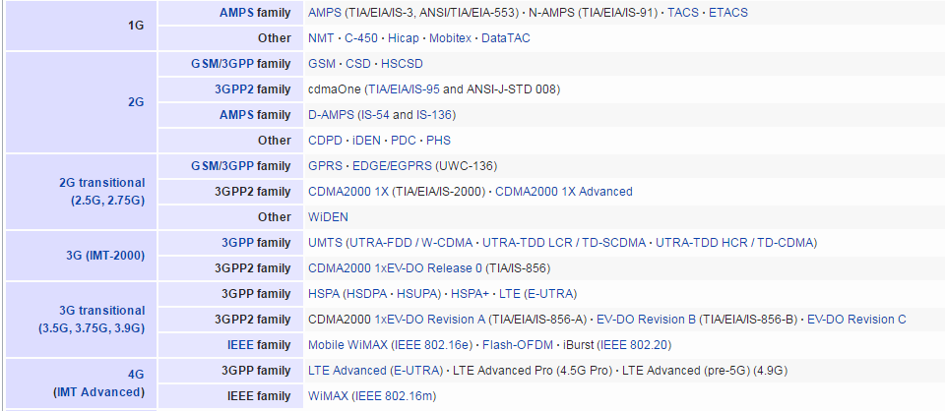
Mobile phone Generations

Slide 3
History of cellular Systems
Initial mobile networks were called 1G and were
based on analog communication in radio paths.
The early 1990 saw replacement of 1G networks with 2G which used digital communication in radio paths.
Four competing technologies were deployed:
GSM
IS-95
PDC
US-TDMA(or D-AMPS)
© 2011, HTDG,C-DAC

Slide 4
2G Systems
GSM: European Telecom Standards Institute
developed the GSM specifications in 1989.
– It used 25Mhz spectrum in 900MHz band. Later 1800MHz and 1900Mhz bands were added
IS-95: Based on CDMA scheme developed by
Qualcomm.
PDC: Personal Digital Cellular was popular in Japan
US-TDMA was popular in US, called as D-AMPS and was backward compatible with 1G system AMPS
© 2011, HTDG,C-DAC

Slide 5
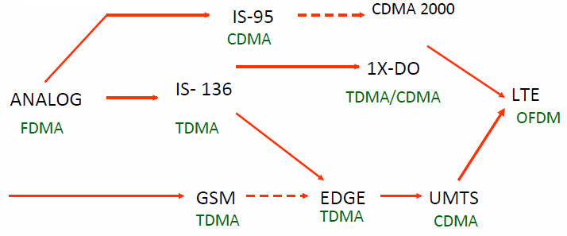
Evolution of Cellular Networks
1G
2G
2.5G
3G
4G

Slide 6
GSM
© 2011, HTDG,C-DAC

Slide 7
What is GSM?
Global System for Mobile communication (derived from original Groupe Spécial Mobile)
– In 1982, CEPT created the GSM to develop a standard for a mobile telephone system that could be used across Europe
Original GSM (or GSM900) is now supplemented by
GSM1800(or DCS1800) and GSM1900 (or PCS1900)
More than 70% of mobile users in the world use GSM technology
GSM technology covers more than 80% population of
the world
© 2011, HTDG,C-DAC

Slide 8
Structure of GSM Network
Functional entities of GSM
The Mobile Station(MS)
Also called as handset
Provides access to the user
The Base Station Subsystem (BSS)
Base stations and their controllers
The Network Switching Subsystem (NSS)
The part most similar to a fixed network
This is sometimes also just called the core network
Used for connecting calls among users
© 2011, HTDG,C-DAC

Slide 9
Structure of GSM Network
Functional entities of GSM (continued)
The Operation Support Subsystem(OSS)
For configuring the network
For maintenance of the network
The GPRS Core Network
optional part which allows packet based Internet
connections
Functions and interfaces are defined are defined in the standard
© 2011, HTDG,C-DAC

Slide 10
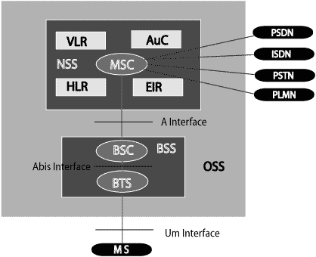
PLMN: The area covered by one network operator. A PLMN can contain one or more MSCs
© 2011, HTDG,C-DAC

Slide 11




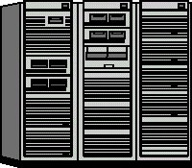

GSM Network Architecture
Access Network:
Base Station Subsystem
Core Network: GSM CS network
HLR
VLR EIR
AuC
BSC
Mobile Station
BTS
SS7
MSC
PSTN
BTS
Um
Abis
A
© 2011, HTDG,C-DAC

Slide 12
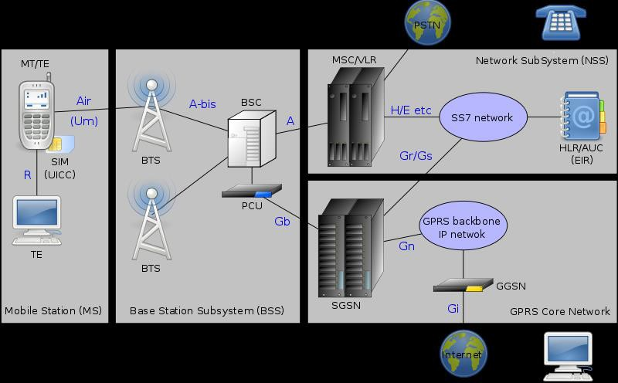
Key Elements in GSM Network
© 2011, HTDG,C-DAC

Slide 13
GSM Interfaces
Um Interface
Mobile Station and Base Station Subsystem communicate across Um interface, also known as air interface or radio link.
Abis interface
Base Transceiver Station (BTS) and Base Station Controller (BSC) communicate across Abis interface.
A interface
Base Station Subsystem communicates with Mobile service Switching Center (MSC) across A interface.
© 2011, HTDG,C-DAC

Slide 14
GSM Functional Entities(contd.)
Registers
HLR – Home Location Register
VLR – Visitor Location Register
AUC – Authentication Centre
EIR – Equipment Identification Register
© 2011, HTDG,C-DAC

Slide 15
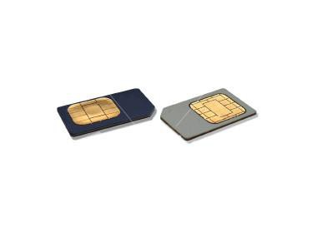
Subscriber Identity Module
A small smart card
Encryption codes needed to identify the subscriber
Subscriber IMSI(International mobile subscriber identity) number
Subscriber’s own information (telephone directory)
Third party applications (banking etc.)
Can also be used in other systems besides GSM, e.g., some WLAN access points accept SIM based user authentication

Slide 16
Subscriber Identity Module (SIM)
The smart card provided by service provider
Plugs into Mobile Equipment and remains in it, till
duration of use
Stores the 15 digit International Mobile Subscriber Identity (IMSI)
The first 3 digits are the Mobile Country Code
Next 3 digits are Mobile Network Code
The remaining digits are the mobile station identification number (MSIN) within the network's customer base
© 2011, HTDG,C-DAC

Slide 17
Subscriber Identity Module (SIM)
SIM carries following information
IMSI
Authentication Key
Subscriber Information
Access control class
Forbidden PLMN (Public Land Mobile Network)
Cipher key
TMSI(Temporary Mobile Subscriber Identity )
Additional GSM services
Location Area Identity
© 2011, HTDG,C-DAC

Slide 18
1G Cellular Systems
Analog signaling for user traffic
No encryption
eavesdropping possible
Inferior call quality
Easily degraded by noise
Spectrum inefficiency
Each RF carrier is dedicated to single user regardless of whether the user is active (speaking) or not (idle within the call)
AMPS(Advanced Mobile Phone System) in US
TACS(Total Access Communication System) in Europe

Slide 19
Advanced Mobile Phone System
Developed by Bell labs and deployed in 1982
Uses a number of 30Khz channels
Carries only voice.
AMPS was allocated bandwidth in 800MHz by FCC
Each cellular telephone includes a Numeric Assignment Module (NAM) in ROM
Telephone number
Serial number of the unit
When phone is turned on this info. is sent to MTSO

Slide 20
2G Cellular Systems
Key improvements over 1G
Digital traffic channels
Readily support digital data
Voice is encoded in digital form
Encryption
Encryption of all traffic to prevent eavesdropping
Error detection and correction
Results in better voice reception
Channel access
Each channel is dynamically shared between
users
353

Slide 21
2G Cellular Systems
 | GSM | IS-136 | IS-95
Year Introduced | 1990 | 1991 | 1993
Access Method | TDMA | TDMA | CDMA
Base station band | 935–960MHz | 869–894MHz | 869–894MHz
Mobile station band | 890–915MHz | 824-849MHz | 824-849MHz
Channel bandwidth | 200KHz | 30KHz | 1250KHz
Number of channel | 125 | 832 | 20
Users per channel | 8 | 3 | 35
Modulation | GMSK | DQPSK | QPSK

Slide 22
GSM Enabled Technologies

Slide 23
Mobile Wireless Data Networks
Driver for Growth
Popularity of internet
Desire for anytime, anywhere data communication
Short Message Service (SMS)
Multimedia Messaging Service (MMS)
General Packet Radio Service (GPRS)
Enhanced Data Rates for GSM Evolution (EDGE)

Slide 24
Constraints with existing network
Data Rates too slow – about 9.6 kbps
Connection setup time too long
Inefficient resource utilization for bursty traffic
Proves expensive for bursty traffic utilization
No efficient method for packet transfers

Slide 25
Comparison of GSM & GPRS
 | GSM | GPRS
Data Rates | 9.6 Kbps | 14.4 to 115.2 Kbps
Modulation Technique | GMSK | GMSK
Billing | Duration of connection | Amount of data transferred
Type of Connection | Circuit – Switched Technology | Packet - Switched Technology

Slide 26
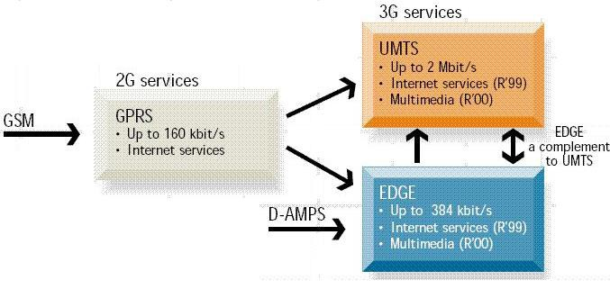
Evolution of GSM Networks
© 2011, HTDG,C-DAC

Slide 27
3G Systems
3G has been in gestation since 1992
International Telecommunications Union (ITU) began
work on a standard called IMT-2000.
IMT stands for International Mobile Telecommunications
The number 2000 initially had three meanings
The year that services should become available
The frequency range in MHz that would be used
and the data rate in Kbits/sec
Regulators, vendors and carriers could not agree
The path to 3G will be gradual, and everyone wants to ensure compatibility with their existing systems

Slide 28
3G Systems
Voice quality comparable to public switched
telephone network
144kbps data rate for users in high speed vehicles
384kbps to stationary or slow moving users
Support for 2.048 Mbps for office use
Symmetrical and asymmetrical data transmission
rates
Support for both packet and circuit switched data services
More efficient use of spectrum

Slide 29
4G (LTE)
LTE stands for Long Term Evolution
Next Generation mobile broadband technology
Promises data transfer rates of 100 Mbps
Based on UMTS 3G technology
Optimized for All-IP traffic

Slide 30
Thank You
491

