Slide 1
CELLULAR NETWORKS

Slide 2
Cellular Technology
Cellular Network is formed of some cells, the cell covers a geographical region.
It has a base station analogous to 802.11 AP which helps mobile users attach to the network.
There is an air interface of physical and link layer protocol between the mobile and base station.
All these base stations are connected to Mobile Switching Center which connects cells to a wide area net, manages call setup, and handles mobility.

Slide 3
Cellular Technology
There are 2 techniques for sharing mobile-to-base station radio spectrum are:
Combined FDMA/TDMA: It divides the spectrum into frequency channels and divides each channel into time slots.
Code Division Multiple Access (CDMA): It allows the reuse of the same spectrum over all cells. Net capacity improvement. Two frequency bands are used, one for the forward channel (cell-site to subscriber) and one for the reverse channel (sub to cell-site).

Slide 4
Cells
In practice cells are of arbitrary shape(close to a circle) because it has the same power on all sides and the same sensitivity on all sides, but putting up two or three circles together may result in interleaving gaps or may intersect each other.
In order to solve this problem we can use an equilateral triangle, square, or regular hexagon in which a hexagonal cell is close to a circle used for a system design.

Slide 5
Cell Splitting and Needs
Cell Splitting
When the number of subscribers in a given area increases allocation of more channels covered by that channel is necessary, which is done by cell splitting. A single small cell midway between two co-channel cells is introduced.
Need for Cellular Hierarchy
Extending the coverage to the areas that are difficult to cover by a large cell. Increasing the capacity of the network for those areas that have a higher density of users. An increasing number of wireless devices and the communication between them.

Slide 6
Cellular Hierarchy
Femtocells
Smallest unit of the hierarchy, these cells need to cover only a few meters where all devices are in the physical range of the uses.
Picocells
Size of these networks is in the range of a few tens of meters, e.g., WLANs.
Microcells
Cover a range of hundreds of meters e.g. in urban areas to support PCS which is another kind of mobile technology.

Slide 7
Cellular Hierarchy
Macro cells
Cover areas in the order of several kilometers, e.g., cover metropolitan areas.
Mega cells
Cover nationwide areas with ranges of hundreds of kilometers, e.g., used with satellites.

Slide 8
Global System for Mobile (GSM)
GSM uses 124 frequency channels, each of which uses an 8-slot Time Division Multiplexing (TDM) system. There is a frequency band which is also fixed.
Transmitting and receiving do not happen in the same time slot because the GSM radios cannot transmit and receive at the same time and it takes time to switch from one to the other.
A data frame is transmitted in 547 microseconds, but a transmitter is only allowed to send one data frame every 4.615 microseconds since it is sharing the channel with seven other stations. The gross rate of each channel is 270, 833 bps divided among eight users, which gives 33.854 kbps gross.

Slide 9
Control Channel (CC)
The broadcast control channel (BCC):
It is a continuous stream of output from the base station’s identity and the channel status. All mobile stations monitor their signal strength to see when they moved into a new cell.
The dedicated control channel (DCC):
It is used for location updating, registration, and call setup. In particular, each base station maintains a database of mobile stations. Information needed to maintain this database is sent to the dedicated control channel.

Slide 10
Common Control Channel
Three logical sub-channels:
Is the paging channel, which the base station uses to announce incoming calls. Each mobile station monitors it continuously to watch for calls should answer.
Is the random access channel that allows the users to request a slot on the dedicated control channel. If two requests collide, they are garbled and have to be retried later.
Is the access grant channel which is the announced assigned slot.

Slide 11
Global System for Mobile Communication

Slide 12
GSM
GSM is an open and digital cellular technology used for mobile communication.
It uses 4 different frequency bands 850 MHz, 900 MHz, 1800 MHz, and 1900 MHz.
It uses the combination of FDMA and TDMA.

Slide 13
Cells in GSM
Macro
In this size of cell, a Base Station antenna is installed.
Micro
In this size of the cell, antenna height is less than the average roof level.
Pico
Small cells’ diameter of a few meters.
Umbrella
It covers the shadowed (Fills the gaps between cells) regions.

Slide 14
Features of GSM
Supports international roaming
Clear voice clarity
Ability to support multiple handheld devices.
Spectral/frequency efficiency
Low-powered handheld devices.
Ease of accessing the network
International ISDN compatibility.

Slide 15
Sub-Systems in GSM
BSS
BSS stands for Base Station Subsystem. BSS handles traffic and signaling between a mobile phone and the network switching subsystem. BSS has two components BTS and BSC.
NSS
NSS stands for Network and Switching Subsystem. NSS is the core network of GSM. That carried out call and mobility management functions for mobile phone present in the network. NSS has different components like VLR, HLR, and, EIR.
OSS
OSS stands for Operating Subsystem. OSS is a functional entity in which the network operator monitors and controls the system. OMC is part of OSS. The purpose of OSS is to offer the customer cost-effective support for all GSM-related maintenance services.

Slide 16
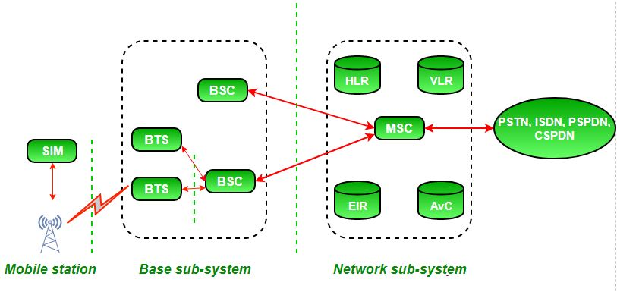

Slide 17
Interfaces in GSM
Air Interface
Air interface is also known as UM interface. Interface between MS and BTS is called as UM interface because it is mobile analog to the U interface of ISDN.
Abis Interface
It is a BSS internal interface linking with BTS and BSC.
A interface
It provides communication between BSS and MSC.

Slide 18
Function of Components
Mobile station (MS)
It refers to the mobile station. Simply, it means a mobile phone.
Base transceiver system (BTS)
It maintains the radio component with MS.
Base station controller (BSC)
Its function is to allocate necessary time slots between the BTS and MSC.
Home location register (HLR)
It is the reference database for subscriber parameters like the subscriber’s ID, location, authentication key, etc.

Slide 19
Function of Components
Visitor location register (VLR)
It contains a copy of most of the data stored in HLR which is temporary and exists only until the subscriber is active.
Equipment identity register (EIR)
It is a database that contains a list of valid mobile equipment on the network.
Authentication center (AUC)
It performs authentication of subscribers.

Slide 20
General Packet Radio Service (GPRS)

Slide 21
GPRS
GPRS is an expansion Global System for Mobile Communication. It is basically a packet-oriented mobile data standard on the 2G and 3G cellular communication network’s global system for mobile communication.
GPRS was built up by European Telecommunications Standards Institute (ETSI) because of the prior CDPD, and I-mode packet switched cell advances.

Slide 22
GPRS
The packet radio standard is utilized by GPRS to transport client information packets in a structured route between GSM versatile stations and external packet information networks.
These packets can be straightforwardly directed to the packet-changed systems from the GPRS portable stations.

Slide 23
Goals of GPRS
Consistent IP services
Leverage industry investment in IP
Open Architecture
Service innovation independent of infrastructure

Slide 24
Services Offered by GPRS
SMS messaging and broadcasting
Push-to-talk over cellular
Instant messaging and presence
Multimedia messaging service
Point-to-Point and Point-to-Multipoint services

Slide 25
Benefits of GPRS
Mobility
The capacity to keep up consistent voice and information interchanges while moving.
Cost Efficient
Communication via GPRS is cheaper than through the regular GSM network.
Immediacy
Allows customers to obtain connectivity when needed, regardless of location, and without a lengthy login session.
Localization
Enables customers to acquire data applicable to their present area.
Easy Billing
GPRS packet transmission offers an easier-to-use billing than that offered by circuit-switched administrations.

Slide 26
GPRS
GPRS is an innovation that numerous GPS beacons are using to get up-to-the-minute data with tracking.
When the GPS gadget records the information, it would then be able to be transmitted through GPRS to another central location, for example, a PC or through an email.

Slide 27
Code Division Multiple Access (CDMA)

Slide 28
Characteristics of CDMA
It allows more users to connect at a given time and thus provides improved data and voice communication capabilities.
A full spectrum is used by all the channels in CDMA.
CDMA systems make use of power control to eliminate interference and noise and thus improve the network quality.
CDMA encodes the user transmissions into distinct and unique codes in order to secure its signals.

Slide 29
Characteristics of CDMA
In CDMA systems all the cells can thus use the same frequency.
CDMA systems have a soft capacity. Thus there is no particular limit to the number of users in a CDMA system but with an increase in the number of users, the performance degrades.

Slide 30
Advantages
Increased user capacity is an advantage of the CDMA as it supports a lot more users in comparison to TDMA or FDMA.
CDMA is more secure as the information transmitted is below the noise floor making the intrusion of the spectrum difficult.
CDMA systems have comparatively fewer dropouts than GSM. Thus, it can also be used in rural areas.
The cost of the calls in CDMA is lower in comparison to the cost in GSM.

Slide 31
Advantages
CDMA provides a high quality of voice with almost no noise during the calls.
Using CDMA problems like multipath and fading do not occur.
CDMA has a very low power requirement.

Slide 32
Disadvantages
CDMA lacks the facility of international roaming which is provided by GSM.
Since there is no limit to the number of users the system performance degrades with an increase in the number of users.
Self-jamming problem occurs in CDMA systems because of loss of orthogonality.
The problem of channel pollution occurs in CDMA systems which thus degrades the quality of audio.
Since most of mobile companies use GSM thus there is a lack of handsets for CDMA technology.

Slide 33
Universal Mobile Telecommunications Framework (UMTS)

Slide 34
UMTS
UMTS or Universal Mobile Telecommunications Framework, is the 3G successor to the GSM family of measures counting GPRS and EDGE.
3G UMTS employments a completely diverse radio interface based around the utilization of Coordinate Grouping Spread Range as CDMA or Code Division Multiple Access.
Although 3G UMTS employments a completely distinctive radio get-to standard, the center arrangement is the same as that utilized for GPRS and EDGE to carry partitioned circuit exchanged voice and bundle data.

Slide 35
Applications
Streaming / Download (Video, Audio)
Videoconferences.
Fast Internet / Intranet.
Mobile E-Commerce (M-Commerce)
Remote Login
Background Class applications
Multimedia-Messaging, E-Mail
FTP Access
Mobile Entertainment (Games)

Slide 36
Features of UMTS
UMTS could be a component of the IMT-2000 standard of the Universal Broadcast Communications Union (ITU), created by 3GPP.
It employments a wideband code division multiple access (W-CDMA) discussion interfaces.
It gives transmission of content, digitized voice, video, and multimedia.
It gives tall transmission capacity to portable operators.
It gives a tall information rate of 2Mbps.

Slide 37
Advantages
UMTS could be a successor to 2G-based GSM advances counting GPRS and EDGE. Gaining a 3rd title 3GSM since it could be a 3G relocation for GSM
Support 2Mbit/s information rates.
Higher Information rates at lower incremental costs.
Benefits of programmed universal wandering also necessarily security and charging capacities, permitting administrators to emigrate from 2G to 3G whereas holding numerous of their existing back-office frameworks.

Slide 38
Disadvantages
It is more expensive than GSM.
Universal Mobile Telecommunication System has poor video experience.
Universal Mobile Telecommunication System still not broadband.

Slide 39
Generations of wireless communication

Slide 40
0th Generation
Pre-cell phone mobile telephony technology, such as radio-telephones some had in cars before the arrival of cell phones.
Communication was possible through voice only.
These mobile telephones were usually mounted in cars or trucks.

Slide 41
1G (1st Generation)
First-time calling was introduced in mobile systems.
It used analog signals.
It used an FDD scheme and typically allocated a bandwidth of 25 Mhz.
The coverage area was small.
No roaming support between various operators.
Low sound quality.
Speed:- 2.4 kbps.

Slide 42
2G (2nd Generation)
Shifted from analog to digital.
It supported both voice and SMS.
Supported all 4 sectors of the wireless industry namely Digital cellular, Mobile Data, PCS, WLAN,
Moderate mobile data service.
2G WLAN provided a high data rate & large area coverage.
Speed:- 64 kbps.

Slide 43
3G (3rd Generation)
The Internet system was improved.
Better system and capacity.
Offers high-speed wireless internet.
The connection used was UMTS and WCMA.
Speed:- 2mbps.

Slide 44
4G (4th Generation)
IP-based protocols.
LTE (Long term evaluation) was mainly for the internet.
Vo-LTE (Voice over LTE) is for both voice and the internet.
Freedom and flexibility to select any desired service with reasonable QoS.
High usability.
Supports multimedia service at a low transmission cost.
HD Quality Streaming.
Speed:-100mbps.

Slide 45
5G (5th Generation)
Higher data rates.
Connectivity will be faster and more secure,
Data Latency will be reduced to a great level.
Massive network capacity.
It is 30 times faster than 4G.
There would be more flexibility in the network.

Slide 46
5G (5th Generation)
5G Wireless Technology is the 5th generation of mobile networks and an evolution from the current 4G LTE networks.
It is specially designed to fulfill the demands of current technological trends, which includes a large growth in data and almost global connectivity along with the increasing interest in the Internet of Things.
In its initial stages, 5G Technology will work in conjugation with the existing 4G Technology and then move on as a fully independent entity in subsequent releases.

Slide 47
5G (5th Generation)
5G Wireless Technology is the latest cellular technology that will greatly increase the speed of wireless networks among other things.
So the data speed for wireless broadband connections using 5G would be at a maximum of around 20 Gbps. Contrasting that with the peak speed of 4G which is 60 Mbps.
Moreover, 5G will also provide more bandwidth and advanced antenna technology which will result in much more data transmitted over wireless systems.
It will also provide various network management features such as Network Slicing.

Slide 48
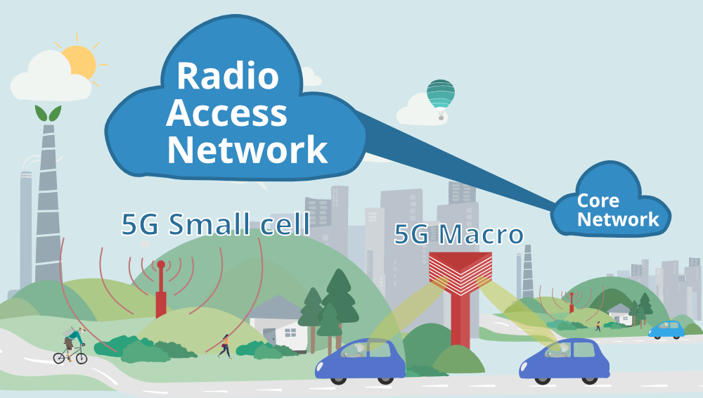

Slide 49
Components of 5G
Radio Access Network
The Radio Access Network mainly includes 5G Small Cells and Macro Cells that form the crux of 5G Wireless Technology as well as the systems that connect the mobile devices to the Core Network.
The 5G Small Cells are located in big clusters because the millimeter wave spectrum (that 5G uses for insanely high speeds!) can only travel over short distances. These Small Cells complement the Macro Cells that are used to provide more wide-area coverage.
Macro Cells use MIMO (Multiple Inputs, Multiple Outputs) antennas which have multiple connections to send and receive large amounts of data simultaneously. This means that more users can connect to the network simultaneously.

Slide 50
Components of 5G
Core Network
The Core Network manages all the data and internet connections for the 5G Wireless Technology.
And a big advantage of the 5G Core Network is that it can integrate with the internet much more efficiently and it also provides additional services like cloud-based services, distributed servers that improve response times, etc.
Another advanced feature of the Core Network is network slicing

Slide 51
Advantages
5G will make our smartphones much smarter with faster and more uniform data rates, lower latency, and cost-per-bit and this, in turn, will lead to the common acceptance of new immersive technologies like Virtual Reality or Augmented Reality.
5G will have the convenience of ultra-reliable, low-latency links that will empower industries to invest in more projects which require remote control of critical infrastructure in various fields like medicine, aviation, etc.
5G will lead to an Internet of Things revolution as it has the ability to scale up or down in features like data rates, power, and mobility which is perfect for an application like connecting multiple embedded sensors in almost all devices!

Slide 52
Parameters
Peak data rate | At least 20Gbps downlink and 10Gbps uplink per mobile base station.
Real-world data rate | Download speed of 100Mbps and upload speed of 50Mbps.
Spectral efficiency | 30bits/Hz downlink and 15 bits/Hz uplink. This assumes 8×4 MIMO
Latency | Maximum latency of just 4ms (compared to 20ms for LTE)
Connection density | At least 1 million connected devices per square km (to enable IoT support)

