Slide 1
GPS and Location-Based Services

Slide 2
Introduction to GPS
(week 2)

Slide 3
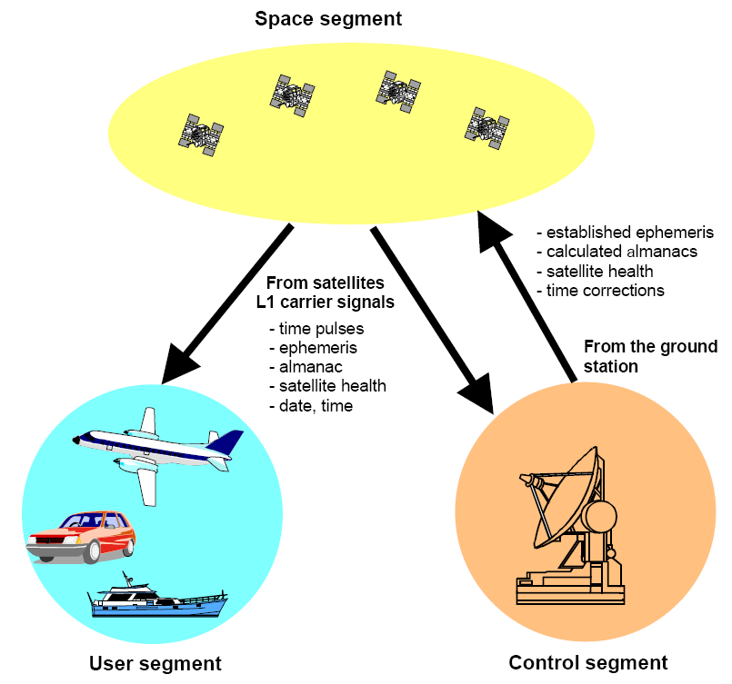
GPS system components
GPS consists

Slide 4
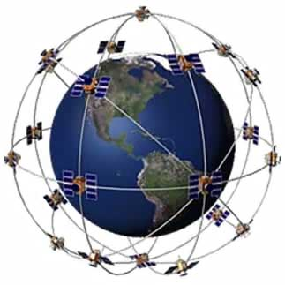
GPS system components
Space segment
At least 24 positioning satellites.
Distribution of High Earth orbit (20200km)of six orbital plane,
the equatorial plane and the orbital inclination angle
of 55 degrees each orbit four satellites.
Earth took up 15 degrees elevation point, you can see four
to eight satellites.
With an atomic clock as the timing
GPS satellites feature
Global 3-D distribution
Orbital altitude: 20,200 km
To around one week: 11hr 58min
Satellite quantity: 24/6 Track
Orbital inclination: 55 °
Coordinate system: WGS 84

Slide 5
GPS System Architecture
Calculate the distance from the point to the satellite
Use Time of arrival (TOA) distance calculation method
Distance (D) = velocity (V) x time (T)

Slide 6
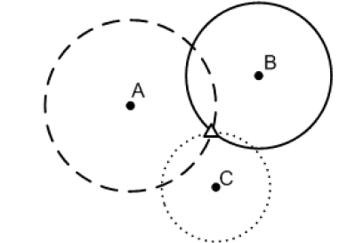
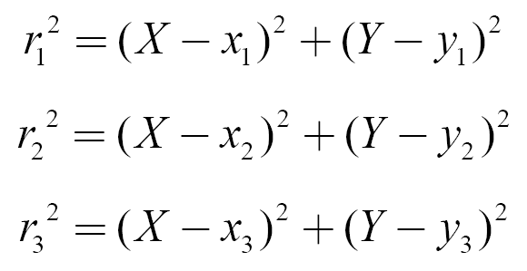
GPS Positioning Technology
Triangulation method
Assuming plane space is considered first, the triangulation method uses the distance between the target to be located and the three known positions to estimate the position without measurement error.
Targets (x, y) has a receiver assumed A, B, C are measured as the distancer1, r2, r3, according to the three intersecting circular reckoning position (x, y).
r2
r1
(x,y)
r3

Slide 7
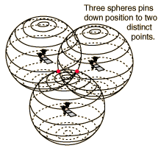
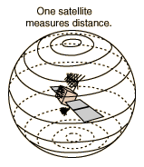
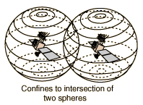
GPS positioning technology cont.
Position calculation
  Use the triangulation to calculate the anchor point
  Using the information of the fourth satellite to do the amendment

Slide 8
GPS Signal
GPS location-based services provided by the system has two levels:
  Standard Positioning Service(Standard Positioning Service, SPS)
    Use GPS L1 frequency, comprising C / A code (Coarse Acquisition Code)
    Accuracy of less than 12.8 meters (95%)
    Time accuracy within 40ns (95%)
  Precise positioning service(Precise Positioning Service, PPS)
    This service requires authorization from the US government
    Using the GPS L1 and L2 frequencies transmitted P (y) Code
    Use two frequency accuracy of less than 11.8 meters (95%)
    Using a frequency of positioning accuracy of less than 12.6 meters (95%)
    Time accuracy within 40ns (95%)

Slide 9
Indian Regional navigation Satellite System
Operational name Navigation with Indian Constellation (NAVIC)
An autonomous regional satellite navigation system that is being set up by India
It will be used to provide accurate real-time positioning and timing services over India and the region extending to 1,500 kilometres (930 mi) around India

Slide 10
The NAVIC System
The NAVIC system will consist of a constellation of 3 satellites in Geostationary orbit(GEO), 4 satellites in Geosynchronous orbit(GSO), approximately 36,000 kilometres (22,000 mi) altitude above earth surface and two satellites on the ground as stand-by, in addition to ground stations.
NAVIC signals will consist of a Standard Positioning Service and a Precision Service. Both will be carried on L5 (1176.45 MHz) and S band (2492.028 MHz). The SPS signal will be modulated by a 1 MHz BPSK signal.
Indian Regional Navigation Satellite System (IRNSS) consist of total 7 Satellites

Slide 11

Coverage of the NAVIC

Slide 12
LBS（Location-Based Service）

Slide 13
LAB- How it works
LBS services can be broadly divided into two categories:
  One does not have a wireless data transmission capacity of the closed system, a dedicated system such as aGPS;
  The other is based on GSM, 3G or WiFi as data, voice and even multimedia communication channels, and also has positioning systems, this is also known as mobile location services (Mobile Location Based Service; MLBS)system.
LBS system components include the following items:
  GPS
  App servers or map databases
  Application interface

Slide 14
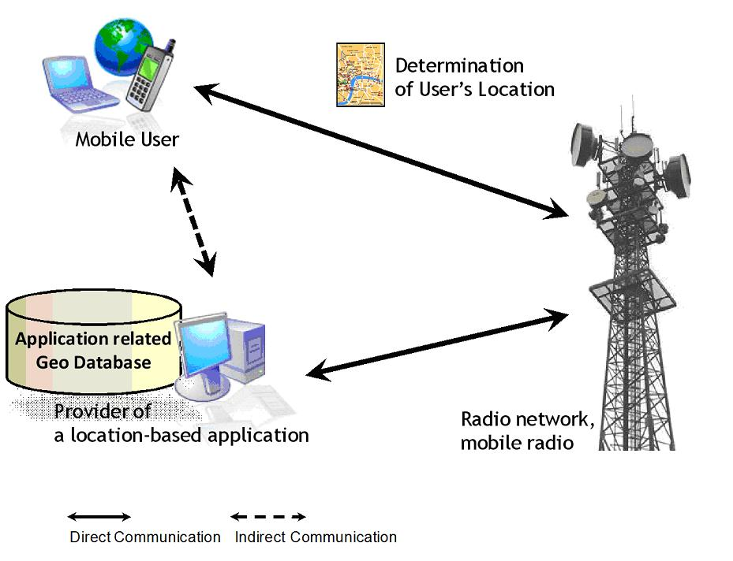
LBS

Slide 15
LBS Applications
Action Safety
Transportation Applications
Smart Library Guided Tour
Guided tours of museums
Commercial and shopping advertising
Entertainment and multimedia image location management

Slide 16
AGPS&DGPS
Introduction

Slide 17
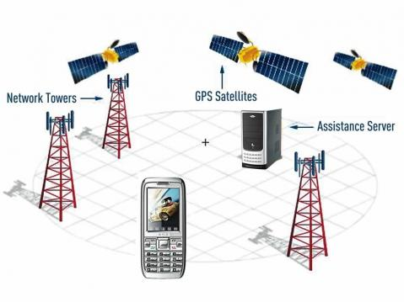
Assisted GPS
It is a system that often significantly improves startup performance—i.e., time-to-first-fix (TTFF), of a GPS satellite-based positioning system. A-GPS is extensively used with GPS-capable cellular phones.

Slide 18
AGPS specifications
A-GPS system can be divided into two categories, namely:
  Connection type A-GPS (Online A-GPS ): When positioning through the Internet to connect to the global reference network to obtain the required satellite message.
  Offline A-GPS (Offline A-GPS ): Offline A-GPS is a satellite message prior to download to the GPS receiver can be positioned when positioning without wires.

Slide 19
Principles of AGPS
A-GPS (Assisted GPS)
A GPS-based positioning technology
You can enhance the GPS start-up performance
Navigation messages get through the base station signalling (control plane) or network packets (user plane)

Slide 20
Principles of DGPS
DGPS (Differential GPS, DGPS) has been developed as a more accurate positioning solutions minimizing the effect of error.
DGPS To enhance the accuracy of the GPS system, the use of terrestrial fixed position of the reference station (Reference Station) for their location and time calculating a differential correction (Differential Correction), and broadcasts this image information to the GPS receiver as the basis for correcting positioning.

Slide 21
Wide Area Augmentation System
The WAAS was developed by the US Federal Aviation Administration (FAA) and the US Department of Transportation to improve flight accuracy because the current use of GPS alone does not meet FAA's requirements for precise flight navigation.
WAAS can correct for GPS signal errors caused by factors such as ionospheric interference, incorrect timing control, and satellite orbital errors, as well as information on whether satellites are operating properly

Slide 22
Wide Area Augmentation System
“Essentially, WAAS is intended to enable aircraft to rely on GPS for all phases of flight, including precision approaches to any airport within its coverage area.”
It is a satellite-based augmentation system (SBAS) developed by the Federal Aviation Administration.
System architecture
  A network of ground-based reference stations
    Measure the GPS satellites' signals
    Send correction messages to WAAS satellites
  Geostationary WAAS satellites
    Receive the correction messages
    Broadcast the correction messages back to Earth

Slide 23
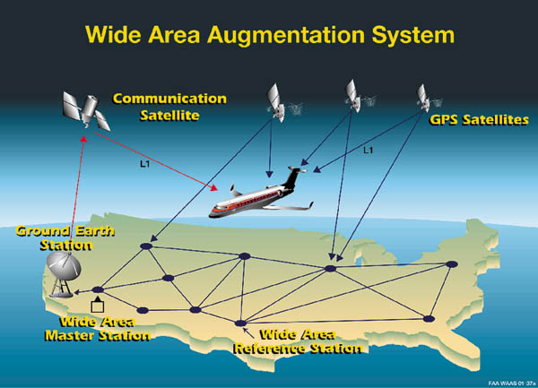
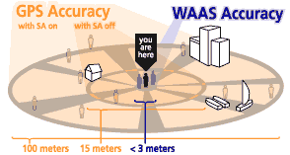
WAAS Architecture

Slide 24
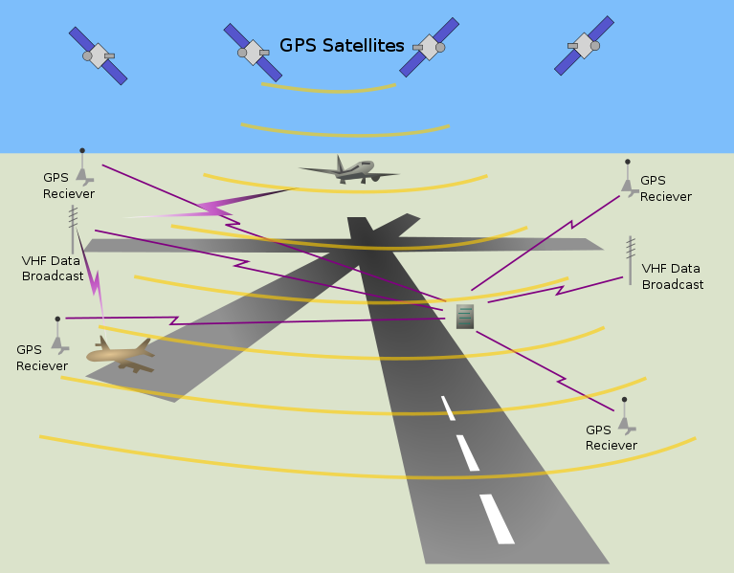
Local Area Augmentation System
(LAAS)
Ground Based Augmentation System (GBAS)
An all-weather aircraft landing system based on real-time differential correction of the GPS signal
System architecture
  Local reference receivers located around the airport send data to a central location at the airport.
  This data is used to formulate a correction message, which is then transmitted to users via a VHF Data Link.
Accuracy
  Currently, Category I ILS accuracy of 16m laterally and 4m vertically
  Future, Category III ILS capability that will allow aircraft to land with zero visibility utilizing 'autoland' systems

Slide 25
Thank you

