Slide 1
SOCKETS

Slide 2
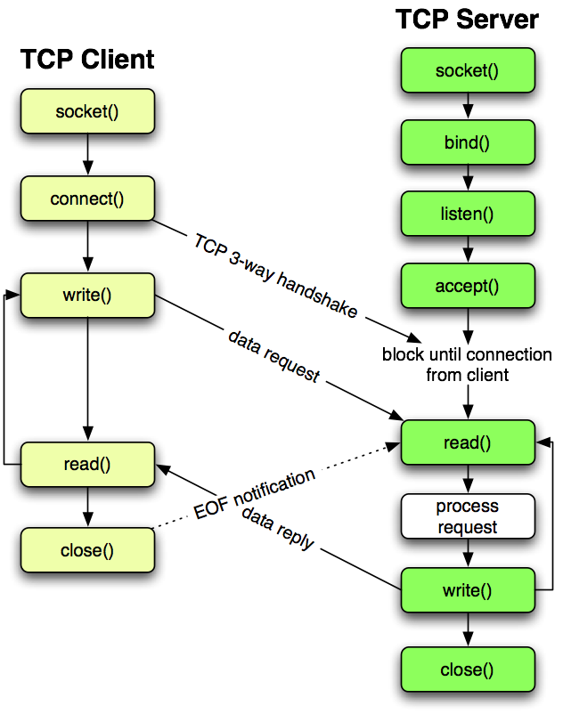

Slide 3
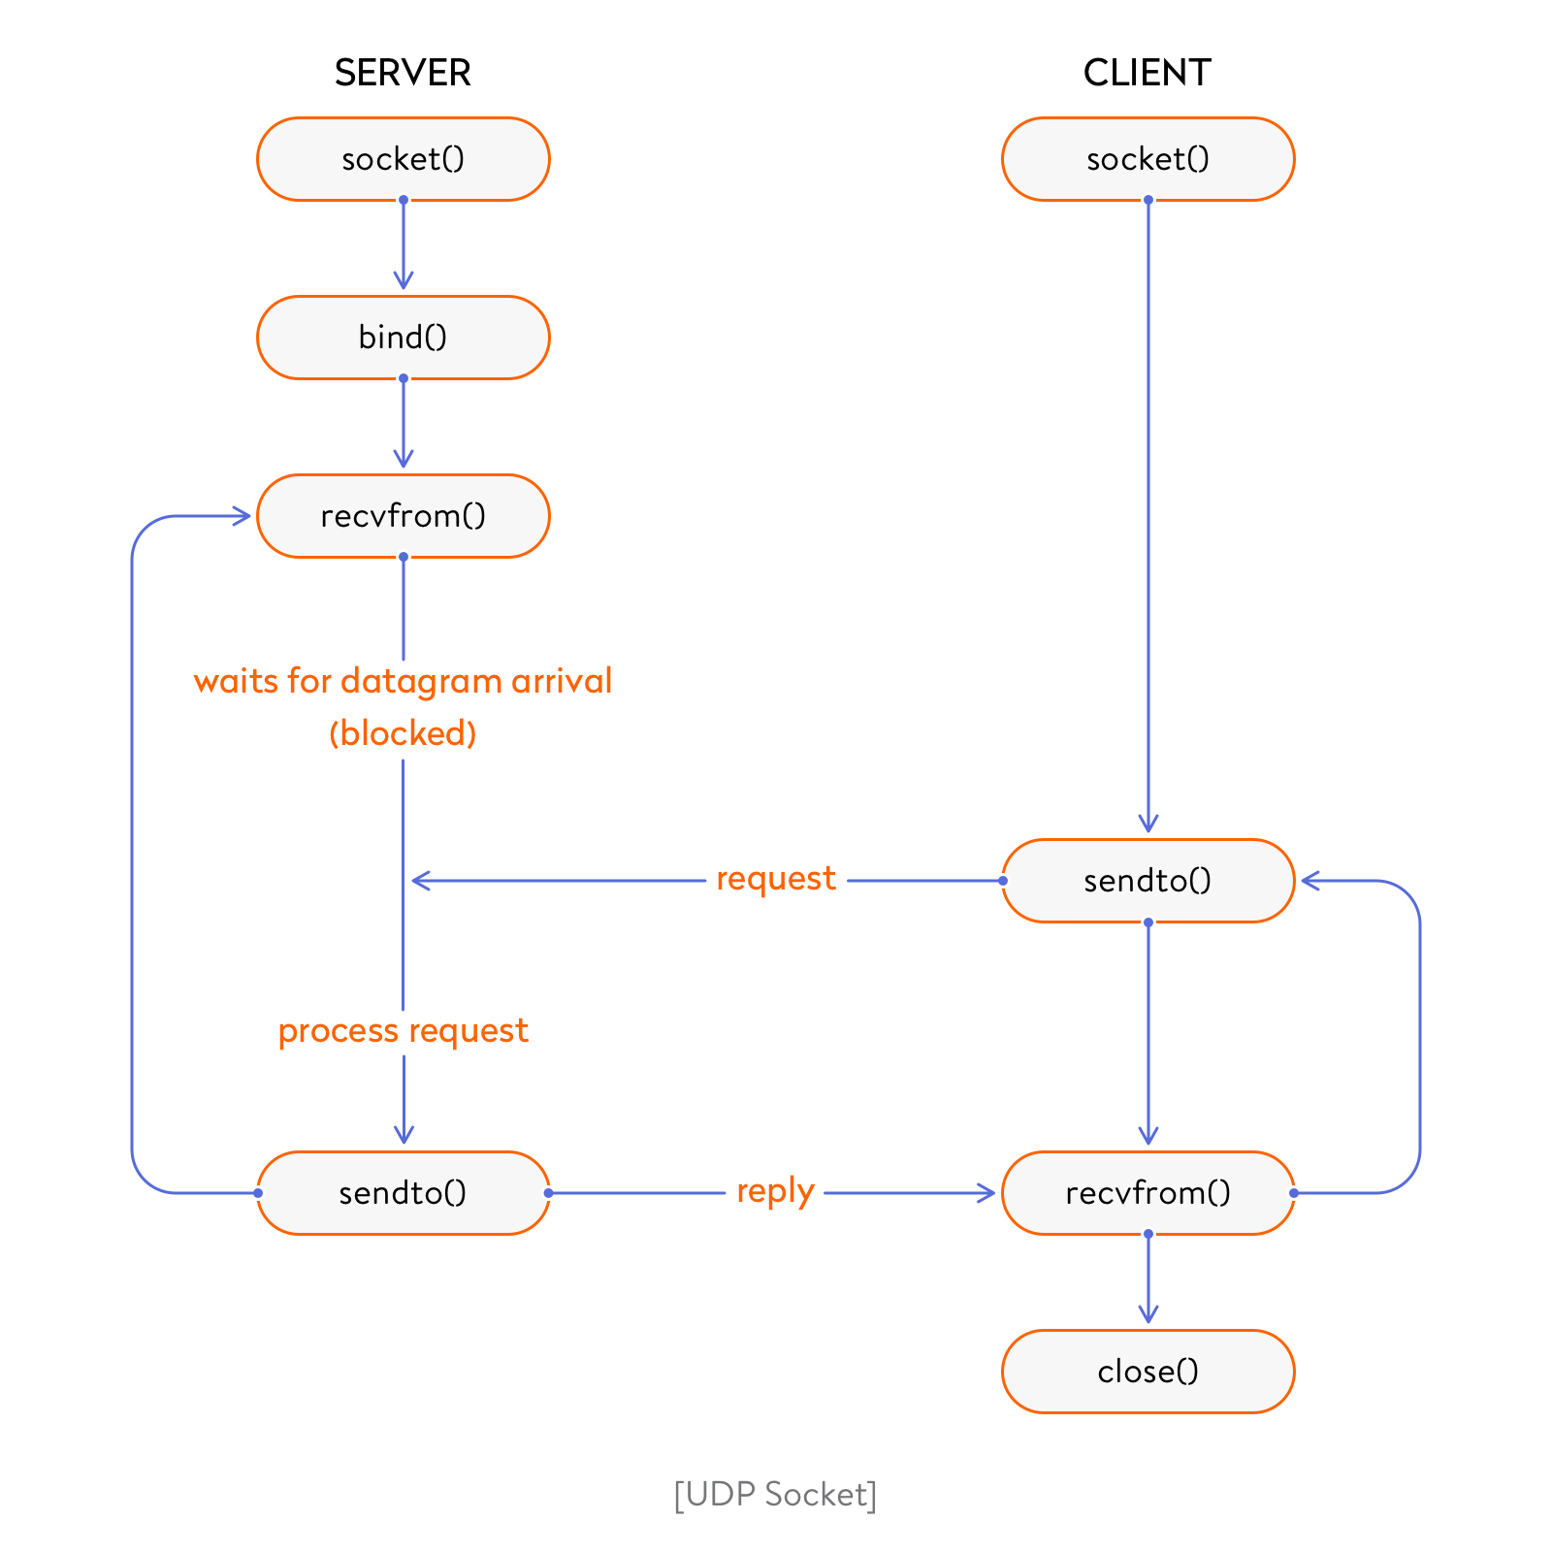

Slide 4
Server Socket Methods
s.bind()
This method binds address (hostname, port number pair) to socket.
s.listen()
This method sets up and start TCP listener.
s.accept()
This passively accept TCP client connection, waiting until connection arrives (blocking).

Slide 5
Client Socket Methods
s.connect()
This method actively initiates TCP server connection.

Slide 6
General Socket Methods
s.recv()
This method receives TCP message
s.send()
This method transmits TCP message
s.recvfrom()
This method receives UDP message

Slide 7
General Socket Methods
s.sendto()
This method transmits UDP message
s.close()
This method closes socket
socket.gethostname()
Returns the hostname.

Slide 8
Python Library For Socket
Socket programming is started by importing the socket library and making a simple socket
import socket
s = socket.socket(socket.AF_INET, socket.SOCK_STREAM)
(AF_INET refers to the address-family ipv4. The SOCK_STREAM means connection-oriented TCP protocol)

