Slide 1

An Introduction to
Beacons
See the world in a whole new way with Bluetooth LE

Slide 2
Because with
Beacons...

Slide 3

I Once Was
Blind

Slide 4
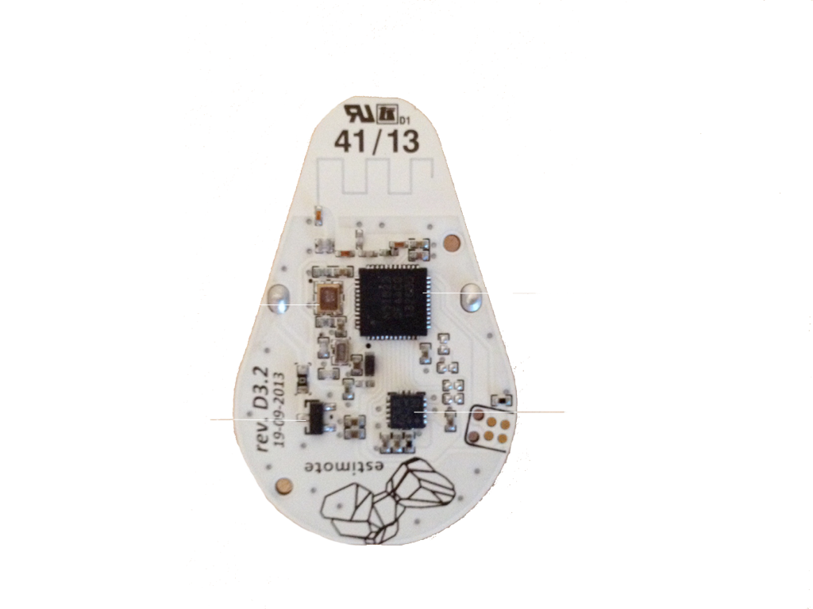
SEE
But Now I

Slide 5


It’s Not a Chip. It’s Not a Technology.
It’s a New Way to Experience the World

Slide 6
We’ll Show You Why It Matters
•What IS Bluetooth LE?
•What’s the Difference Between Proximity and Location
•Is Bluetooth LE Really a Big Deal?

Slide 7
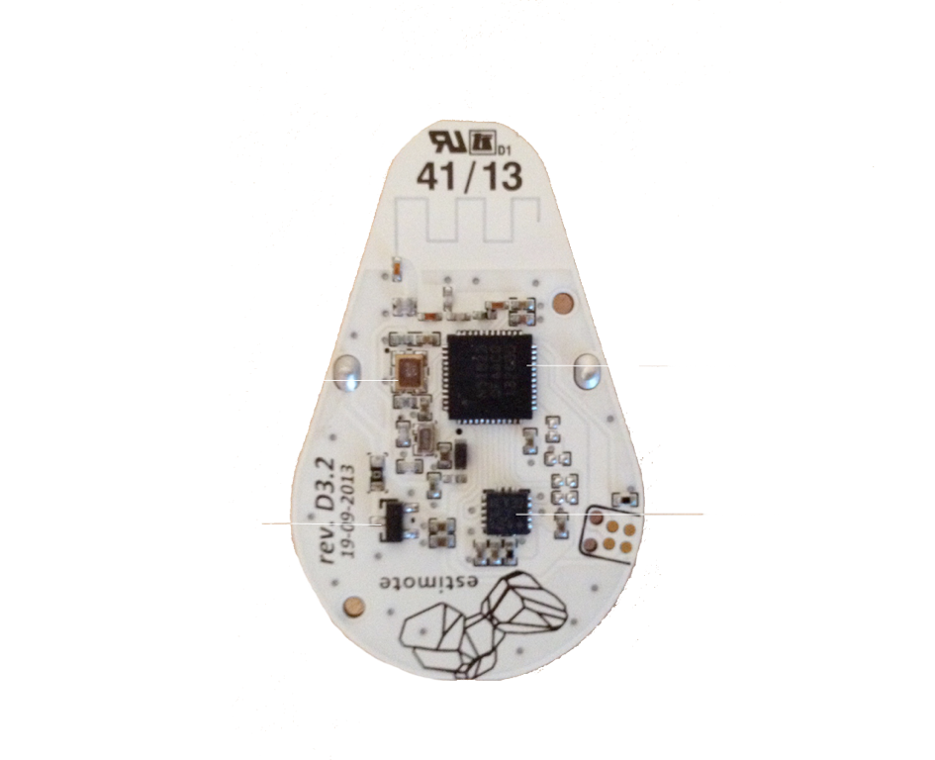
Bluetooth LE:
What is It?
In which we go from geeky to less geeky

Slide 8
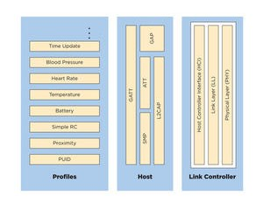
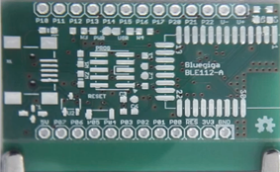
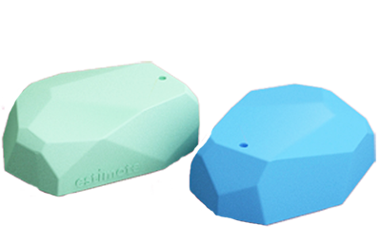
What is It?
Bluetooth LE:
Bluetooth LE is a specification
Not to be confused with Bluetooth
The specification is used to create Bluetooth LE chipsets
e.g. Kontakt Chipset
The chipsets are embedded in
devices
e.g. Estimote Device

Slide 9
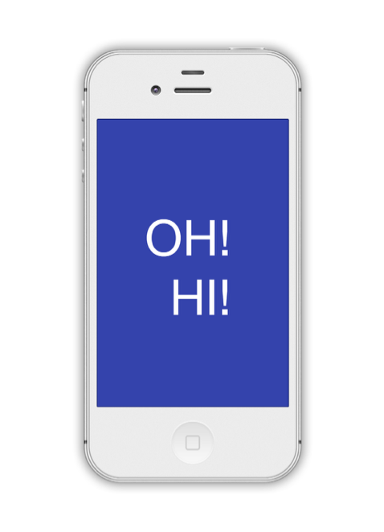
Bluetooth LE:
What is It?
Bluetooth LE Devices Transmit Small Packets of Data
Which wake up a “listener” to let it know that it’s there.

Slide 10
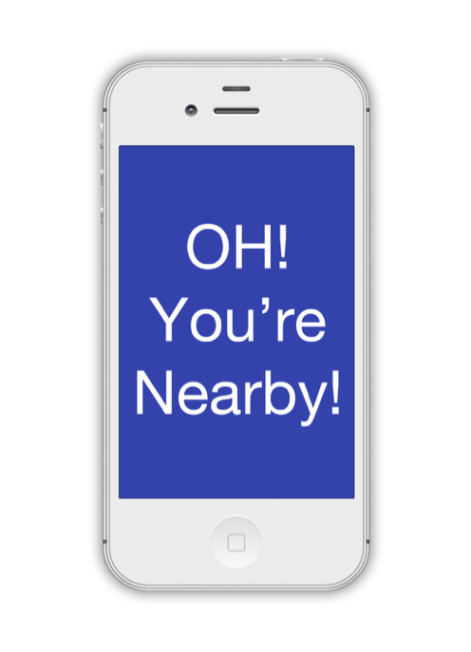
Bluetooth LE:
What is It?
Which Then Lets You Calculate PROXIMITY To The Beacon

Slide 11
What is It?
Bluetooth LE:
2-3’ 3-10M
Which Then Lets You Calculate PROXIMITY To The Beacon
70M

Slide 12
What is It?
Bluetooth LE:
Remember NFC? It only works here
2-3’ 3-10M
Which Then Lets You Calculate PROXIMITY To The Beacon
70M

Slide 13

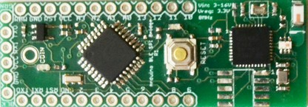
What is It?
Bluetooth LE:
This is ONE type of beacon.
(It’s called an Estimote)
This is another. (Kontakt)
Here’s a “do it yourself” kit (Coin)

Slide 14

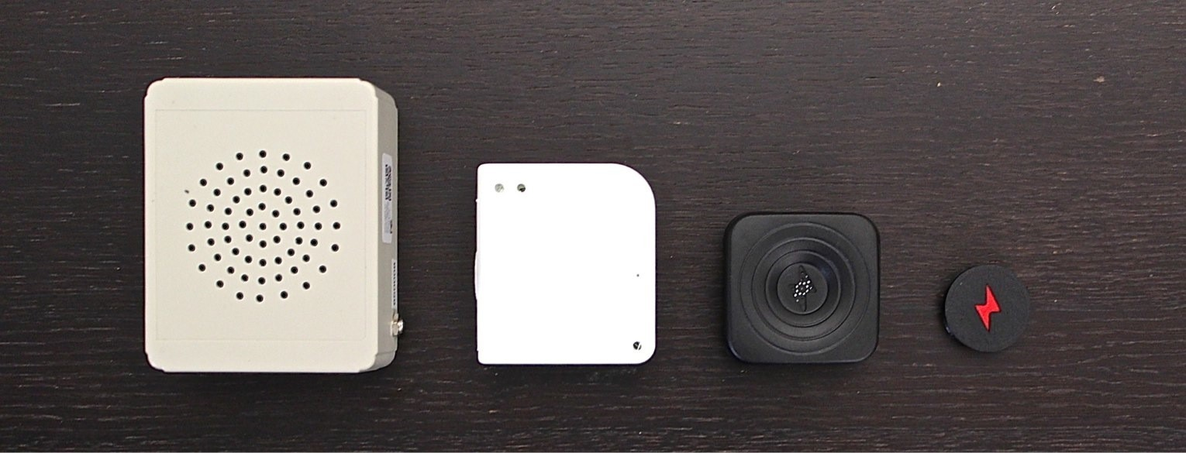
What is It?
Bluetooth LE:
These beacons combine Bluetooth LE with beacons based on audio waves.
(Sonic Notify)

Slide 15

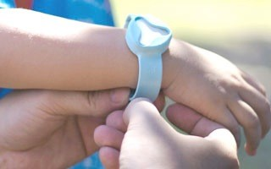
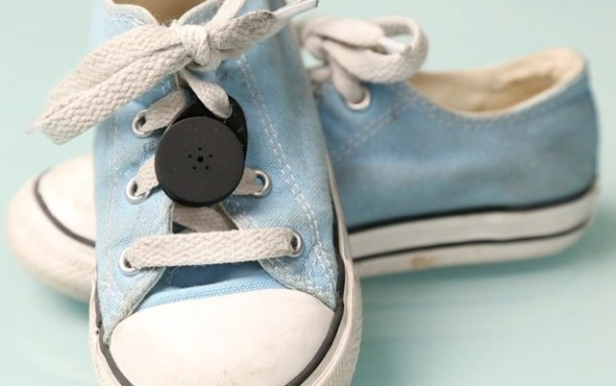
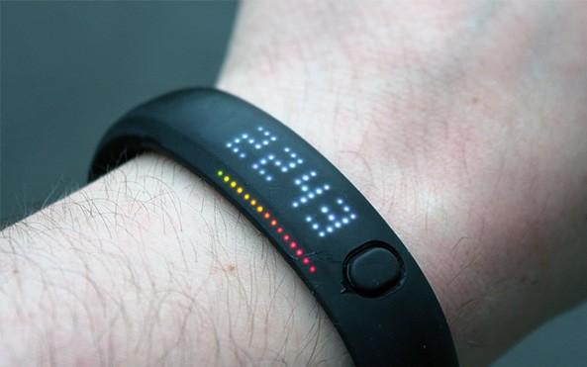
What is It?
Bluetooth LE:
Bluetooth LE is also embedded in other things like watches, tags or detectors.

Slide 16
But did you know there are
MILLIONS
of Bluetooth LE beacons in the world?

Slide 17
MILLIONS
But did you know there are
of Bluetooth LE beacons in the world?
They’re Called Phones
(Or tablets. Because your mobile device is a beacon too)

Slide 18

Um, in plain English please?

Slide 19
What is It?
Phones (and tablets) can finally “see” what they’re close to.
It’s low energy: your phone doesn’t lose battery and a beacon can last for years without being plugged in.
It’s cross-platform: all the major phone platforms have Bluetooth LE capabilities (although some still need to turn those capabilities “on”)

Slide 20
Hold on
I can already use my phone to figure out where I am. What’s the big deal?

Slide 21
Ah Yes, GPS
On the one hand, you can think of Bluetooth LE as an ‘extension’ of location technology:
•It’s a lot like GPS but also uses a LOT less battery
•GPS doesn’t work very well once you get inside. Bluetooth LE does.

Slide 22
Ah Yes, GPS
But if you think of Bluetooth LE as “indoors/low battery GPS” you’re missing the bigger picture.

Slide 23


GPS is navigation through a stormy sea. Only if you see the stars can you roughly figure out where you are.

Slide 24

What a better world it would be if there was a beacon to guide you.
I’m here!
Oh, hi!

Slide 25
Be Close to Me
GPS is a LOCATION technology.
Bluetooth LE is a PROXIMITY technology.
Which means that even if the beacon MOVES you’ll still be able to find it*.
* Like a store shelf say. Or a register. Or people.

Slide 26

Why now?

Slide 27
Why now?
With Apple on board, Bluetooth LE is the first proximity technology supported by all the major mobile platforms.
Apple might have been the last to figure out what kind of technology to use. But somehow it’s getting all the buzz and credit. (Imagine that)

Slide 28

So it may be a young technology,
but it’s big news.

Slide 29
Why it
Matters

Slide 30
In a Word: Context
We can now deliver content and experiences to users based on precise proximity to things in the physical world.
Just think of all the things you’re “near” in a day.

Slide 31


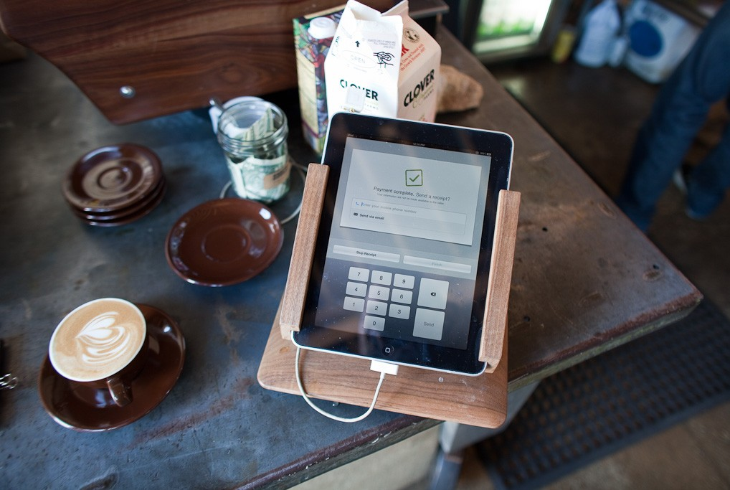


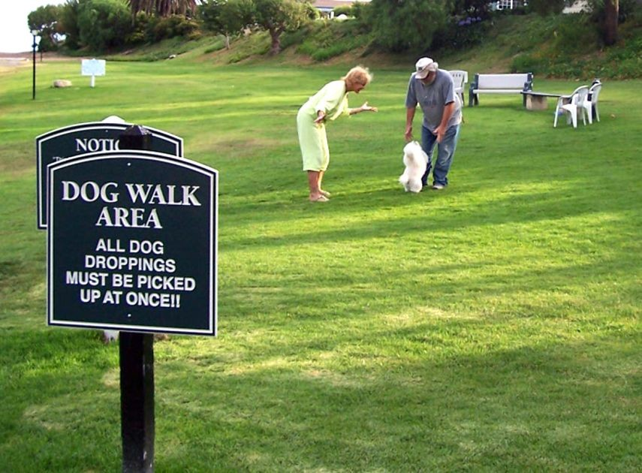

In a Word: Context

Slide 32
Did You
Notice?

Slide 33
Did You
Notice?
Those were all physical, real world places.

Slide 34

There is NO OFFLINE

Slide 35
There is NO OFFLINE
THE PHYSICAL WORLD IS THE NEW DIGITAL CHANNEL

Slide 36
Case Study:
Retail
Perhaps the most obvious use of beacons.

Slide 37
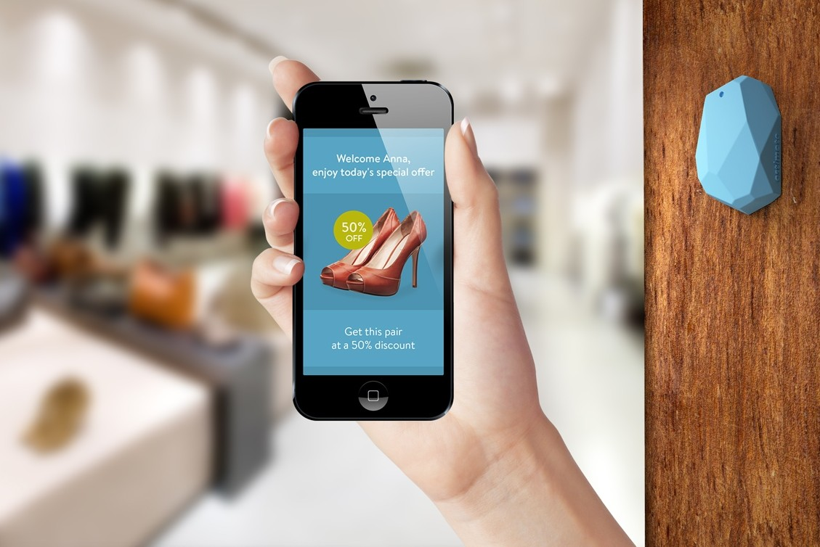
* Estimote images for the win!!! http://estimote.com/estimote-press-kit.html

Slide 38

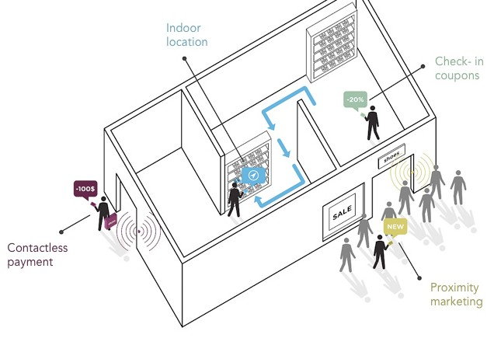
* Estimote images for the win!!! http://estimote.com/estimote-press-kit.html

Slide 39

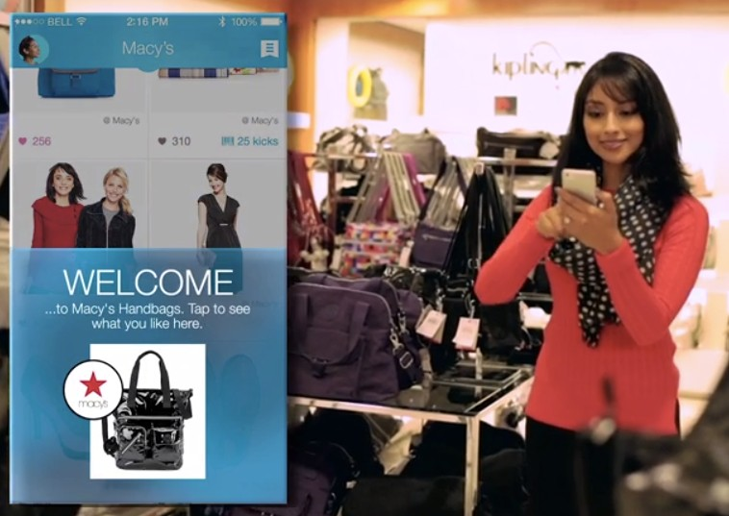
Macy’s

Slide 40
Retail
•
•
Greet customers when they arrive
Send them specials, offers and coupons at specific locations in the store
Connect to loyalty programs Offer contactless payment Upsell
•
•
•

Slide 41
Imagination
Think big. Think beyond transactions.
Because remember….

Slide 42
It’s Not a Chip. It’s Not a Technology.
It’s a New Way to Experience the World

Slide 43
What is Eddystone?
Just like iBeacon™ is a Bluetooth 4.0 communication protocol designed by Apple, Eddystone™ is an open Bluetooth 4.0 protocol from Google.

Slide 44
Eddystone & iBeacon comparison
While iBeacon is officially supported by iOS devices only, Eddystone has official support for both iOS and Android.
Eddystone is an open protocol, i.e., its specification is available for everyone.
The advertising packet is naturally different from that of iBeacon. In fact, Eddystone is designed to support multiple data packet types, starting with two: Eddystone-UID and Eddystone-URL. We’ll describe them in more detail below.
There’s a third type of packet: Eddystone-TLM, as in “telemetry.” This packet is broadcast alongside the Eddystone-UID or Eddystone-URL packets and contains beacon’s “health status” (e.g., battery life). This is mainly intended for fleet management, and because of that, the TLM “service” packet is broadcast less frequently than the “data” packets.

Slide 45
Comparison cont.
iBeacon provides two API methods for apps to detect iBeacons devices: ranging, which works only when the app is active, and provides proximity estimations; and monitoring, which works even if the app is not running, and provides a binary “in range” and “out of range” information.
Eddystone support in the Estimote iOS and Android SDKs is based on a single method at this time: Eddystone discovery, which is similar to iBeacon’s ranging. It provides proximity estimates and works only when the app is active.

