Slide 1
Personal Area Networks (PAN)

Slide 2
Personal Area Networks
A data network used for communication among
computing devices close to one person
Mobile Telephones
Personal Digital Assistants
The devices may or may not belong to the person in
question.
The reach of a PAN is typically a few meters.
PANs can be used for communication
among the personal devices themselves
connecting to a non-personal device

Slide 3
Personal Area Networks
Personal area networks may be wired
USB
FireWire
Thunderbolt
Digital Visual Interface
Display Port
Or may be wireless
IrDA
Bluetooth
ZigBee
– IEEE 802.15.4

Slide 4
Bluetooth

Slide 5
What is Bluetooth
Facilitates voice and data transfers
Allows users to connect a wide range of computing
and telecommunications devices without cables
Provides on-the-fly connections between devices
– Offers the possibility of ad hoc networks
Delivers synchronicity between personal devices
Packet based two way communication
Low power devices
Small size
Low cost ( USD $5)

Slide 6
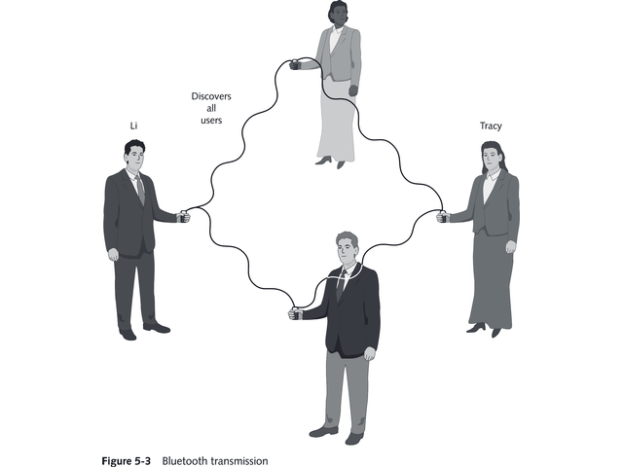
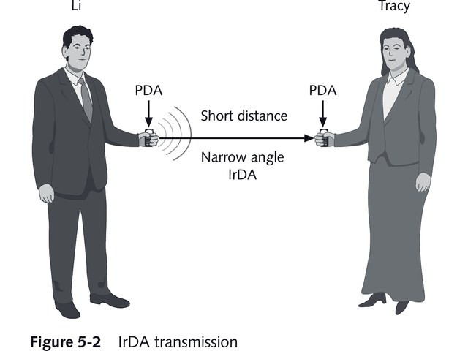
IrDA Vs Bluetooth
The two technologies complement each other
Bluetooth is omni-directional and can synchronize while user is mobile
IRDA has limited range and narrow angle

Slide 7
Bluetooth Specifications
Specification contains both link layer and application
layer definitions, for data and voice applications
Operates in the unlicensed industrial, scientific and medical (ISM) band at 2.4 to 2.485 GHz,
Uses spread spectrum, frequency hopping,
full-duplex signal at a nominal rate of 1600
hops/sec.
Uses adaptive frequency hopping (AFH) to reduce interference between wireless technologies sharing the 2.4 GHz spectrum.

Slide 8
Bluetooth Specifications
The operating range depends on the device class:
Class 3 radios – have a range of up to 1 meter
Class 2 radios – most commonly found in mobile devices – have a range of 10 meters
Class 1 radios – used primarily in industrial use
cases – have a range of 100 meters
The most commonly used radio Class 2 uses 2.5 mW of power.
radios are powered down when inactive
Data Rate
1 Mbps for Version 1.2
Up to 3 Mbps supported for Version 2.0

Slide 9
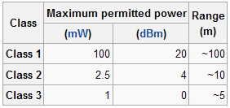
Power Transmitted vs Range

Slide 10
Overview of operation
During typical operation, a physical radio channel is
shared by a group of devices
Synchronized to a common clock and frequency hopping pattern.
One device provides the synchronization
reference and is known as the master.
All other devices are known as slaves.
A group of devices synchronized in this fashion form a piconet.
This is the basic building block of communication

Slide 11
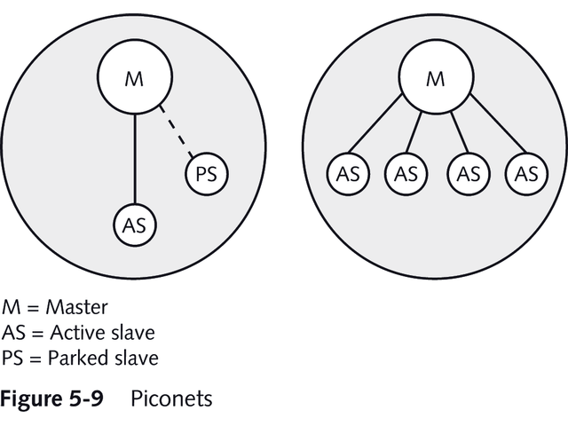
Piconet
•
One master and at least one slave using the same channel
An active slave is sending transmissions
A passive slave is not actually participating

Slide 12
Piconet
A good example of a piconet is the Playstation 3 (PS3) console gaming system. Instead of having wired controllers, the PS3 implements Bluetooth technology to connect up to four controllers at the same time. The main console acts as the master and the controllers act as slaves. Newer home appliances are also able to communicate through Bluetooth.

Slide 13
Modes of devices
Devices in a Piconet can be in one of five different
modes
Standby—waiting to join a Piconet
Inquire—looking for other devices
Page—master device is asking to connect to
specified slave
Connected—either active slave or master is connected
Park/Hold—device is part of piconet, but in a low- power state

Slide 14
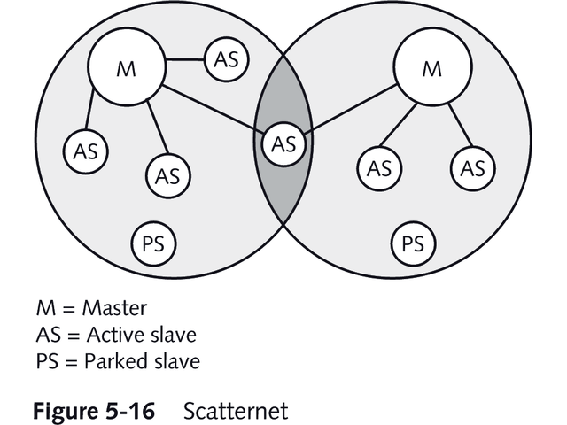
Scatternet

Slide 15
Scatternet
Multiple piconets can cover same area with different
master and hop sequences
Device can be a member of two or more overlaying piconets
Group of piconets connected together is called
a scatternet
Communication among piconets occurs using master device address and clock for each piconet
Bluetooth device can be a slave in several piconets,
but master in only one

Slide 16
Hopping Pattern
Devices in a piconet use a specific frequency
hopping pattern
Pattern is algorithmically determined by certain fields
address and clock of the master.
It is a pseudo-random ordering of the 79
frequencies in the ISM band.
The hopping pattern may be adapted to exclude a portion of the frequencies that are used by interfering devices.
improves co-existence with static (non-hopping)
ISM systems when these are co-located

Slide 17
Sending Data
The physical channel is sub-divided into time units
known as slots.
Data is transmitted between devices in packets that are positioned in these slots.
At times, a number of consecutive slots may be
allocated to a single packet.
Frequency hopping takes place between the transmission or reception of packets.
Effect of full duplex transmission through the use of a
time-division duplex (TDD) scheme.

Slide 18
Sending Data
Bluetooth is a packet-based protocol with a master-
slave structure.
One master may communicate with up to 7 slaves in a piconet
The master switches rapidly from one device to another in a round-robin fashion.
Simultaneous transmission from the master to multiple other devices is possible via broadcast mode, but not used much.
All devices share the master's clock.
Packet exchange is based on the basic clock, defined by the master, which ticks at 312.5 µs intervals.

Slide 19
Sending Data
Two clock ticks make up a slot of 625 µs
two slots make up a slot pair of 1250 µs.
In the simple case of single-slot packets the master transmits in even slots and receives in odd slots
the slave, conversely, receives in even slots and
transmits in odd slots.
Packets may be 1, 3 or 5 slots long but in all cases the master transmit will begin in even slots and the slave transmit in odd slots.

Slide 20
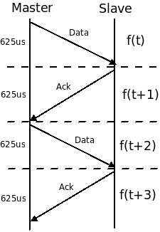
Bluetooth Sending Data

Slide 21
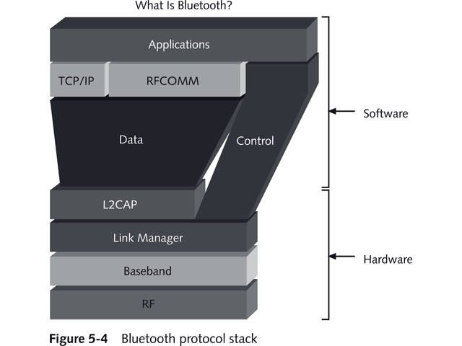
Bluetooth Protocol Stack

Slide 22
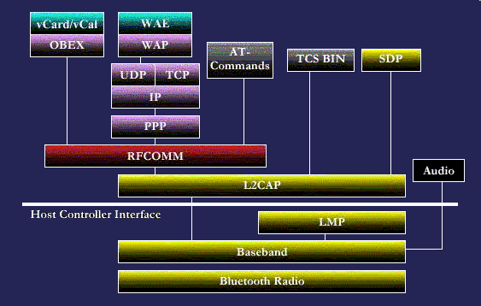
Bluetooth Protocol Stack
Notes:
Radio: This protocol specification defines air interface, frequency bands, frequency hopping specifications, modulation technique used and transmit power classes.
Baseband: Addressing scheme, packet frame format , timing and power control algorithms required for establishing connection between bluetooth devices within piconet defined in this part of protocol specification.
Link Manager protocol: It is responsible to establish link between bluetooth devices and to maintain the link between them. This protocol also includes authentication and encryption specifications. Negotiation of packet sizes between devices can be taken care by this.
Logical link control and adaptation protocol: This L2CAP protocol adapts upper layer frame to baseband layer frame format and vice versa. L2CAP take care of both connection oriented and connectionless services.
Service discovery protocol: Service related queries including device information can be taken care at this protocol so that connection can be established between bluetooth devices.
RFCOMM :Cable replacement protocol
Serial ports are popular to provide serial communication between devices. Bluetooth uses RFCOMM as cable replacement protocol. RFCOMM functions as virtual serial port and does transport of binary digital data bits. It basically emulates RS232 specifications over bluetooth physical layer.
Telephony Control Protocols
TCS-BIN is the protocol used here which is a bit oriented one. It specifies call control signals and mobility management procedures. These signals take care of establishing speech and data calls.
Adopted protocols
These protocols are already defined by other standard bodies which are incorporate without any change in the bluetooth protocol stack architecture. The protocols are PPP,TCP/UDP/IP,OBEX and WAE/WAP.
PPP is a point to point protocol used to transfer IP datagrams. TCP/UDP and IP are part of basic TCP/IP model, for more refer our article on Basics of OSI and TCPIP layers. OBEX is a object exchange protocol developed by IrDA and it is similar to HTTP. It is a session level protocol. WAE and WAP provides Wireless Application Environment and WAP provides Wireless Application Protocol.

Slide 23
Layers
The protocol architecture of the bluetooth consists of following in a bluetooth protocol stack
Core protocols consisting 5 layer protocol stack viz.
radio
baseband
link manager protocol,
L2CAP-logical link control and adaptation protocol
service discovery protocol.

Slide 24
Physical Channel and links
Within a physical channel, a physical link is formed between any two devices that transmit packets in either direction between them.
In a piconet physical channel there are restrictions on which devices may form a physical link.
There is a physical link between each slave and
the master.
Physical links are not formed directly between the slaves in a piconet.

Slide 25
Logical Transport
The physical link is used as a transport for one or
more logical links that support
unicast synchronous,
asynchronous and isochronous traffic,
broadcast traffic
Traffic on logical links is multiplexed onto the physical link by occupying slots assigned by a scheduling function in the resource manager
A control protocol, Link Manager Protocol (LMP) is carried over logical links in addition to user data.

Slide 26
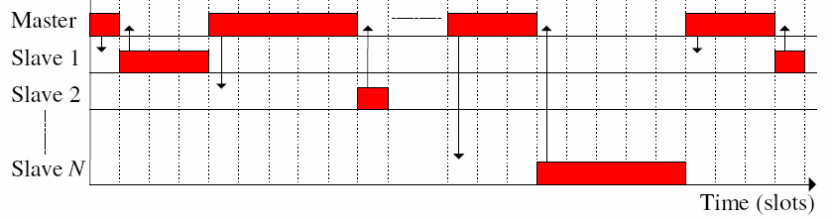
Time Division Duplexing
© 2011, HTDG,C-DAC

Slide 27
SCO Link- Voice
Synchronous connected-oriented (SCO) link is used
primarily for voice transmission at a speed of 64 Kbps
It is a Symmetrical point-to-point connection between a master and a single slave
A master can support up to three simultaneous SCO
links while slaves can support two or three SCO links

Slide 28
ACL- Data
Asynchronous connection-less Link (ACL) is used for
transmission of data
Packet-switched link from one master to all slaves
Also called point-to-multipoint link
Only one ACL link can exist
The default ACL logical transport is created
whenever a device joins a piconet.

Slide 29
High Level View of Bluetooth stack
Application Group
Middleware Protocol Group
Transport Protocol Group

Slide 30
Transport Protocol Group
To allow devices to locate each other
To create, configure and manage Physical and
Logical links
To allow higher layers to pass data through this layer
Protocols in this group are
RF, baseband
Link Manager Protocol(LMP)
L2CAP

Slide 31
Middleware Protocol Group
Includes transport protocols required for existing and
new applications to operate over bluetooth
They can be adopted
IP, PPP, OBEX, etc
They can be Bluetooth specific
RFCOMM, TCS-BIN, SDP, etc
Notes:
Obex= object exchange
Session-layer protocol for the exchange of objects, providing a model for object and operation representation
SDP
The Service Discovery Protocol (SDP) allows a device to discover services offered by other devices, and their associated parameters. For example, when you use a mobile phone with a Bluetooth headset, the phone uses SDP to determine which Bluetooth profiles the headset can use (Headset Profile, Hands Free Profile, Advanced Audio Distribution Profile (A2DP) etc.) and the protocol multiplexer settings needed for the phone to connect to the headset using each of them. Each service is identified by a Universally Unique Identifier (UUID), with official services (Bluetooth profiles) assigned a short form UUID (16 bits rather than the full 128).
TCS
The Telephony Control Protocol – Binary (TCS BIN) is the bit-oriented protocol that defines the call control signaling for the establishment of voice and data calls between Bluetooth devices. Additionally, "TCS BIN defines mobility management procedures for handling groups of Bluetooth TCS devices."

Slide 32
Application Group
Includes actual applications that make use of
bluetooth links
This could be legacy, unaware of bluetooth transports
Modem dialer
Web browser
This could be bluetooth aware
One that uses TCS for controlling telephony equipment

Slide 33
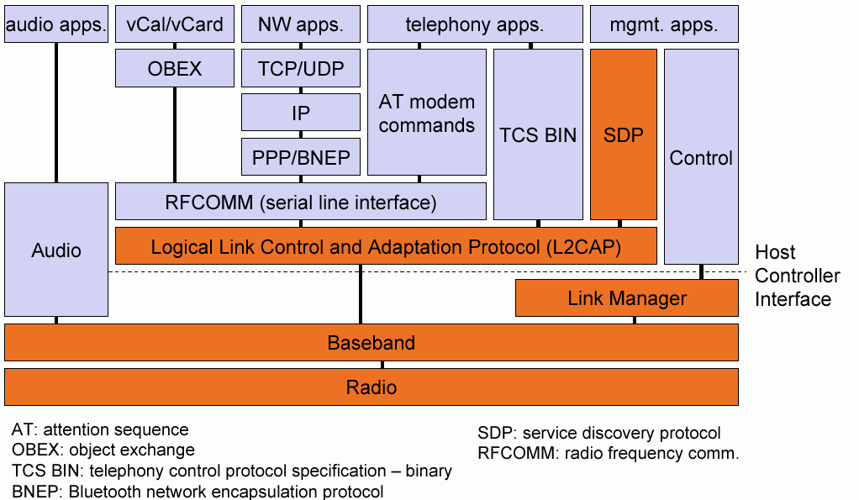
Bluetooth protocol stack
Notes:
BNEP
The Bluetooth Network Encapsulation Protocol (BNEP) is used for transferring another protocol stack's data via an L2CAP channel. Its main purpose is the transmission of IP packets in the Personal Area Networking Profile. BNEP performs a similar function to SNAP in Wireless LAN.

Slide 34
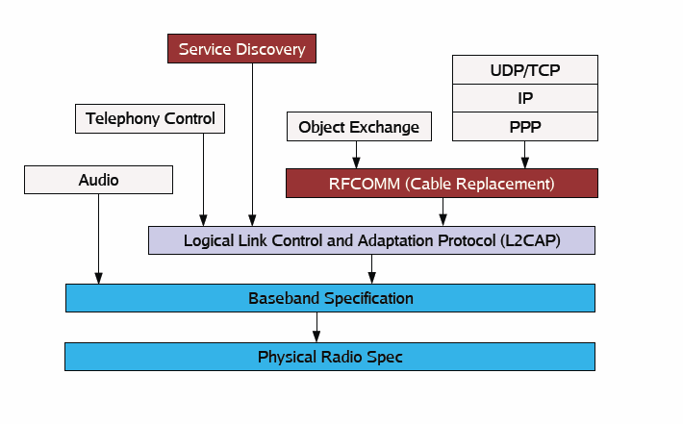
Protocol Architecture

Slide 35
Bluetooth Profiles
A Bluetooth profile is a specification regarding an aspect of Bluetooth-based wireless communication between devices.
In order to use Bluetooth technology, a device must be compatible with the subset of Bluetooth profiles necessary to use the desired services.
A Bluetooth profile resides on top of the Bluetooth Core Specification and (optionally) additional protocols.

Slide 36
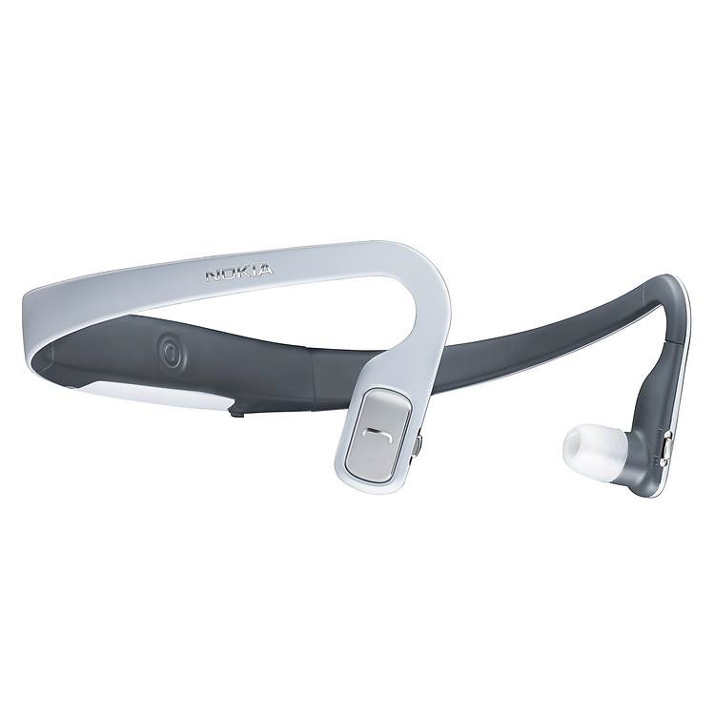
Bluetooth Profiles(contd.)
The profiles provide standards which manufacturers follow to allow devices to use Bluetooth in the intended manner
Eg. BH-505 supports
Advanced Audio Distribution Profile (A2DP) Audio/Video Remote Control Profile (AVRCP)
Hands Free Profile(HFP) Headset Profile (HSP)

Slide 37
Bluetooth Profiles
Generic
GAP
SDAP
Serial
SPP
GOEP
OPP
FTP
SP
Generic Access Profile
Service Discovery Application Profile
Serial Port Profile
Generic Object Exchange Profile Object Push Profile
File Transfer Profile
Synchronization Profile

Slide 38
Bluetooth Profiles
Telephony
CTP
IP
HS
Cordless Telephony Profile Intercom Profile
Headset Profile
Networking
DNP Dial-up Networking Profile
FP Fax Profile
LAP LAN (Local Area Network) Access Profile

Slide 39
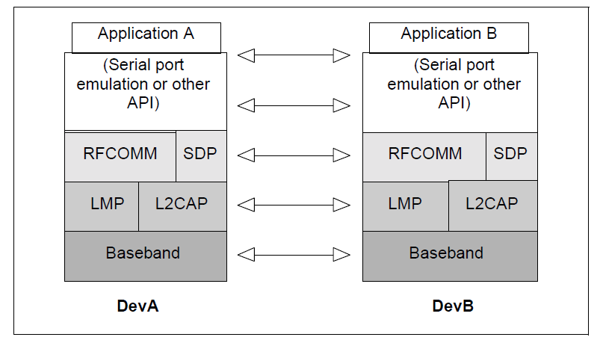
Serial Port Profile

Slide 40
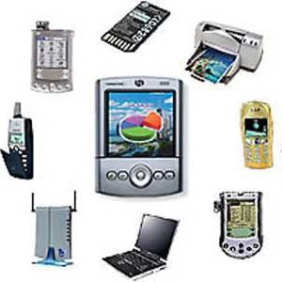
Bluetooth devices

Slide 41
Thank You
491

