Slide 1
NETWORK OVERVIEW
SESSION - 1

Slide 2
Contents
Host
IP Address
Network
Repeater
Hub
Switch
Router

Slide 3
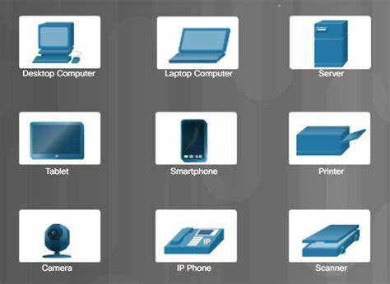
Network Devices
Hosts are any devices that send or receive traffic

Slide 4
Hosts
Also any Internet of Things (IoT) devices
TV
Speaker
Smart Watches
Thermometers
Lights
Refrigerators
Anything that can send or receive traffic over a network

Slide 5

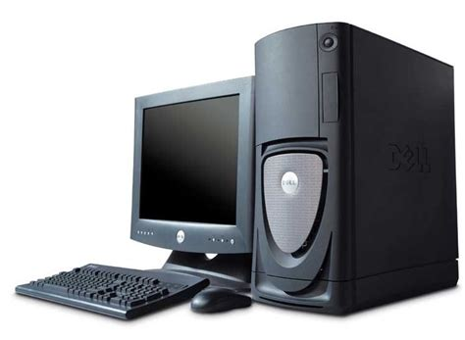
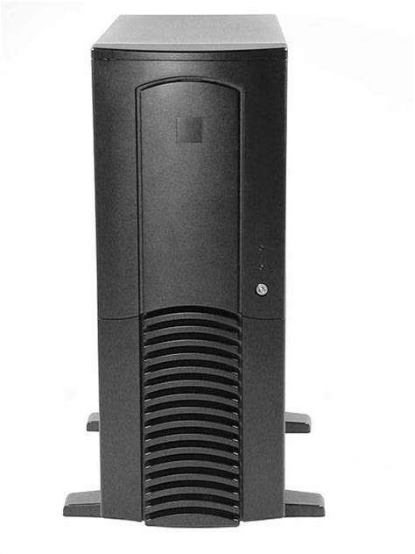

Client and Server
Client initiate request and server responds

Slide 6
IP Address
An IP address is the identity of each host
72.45.128.15
172.16.254.1

Slide 7
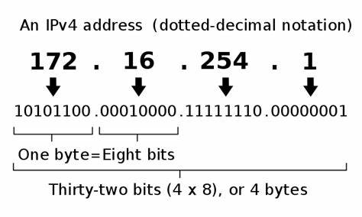
IP addresses are 32-bits, represented as 4 octets of 0 - 255
An IP address is a 32-bit
Bit = 1 or 0

Slide 8
XYZ inc. – 10.x.x.x
New York
10.20.x.x
London
10.30.x.x
Tokyo
10.40.x.x
SALES
10.20.55.x
SALES
10.30.55.x
SALES
10.40.55.x
ENGINEERING
10.20.66.x
ENGINEERING
10.30.66.x
ENGINEERING
10.40.66.x
MARKETING
10.20.77.x
MARKETING
10.30.77.x
MARKETING
10.40.77.x
10.30.55.127 – Host at XYZ Inc, in London, in SALES

Slide 9
A network transports traffic between hosts
Before Networks
Transferring data between devices using portable media
Disks, thumb drives, etc.

Slide 10




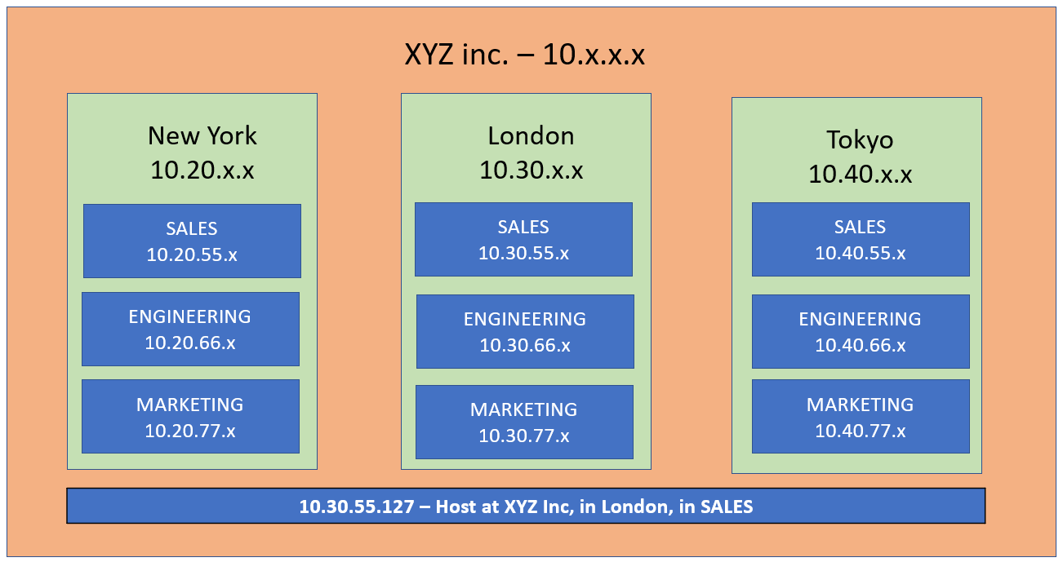

A network transports traffic between hosts
Logical grouping of hosts which require similar connectivity
A network can contain some other networks
Sometimes called Sub-networks or subnets
The network connects to other networks
Home
Interconnected Network
Coffee Shop
School
Class Room 1
Class Room 4
Class Room 2
Class Room 5
Class Room 3
Class Room 6

Slide 11

Repeaters
Repeaters are network devices that amplify or regenerate an incoming signal before retransmitting it. They are incorporated into networks to expand the coverage area. They are also known as signal boosters.

Slide 12
Hubs
Hubs are simply multi-port repeaters
Facilitates scaling communication between additional hosts
Everyone receives everyone else’s data

Slide 13
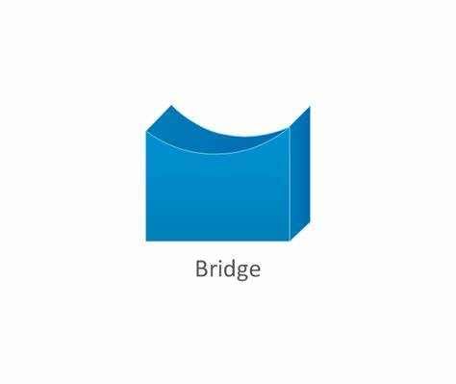
Bridge
Bridges sit between Hub-connected hosts
Bridges only have two ports
Bridges learn which hosts are on each side

Slide 14
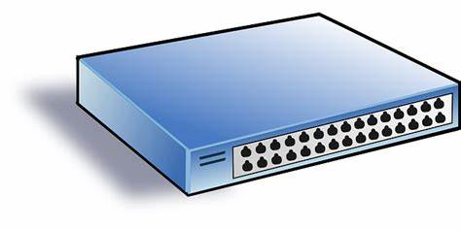
Switch
Switches facilitate communication within a network
Switches are a combination of Hubs and Bridges
Multi-ports
Learns which hosts are on each port

Slide 15
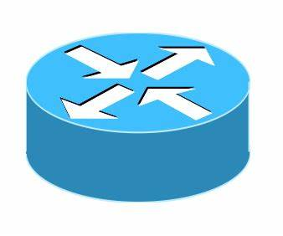
Routers
Routers facilitate communication between networks
Network: Grouping of hosts which require similar connectivity
Provides a traffic control point (security, filtering, and redirecting)
172.16.20.x
172.16.30.x
Internet

Slide 16
Router
Routers learn which network they are attached to
Known as Routes – stored in a Routing Table
Routing Table – all networks a router knows about
A router has an IP address in every network that they are attached to
Router’s IP address serves as a Gateway
Gateway – each host way out to their local network

Slide 17
Router
Routers create a hierarchy in the network and the entire internet
Internet
New York
10.20.x.x
Tokyo
10.40.x.x
SALES
10.20.55.x
SALES
10.40.55.x
ENGINEERING
10.20.66.x
ENGINEERING
10.40.66.x
MARKETING
10.20.77.x
MARKETING
10.40.77.x

Slide 18
Routers facilitate communication between networks
Switches facilitate communication within a network
Routing is a process of moving data between networks
A router is a device whose primary purpose is routing
Switching is a process of moving data within networks
A switch is a device whose primary purpose is switching
There are many other network devices:
Access points
Firewall
Load balancers
Virtual switches
Layer-3 switches
Proxies

Slide 19
LAN (Local Area Network)
It is a group of network devices that allow communication between various connected devices.
LAN has a short propagation delay than MAN as well as WAN. It covers smaller areas such as colleges, schools, hospitals, and so on.

Slide 20
WAN (Wide Area Network)
It covers a larger area than LAN as well as a MAN such as country/continent etc.
WAN is expensive and should or might not be owned by one organization. PSTN or satellite medium is used for wide area networks.

Slide 21
MAN (Metropolitan Area Network)
It covers a larger area than LAN such as small towns, cities, etc.
MAN connects two or more computers that reside within the same or completely different cities.
MAN is expensive and should or might not be owned by one organization.

Slide 22
Transmission Modes
Transmission mode means, the mode in which data is transmitted between two devices. It is also known as communication mode.
Buses and networks are designed to allow communication to occur between individual devices that are interconnected.
There are three types of transmission mode
Simplex mode
Half-duplex mode
Full-duple mode

Slide 23
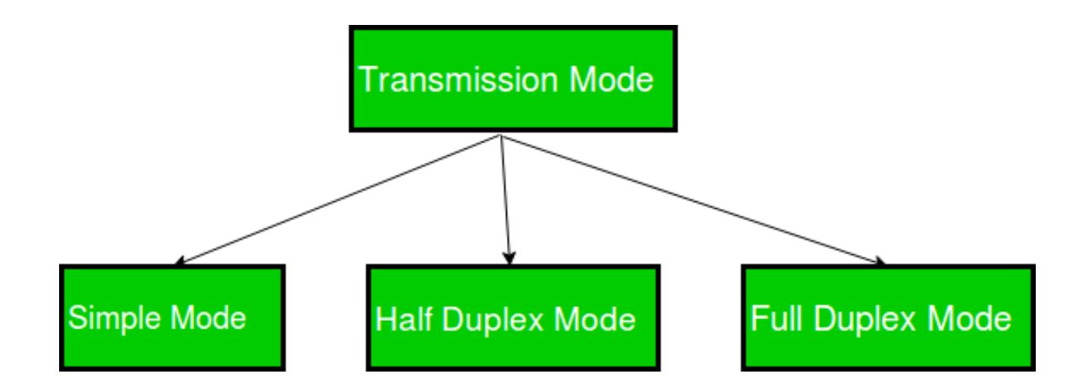

Slide 24
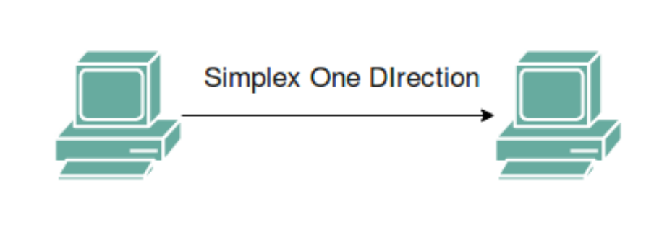
Simplex Mode
In Simplex mode, the communication is unidirectional, as on a one-way street. Only one of the two devices on a link can transmit, and the other can only receive. The simplex mode can use the entire capacity of the channel to send data in one direction.
Example: Keyboard and traditional monitors. The keyboard can only introduce input, the monitor can only give the output.

Slide 25
Half-Duplex Mode
In half-duplex mode, each station can both transmit and receive, but not at the same time. When one device is sending, the other can only receive it, and vice versa.
The half-duplex mode is used in cases where there is no need for communication in both directions at the same time. The entire capacity of the channel can be utilized for each direction.
Example: Walkie-talkie in which message is sent one at a time and messages are sent in both directions.
Channel capacity = Bandwidth * Propagation Delay

Slide 26
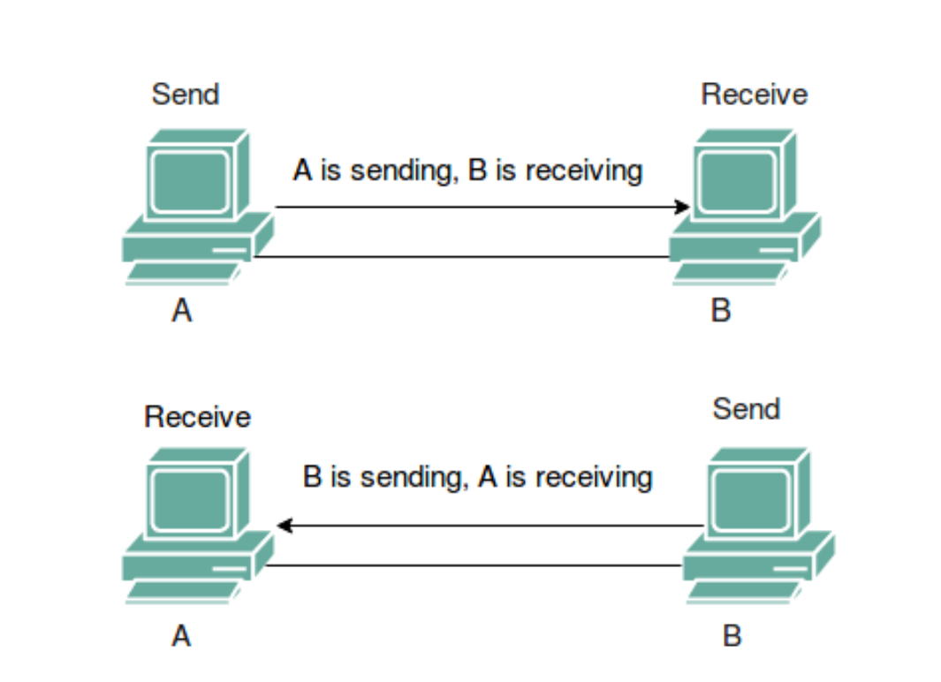

Slide 27
Full-Duplex Mode
In full-duplex mode, both stations can transmit and receive simultaneously. In full-duplex mode, signals going in one direction share the capacity of the link with signals going in another direction, this sharing can occur in two ways:
Either the link must contain two physically separate transmission paths, one for sending and the other for receiving.
Or the capacity is divided between signals traveling in both directions.
Full-duplex mode is used when communication in both directions is required all the time. The capacity of the channel, however, must be divided between the two directions.

Slide 28
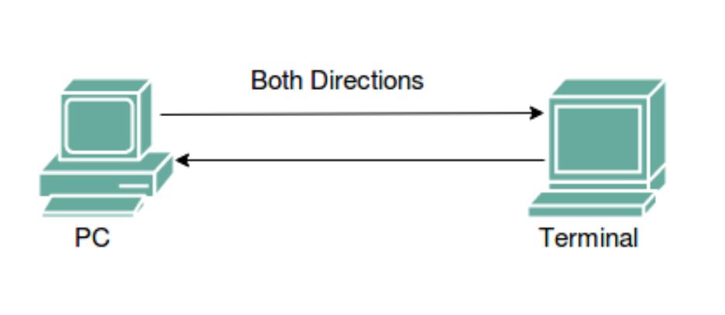
Full-Duplex Mode
Example: Telephone Network in which there is communication between two persons by a telephone line, through which both can talk and listen at the same time.
Channel Capacity = 2* Bandwidth*propagation Delay

Slide 29
Thank You

