Slide 1
NETWORKING BASICS
BY – ABU TURAB KAZMI

Slide 2
We will discuss about
OSI Model
TCP/IP Protocol
UDP Protocol
Wi-Fi Standards
WLAN Components

Slide 3
OSI Model
OSI stands for Open Systems Interconnection. It has been developed by ISO – ‘International Organization for Standardization, in the year 1984. It is a 7-layer architecture with each layer having specific functionality to perform. All these 7 layers work collaboratively to transmit the data from one person to another across the globe.

Slide 4
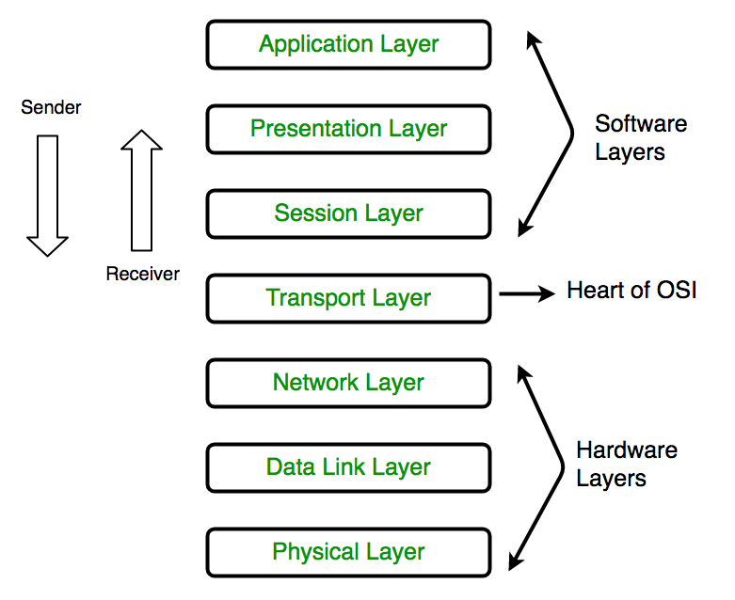
Layers of OSI Model

Slide 5
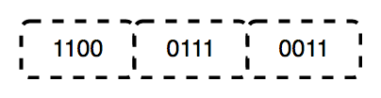
Physical Layer (Layer 1)
The physical layer contains information in the form of bits.
The functions of the physical layer are as follows:
Bit synchronization
Bit rate control
Physical topologies
Transmission mode

Slide 6
Data Link Layer (DLL) (Layer 2)
The main function of this layer is to make sure data transfer is error-free from one node to another.
Data Link Layer is divided into two sublayers
Logical Link Control (LLC)
Media Access Control (MAC)
DLL also encapsulates Sender and Receiver’s MAC address in the header.

Slide 7
Functions of the Data Link layer
Framing
Physical Addressing
Error Control
Flow Control
Access Control

Slide 8
Network Layer (Layer 3)
The network layer works for the transmission of data from one host to the other located in different networks.
The functions of the Network layer are
Routing
Logical Addressing

Slide 9
Transport Layer (Layer 4)
The transport layer provides services to the application layer and takes services from the network layer.
The functions of the transport layer are as follows
Segmentation and Reassembly
Service Point Addressing

Slide 10
Session Layer (Layer 5)
This layer is responsible for the establishment of connection, maintenance of sessions, and authentication, and also ensures security.
The functions of the session layer are
Session establishment, maintenance, and termination
Synchronization
Dialog Controller

Slide 11
Presentation Layer (Layer 6)
The data from the application layer is extracted here and manipulated as per the required format to transmit over the network.
The functions of the presentation layer are
Translation
Encryption/ Decryption
Compression

Slide 12
Application Layer (Layer 7)
This layer serves as a window for the application services to access the network and for displaying the received information to the user.
The functions of the Application layer are
Network Virtual Terminal
FTAM-File transfer access and management
Mail Services
Directory Services

Slide 13
TCP/IP Model

Slide 14
TCP/IP Model
TCP/IP model, was designed and developed by the Department of Defense (DoD) in the 1960s and is based on standard protocols.
It contains four layers
Process/Application Layer
Host-to-Host/Transport Layer
Internet Layer
Network Access/Link Layer

Slide 15
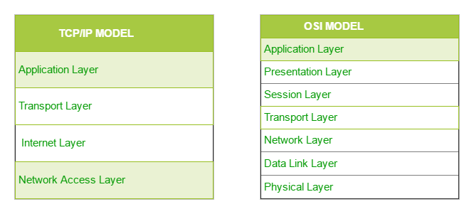
The diagrammatic comparison of the TCP/IP and OSI model

Slide 16
Network Access Layer
This layer corresponds to the combination of the Data Link Layer and the Physical Layer of the OSI model.
It looks out for hardware addressing and the protocols present in this layer allow for the physical transmission of data.

Slide 17
Internet Layer
This layer parallels the functions of OSI’s Network layer.
The main protocols residing at this layer are
IP
ICMP
ARP

Slide 18
Host-to-Host Layer or Transport Layer
It is responsible for end-to-end communication and error-free delivery of data. It shields the upper-layer applications from the complexities of data.
The two main protocols present in this layer are
Transmission Control Protocol (TCP)
User Datagram Protocol (UDP)

Slide 19
Application Layer
This layer performs the functions of the top three layers of the OSI model.
Some of the protocols present in this layer are: HTTP, HTTPS, FTP, TFTP, Telnet, SSH, SMTP, SNMP, etc.

Slide 20
User Datagram Protocol (UDP)
User Datagram Protocol (UDP) is a Transport Layer protocol. UDP is a part of the Internet Protocol suite, referred to as UDP/IP suite. Unlike TCP, it is an unreliable and connectionless protocol.
User Datagram Protocol (UDP) is more efficient in terms of both latency and bandwidth.

Slide 21
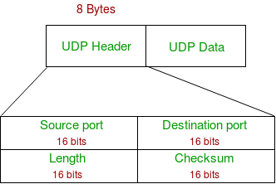
UDP Header

Slide 22
Source Port: Source Port is a 2 Byte long field used to identify the port number of the source.
Destination Port: It is a 2 Byte long field, used to identify the port of the destined packet.
Length: Length is the length of UDP including the header and the data. It is a 16-bits field.
Checksum: Checksum is 2 Bytes long field.

Slide 23
Applications of UDP
NTP (Network Time Protocol)
DNS (Domain Name Service)
BOOTP, DHCP.
NNP (Network News Protocol)
Quote of the day protocol
TFTP, RTSP, RIP.

Slide 24
Thank You

