Slide 1
ARTIFICIAL INTELLIGENCE / BCSE306L COURSE PROJECT
Campus Navigation
Assistant using A*
A working pedestrian route planner for VIT Vellore
PROJECT TEAM
Rohit Arya · Nayan Gattani
Aditya Kumar · Ashish Kumar
Intelligent Search Techniques / Heuristic Graph Search
Notes:
Project title, course, team names and registrations: Campus_Navigation_Proposal (2).pdf. Implementation scope: README.md.

Slide 2
VIT VELLORE / ARTIFICIAL INTELLIGENCE
Problem statement and project objective
PROBLEM
Finding a walkable route across a large campus takes time.
During short class transitions, students need routes between distant buildings. Straight-line distance alone cannot represent connected paths, gates and walkway junctions.
OBJECTIVE
AI SYLLABUS FIT
Given two campus places, find a minimum-cost pedestrian route and report its checkpoints, physical distance and estimated walking time.
Informed graph search: represent locations as states, walking segments as actions, distance as path cost, and Euclidean distance as the A* heuristic.
Scope: static mapped paths. Crowd scenarios adjust cost, but the app does not use live crowd sensing.
CAMPUS NAVIGATION ASSISTANT / 02
Notes:
Problem, inputs and outputs: README.md and campus_nav.py. Syllabus relevance: the project’s A* graph search formulation.

Slide 3
VIT VELLORE / ARTIFICIAL INTELLIGENCE
Implementation methodology and workflow
One Python search core powers both the command-line demo and the local browser app.
Campus graph
Route request
Search core
Route results
OpenStreetMap walkways
JSON nodes and weighted edges
Start landmark
Destination landmark
Selected crowd scenario
A* / Dijkstra / BFS
Priority queue or FIFO
Parent links rebuild route
Path and checkpoints
Physical distance + time
Expanded nodes + search time
Web layer: index.html + Leaflet · Python service: /api/map and /api/route · Search: campus_nav.py
CAMPUS NAVIGATION ASSISTANT / 03
Notes:
Workflow and architecture: campus_nav.py; web_app.py; index.html; build_osm_map.py; README.md.

Slide 4
VIT VELLORE / ARTIFICIAL INTELLIGENCE
VIT Vellore walking network
INCLUDED MAP BUNDLE
1,965
2,131
35
walkway nodes
walkway edges
named campus places
PLACE CATEGORIES
25
Campus places
10
Hostels
MAPPED EXAMPLES
A–H blocks, MGB, EV Periyar Library, Anna Auditorium, Food Court, Main Gate and mapped hostels.
OpenStreetMap contributors · retrieved 21 Oct 2026 · ODbL
CAMPUS NAVIGATION ASSISTANT / 04
Notes:
Counts and source metadata: campus_map.json. Graph generation and place categories: build_osm_map.py.

Slide 5
VIT VELLORE / ARTIFICIAL INTELLIGENCE
Graph model and landmark snapping
Walkway junctions are nodes; mapped pedestrian segments are distance-weighted edges.
Named place
Walkway node
Landmarks snap to their nearest mapped walkway node. The estimated straight-line access offset is included in route totals and shown to the user.
CAMPUS NAVIGATION ASSISTANT / 05
Notes:
Landmark snapping and route distance model: campus_map.json, build_osm_map.py and campus_nav.py. Diagram is illustrative, not to scale.

Slide 6
VIT VELLORE / ARTIFICIAL INTELLIGENCE
A* heuristic graph search
f(n) = g(n) + h(n)
HEURISTIC SAFETY
The map loader rejects any edge shorter than the straight-line distance between its endpoints.
SEARCH SCORE
g(n)
Known weighted cost from the start.
h(n)
Straight-line Euclidean estimate to the goal.
With non-negative costs, Euclidean h(n) stays admissible and consistent for this graph.
Parent map
Records each best predecessor to rebuild the route.
A* returns an optimal weighted route on the validated graph.
CAMPUS NAVIGATION ASSISTANT / 06
Notes:
Algorithm and graph validation: campus_nav.py; README.md; test_campus_nav.py.

Slide 7
VIT VELLORE / ARTIFICIAL INTELLIGENCE
Algorithms implemented and compared
A*
g(n) + h(n)
Uses accumulated route cost plus straight-line look-ahead to prioritize promising nodes.
Dijkstra
g(n)
Uses the same weighted graph with h(n) = 0. Optimal-cost reference for the experiment.
BFS
edge count
Finds the route with fewest graph segments. It ignores edge lengths during search.
BFS minimizes hops, not walking distance. On this map, its default route is longer than the A* and Dijkstra route.
CAMPUS NAVIGATION ASSISTANT / 07
Notes:
Algorithm definitions: campus_nav.py and README.md.

Slide 8
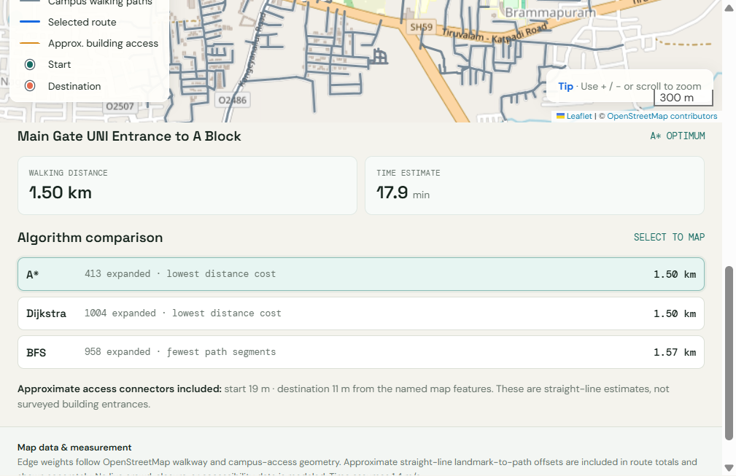
VIT VELLORE / ARTIFICIAL INTELLIGENCE
Interactive web application
ROUTE CONTROLS
Choose and swap places
Select a start and destination from 35 named campus places, then calculate a route.
ALGORITHM CARDS
A* · Dijkstra · BFS
Compare cost and expanded nodes. Select a card to redraw its route on the map.
Normal scenario screenshot · physical distance 1.50 km · estimated time 17.9 min
CAMPUS NAVIGATION ASSISTANT / 08
Notes:
Screenshot captured from app-results.png. Interface implementation: index.html and web_app.py.

Slide 9
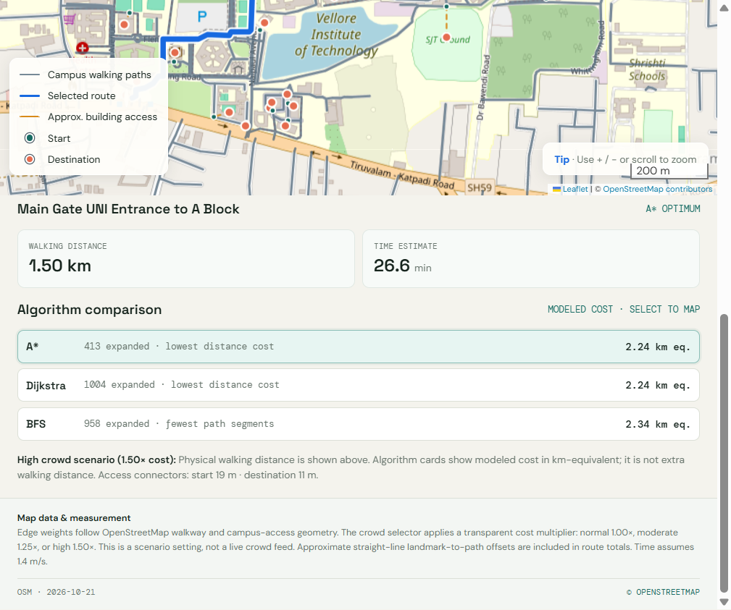
VIT VELLORE / ARTIFICIAL INTELLIGENCE
User-selected crowd cost scenario
HIGH CROWD SETTING
1.50×
applied to modeled path cost
Physical route: 1,501.9 m
Modeled A* cost: 2,238.2 m-equivalent
Estimated time: 26.6 min
This is a user-selected scenario multiplier, not live crowd sensing. Modeled cost can change while mapped physical distance stays the same.
Screenshot: high crowd scenario · cost multiplier 1.50×
CAMPUS NAVIGATION ASSISTANT / 09
Notes:
Screenshot captured from app-results-crowd.png. Scenario multipliers and limits: index.html, README.md and campus_nav.py.

Slide 10
VIT VELLORE / ARTIFICIAL INTELLIGENCE
Experimental results: Main Gate to A Block
Default scenario on the included campus_map.json. Search times are single-run measurements.
Algorithm | Physical distance | Nodes expanded | Search time*
A* | 1,501.9 m | 413 | 1.636 ms
Dijkstra | 1,501.9 m | 1,004 | 1.904 ms
BFS | 1,570.5 m | 958 | 0.784 ms
WHAT THE COMPARISON SHOWS
A* matches Dijkstra’s minimum distance and expands 59% fewer nodes (413 vs 1,004).
BFS returns a route 68.6 m longer because it minimizes segments rather than weighted distance.
* Search time varies with machine load. Route cost and expansions are more useful comparison measures.
CAMPUS NAVIGATION ASSISTANT / 10
Notes:
Values from running campus_nav.py on the included campus_map.json on 29 Oct 2026. Search timings are one run, not benchmarks.

Slide 11
VIT VELLORE / ARTIFICIAL INTELLIGENCE
Validation, assumptions and limitations
AUTOMATED TEST COVERAGE
MAP AND TIME ASSUMPTIONS
Seven included tests cover A* vs Dijkstra, BFS hop behavior, start = goal, unreachable routes, unknown places, unique hostel labels, and heuristic safety.
OpenStreetMap is community-maintained. Landmarks may not have mapped entrances, so the app estimates access offsets to nearby paths.
Edges are treated as two-way. Mapped steps and access roads are included. Walking time assumes a constant 1.4 m/s.
INPUT VALIDATION
Graph loading checks duplicate IDs, finite coordinates, valid edge endpoints, positive distances and crowd factors ≥ 1.
NOT MODELED IN CURRENT DATA
Live crowd sensing, closures, step-free access, terrain difficulty and personalized walking speed. The high-crowd setting is a scenario input.
CAMPUS NAVIGATION ASSISTANT / 11
Notes:
Test scope and project assumptions: test_campus_nav.py; README.md; build_osm_map.py. This slide summarizes the test cases present in the project.

Slide 12
VIT VELLORE / ARTIFICIAL INTELLIGENCE
Conclusion and individual contributions
CONCLUSION
A* found the same minimum-distance route as Dijkstra while expanding fewer nodes.
The project connects a validated heuristic search core to a real campus walking graph, a working CLI and an interactive browser demonstration.
TEAM CONTRIBUTIONS
Rohit Arya
Campus graph, weighted edges and Dijkstra/BFS baselines.
Nayan Gattani
A* search, Euclidean heuristic and validation logic.
Aditya Kumar
Local web service, route API and browser result flow.
Ashish Kumar
Testing, result comparison, documentation and demo preparation.
CAMPUS NAVIGATION ASSISTANT / 12
Notes:
Team contributions reproduced from the project’s final report. Conclusion based on the default route comparison and implemented project features.

