Slide 1


Bank of Baroda Hackathon - 2022
Technology Partner
Team Name : LoneCoder
Your team bio :
Date :20/09/2022

Slide 2
Problem Statement?
Statement: Automated Cheque Processing
I love architecting and providing solution to interesting problems and one those requires innovating solutions

Slide 3
Pre-Requisite
As the solution will be used by internal users of the banks(Tellers), we can assume to that we can get a clear scanned copy of the cheque leaf that is presented for clearnace. That image should be available via FTP or any service to Azure Storage.
Since the system will be created on azure cloud, we should have a api to get user account details such as signature and account balance etc from on premise or existing system of the bank.(for prototye these will be mocked)

Slide 4
Azure tools or resources to be used as a part of solution
Azure functions
Azure Storage
Azure Service bus
Queue
Topics
Azure Logic Apps
Azure Cognitive Service
The Computer Vision Read API
Form Recognizer
Azure Cosmos DB

Slide 5
Tech Stack
Typescript
Node.js
Python
REST API
Vue JS (for Frontend)
Git

Slide 6
Proposed solution
We propose a Production ready and scalable solution which will be cost effective in nature having a 0.50₹ cost per cheque processed.
The system will be event based asynchronous in nature as the cheque processing can be done in batches ( though we can build a synchronous flow if cheque processing needs to be done in Realtime).
We will use the azure functions as a choice for our computing needs.
We will use service bus to manage different queues and events in the system.
We will use Azure cognitive services for OCR and signature recognition.
We will write a custom function to remove whitespace of the scanned image as a part of preprocessing
For OCR we will use azure read API.
For signature verification we will use form recognizer API.
We will use azure logic app as our flow orchestrator.

Slide 7
Proposed solution (continued)
we will use Cosmos DB to save the intermediate states and results of the system.
We will also have a manual flow for the cases where the confidence of the system falls below 50%(configurable) so that a human review will be required.
We can also have multilevel queue system so that cheques will go through multiple authorization even after passing from the system(optional).
We will have a frontend system where the end user can check if there are any items present on any queue or fetch any cheque specific details.
We will have a rest based microservice for fetching the details from the system to display on front end or to be consumed further by internal backend.
We will also have a mockup customer service to mimic the real-life account of a customer.

Slide 8
Validations identified for implementation
Remove Whitespaces around the cheque leaf scanned image.
Check if the cheque number is valid and belongs to some customer.
Check if the branch and the bank name is correct.
Check if The current date is greater than or equal to cheque issuance date and current date is less than or equal to the cheque expiry date(3 months from issuance date or as configured).
Check if customer has requested the cheque to be stopped from clearance.
Check if the customer account is not frozen or suspended.
Check if customer have enough balance in account for cheque to be cleared.
Check if customer signature matches with the cheque signature.
Detect if there is any tampering made on the cheque.

Slide 9
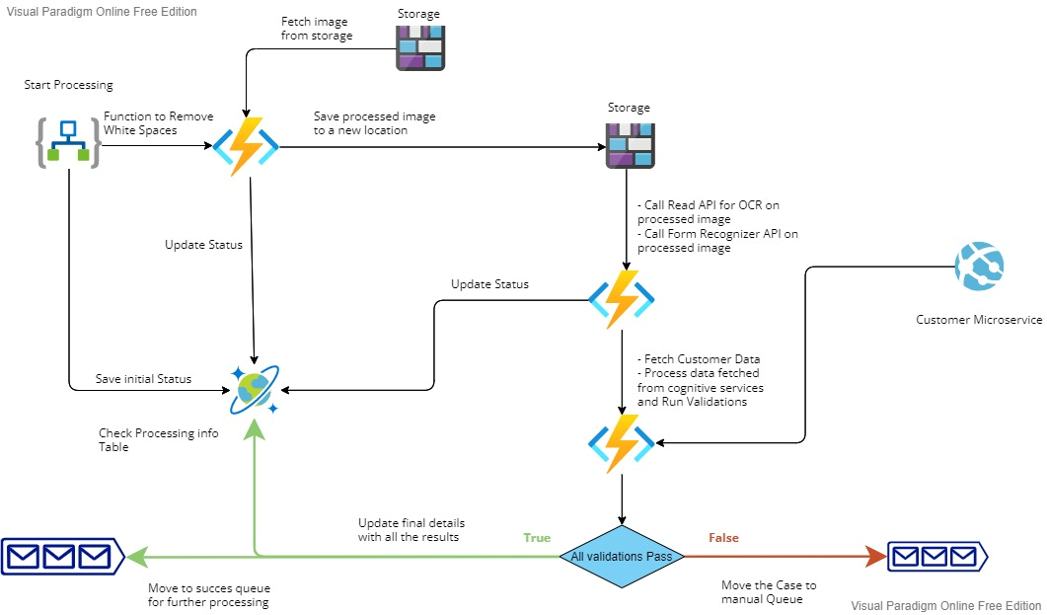
Proposed System Design Diagram

Slide 10
Adoption Plan
Since it is a cloud-based solution, by securely exposing a subset of apis for user info, we can get the system working which will be loosely coupled with the core banking system.
We will get the benefit of Fault tolarance and DR capabilities as it is a cloud-based solution.
Since we will be using azure cognitive services for AI/ML use cases, system will be more focused on the business use case rather than building and maintaining ML models and keeping them up to date over time thus saving time, money, and resources.
Using azure cognitive services will make system robust as the models used are tried and tested and of industry standards with all the security and privacy requirements in place.
As Proposed system is serverless, no upfront Capital expenses are required and the proposed cost per cheque processed will be as low as 0.50 ₹.
As the system is Serverless in nature it can be scaled multi fold without managing any infrastructure or house keeping tasks.

Slide 11
Github Repository
https://github.com/RohitBN/automated-cheque-processing-bob-microsoft

Slide 12
Thank You
Rohit Nagbhidkar

