Slide 1
4 Weeks ML Project Challenge

Slide 2
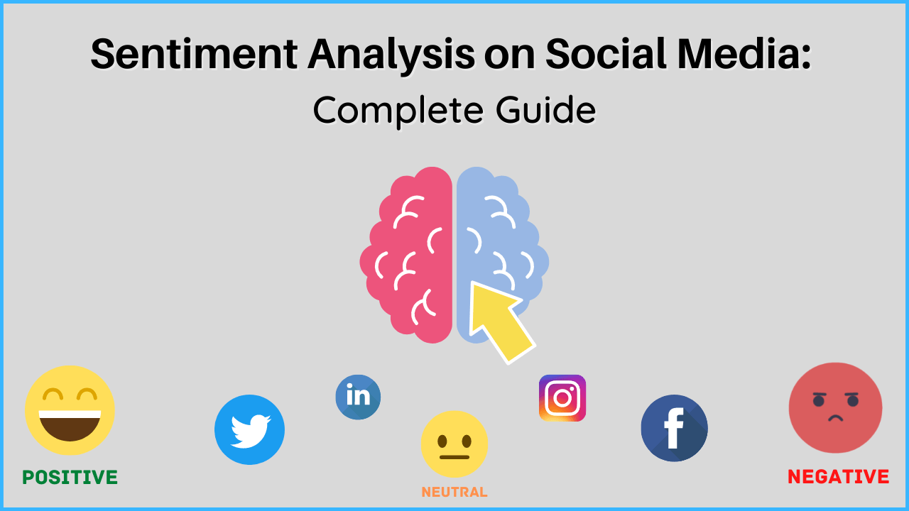
Project Title:
Sentiment Analysis on Social Media Data
Description:
Analyze sentiment from social media posts (e.g., Twitter) regarding a specific topic or product.
Use natural language processing techniques to preprocess text data, extract features, and classify sentiments as positive, negative, or neutral.

Slide 3
ML -Project Challenge
Week 1
Week 2
Week 3
Week 4
Week 1 | Literature Review Task
Week 2 | Fundamentals, ML Specific Concepts
Week 3 | Coding Implementation
Week 4 | GitHub Deployment + Summarization

Slide 4
Week 1
Literature Review Task
Referring IEEE Papers
It will help to understand the current work status in the respective domain.
You have to refer minimum 10-15 latest papers (last 3-5 years) to work on the domain as well to understand the literature survey.
This video is sole property of Talent Battle Pvt. Ltd. Strict penal action will be taken against unauthorized piracy of this video

Slide 5
1. Define your Research Question or Topic
2. Identify Keywords and Search Terms
3. Select Relevant Databases and Resources
4. Conduct Initial Searches
5. Refine Search Criteria
6. Review Abstract and Titles
7. Organize and Summarize
8. Identify Key Authors and Pivotal Works
9. Synthesize Information
10. Create an Annotated Bibliography
11. Draft the Literature Review
12. Revise and Finalize
13. Update Regularly

Slide 6
ML -Project Challenge
Week 1
Week 2
Week 3
Week 4
Week 1 | Literature Review Task
Week 2 | Fundamentals, ML Specific Concepts
Week 3 | Coding Implementation
Week 4 | GitHub Deployment + Summarization

Slide 7
How To Install Python
1. Open a browser to the Python website and download the Windows installer.

Slide 8
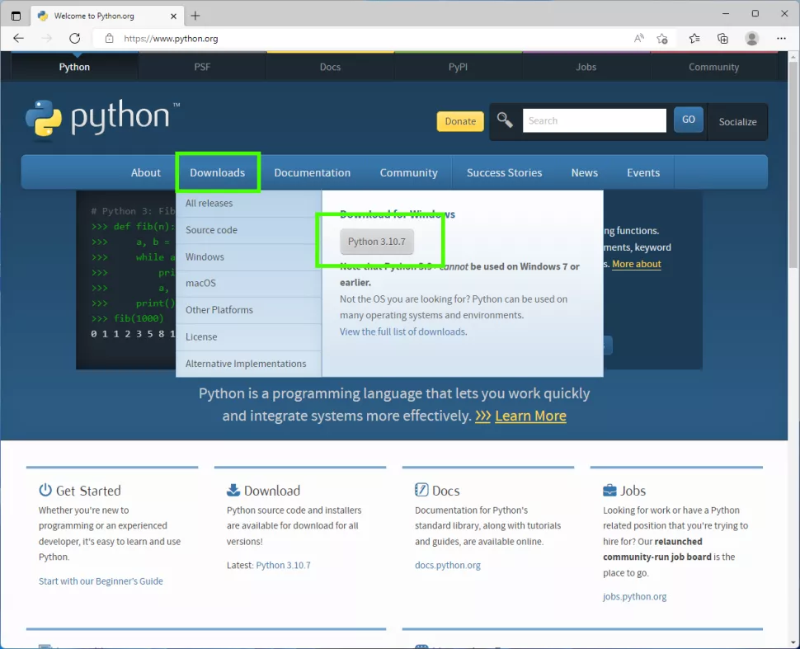

Slide 9
2. Double click on the downloaded file and install Python for all users, and ensure that Python is added to your path.
Click on Install now to begin.
Adding Python to the path will enable us to use the Python interpreter from any part of the filesystem.

Slide 10
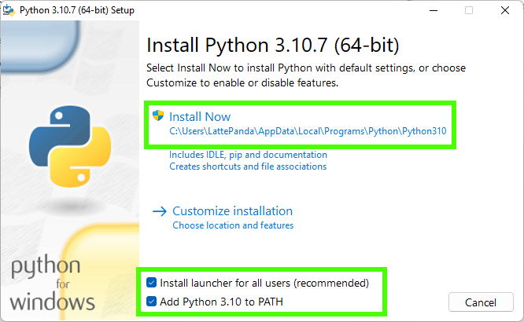

Slide 11
Open a Command Prompt and type “python” then press Enter.

Slide 12
Installing Anaconda
Download and Install Anaconda
1. Go to the Anaconda Website and choose a Python 3.x graphical installer

Slide 13
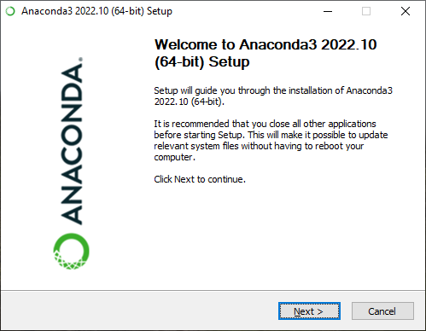

Slide 14
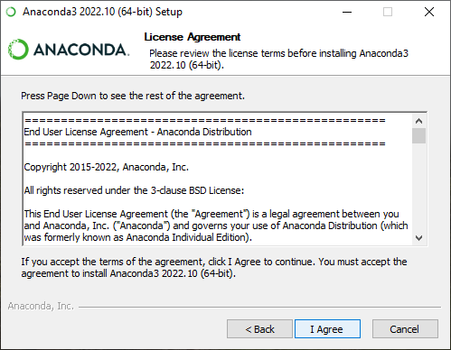

Slide 15
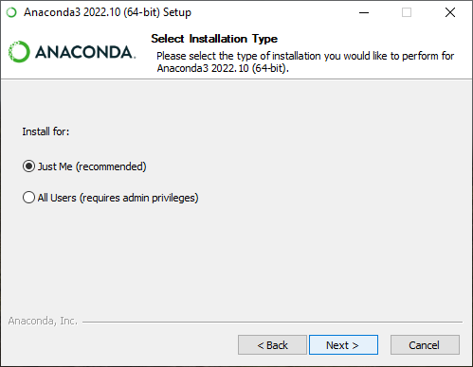

Slide 16
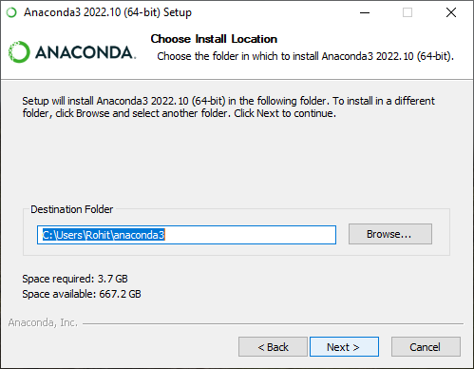

Slide 17
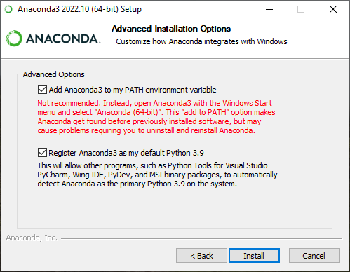

Slide 18
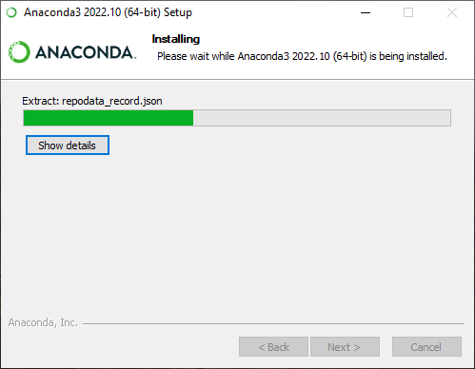

Slide 19
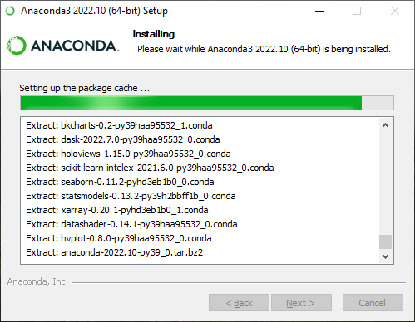

Slide 20
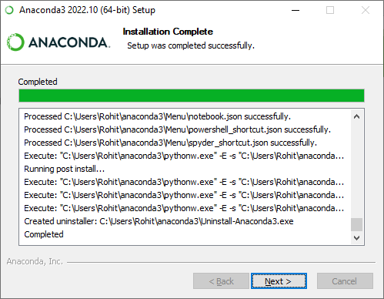

Slide 21
An Introduction to Machine Learning
The field of study known as machine learning is concerned with the question of how to construct computer programs that automatically improve with experience.
Examples
A robot driving learning problem
Handwriting recognition learning problem

Slide 22
A computer program which learns from experience is called a machine learning program or simply a learning program .
Classification of Machine Learning
1. Supervised Learning
2. Unsupervised Learning
3. Reinforcement Learning
4. Semi-Supervised Learning

Slide 23
Supervised learning:
Supervised learning is the machine learning task of learning a function that maps an input to an output based on example input-output pairs. The given data is labeled .
Both classification and regression problems are supervised learning problems .

Slide 24
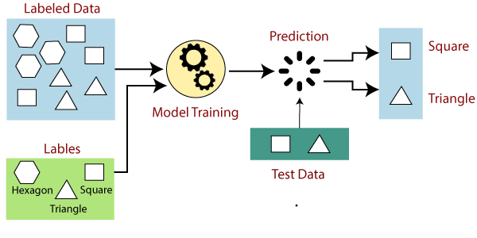

Slide 25
Unsupervised learning:
Unsupervised learning is a type of machine learning algorithm used to draw inferences from datasets consisting of input data without labeled responses.
In unsupervised learning algorithms, classification or categorization is not included in the observations.

Slide 26
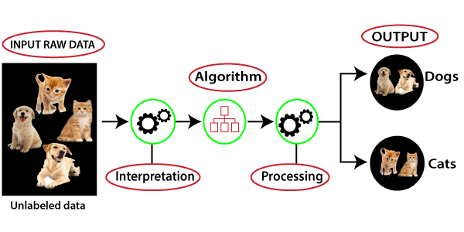

Slide 27
Reinforcement learning:
Reinforcement learning is the problem of getting an agent to act in the world so as to maximize its rewards.
A learner is not told what actions to take as in most forms of machine learning but instead must discover which actions yield the most reward by trying them.

Slide 28
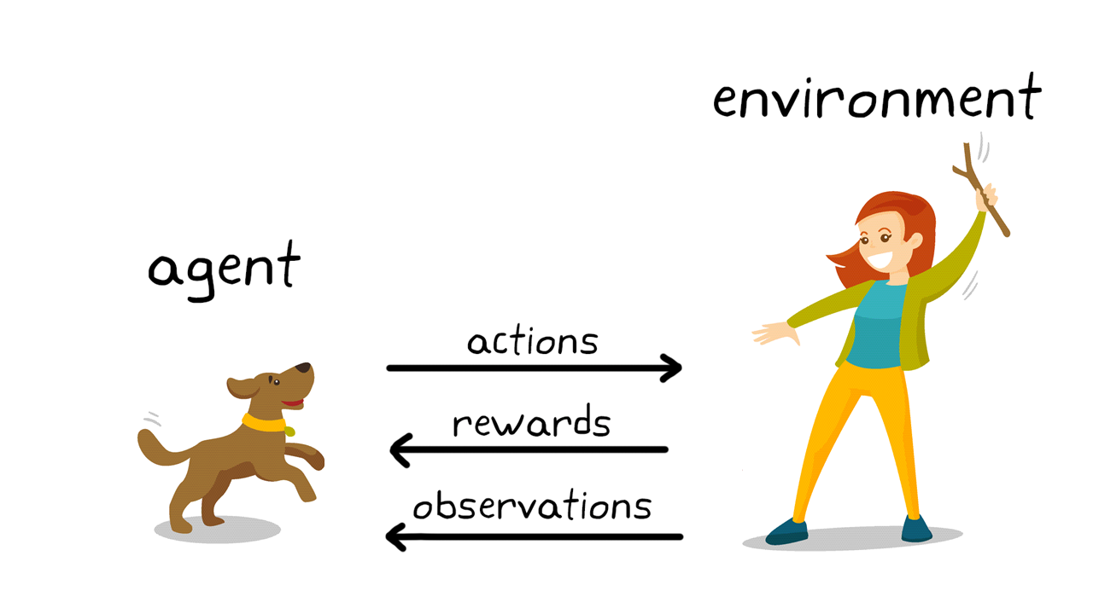

Slide 29
Semi-supervised learning:
Semi-supervised learning is an approach to machine learning that combines small labeled data with a large amount of unlabeled data during training.
Semi-supervised learning falls between unsupervised learning and supervised learning.

Slide 30
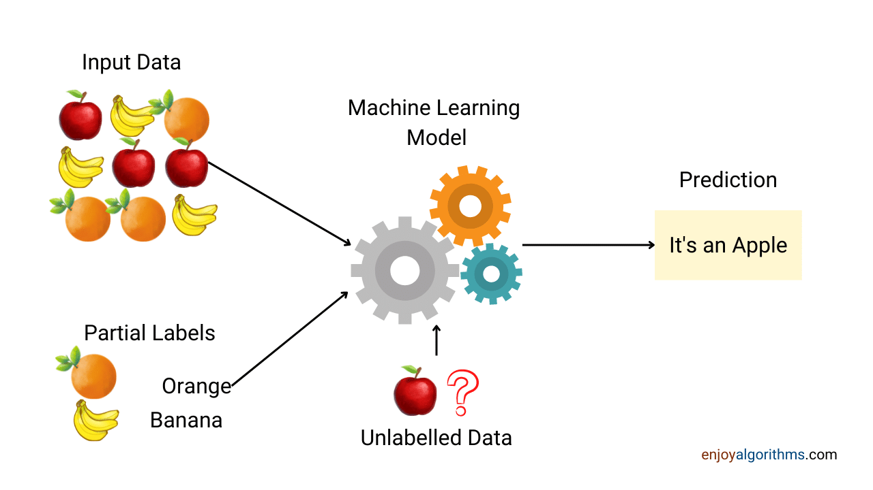

Slide 31
Machine Learning Model Development Steps
Collecting Data
Preparing the Data
Choosing a Model
Training the Model
Evaluating the Model
Parameter Tuning
Making Predictions

Slide 32
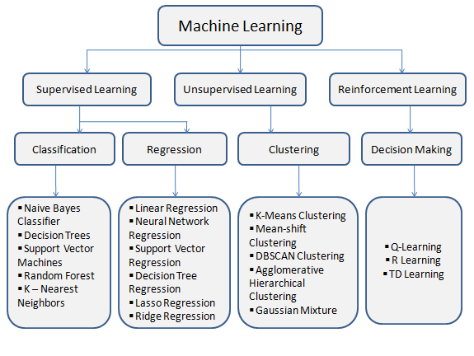

Slide 33
ML Specific Concepts:
Dependencies:
re
pandas
numpy
seaborn
wordcloud
train test split
confusion matrix
classification report
Logistic Regression
Bernoulli Naive Bayes
SVM
TF-IDF
Accuracy and F1 score
NLP using nltk library
Stemming
Lemmatization
Regexp Tokenizer
ROC AUC Curve

Slide 34
The `re` module
Data Preprocessing
Feature Extraction
Text Tokenization
Text Matching and Filtering

Slide 35
Pandas is a popular open-source Python library
Data Structures
Data Loading and Saving
Data Exploration and Manipulation
Feature Engineering
Data Transformation
Integration with ML Libraries

Slide 36
NumPy (Numerical Python) is a fundamental package for numerical computing in Python.
Multidimensional Arrays
Mathematical Operations
Linear Algebra
Random Number Generation
Array Manipulation
Integration with Other Libraries

Slide 37
Seaborn is a Python data visualization library.
Statistical Visualization
Pairwise Relationship
Categorical Data Visualization
Regression Analysis
Distribution Visualization
Customization and Styling

Slide 38
Matplotlib is a comprehensive library for creating static, animated, and interactive visualizations in Python.
Basic Plots
Customization and Styling
Subplots and Layouts
Annotations and Text
3D Plotting
Interactive Visualization
Integration with Libraries
Exporting and Saving Plots

Slide 39
WordCloud is a Python library used for generating word clouds, which are visual representations of text data where the size of each word corresponds to its frequency or importance within the text.
Word Frequency Calculation
Customization Options
Visualization of Textual Data
Text Preprocessing
Topics Identification and Analysis
Result Interpretation and Communication

Slide 40
The train-test split is a fundamental technique used in machine learning (ML) projects for evaluating the performance of predictive models.
Dataset Partitioning
Evaluation of Model Performance
Preventing Overfitting
Parameter Tuning and Model Selection
Cross Validation
Stratified Splitting

Slide 41
A confusion matrix is a performance measurement tool used in machine learning (ML) projects, particularly in classification tasks.
Basic Structure
Evaluation Metrics
Visualization
Error Analysis
Model Comparison
Threshold Optimization

Slide 42
A classification report is a summary of the performance of a classification model, typically generated using the predictions made by the model and the actual labels from the test dataset.
Metrics Included
Interpretation
Visualization
Model Comparison
Error Analysis
Threshold Optimization

Slide 43
Stemming is a text processing technique used in natural language processing (NLP) to reduce words to their root or base form.
Normalization of Text
Feature Extraction
Information Retrieval
Text Preprocessing
Implementation
Limitations

Slide 44
Lemmatization is a technique used in natural language processing (NLP) and machine learning (ML) projects to reduce words to their base or root form.
POS Tagging
Normalization
Word Sense Disambiguation
Implementation

Slide 45
A regexp tokenizer, short for regular expression tokenizer, is a tokenizer used in natural language processing (NLP) tasks to split text into individual tokens based on specific patterns defined by regular expressions.
Tokenization
Regular Expressions
Customization
Handling Special Cases
Language Specific Tokenization

Slide 46
The Receiver Operating Characteristic (ROC) curve and Area Under the Curve (AUC) are evaluation metrics used in machine learning (ML) projects, particularly for binary classification tasks.
ROC Curve
Interpretation
AUC
Evaluation
Threshold Selection
Implementation

Slide 47
Natural Language Processing (NLP) is a field of artificial intelligence (AI) and computational linguistics focused on enabling computers to understand, interpret, and generate human language in a meaningful way.
NLP Tasks
NLTK Library
Functionalities of NLTK
Integration with ML

Slide 48
Logistic regression is a statistical method used for binary classification tasks in machine learning (ML) projects.
Model Representation
Decision Boundary
Training
Regularization
Evaluation
Implementation Example

Slide 49
Bernoulli Naive Bayes is a variant of the Naive Bayes algorithm, specifically designed for binary classification tasks where the features are binary-valued (e.g., presence or absence of a feature).
Model Representation
Parameter Estimation
Prediction
Smoothing
Evaluation
Implementation Example

Slide 50
Support Vector Machine (SVM) is a powerful supervised learning algorithm used for classification, regression, and outlier detection tasks in machine learning (ML) projects.
Objective
Linear Seperability
Kernel Trick
Margin Maximization
Regularization
Dual Optimization Problem
Implementation Example

Slide 51
TF-IDF (Term Frequency-Inverse Document Frequency) is a numerical statistic used in natural language processing (NLP) and information retrieval to evaluate the importance of a word in a document relative to a collection of documents.
TF
IDF
TF – IDF Calculation
Functionalities

Slide 52
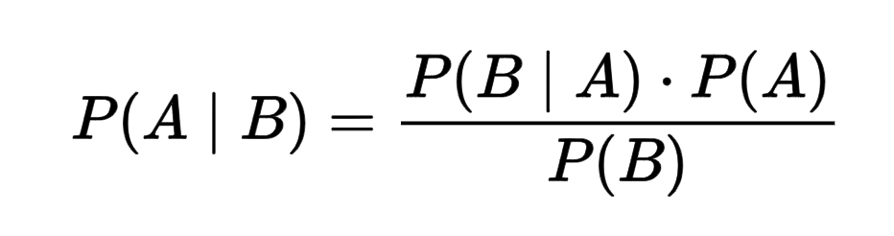
Bernoulli Naive Bayes
To understand Bernoulli Naive Bayes algorithm, it is essential to understand Naive Bayes.
Naive Bayes is a supervised machine learning algorithm to predict the probability of different classes based on numerous attributes. It indicates the likelihood of occurrence of an event. Naive Bayes is also known as conditional probability.
Naive Bayes is based on the Bayes Theorem.

Slide 53
The Naive Bayes classifier is based on two essential assumptions:-
(i) Conditional Independence - All features are independent of each other. This implies that one feature does not affect the performance of the other. This is the sole reason behind the ‘Naive’ in ‘Naive Bayes.’
(ii) Feature Importance - All features are equally important. It is essential to know all the features to make good predictions and get the most accurate results.

Slide 54
Let there be a random variable 'X' and let the probability of success be denoted by 'p' and the likelihood of failure be represented by 'q.'
Success: p
Failure: q
q = 1 - (probability of Sucesss)
q = 1 - p

Slide 55
Let us consider the example below to understand Bernoulli Naive Bayes:-
Adult | Gender | Fever | Disease
Yes | Female | No | False
Yes | Female | Yes | True
No | Male | Yes | False
No | Male | No | True
Yes | Male | Yes | True

Slide 56
In the provided dataset, we are trying to predict whether a person has a disease or not based on their age, gender, and fever. Here, ‘Disease’ is the target, and the rest are the features.
All values are binary.
We wish to classify an instance ‘X’ where Adult=’Yes’, Gender= ‘Male’, and Fever=’Yes’.

Slide 57
Firstly, we calculate the class probability, probability of disease or not.
P(Disease = True) = ⅗
P(Disease = False) = ⅖
Secondly, we calculate the individual probabilities for each feature.
P(Adult= Yes | Disease = True) = ⅔
P(Gender= Male | Disease = True) = ⅔
P(Fever= Yes | Disease = True) = ⅔
P(Adult= Yes | Disease = False) = ½
P(Gender= Male | Disease = False) = ½
P(Fever = Yes | Disease = False) = ½

Slide 58
Now, we need to find out two probabilities:-
(i) P(Disease= True | X) = (P(X | Disease= True) * P(Disease=True))/ P(X)
(ii) P( Disease = False | X) = (P(X | Disease = False) * P(Disease= False) )/P(X)
P(Disease = True | X) = (( ⅔ *⅔ * ⅔ ) * (⅗))/P(X) = (8/27 * ⅗) / P(X) = 0.17/P(X)
P(Disease = False | X) = [(½ * ½ * ½ ) * (⅖)] / P(X) = [⅛ * ⅖] / P(X) = 0.05/ P(X)

Slide 59
Now, we calculate estimator probability:-
P(X) = P(Adult= Yes) * P(Gender = Male ) * P(Fever = Yes)
= ⅗ * ⅗ * ⅗ = 27/125 = 0.21
So we get finally:-
P(Disease = True | X) = 0.17 / P(X)
= 0.17 / 0.21
= 0.80 - (1)
P(Disease = False | X) = 0.05 / P(X)
= 0.05 / 0.21
= 0.23 - (2)
Now, we notice that (1) > (2), the result of instance ‘X’ is ‘True’, i.e., the person has the disease.

Slide 60
ML -Project Challenge
Week 1
Week 2
Week 3
Week 4
Week 1 | Literature Review Task
Week 2 | Fundamentals, ML Specific Concepts
Week 3 | Coding Implementation
Week 4 | GitHub Deployment + Summarization

Slide 61
Twitter Sentiment Analysis: Project Pipeline
Import Necessary Dependencies
Read and Load the Dataset
Exploratory Data Analysis
Data Visualization of Target Variables
Data Preprocessing
Splitting our data into Train and Test sets.
Transforming Dataset using TF-IDF Vectorizer
Function for Model Evaluation
Model Building
Model Evaluation

Slide 62
ML -Project Challenge
Week 1
Week 2
Week 3
Week 4
Week 1 | Literature Review Task
Week 2 | Fundamentals, ML Specific Concepts
Week 3 | Coding Implementation
Week 4 | GitHub Deployment + Summarization

Slide 63


Git and GitHub

Slide 64
Git is an open-source, version control tool created in 2005 by developers working on the Linux operating system; GitHub is a company founded in 2008 that makes tools which integrate with git.
You do not need GitHub to use git, but you cannot use GitHub without using git.

Slide 65
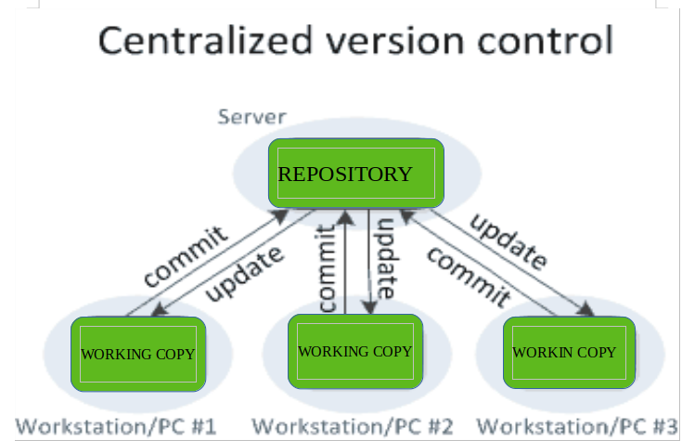

Slide 66
Step 1: Create a local git repository
To initialize a git repository in the root of the folder, run the git init command:
Step 2: Add a new file to the repo
Add a new file to the project, using any text editor you like or running a touch command. `touch newfile.txt` just creates and saves a blank file named newfile.txt.
After creating the new file, you can use the git status command to see which files git knows exist.

Slide 67
Step 3: Add a file to the staging environment
Add a file to the staging environment using the git add command.
Step 4: Create a commit
Run the command git commit -m "Your message about the commit"

Slide 68
Step 5: Create a new branch
Say you want to make a new feature but are worried about making changes to the main project while developing the feature. This is where git branches come in.
Branches allow you to move back and forth between 'states' of a project. Official git docs describe branches this way: ‘A branch in Git is simply a lightweight movable pointer to one of these commits.’ For instance, if you want to add a new page to your website you can create a new branch just for that page without affecting the main part of the project. Once you're done with the page, you can merge your changes from your branch into the primary branch. When you create a new branch, Git keeps track of which commit your branch 'branched' off of, so it knows the history behind all the files.

Slide 69
Run git checkout -b <my branch name>.
This command will automatically create a new branch and then 'check you out' on it, meaning git will move you to that branch, off of the primary branch.
After running the above command, you can use the git branch command to confirm that your branch was created.
By default, every git repository’s first branch is named `master` (and is typically used as the primary branch in the project).

Slide 70
Step 6: Create a new repository on GitHub
If you only want to keep track of your code locally, you don't need to use GitHub. But if you want to work with a team, you can use GitHub to collaboratively modify the project's code.
To create a new repo on GitHub, log in and go to the GitHub home page. You can find the “New repository” option under the “+” sign next to your profile picture, in the top right corner of the navbar.

Slide 71
Step 7: Push a branch to GitHub
Now we'll push the commit in your branch to your new GitHub repo. This allows other people to see the changes you've made. If they're approved by the repository's owner, the changes can then be merged into the primary branch.
To push changes onto a new branch on GitHub, you'll want to run git push origin yourbranchname. GitHub will automatically create the branch for you on the remote repository.

Slide 72
Step 8: Create a pull request (PR)
A pull request (or PR) is a way to alert a repo's owners that you want to make some changes to their code. It allows them to review the code and make sure it looks good before putting your changes on the primary branch.
Step 9: Merge a PR
This will merge your changes into the primary branch.

Slide 73
Step 10: Get changes on GitHub back to your computer
Right now, the repo on GitHub looks a little different than what you have on your local machine.
For example, the commit you made in your branch and merged into the primary branch doesn't exist in the primary branch on your local machine.
In order to get the most recent changes that you or others have merged on GitHub, use the git pull origin master command (when working on the primary branch). In most cases, this can be shortened to “git pull”.

Slide 74



