Slide 1




SMART INDIA HACKATHON 2026
TITLE PAGE
  Problem Statement ID – SIH26086
  Problem Statement Title - Hyperlocal Monsoon Onset & Break Prediction System
  Theme- Agriculture,FoodTech & Rural Development
  PS Category- Software
  Team ID - 173900
  Team Name - FAST&CURIOUS

Slide 2
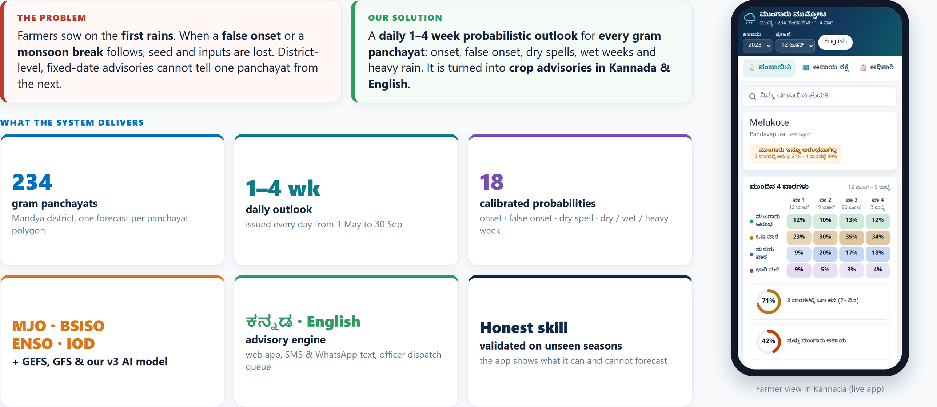
Monsoon Outlook
FAST&
CURIOUS
Daily 1–4 week probabilistic monsoon outlook for every gram panchayat, turned into farmer advisories in Kannada & English.
@SIH Idea submission
2
Notes:
2

Slide 3
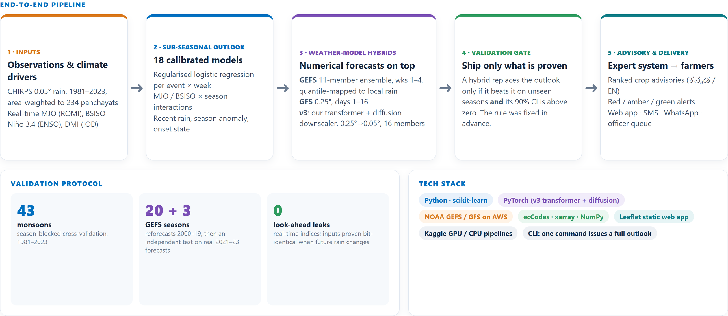
TECHNICAL APPROACH
FAST&
CURIOUS
@SIH Idea submission
3
Notes:
3

Slide 4
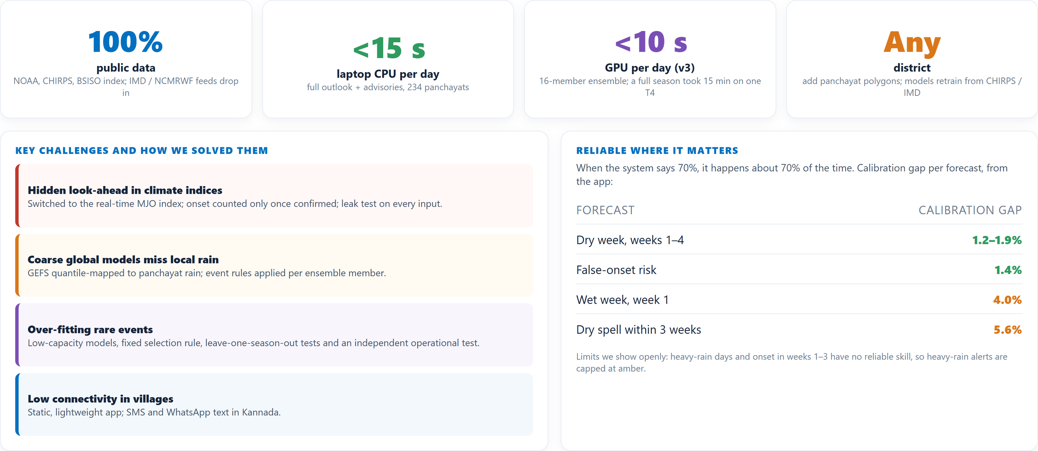
FEASIBILITY AND VIABILITY
FAST&
CURIOUS
@SIH Idea submission
4
Notes:
4

Slide 5
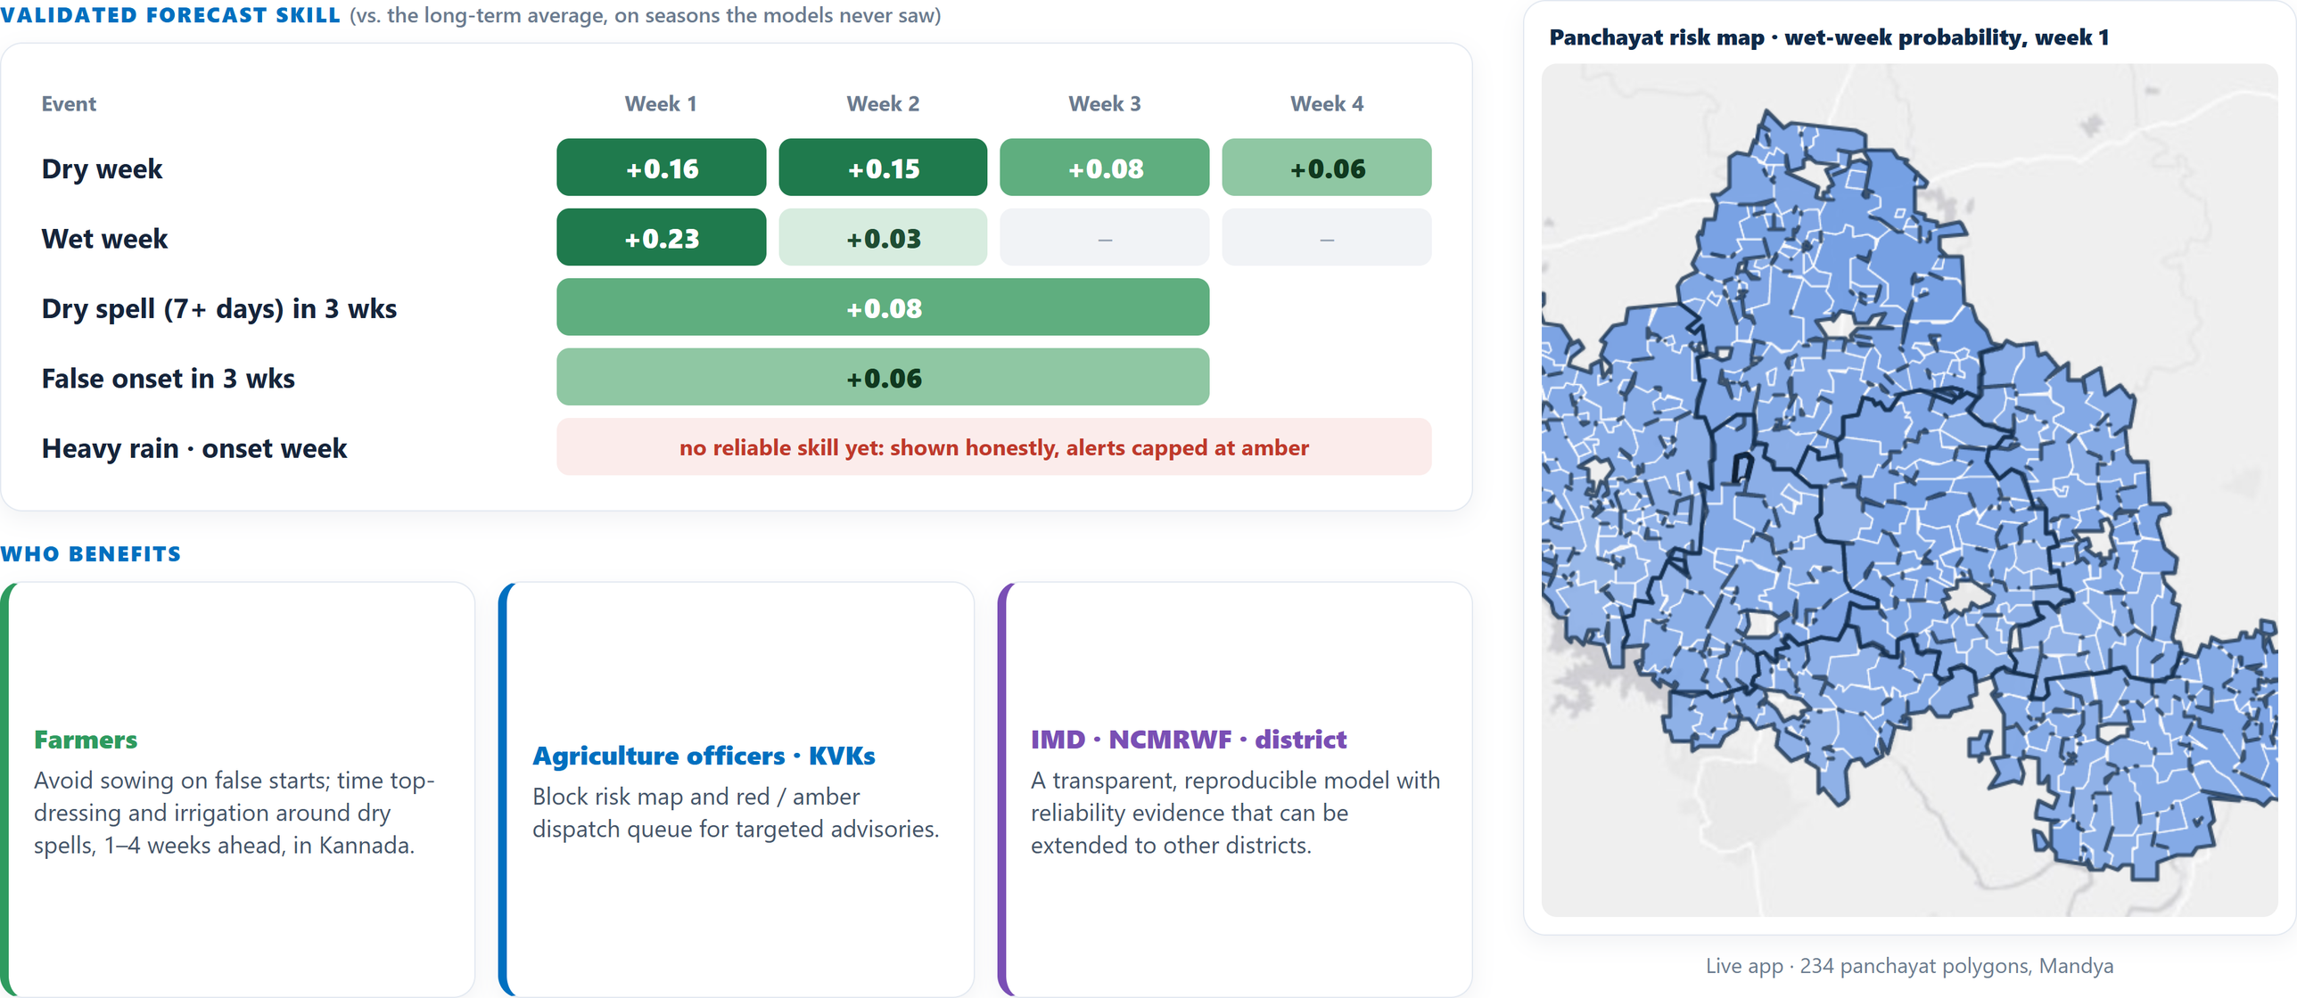
IMPACT AND BENEFITS
FAST&
CURIOUS
@SIH Idea submission
5
Notes:
4

Slide 6
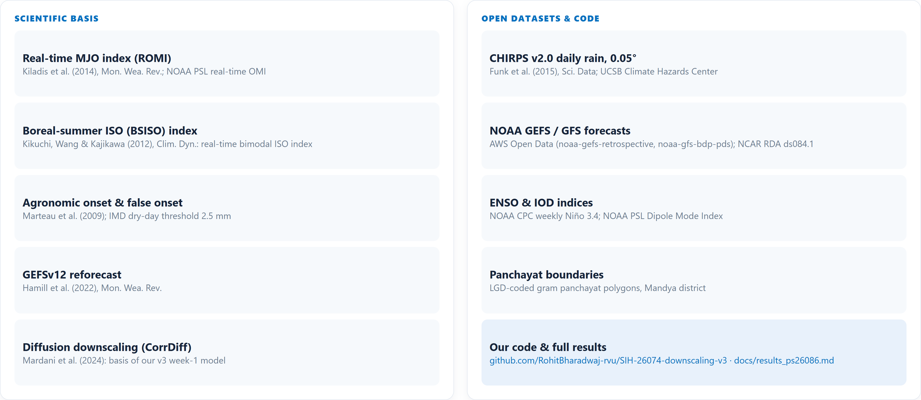
RESEARCH AND REFERENCES
FAST&
CURIOUS
@SIH Idea submission
6
Notes:
4

