Slide 1


SMART INDIA HACKATHON 2026
Problem Statement ID – SIH26074
Problem Statement Title - Downscaling of Weather Forecast from Block level to Panchayat level
Theme- Agriculture,FoodTech & Rural Development
PS Category- Software
Team ID - 173900
Team Name - FAST&CURIOUS

Slide 2
FAST&
CURIOUS
Spatiotemporal Diffusion Downscaler
Problem Statement: A coarse 27 km (0.25°) GFS forecast gives one value for dozens of Gram Panchayats, missing local showers and terrain effects.
INPUTS
Real GFS 0.25° (7 days × 6 vars), ERA5 history, Terrain
Proposed Solution:
Spatiotemporal Transformer Downscaling: attention across space, time and the 6 variables, with a Mixture-of-Experts layer, turns the coarse forecast into a 0.05° (~5.5 km) field.
Cross-Fitted Residual Diffusion: generates an ensemble of fine-scale detail on top of the transformer; each training season comes from a model that never saw it (rain CRPS −19 %).
Topography Coupling: Copernicus GLO-30 elevation layers and a land mask capture ridge and valley effects.
Calibrated Uncertainty: spread calibration and a rain tail cap; 5–95 % ranges cover 88 % of outcomes on the unseen 2023 monsoon.
Real Forecasts, Real Skill: trained on 1,096 genuine GFS forecasts; on 2023 it cuts wet-day rain error by 20 % and Tmax error by 24 % versus raw GFS.
TRANSFORMER BACKBONE
Spatiotemporal attention + Mixture-of-Experts
MACRO BASELINE B(X)
Deterministic forecast, 3 seeds averaged (FAST)
Noise:
z_T ~ N(0, I)
RESIDUAL DIFFUSION
Cross-fitted, DPM-Solver++ 24–32 steps
PROBABILISTIC FORECAST: Y = B(X) + R
7-Day × 6-Variable (P, Tmax, Tmin, RH, U, V) → 234 Gram Panchayats
@SIH Idea submission
2

Slide 3



FAST&
CURIOUS
TECHNICAL APPROACH
TECH STACK
STAGE 1 - INPUTS
STAGE 2 - SPATIOTEMPORAL BACKBONE
Transformer + Cross-Attention
(History <-> Future Conditioning)
Mixture-of-Experts: 8 experts, top-2 routing
Variables: P, T_max, T_min, RH, U, V
Deterministic Macro Baseline B(X)
Agro-Weather PWA
7-Day × 6-Variable Panchayat Forecast
5–95 % Ranges & Exceedance Probabilities
4 Modes: FAST to 16-member ENSEMBLE
Proof plots: GFS vs v3 vs observed
PyTorch
Python, NumPy
Xarray, Zarr, NetCDF
ecCodes (GRIB)
FastAPI, Uvicorn
Pydantic
Shapely
Leaflet.js
HTML5, CSS, JS
Service Worker (PWA)
SQLite
Kaggle T4 GPUs
Historical Weather
(ERA5, last H = 3 days,
actual obs up to t0)
STAGE 3 - CROSS-FITTED RESIDUAL DIFFUSION
Gaussian Initialization: z_T ~ N(0, I)
Cross-Fitting: each season's residuals from a model that never saw it
Reverse Denoising: DPM-Solver++, 24–32 steps
Ensemble: 8–16 members, R(1) … R(E)
Future Coarse NWP
(real GFS 0.25°,
D+1 … D+7)
CODE & MODEL WEIGHTS
github.com/rohzhegde26/
SIH-26074-Fast-and-Curious
STAGE 4 - CALIBRATION & POST-PROCESSING
Y = B(X) + R (summation per ensemble member)
Calibration: spread per lead × variable, rain quantile mapping, rain tail cap
Physical Inversion: expm1(precip), unstandardize physical vars
Zonal GIS Aggregation: 0.05° grid → 234 Gram Panchayats of Mandya (area-weighted)
PROBABILISTIC EVALUATION & VALIDATION
Held-out Test
(2023 monsoon, 122 forecasts; trained 2015–22)
Metrics: CRPS, spread-skill ratio, coverage, CSS
PERFORMANCE &
TESTING
Terrain & Context
(Copernicus GLO-30 DEM
layers + land mask)
0.17 s FAST forecast (T4)
8.3 s for 16 members
< 1 GB GPU memory
234 GPs × 7 days × 6 vars
Note: Real GFS forecasts only - no future leakage
Note: Every setting chosen on 2022 or out-of-fold, never on 2023
@SIH Idea submission
3

Slide 4
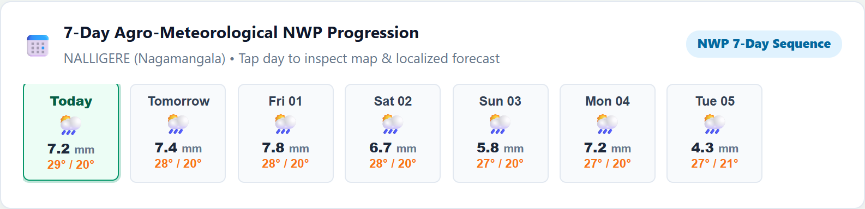
FAST&
CURIOUS
FEASIBILITY AND VIABILITY
FEASIBILITY
VIABILITY
Runs in 0.17 s (FAST) to 8.3 s (16-member ensemble) on one T4 GPU, using < 1 GB of memory.
Generates fine-resolution 7-day, 6-variable forecasts with calibrated uncertainty ranges.
Copernicus GLO-30 elevation layers and a land mask condition the model, capturing terrain effects at panchayat scale.
Converts GFS into Panchayat-level forecasts, maps and exceedance probabilities.
Supports localized agro-weather advisories, Panchayat maps and spatial risk visualization.
Uses free, operational GFS forecasts as the input layer, avoiding the need to build a new numerical weather prediction system.
Input-agnostic: NCMRWF or IMD forecasts can replace GFS after retraining on their archives.
Scales to any region with the same global data (GFS, CHIRPS, ERA5-Land, GLO-30) by retraining; the current model and demo cover all 234 Gram Panchayats of Mandya.
@SIH Idea submission
4

Slide 5
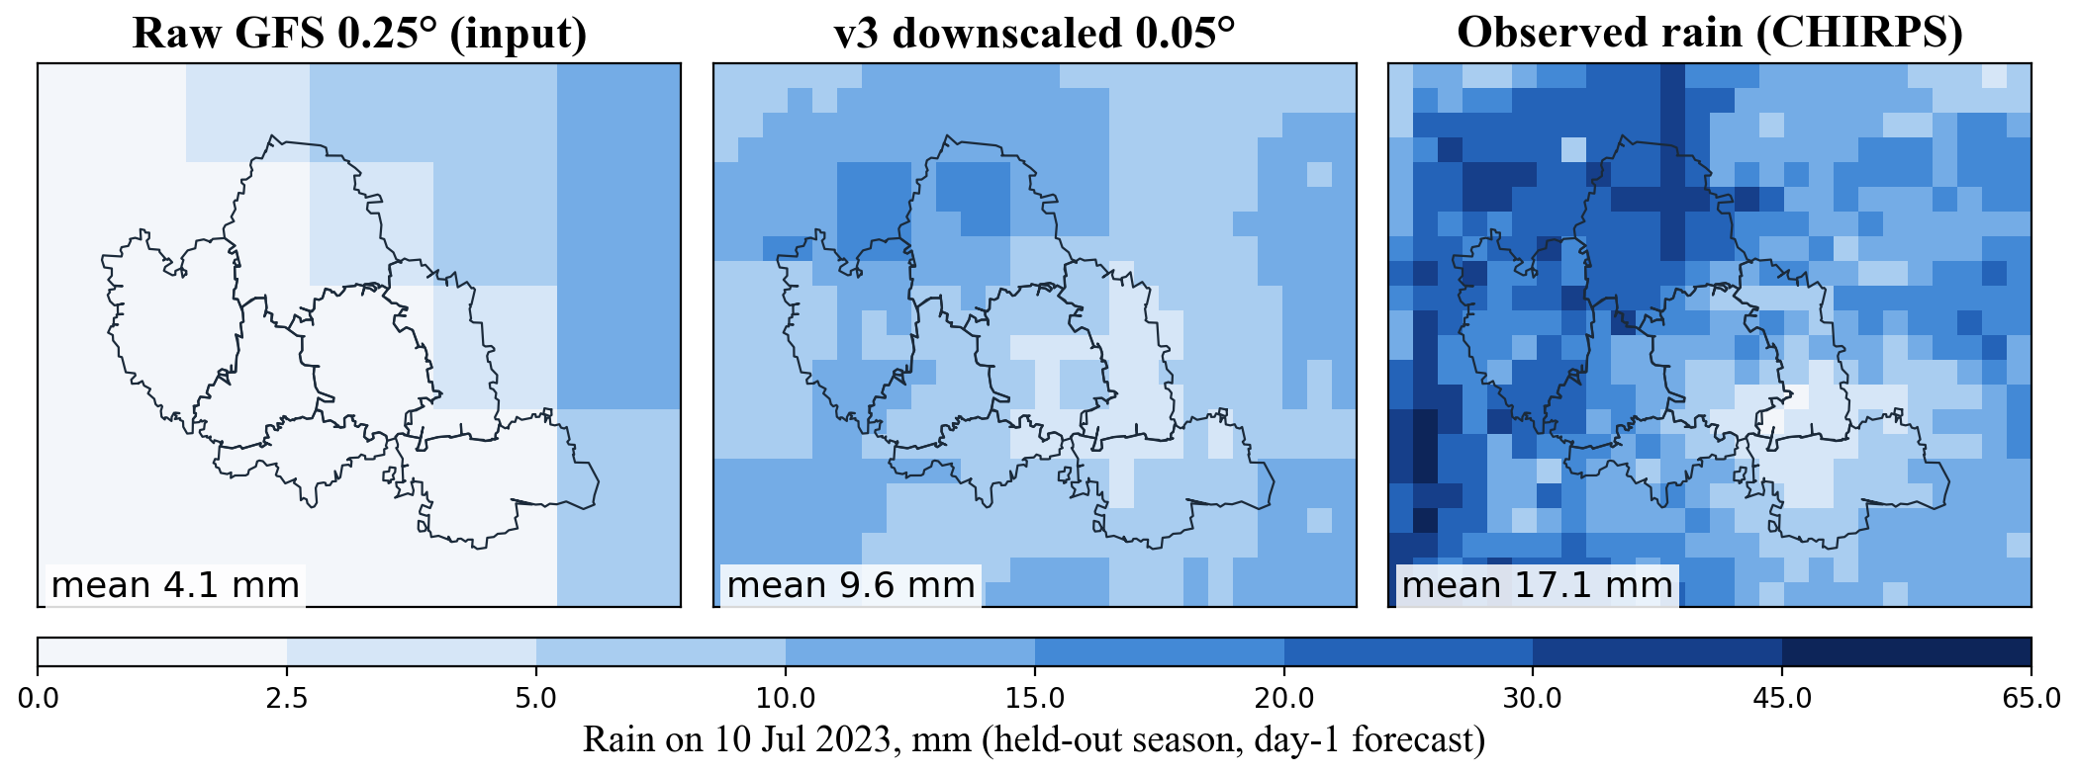
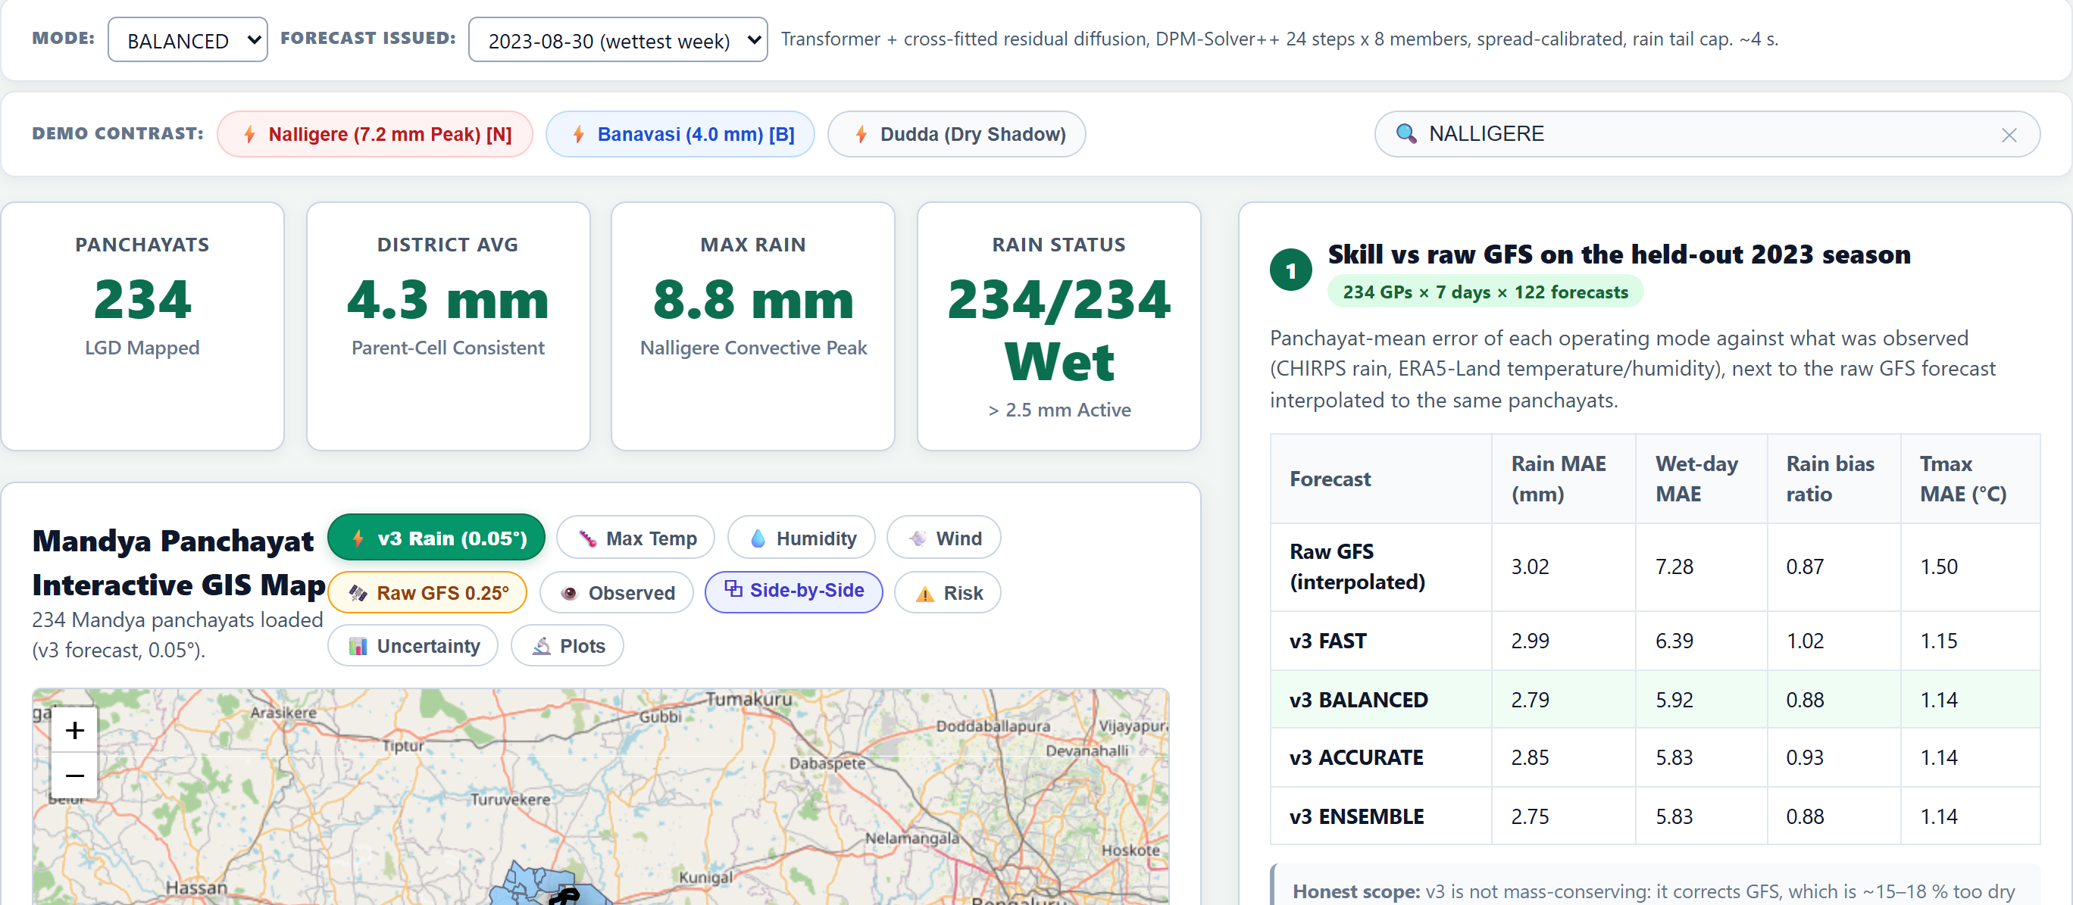
FAST&
CURIOUS
IMPACT AND BENEFITS
IMPACT
Panchayat-level forecasts for all 234 Gram Panchayats of Mandya, validated on the unseen 2023 monsoon.
Hyper-local weather information (0.25° → 0.05°)
Beats raw GFS at Panchayat level: wet-day rain error −20 %, Tmax error −24 %.
BENEFITS
6-Variable, 7-Day Forecasts: Joint precipitation, temperature, humidity and wind information provides richer agricultural context than rainfall alone.
Calibrated Uncertainty: 5–95 % ranges cover 88 % of outcomes, and heavy-rain maps double the detection of ≥ 64.5 mm days.
@SIH Idea submission
5

Slide 6
FAST&
CURIOUS
RESEARCH AND REFERENCES
DATASETS & PROJECT BASES
KEY METHODOLOGICAL REFERENCES
NOAA GFS 0.25° operational forecasts (AWS Open Data, NCAR RDA ds084.1); model input.
Mardani et al. (2025) CorrDiff: residual corrective diffusion for km-scale downscaling. Commun. Earth Environ.
CHIRPS v2.0 0.05° daily precipitation (Funk et al., 2015); high-res rain target.
Ho, Jain & Abbeel (2020) DDPM: basis for the residual diffusion component. NeurIPS 2020.
Copernicus DEM GLO-30 30m DEM; terrain conditioning (elevation layers, land mask).
Lu et al. (2022) DPM-Solver++: fast sampling of diffusion models. arXiv:2211.01095.
ERA5 history & ERA5-Land 0.1° (Tmax, Tmin, RH, U, V) targets; Hersbach et al. 2020.
Fedus, Zoph & Shazeer (2022) Switch Transformers: sparse Mixture-of-Experts. JMLR 23.
Panchayat Boundaries & LGD Codes for Mandya, Karnataka (234 Gram Panchayats).
Vandal et al. (2017) DeepSD: High-res climate projections via image super-resolution. KDD 2017.
Code, model weights & reports: github.com/rohzhegde26/SIH-26074-Fast-and-Curious
@SIH Idea submission
6

