Slide 1
PG Dissertation Management System
Team Name: Arogya Squad Team Leader Name: Rohit Chandra Joshi

Slide 2


ABSTRACT
PG Dissertation Management System is a comprehensive digital solution according to the needs of graduate students and faculty. It provides a central location for real-time progress tracking, efficient work delivery, secure document sharing, and easy communication. This process not only increases productivity but also improves collaboration, ensuring that everyone involved in the thematic process is on the same page. By leveraging technology, our system enables educational institutions to improve the efficiency of their thesis programs while reducing administrative burden.

Slide 3
INTRODUCTION
In the fast-paced world of postgraduate studies, managing and organizing dissertation projects can be a daunting task. We recognize the challenges students and faculty face when juggling multiple dissertations. Our PG Dissertation Management System is a leading solution designed to simplify the management of postgraduate dissertations. Designed with the needs of students and faculty in mind, our program is poised to change the way dissertations are managed at your institution. With this initiative, we aim to provide a useful, user-friendly and efficient platform that facilitates the entire dissertation process.

Slide 4
APP DESIGNS
Effective app design plays an important role in the success of any digital solution. It goes beyond aesthetics, as it affects the user experience, accessibility, and overall functionality. Our commitment to creating well-thought-out interfaces reflects our commitment to advancing user satisfaction, ease of use, and the overall value of our PG dissertation management system.

Slide 5
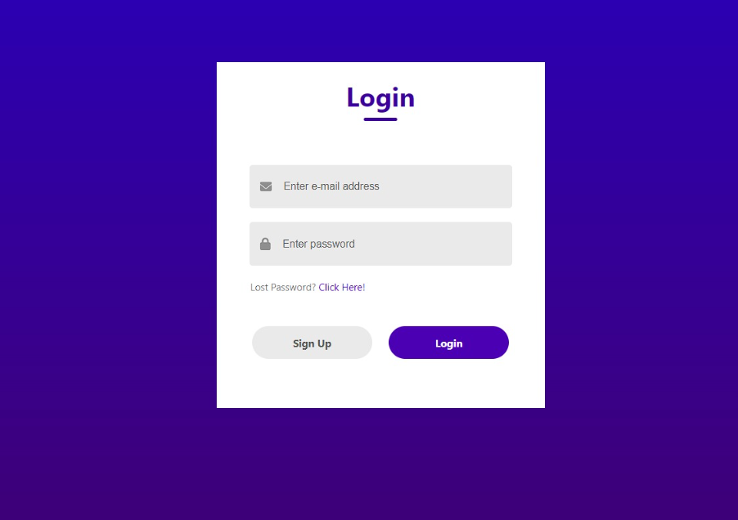
LOGIN PAGE
The login page is the gateway to our PG Dissertation Management System. Its design is important because it sets the tone for user interaction. Our optimized login page prioritizes security and user friendliness, ensuring easy and secure access to the system. This page represents our commitment to a comfortable and easy user experience.

Slide 6
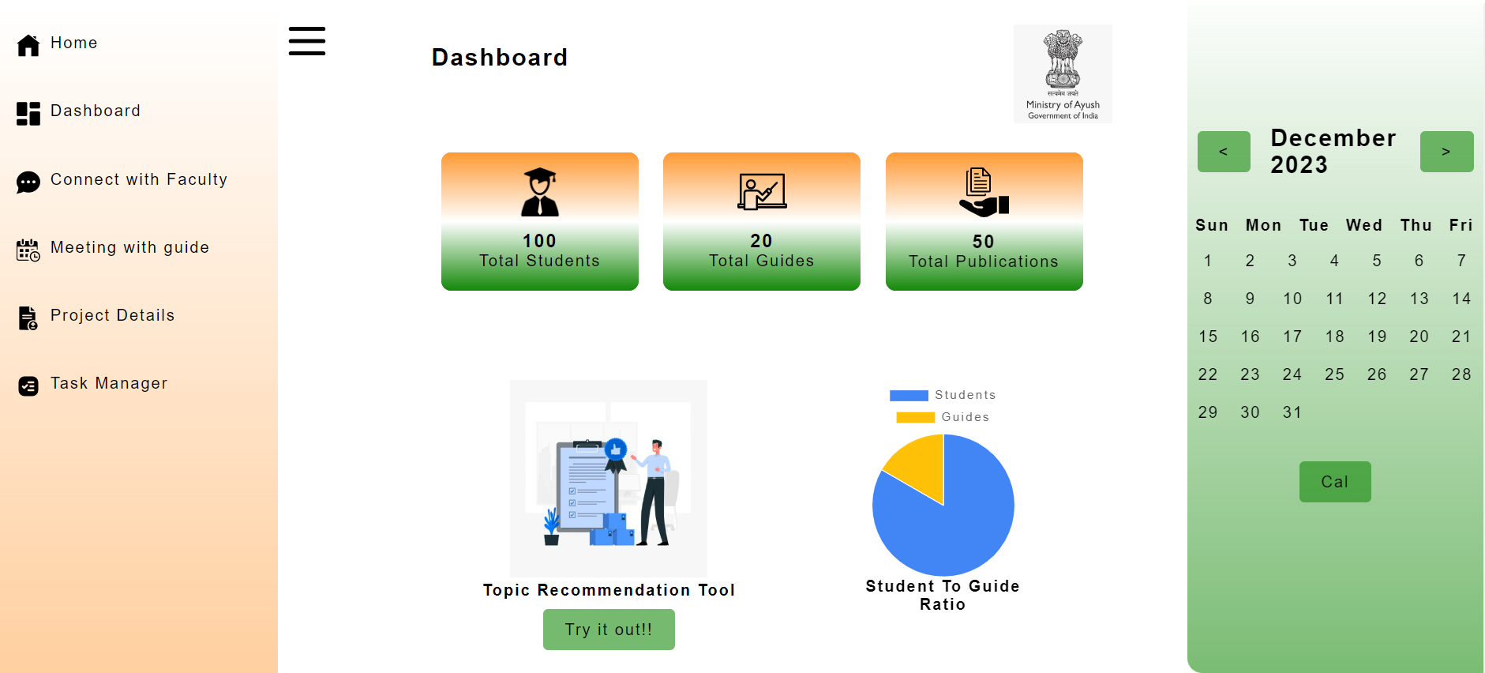
DASHBOARD
Our dashboard provides users with a centralized view of their critical information. It serves as a control center for effortless navigation and access to essential features, allowing users to stay organized, track progress, and manage their dissertation-related tasks effectively.

Slide 7
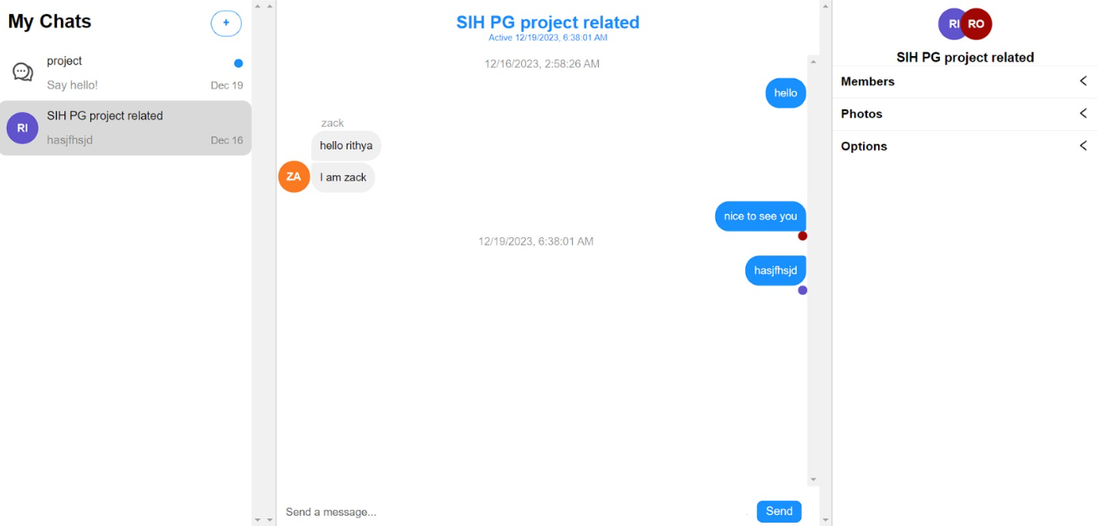
CHAT SCREEN
The chat screen is where conversations come to life. It offers an intuitive and visually engaging platform for users to interact. Through thoughtful design, we've focused on user accessibility and conversation management, enhancing the overall user experience. The chat screen fosters productive and meaningful discussions.

Slide 8
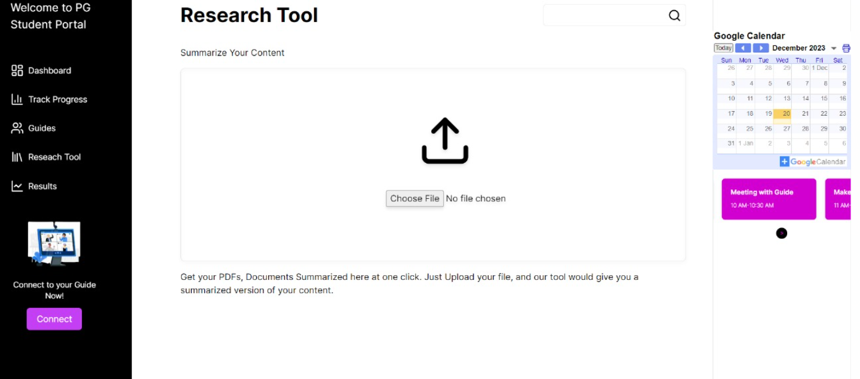
DOCUMENTATION SUMMARIZE
The PPT summarize feature represents our commitment to making the dissertation management process more efficient. It allows users to extract key insights and highlights from presentations and discussions. With a user-centric design, it simplifies the summarization process, making it easier for users to distill valuable information from presentations.

Slide 9
USES
The Master’s (PG) Dissertation Management System is a comprehensive software solution designed to help students, professors, and administrators manage various aspects of their postgraduate dissertation projects Here are some of its comprehensive functions :-
Student registration and profile management: The system allows students to write their thesis topics, upload documents and manage their profiles. It acts as an on-site hub for students to post their project proposals.
Progress Monitoring: Students and teachers can monitor the progress of the topic. It keeps track of milestones reached, deadlines, and any pending projects. This helps with accountability.

Slide 10
Document Management: Students can upload a variety of documents related to the project such as proposals, literature reviews, research papers and presentations. This puts document storage in place, making it easy to access and track progress.
Topic selection and approval: Students may propose dissertation topics, and faculty members may review and approve or suggest changes. The system facilitates topic selection and ensures that students are working in appropriate and approved research areas.
Communication and Discussion: The program often includes communication tools for students and their advisors to exchange messages and updates. Collaboration tools can facilitate virtual meetings, file sharing, and chat.

Slide 11
Resource distribution: Can help distribute access to resources such as lab equipment, library materials, or specialized software. Students can request these items through the program.
Evaluation and Grading: Faculty can use the system to evaluate and grade works.

Slide 12
CHALLENGES
The implementation of a postgraduate (PG) dissertation management system can present many challenges, which institutions and professionals have to deal with in order to be effective. Here are some of the challenges:
User recruitment: Encouraging students, teachers, and administrators to adapt to a new system can be challenging. Training and support may be needed to make users comfortable with the technology.
Data Security: Protecting sensitive student and research data is critical. Ensuring data security and privacy can be challenging, especially given the possibility of a data breach.

Slide 13
Integrating existing systems: Many organizations already have software systems. Integrating new performance management systems into these existing systems can be complex and may require customization.
Scalability: As the number of graduate students increases, the system must be scalable to keep up with the increasing workload and data. Making sure it can handle multiple users and documents is a challenge.
Adaptation: Academic disciplines and institutions have unique requirements for dissertation management. Modifying the system to meet these specific needs may require significant modifications, which can be time-consuming and expensive.
Technical Support and Maintenance: Systems require ongoing technical support and maintenance to function properly. This includes updating features, fixing bugs, and handling user feedback.

Slide 14
Cost: Developing, implementing, and maintaining a thematic management system can be expensive. Organizations must allocate ongoing software, hardware, and operating costs areas.

Slide 15
SCOPE
The future PG dissertation management system is promising and can be extended as follows :
Improvement and Enhanced User Experience: Future initiatives could focus on ways to improve students and faculty, and make it easier for users to find and interact with dissertation-related information They can developed user-friendly interfaces and mobile applications to enhance the user experience.
Data analysis and insights: The use of advanced data analysis tools can help organizations gain insights into the performance of students, faculty, and the dissertation program. This can help identify trends, challenges and opportunities for improvement.

Slide 16
Integration with Learning Management System (LMS): Integrating a thesis management system with an institution’s LMS can streamline the process by allowing students and faculty to access resources and collaborate seamlessly.
Automation of workflows and reporting: Future systems may incorporate automation to manage workflows, including proposal submission, review, and approval. Automated reporting can keep stakeholders informed about deadlines and progress.
AI and Machine Learning: Incorporating AI and machine learning can help identify plagiarism, improve content, and provide relevant recommendations for analytical tools and resources.

Slide 17
Digital archives and repositories: The creation of digital repositories for dissertations, research papers, and related materials can generate valuable knowledge for the institution and students.
Security and Privacy: Given the growing concern over data security and privacy, future policies should emphasize strong security measures and compliance with data protection laws.

Slide 18
CONCLUSION
In conclusion, this dissertation emphasizes the pivotal role of an effective management system in organizational success. Key factors like leadership, employee engagement, and technology integration have been highlighted as critical. These insights provide practical guidance for organizations striving to excel in a dynamic business landscape. Continuous research and adaptation are essential to meet evolving challenges. This study lays the groundwork for optimizing management systems and achieving sustained excellence in organizations.

