Slide 1
JavaScript & RequireJS
[ Rohit Chaturvedi ]

Slide 2
Course Content
JavaScript
Object
Scope
Functions
Normal Functions
Anonymous Functions
Constructor Functions
Callback Functions
IIFE
Closures
Prototype
Require
JavaScript Modules
Introduction
Usage
Modular Patterns
Global Import
Object Interface
Revealing module pattern
Configuration
Require
Define

Slide 3
JavaScript

Slide 4
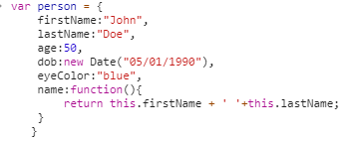
Object
A JavaScript object is a collection of named values.
In JavaScript almost “everything” is Object.
Notes:
//===========[Example-1]===============
var person={
firstName:"Jhon",
lastName:"Doe",
age:30,
dob:new Date('05/01/1980'),
name:function(){
return this.firstName+' '+this.lastName
}
}
//===========[Example-2]===============
var num=1;
var bool=false;
var str="jhon";
var arr=[];

Slide 5
Scope
Scope determines the accessibility/visibility of variables, object or functions.
JavaScript has function scope.
In JavaScript there are two types of scope:
Local scope
A variables declared within a JavaScript function become LOCAL to that function. Such variables have local scope, They can only be accessed within the function.
Global scope
A variable declared outside a function, becomes GLOBAL., this type of variable have Global scope and will accessible in all scripts and functions.
Notes:
// app.js
var x=10;
function fun1(){
//var x=20
/*
function fun2(){
//var x=30
console.log('fun2',x);
};
*/
fun2();
console.log('fun1',x);
};

Slide 6


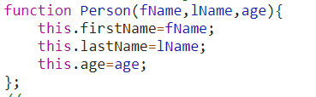
Function
A function is a subprogram designed to perform a particular task.
In JavaScript, functions are first-class objects.
Types
Normal Functions
Anonymous Functions
Constructor Functions
Notes:
//===================[Clasical Function]=============================
function add(num1,num2){
return num1+num2;
}
//===================[Anonymous Function]=============================
var anonymous=function(x){
return x+=1;
};
//===================[Constructor Function]============================
function Person(fName,lName,age){
this.firstName=fName;
this.lastName=lName;
this.age=age;
};

Slide 7
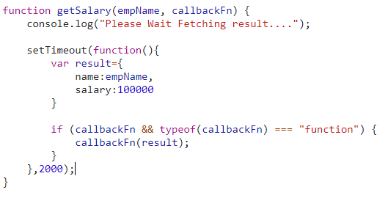

Function
Callback
A callback function, also known as a higher-order function.
It is a function that is passed to another function as a parameter, and the callback function is invoked inside the that function.
IIFE- Immediate Invoked Function Expression.
It executes immediately after it's created.
often used when trying to avoid polluting the global namespace
Notes:
function getSalary(empName, callbackFn) {
console.log("Please Wait Fetching result....");
setTimeout(function(){
var result={
name:empName,
salary:100000
}
if (callbackFn && typeof(callbackFn) === "function") {
callbackFn(result);
}
},2000);
}
//========================
(function() {
var x=10;
console.log('function is executed');
}());

Slide 8
Closure
A closure is an inner function that has access to the outer (enclosing) function’s variables-scope chain.
The closure has three scope chains
it has access to its own scope (variables defined between its curly brackets)
It has access to the outer function’s variables,
It has access to the global variables.
Notes:
var gl=10;
function closureEx(){
var fn1=20
return function(){
var fn2=30
return gl+fn1+fn2;
};
};
var getSum=closureEx();
//getSum();

Slide 9
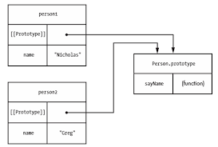
Prototype
When a function is created in JavaScript, JavaScript engine adds a prototype property to the function.
This prototype property is an object (called as prototype object).
Notes:
function Person(first, last, age) {
this.firstName = first;
this.lastName = last;
this.age = age;
}
Person.prototype.sayName = function() {
return this.firstName + " " + this.lastName
};
var person1= new Person("John", "Doe", 50);
var person2= new Person(“Jane", "Doe", 50);

Slide 10
Require JS

Slide 11
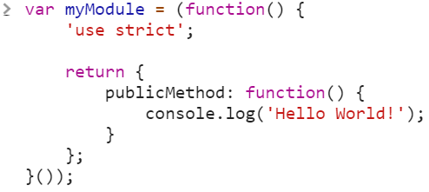
JavaScript Modules
A module is a reusable and self-contained piece of JavaScript which exports a specific objects.
Good authors divide their books into chapters and sections; good programmers divide their programs into modules.
Notes:
var myModule = (function () {
'use strict';
return {
publicMethod: function () {
console.log('Hello World!');
}
};
}());

Slide 12
JavaScript Modules
Why use modules?
Maintainability
Updating a single module is much easier when the module is decoupled from other pieces of code.
Namespacing
Modules allow us to avoid namespace pollution by creating a private space for our variables.
Reusability
A module can reuse over and over again. We can pass a module as dependency in other modules

Slide 13
Modular patterns
The Module pattern is used to mimic the concept of classes.
With these patterns are used to create public and private methods and variables inside a single object , like other programming languages such as Java or Python.
There are several ways to accomplish the module pattern
Global import
Object interface
Revealing module pattern

Slide 14
RequireJS
RequireJS is a JavaScript file and module loader.
RequireJS uses AMD (Asynchronous Module Definition).
Why RequireJS
Module Definition
Dependency injection
Lazy loading or Asynchronous module loading
Optimization

Slide 15


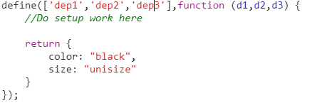
RequireJS
config
require
define

Slide 16
RequireJS
Let’s Dive into it …

Slide 18
Thanks !!

