Slide 1
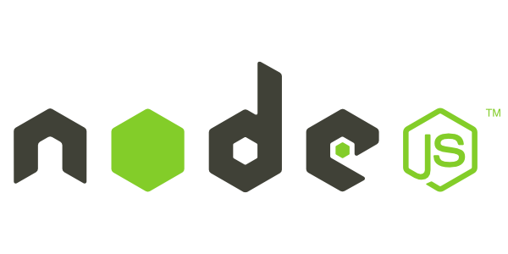

&
[ Rohit Chaturvedi ]

Slide 2
Course Content
Node
Getting Started
NPM
Introduction
Semantic versioning
Usage
Package.json
Introduction
Module Loading
Non-Blocking Code
Event Loop
Events
Event Emitters
Streams
Express
Node Application

Slide 3
Node – Getting Started
Visit node.js download page- http://nodejs.org/download/
Installers available for Windows & Mac OS X
Binaries available for Windows, Mac, Linux and SunOS Also available via many Linux package managers
Source code also available

Slide 4
[Node Package Manager]

Slide 5
NPM – Node Package Manager
NPM is a package manager for Node.js packages, or modules.
NPM is world's largest software registry it contains over 600,000 packages, with approximately 3 billion downloads per week.
www.npmjs.com hosts free packages to download and use.
The NPM program is installed on your computer when you install Node.js

Slide 6
Package
grunt
package.json
mocha package.json
request package.json
angular
package.json
reusable-code
reusable-code.js
-module-1.js
-module-2.js
package.json
Aysnc
package.json
moment package.json
Socket.io package.json
lodash package.json
connect package.json
colors package.json
connect package.json
connect package.json

Slide 7
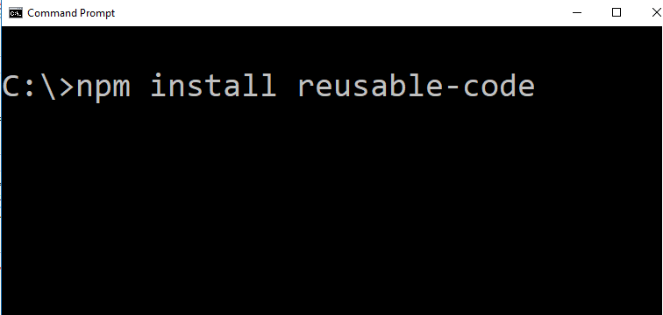
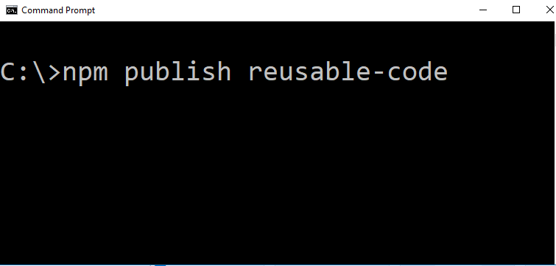
What NPM Does?
Public
registry
publish
Version 2.0
Version 2.0

Slide 8
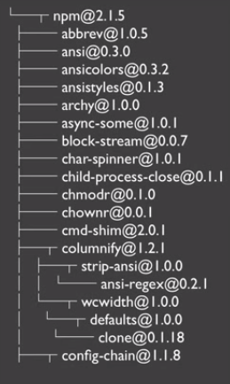
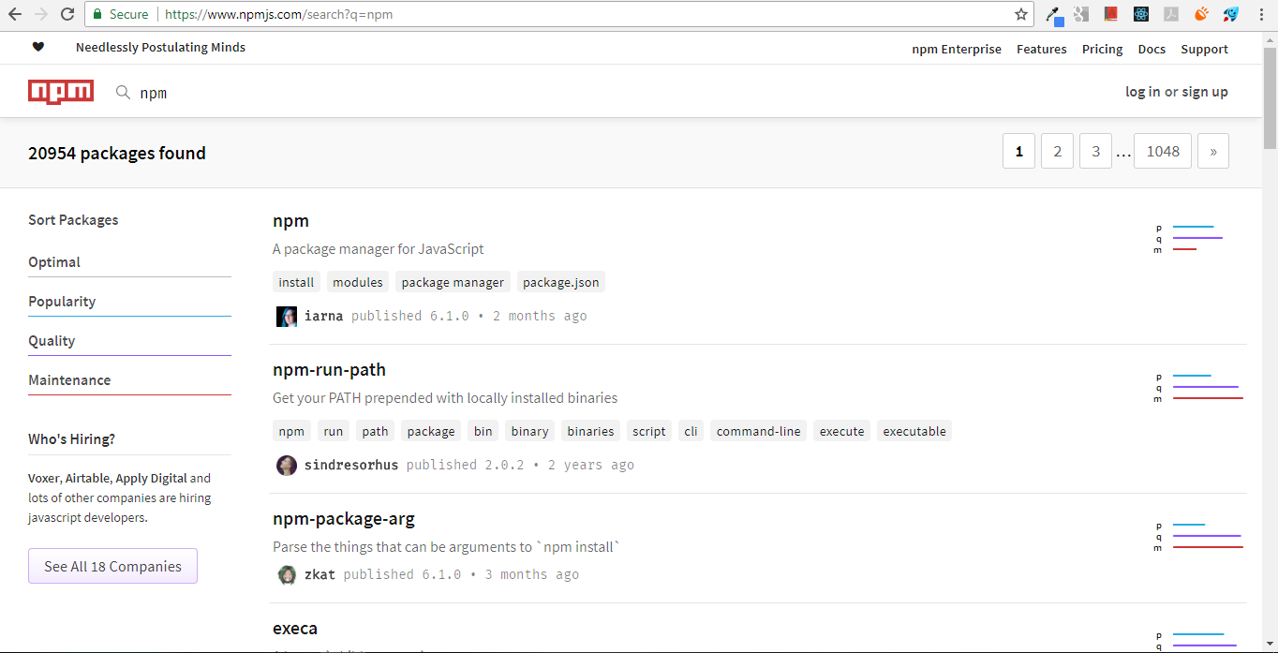
How NPM do it ?
publish
install
Client
Website
registry

Slide 9
NPM - Usage
Help
npm help install
Npm help-search prone
Installation
npm install package-name
npm install package-name –save
npm install package-name –save-d
Uninstall
npm uninstall package-name
npm un package-name
npm rm package-name
List
npm list –depth 0
npm ls–depth 0
Update
Npm update –prod
Npm update –dev

Slide 10
NPM – Semantic Versioning
1 . 0 . 0
Major Release
Patch Release
Minor Release

Slide 11
Node - Introduction
Node.js is a JavaScript runtime built on Chrome’s V8 JavaScript engine.
Node.js uses an non-blocking, event-driven I/O that makes it lightweight and efficient.

Slide 12
Node - Features
Asynchronous and Event Driven − All APIs of Node.js library are asynchronous, that is, non-blocking.
Very Fast − Being built on Google Chrome's V8 JavaScript Engine, Node.js library is very fast in code execution.
Single Threaded but Highly Scalable − Node.js uses a single threaded model with event looping.
No Buffering − Node.js applications never buffer any data. These applications simply output the data in chunks.
License − Node.js is released under the MIT License.
Notes:
Asynchronous and Event Driven − All APIs of Node.js library are asynchronous, that is, non-blocking. It essentially means a Node.js based server never waits for an API to return data. The server moves to the next API after calling it and a notification mechanism of Events of Node.js helps the server to get a response from the previous API call.
Very Fast − Being built on Google Chrome's V8 JavaScript Engine, Node.js library is very fast in code execution.
Single Threaded but Highly Scalable − Node.js uses a single threaded model with event looping. Event mechanism helps the server to respond in a non-blocking way and makes the server highly scalable as opposed to traditional servers which create limited threads to handle requests. Node.js uses a single threaded program and the same program can provide service to a much larger number of requests than traditional servers like Apache HTTP Server.
No Buffering − Node.js applications never buffer any data. These applications simply output the data in chunks.
License − Node.js is released under the MIT license.

Slide 13
Node – REPL Terminal
READ
EVAL
PRINT
LOOP

Slide 14
Node – Modules Source
1. Built-in Modules
Node include many built in modules like-
FS
http
Crypto
OS
Notes:
var os = require('os');
var toMb = function(f) {
return(Math.round((f/1024/1024)*100)/100);
}
console.log('Host: ' + os.hostname());
console.log('15 min. load average: ' + os.loadavg()[2]);
console.log(toMb(os.freemem()) + ' of ' + toMb(os.totalmem()) + ' Mb free');

Slide 15
Node – Modules Source
2. Project Files
We can create function and variables in a file and export them via “module.exports”
one.js
var count = 2;
var doIt = function(i, callback) {
// do something, invoke callback
}
module.exports.doIt = doIt;
module.exports.foo = ‘bar’;
two.js
var one = require(‘./one’);
one.doIt(23, function (err, result) {
console.log(result);
});
console.log(one.foo);
console.log(one.count);
Notes:
//one.js
var count = 2;
var doIt = function(i, callback) {
// do something, invoke callback
}
module.exports.doIt = doIt;
module.exports.foo = ‘bar’;
//two.js
var one = require(‘./one’);
one.doIt(23, function (err, result) {
console.log(result);
});
console.log(one.foo);
console.log(one.count);

Slide 16
Node – Modules Source
3. NPM Packages
Installed via “npm install module_name” into “node_modules” folder
Are require()’d via simple string identifiers, similar to built-ins
var request = require(‘request’);
Can require() individual files from within a module, but be careful!
var BlobResult = require(‘azure/lib/services/blob/models/blobresult’);

Slide 17
Non-Blocking Programing
A typical approach
var conn = getDbConnection(connectionString);
var stmt = conn.createStatement();
var results = stmt.executeQuery(sqlQuery);
for (var i=0; i<results.length; i++) {
// print results[i];
}
Notes:
var conn = getDbConnection(connectionString);
var stmt = conn.createStatement();
var results = stmt.executeQuery(sqlQuery);
for (var i=0; i<results.length; i++) {
// print results[i];
}

Slide 18
Non-Blocking Programing
Non-Blocking Approach
getDbConnection(connectionString, function (err, conn) {
conn.createStatement(function (err, stmt) {
var results = stmt.executeQuery(sqlQuery);
results.on(‘row’, function (result) {
// print result
});
});
});
Notes:
getDbConnection(connectionString, function (err, conn) {
conn.createStatement(function (err, stmt) {
var results = stmt.executeQuery(sqlQuery);
results.on(‘row’, function (result) {
// print result
});
});
});

Slide 19
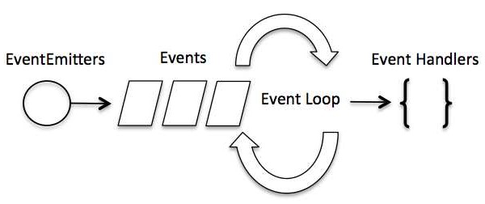
Event Loop
In an event-driven application, there is generally a main loop that listens for events, and then triggers a callback function when one of those events is detected.

Slide 20
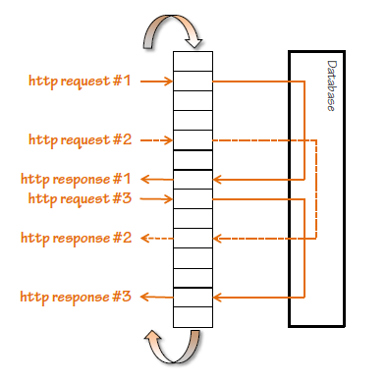
Event Loop
What does this mean in practice?

Slide 21
Node- Events
Callbacks:
getThem(param, function(err, items) {
// check for error
// operate on array of items
});
Events:
var fs = require('fs'); var rs = fs.createReadStream('./input.txt'); rs.on('open', function () { console.log('The file is open'); });
Request / Reply
No results until all results
Either error or results
Publish / Subscribe
Act on results as they arrive
Partial results before error

Slide 22
Node- Events
Node.js is perfect for event-driven applications.
Every action on a computer is an event. Like when a connection is made or a file is opened.
Node.js has a built-in module, called "Events", where you can create-, fire-, and listen for- your own events.
Methods
addListener(event, listener)
on(event, listener)
emit(event, [arg1], [arg2], [...])
removeListener(event, listener)
removeAllListeners([event])
setMaxListeners(n)
once(event, listener)
listeners(event)

Slide 23
Node - Streams
Streams are objects that let you read data from a source or write data to a destination in continuous fashion.
Stream is an EventEmitter instance and throws several events at different instance of times
Readable − Stream which is used for read operation.
Writable − Stream which is used for write operation.
Duplex − Stream which can be used for both read and write operation.
Example-

Slide 24
Node – Project Setup
Let’s Setup our Node Project…

