Slide 1

Basic Details of the Team and Problem Statement
Ministry: Ministry of Commerce and Industries
PS Code: SIH1357
Problem Statement Title: Sentiment analysis of Social Media presence
Team Name: BLINDERS
Team Leader Name: Aditya Datta
Institute Code (AISHE): C-6202
Institute Name: Heritage Institute Of Technology
Theme Name:Miscellaneous

Slide 2
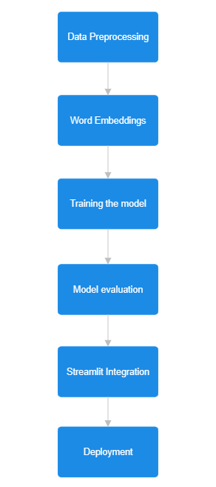
Idea/Approach Details
Describe your idea/Solution/Prototype here:
Video Link: https://youtu.be/9y8f4JikkaM
Sentix is a social media sentiment analyzer tool to monitor social media presence. Our tool utilizes LSTM models, a powerful deep learning technique, to accurately analyze and classify sentiment in social media posts and comments. To enhance usability, we have integrated Streamlit, a state-of-the-art framework, to create an intuitive user interface. Brands can easily input their social media data and obtain meaningful insights with just a few clicks.
Describe your Technology stack here:
Frontend : Streamlit
NLP library: SpaCy/ NLTK
Data Processing : Pandas
API : FastAPI
Data Visualization : Matplotlib, Seaborn
Deep Learning Models : Keras

Slide 3
Idea/Approach Details
Describe your Use Cases here
Describe your Dependencies / Show stopper here
Social Media Monitoring: Gain insights into customer opinions, identify areas of improvement, and enhance brand reputation.
Competitive Analysis: Analyze competitor sentiment to identify areas of differentiation and develop competitive strategies.
Trend Analysis: Gain insights into customer preferences, emerging trends, and consumer sentiment.
Customer Feedback Analysis: Analyze customer feedback and reviews to improve products and services.
Data availability for sentiment analysis
LSTM model training can be computationally intensive and time-consuming.
Ensuring scalability for concurrent users.
Maintaining high accuracy and generalization
Robust security measures are necessary for user data handling
User-friendly interface design is vital for user satisfaction

Slide 4
Team Member Details
Team Leader Name: Aditya Datta
Branch : Btech Stream : CSE(AI-ML) Year (I,II,III,IV): III
Team Member 1 Name: Jyotiraditya Roy
Branch : Btech Stream : CSE(AI-ML) Year (I,II,III,IV): III
Team Member 2 Name: Saptak Dutta
Branch : Btech Stream : CSE(AI-ML) Year (I,II,III,IV): III
Team Member 3 Name: Rohit Choudhury
Branch : Btech Stream : CSE(AI-ML) Year (I,II,III,IV): III
Team Member 4 Name: Debdipta Mitra
Branch : Btech Stream : CSE(AI-ML) Year (I,II,III,IV): III
Team Member 5 Name: Adhrit Bhowmick
Branch : Btech Stream : CSE(AI-ML) Year (I,II,III,IV): III
Team Mentor 1 Name: Prof.(Dr.) Raja Karmakar
Category : Academic Expertise : AI/ML Domain Experience (in years): 18

