Slide 1
SoliDoX
Under the Guidance of
Ajini A
Assistant Professor
Department of Information Technology
GEC Barton Hill
Presented By
TRV20IT024 Ashwin Joy
TRV20IT032 Faheem M
TRV20IT054 Rohit V
TRV20IT064 Sreekuttan J S
Document verification using Blockchain

Slide 2
Introduction
To create a Document verification system using Blockchain technology.
Objectives
Prevent document manipulation frauds
Developing a smart-contract for the Ethereum Virtual Machine
Create an easy to use platform to interact with the verification smart contract
Optionally store the document in an encrypted form in an off-chain storage solution like IPFS (Inter Planetary File System)

Slide 3
Solution
Identity
Each institution should publicly disclose an Ethereum Address associated with them.
Issuing
Institutions can issue a document and upload the hash of it to the blockchain, with or without our platform. A document ID will be associated with the document which can be shared to the acquirer along with the document. Optionally, a copy of the document can be stored on an off-chain storage with encryption.
Verification
Acquirer can submit the document ID and the document/decryption key to verify the document. The blockchain will point to the issuer’s Ethereum Address which is public knowledge.

Slide 4
Working
Smart-Contract
Immutable code stored in the blockchain responsible for issuing documents.
SoliDoX Platform
A portal for authorities to issue documents. Also can verify documents with it.
SoliDoX App
A simple app to verify documents using SoliDoX.
Alternatively, if the issuer and verifier has the technical know how, they can issue and very independently even without the platform.
But it is guaranteed that the original document cannot be tampered with.

Slide 5
Working
IPFS
Ethereum Network
SoliDoX Smart-Contract
Encrypted
File
Document ID
Hash and
CID (optional)
Hash
Document ID
Hash and
CID (optional)
Key
Document ID
Document ID
Hash
SoliDoX Platform
Independent Issuing
Independent Verification
Document
Document/Key and Document ID
Document ID and Key (Optionally)
Verification
Issuing Authorities
Verifiers
Document ID, Document and
Key (Optionally)
Acquirer
Document/Key and Document ID

Slide 6
Working
Issuer’s Address
0x361533c45e0a39f1dCE71b917c695CAAa73a1043
Document ID
SHA256
IPFS CID (Optional)
Expiry (Optional)
7c311687f897d351983782f93c5e69391db1e469ae9ed14ba319d125a5efecb2
Qme7ss3ARVgxv6rXqVPiikMJ8u2NLgmgszg13pYrDKEoiu
1677996803634

Slide 7
Technologies Used
Smart-Contract
Solidity
SoliDoX Platform
HTML, CSS, JavaScript, Node.js, MongoDB
SoliDoX App
Flutter

Slide 8
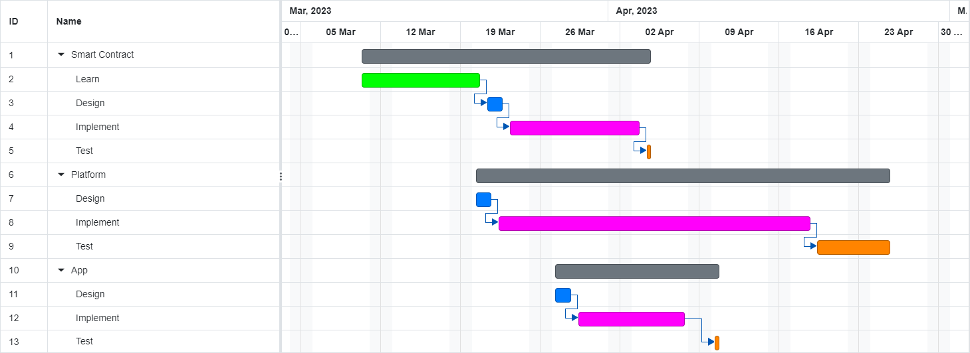
Implementation Plan

Slide 9
Conclusion
A blockchain based application used to check the genuineness of the document uploaded in order to prevent the flow of fake documents in the real world. When an authority issues a document, the Ethereum blockchain gives it an ID. Any user can verify the digital signature of a document, certifying its authenticity by referring the data on the blockchain corresponding to the ID.

Slide 10
THANK YOU

