Slide 1

Retail Sales & Customer
Performance Analysis
RETAIL ANALYTICS
PROJECT PRESENTATION
PYTHON • SQL • POWER BI
Intern Name: Rohit Rajendra Gaikwad
Internship / Organization: StarCentauri Technologies Pvt. Ltd.
Date: 22/10/2026
Every sale tells a story.

Slide 2
Business Problem & Objectives
BUSINESS PROBLEM
PROJECT OBJECTIVES
• Large transaction data makes it difficult to compare performance quickly.
• Management needs a clear view of sales, profit, customers, products and regions.
• Revenue alone is not enough; profitability and customer behaviour also matter.
• Clean and transform the dataset for reliable analysis.
• Explore trends and performance using Python and
SQL.
• Define clear KPIs for business monitoring.
• Build an interactive three-page Power BI dashboard.
2

Slide 3
Dataset Overview
TRANSACTION ROWS
TRANSFORMED COLUMNS
DISTINCT ORDERS
CUSTOMERS
51,290
35
25,035
1,590
DATA SOURCE & CONTENT
KEY FIELDS
• Source: superstore_dataset2011-2015 CSV files.
• Transaction records include orders, customers, products,
geography and financial measures.
• Order dates in the supplied transformed file span 2011–
2014.
• Sales, Profit, Quantity, Discount
• Order ID, Order Date, Customer ID
• Product ID, Category, Sub-Category, Region
3
Cleaning output: 51,290 rows × 23 columns. Transformation output: 51,290 rows × 35 columns.

Slide 4
Data Cleaning & Exploratory Analysis
DATA CLEANING
EDA ACTIVITIES
• Inspected shape, columns, data types and missing values.
• Checked duplicate rows.
• Removed Postal Code because of extensive missingness.
• Converted order and ship dates to datetime.
• Validated numeric fields and saved the cleaned CSV.
Monthly sales trend
Line chart · Identifies sales fluctuations across months and helps reveal high- and low-performing periods.
Sales by category
Bar chart- Compares Technology, Furniture and Office Supplies by sales and profit.
Sales by region
Horizontal bar chart · Highlights regions contributing the most and least revenue.
Top / bottom products
Ranked bar charts · Identifies top-selling products, low-selling products
Profit analysis
Category and region comparison
Before cleaning | After cleaning
Missing values inspected | Postal Code removed due to extensive missingness
Date formats checked | Order and Ship Date converted to datetime
Duplicate rows checked | Duplicate rows checked
Data types reviewed | Numeric columns validated
Duplicate rows in the transformed file: 0
4

Slide 5
KPIs & Analytical Visualizations
TOTAL REVENUE
TOTAL PROFIT
TOTAL ORDERS
$12.64M
$1.47M
25K
TOTAL CUSTOMERS
AVERAGE ORDER VALUE
PROFIT MARGIN
1.59K
$504.99
11.61%
CORE MEASURES
IMPORTANT VISUALS
• AOV = Revenue ÷ Distinct Orders
• Profit Margin = Profit ÷ Revenue × 100
• Monthly revenue and profit trends
• Category and region comparisons
• Top products and customer rankings
5

Slide 6
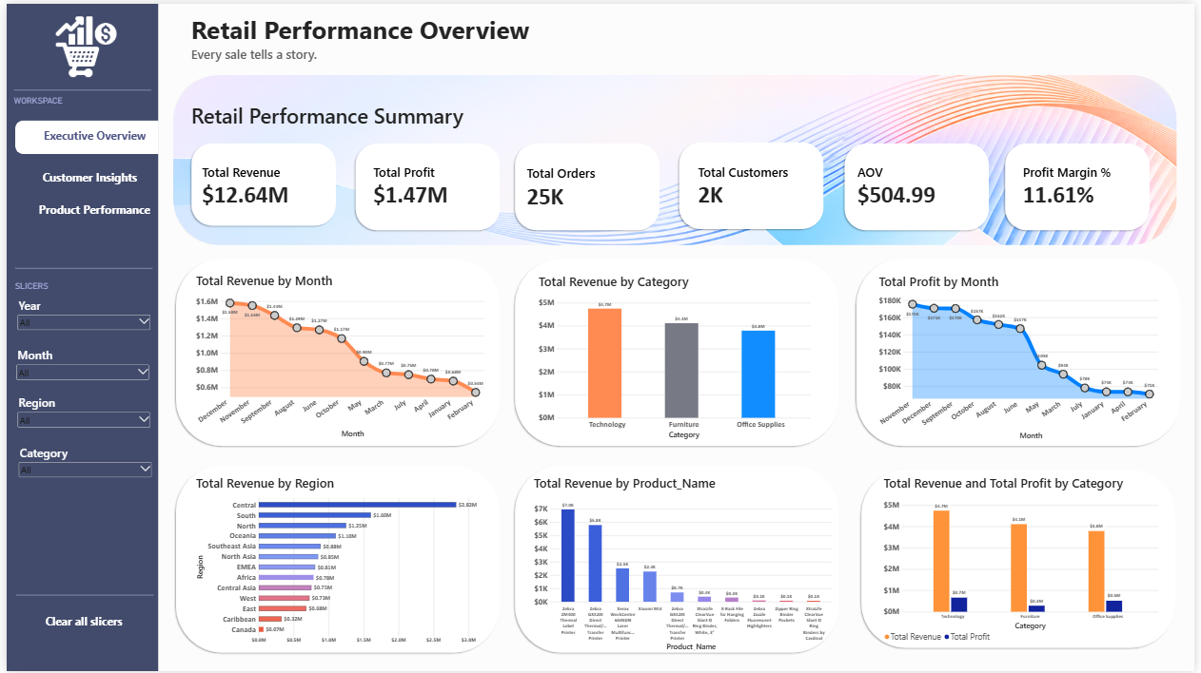
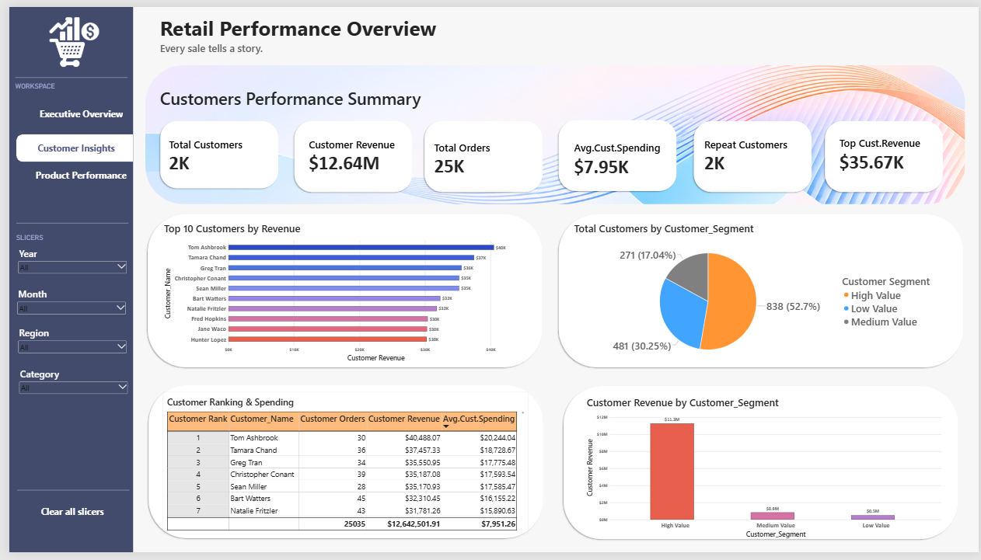
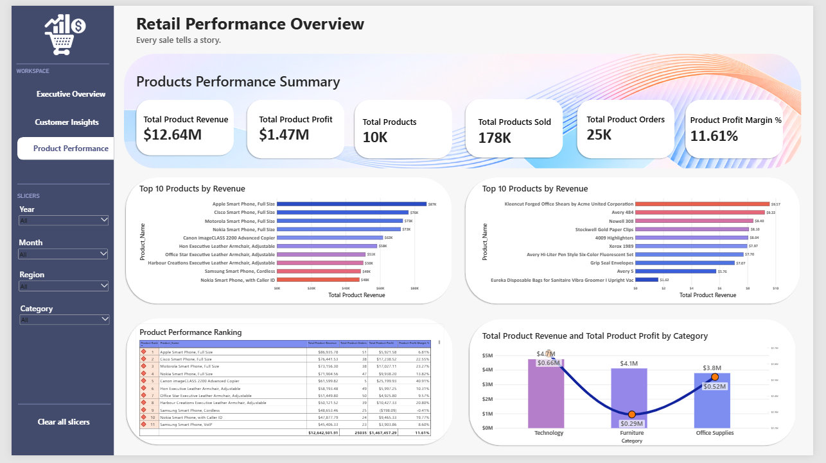
Power BI Dashboard & Key Insights
6

Slide 7
Power BI Dashboard & Key Insights
10 MAJOR FINDINGS
1. Total sales: $12.64M.
2. Total profit: $1.47M.
3. Overall profit margin: 11.61%.
4. 25,035 distinct orders were recorded.
5. 1,590 distinct customers were identified.
6. Technology had the highest category revenue.
7. Technology generated the highest category profit.
8. Office Supplies had a higher margin than Furniture.
9. Central was the leading region by sales.
10. Apple Smart Phone, Full Size was the top product by sales.

Slide 8
Challenges & Solutions
MISSING DATA
SQL IMPORT
Problem: Postal Code had extensive missing values.
Problem: Local file loading was blocked by settings.(OPT_LOCAL_INFILE=1)
Solution: Removed the field because it was not required for core analysis.
Solution: Imported the CSV using Python into retail_analysis.retail_sales_import.
POWER BI RELATIONSHIPS
DAX RANKING
Problem: Duplicate IDs blocked dimension relationships.
Problem: Customer ranks returned repeated or blank values.
Solution: Checked dimension keys and relationship cardinality.
Solution: Tested measure context and customer relationships.
DASHBOARD READABILITY
Problem: Many charts could overcrowd one page.
Solution: Separated the report into three focused pages with slicers.
7

Slide 9
Conclusion & Future Scope
WHAT WAS LEARNED
FUTURE SCOPE
• A complete analytics workflow: clean, transform, analyse and report.
• Use Python for data preparation and exploratory analysis.
• Use SQL for repeatable business queries and rankings.
• Use Power BI relationships, DAX measures, slicers and navigation.
• Validate measures and data relationships before presenting results.
• Automate data refresh and quality checks.
• Add monthly sales and profit forecasting.
• Analyse customer retention and cohorts.
• Create alerts for low-margin or declining products.
• Integrate inventory data and publish securely to Power BI Service.
THANK YOU
8

