Slide 1


Dr. D. Y. Patil Pratishthan's
Institute for Advanced Computing and Software Development
ENTERPRISE NETWORK DEFENCE AND APPLICATION MONITORING
GROUP NO. 8
KUNJAN SHARMA 258418
ROHIT GAJRE 258429
MS. RUTUJA KULKARNI
PROJECT GUIDE
MR. ANIL SHARMA
CENTRE CO-ORDINATOR

Slide 2
Network Defense Concepts
Enterprise Network
Defense Implementation
A Comprehensive Security Architecture Using DMZ, IDS, and SIEM
Defense-in-Depth
Network Segmentation
Continuous Monitoring

Slide 3
Navigation
Presentation Overview
01
Introduction & Context
02
Methodology
Modern threat landscape and security challenges
Layered defense approach and network zones
03
System Architecture
04
System Working Flow
Defense-in-depth design with four security zones
Five-phase security lifecycle from normal traffic to response
05
Implementation
06
Applications & Use Cases
Network infrastructure and security controls deployment
SOC training, incident response, and compliance audits
07
Advantages & Limitations
08
Conclusion & Future Scope
Comprehensive analysis of strengths and challenges
Key achievements and enhancement opportunities

Slide 4
Introduction & Context
The Modern Threat Landscape
Digital Transformation
Network Defense Concepts
Enterprises increasingly rely on web applications, cloud platforms, and interconnected digital systems. This transformation expands the attack surface through public-facing services and potential misconfigurations.
NDC promotes defense-in-depth using multiple security layers to protect critical assets and detect threats at various stages.
Multi-Stage Attack Lifecycle
Segmentation
Access Control
Modern cyber-attacks follow sophisticated multi-stage lifecycles: reconnaissance , exploitation , lateral movement , and data exfiltration .
IDS
Monitoring
Perimeter Security Limitations
Traditional perimeter-based security is insufficient against advanced persistent threats that bypass outer defenses and operate within the network.
Project Goal: Implement an enterprise-grade secure network using DMZ architecture, Suricata IDS, and Wazuh SIEM for comprehensive detection, monitoring, and response.

Slide 5
Methodology
Layered Defense Approach
The project follows a layered defense methodology based on Network Defense Concepts (NDC), implementing multiple security controls at different network layers to create a comprehensive protection strategy.
1
External Zone
2
DMZ Network
3
Internal Network
4
Security Zone
Internet-facing perimeter where threats originate. Contains untrusted traffic and potential attack sources.
Demilitarized Zone hosting public-facing web services. Acts as a buffer between external and internal networks.
Protected zone containing sensitive data and critical assets. No direct internet access allowed.
Dedicated monitoring infrastructure housing IDS sensors and SIEM platform for centralized security analysis.
Untrusted Network
Web Frontend
Database Server
IDS & SIEM
Network Segmentation
IDS Monitoring
SIEM Correlation
Isolates public-facing services and limits lateral movement of threats
Monitors inter-zone traffic for scans, DoS, and application-layer attacks
Centrally collects and correlates system, application, and security logs

Slide 6
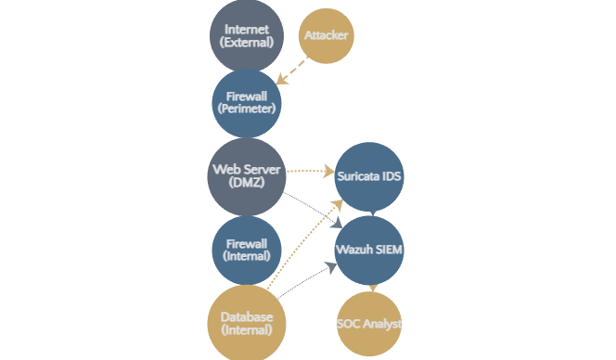
System Architecture
Defense-in-Depth Design
The architecture implements defense-in-depth and network isolation principles through strategic zoning and traffic control mechanisms.
Firewall Enforcement
Strict allow-list rules with default-deny policy between all zones
Authorized Traffic
HTTP/HTTPS to DMZ, database access from DMZ only
IDS Monitoring
Suricata passively monitors inter-zone traffic for threats
SIEM Correlation
Wazuh collects and correlates logs from all components
TLS Encryption
Secures all inter-component communication channels

Slide 7
System Working Flow
Five-Phase Security Lifecycle
1
Normal
Traffic
2
Attack
Simulation
3
Threat
Detection
4
Event
Correlation
5
SOC
Monitoring
Users access web application via HTTP/HTTPS
Controlled attacks from external machine
Suricata IDS inspects inter-zone traffic
Wazuh SIEM collects logs from all sources
Analysts monitor dashboards and alerts
Frontend communicates with database through approved ports
Attack Types:
Detection Capabilities:
Correlates related events into incidents
Investigate using logs and packet data
• Port scanning
• Port scans
• SQL injection
• SYN floods
Reduces noise and improves prioritization
Enable rapid response and escalation
Traffic forwarded to Suricata and Wazuh
• XSS attacks
• SQLi patterns
• DoS & brute-force
• Malformed requests
Complete incident response cycle
Baseline behavior established
Real-world threat scenarios
Real-time alerts generated
Consolidated incidents created
Continuous Cycle: Each phase feeds into the next, creating a comprehensive security workflow from baseline establishment through detection, correlation, and response.

Slide 8
Implementation • Part 1
Network Infrastructure Setup
Virtual Machine Architecture
Network Segmentation
Networks segmented into four distinct zones with isolated traffic flows and controlled inter-zone communication.
Implemented using multiple virtual machines to simulate a complete enterprise network environment with realistic traffic patterns and security controls.
External Network (Internet-facing)
DMZ Network (Public services)
Internal Network (Protected assets)
Web Server
Database Server
Security Zone (Monitoring tools)
DMZ Zone
Internal Zone
Static IP Addressing
Suricata IDS
Wazuh SIEM
Security Zone
Security Zone
Static IP configuration ensures consistent routing and reliable firewall rule enforcement across all network segments.
Attacker Simulation VM
Firewall Configuration
Dedicated VM for launching controlled attacks to test detection capabilities and validate security controls.
Enforced using iptables/nftables with strict default-deny policy.
Allowed: HTTP/HTTPS to DMZ, DB access from DMZ
Blocked: Internal network internet access

Slide 9
Implementation • Part 2
Security Controls Deployment
Suricata IDS
Wazuh SIEM
Intrusion Detection System
Security Information & Event Management
Passive Sensor Deployment
Manager-Agent Architecture
Deployed on mirrored interfaces for non-intrusive traffic monitoring
Scalable deployment with centralized management
Rule Configuration
Comprehensive Log Collection
Emerging Threats rules + custom rules for SQLi, XSS, HTTP anomalies
System, web, authentication, and file-integrity logs
Real-time Detection
Active Response
Inspects inter-zone traffic and generates immediate security alerts
Automated actions triggered by critical alerts
Key Benefit: Suricata provides deep packet inspection capabilities to detect sophisticated attacks at the application layer.
TLS Encryption
All inter-component communication secured with TLS encryption to protect data in transit and prevent eavesdropping.

Slide 10
Applications & Use Cases
Practical Applications
SOC Training Labs
Network Defense Demonstrations
Incident Response Exercises
Hands-on experience with real-time dashboards, alert correlation, and incident response workflows.
Visual explanation of security architecture components and their interactions for stakeholders and management.
Practice detection, containment, forensic analysis, and recovery procedures in a controlled environment.
Simulations:
Demonstrations:
Activities:
• Port scanning detection
• DMZ architecture concepts
• Packet capture analysis
• Web attack scenarios
• Firewall segmentation logic
• SIEM alert correlation
• DoS mitigation exercises
• IDS & SIEM integration
• Forensic investigation
Cybersecurity Education
Blue Team & Compliance Audits
Academic and professional training using industry-standard tools like Suricata and Wazuh.
Evaluate detection coverage using frameworks like MITRE ATT&CK and validate security posture.
Verification Areas:
Compliance Ready
Concepts:
• Comprehensive logging
ISO 27001
NIST CSF
• Defense-in-depth principles
• Access control effectiveness
• Network zoning strategies
• Encryption implementation
PCI DSS
SOC 2
• Secure design patterns
• Network isolation validation

Slide 11
Analysis
Advantages & Limitations
Advantages
Limitations
Defense-in-Depth
Complex Deployment
Layered security using segmentation, firewalls, IDS, encryption, and monitoring
Requires careful planning of zones, IDS, and SIEM setup
Enterprise-Like Architecture
High Resource Usage
DMZ and internal network separation mirrors real production environments
Multiple VMs and packet inspection need more CPU and RAM
SOC Visibility
Rule Tuning Required
Centralized logging and correlation via Wazuh SIEM enables fast detection
IDS and SIEM rules must be continuously optimized
Open-Source & Cost Effective
False Positives
Uses Suricata and Wazuh with professional-grade capabilities
Legitimate traffic may be incorrectly flagged as malicious
Multi-Attack Detection
Maintenance Overhead
Detects scans, DoS, and OWASP Top 10 web attacks
Regular updates of systems, rules, and certificates required
Modular & Scalable
Easy integration of new sensors, automation, and threat feeds
Balanced Perspective: While limitations exist, the advantages significantly outweigh challenges for organizations seeking robust security monitoring capabilities.

Slide 12
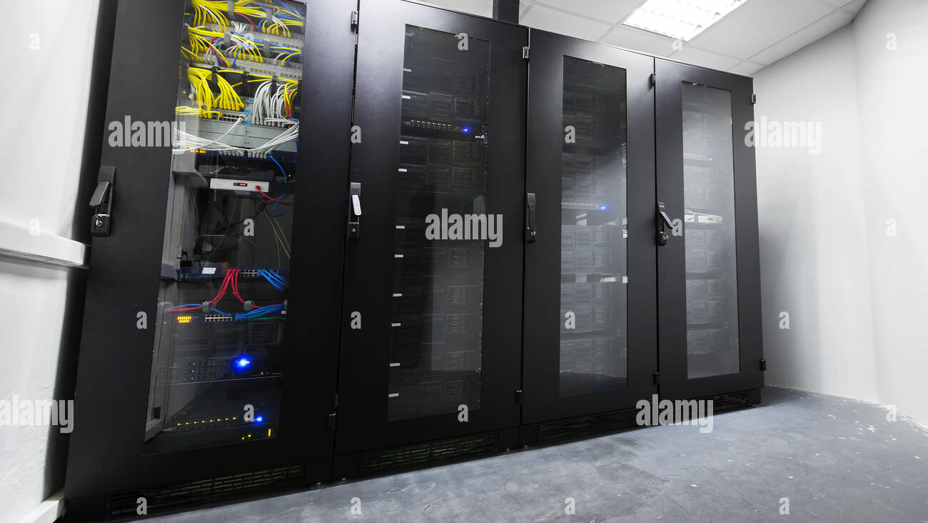
Conclusion
Key Achievements & Impact
The project successfully demonstrates Network Defense Concepts using open-source security tools, creating a comprehensive security architecture that provides enterprise-grade protection and visibility.
Strong Foundation
SOC Environment
Detection Focus
Network segmentation, firewall enforcement, Suricata IDS, and Wazuh SIEM work together to provide robust visibility and detection capabilities.
The architecture mirrors a real Security Operations Center (SOC) environment, providing hands-on experience with industry-standard tools and workflows.
Emphasizes detection and monitoring rather than perimeter-only prevention, enabling early threat identification and rapid response.
Proactive security posture
Multi-layered protection
Production-ready design
Core Achievement
Layered security and continuous monitoring significantly improve early threat identification and incident response capabilities, reducing mean time to detect (MTTD) and respond to security incidents.

Slide 13

Future Scope & Enhancements
Next Generation Security
SOAR Integration
Threat Intelligence
Integration with Security Orchestration, Automation and Response (SOAR) platforms for automated response and threat containment workflows.
Use of threat-intelligence feeds for enriched alerts, contextual awareness, and proactive threat hunting capabilities.
Automated Blocking
ML-Based Detection
Implementation of automated blocking at network boundaries based on real-time threat detection and correlation.
Machine-learning-based anomaly detection to complement signature-based IDS and identify zero-day threats.
Continuous Evolution
Security architecture designed for growth, adaptation, and integration with emerging technologies

