Slide 1

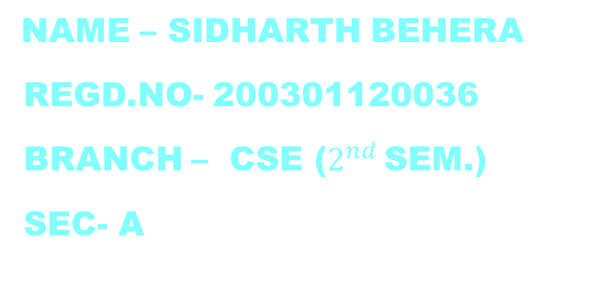
Database creation and maintenance
$2^{nd }$ INTERNAL PRESENTATION
Topic : Database Management System
NAME – sidharth beherA
Regd.no- 200301120036
Branch – cse ($2^{nd }$sem.)
Sec- a
GUIDED BY- DR. SANGRAM KESHARI SWAIN

Slide 2
Contents
What is Database Management System?
Why Use a DBMS?
Data models
Architecture of DBMS
Levels or layers of DBMS architecture
Components of DBMS
Advantage of DBMS
Disadvantage of DBMS

Slide 3
What is Database Management System?
A Database Management System (DBMS), or simply a Database System (DBS) consist of :
A collection of interrelated and persistent data (usually referred to as the database).
A set of application programs used to access, update and manage that data (which form the data management system).

Slide 4
Why Use a DBMS?
Data independence and efficient access.
Reduced application development time.
Data integrity and security.
Uniform data administration.
Concurrent access, recovery from crashes.

Slide 5
Data models
Data models define how the logical structure of a database is modeled. Data Models are fundamental entities to introduce abstraction in a DBMS.
Data models define how data is connected to each other and how they are processed and stored inside the system.
Types:
Hierarchical Model
Network Model
Relational Model
Object-Oriented Data Model
Semi-Structured Data Model

Slide 6
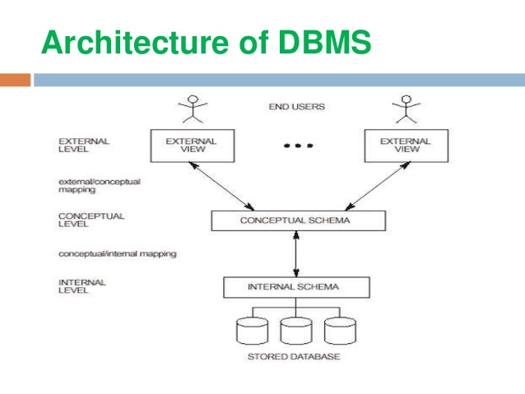
Architecture of DBMS
There are following three levels or layers of DBMS architecture:
1. External Level
2. Conceptual Level
3. Internal Level

Slide 7
Levels or layers of DBMS architecture
External Level: - External Level is described by a schema i.e. it consists of definition of logical records and relationship in the external view.
Conceptual Level: - Conceptual Level represents the entire database. Conceptual schema describes the records and relationship included in the Conceptual view.
Internal Level: - Internal level indicates hoe the data will be stored and described the data structures and access method to be used by the database.

Slide 8
Components of DBMS
1. Hardware: Can range from a PC to a network of computers.
2. Software: DBMS, operating system, network software (if necessary) and also the application programs.
3. Data: Used by the organization and a description of this data called the schema.
4. People: Includes database designers, DBAs, application programmers, and end-users.
5. Procedure: Instructions and rules that should be applied to the design and use of the database and DBMS.

Slide 9
Advantage of DBMS
Controlling Redundancy
Sharing of Data
Data Consistency
Integration of Data
Integration Constraints
Data Security
Report Writers
Control Over Concurrency
Backup and Recovery Procedures
Data Independence

Slide 10
Disadvantage of DBMS
Cost of Hardware and Software
Cost of Data Conversion
Cost of Staff Training
Appointing Technical Staff
Database Damage

Slide 11
THANK YOU

