Slide 1
Bank Loan Analysis
Comprehensive Analysis of Lending Activities and Performance of Bank Loan

Slide 2
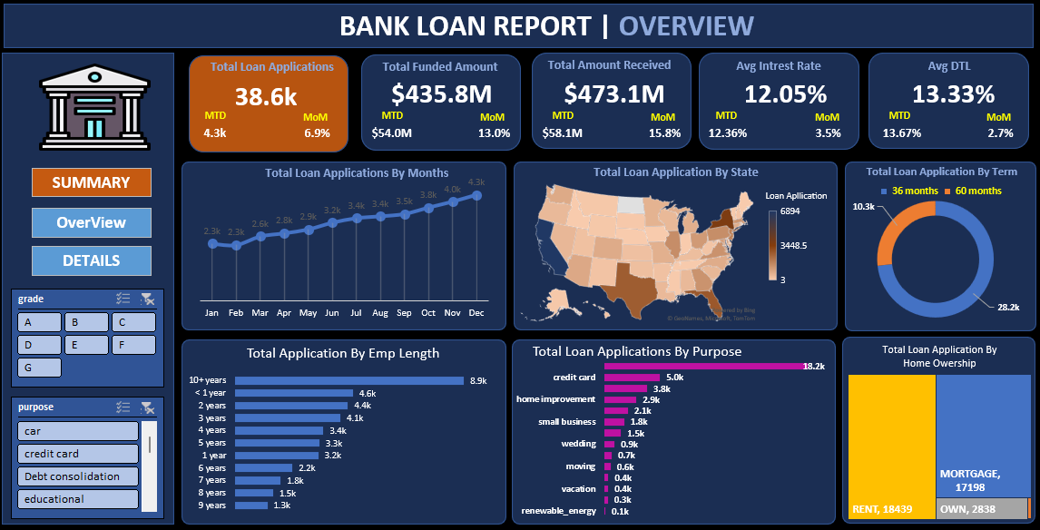
Overview Dashboard
The Overview Dashboard visually represents critical loan-related metrics and trends. It uses diverse chart types to facilitate data-driven decision-making and insights into loan parameters, lending trends, and borrower behavior.

Slide 3
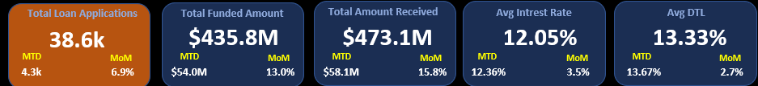
Monthly Trends by Issue Date
- Line Chart showcasing 'Total Loan Applications,' 'Total Funded Amount,' and 'Total Amount Received' over time.
- Identifies seasonality and long-term trends in lending activities.

Slide 4
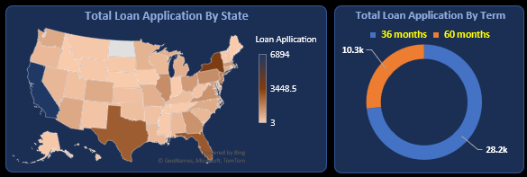
Regional and Loan Term Analysis
1. Regional Analysis by State (Filled Map):
- Visualize lending metrics by state.
- Identify regional disparities and significant lending activities.
2. Loan Term Analysis (Donut Chart):
- Depict loan statistics based on different term lengths (e.g., 36 months, 60 months).

Slide 5
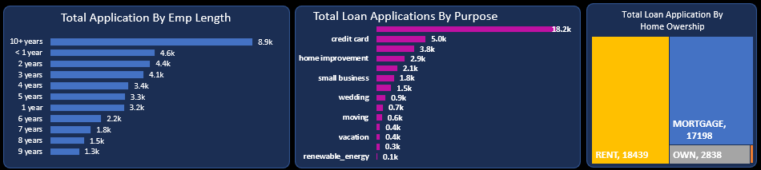
Borrower Insights
1. Employee Length Analysis (Bar Chart):
- Lending metrics distributed among borrowers with different employment lengths.
2. Loan Purpose Breakdown (Bar Chart):
- Visual breakdown of loan metrics based on loan purposes (e.g., debt consolidation).
3. Home Ownership Analysis (Tree Map):
- Hierarchical view of loan metrics by home ownership statuses.

Slide 6
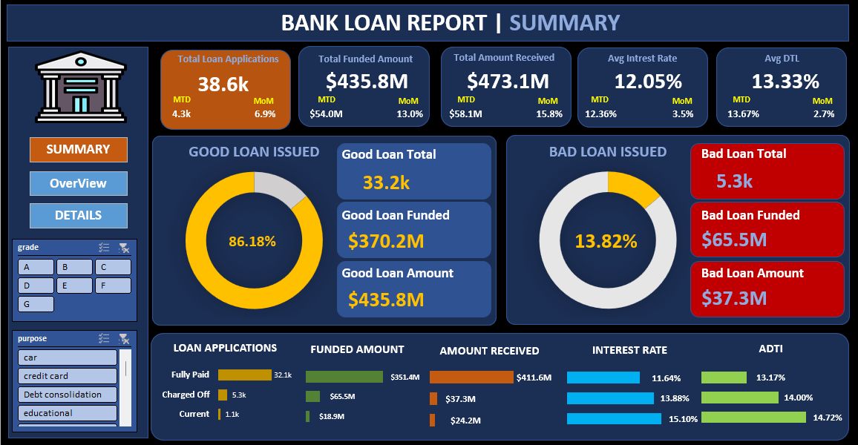
SUMMARY Dashboard
The Summary Dashboard provides detailed insights into loan performance metrics, distinguishing between 'Good Loans' and 'Bad Loans.' It helps monitor lending quality, track repayment performance, and assess overall portfolio health.

Slide 7
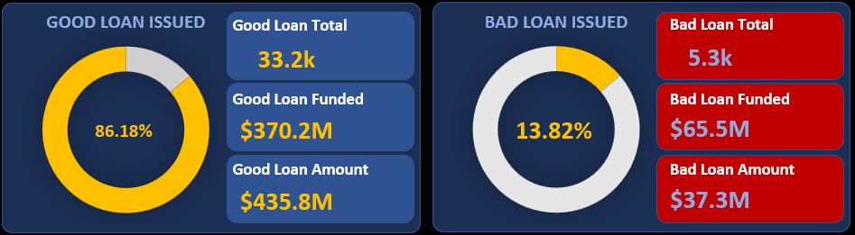
Good Loans KPIs
1. Good Loan Application Percentage: Percentage of 'Fully Paid' and 'Current' loans.
2. Good Loan Applications: Total number of 'Good Loans.'
3. Good Loan Funded Amount: Total funds disbursed for 'Good Loans.'
4. Good Loan Total Received Amount: Total repayments from 'Good Loans.'

Slide 8
Bad Loans KPIs
1. Bad Loan Application Percentage: Percentage of 'Charged Off' loans.
2. Bad Loan Applications: Total number of 'Bad Loans.'
3. Bad Loan Funded Amount: Total funds disbursed for 'Bad Loans.'
4. Bad Loan Total Received Amount: Total repayments from 'Bad Loans.'

Slide 9
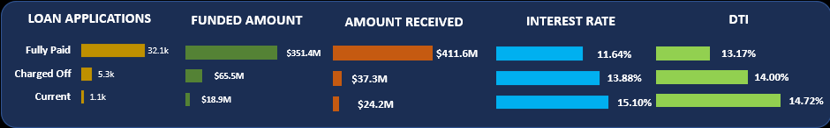
Loan Status Grid View
- Comprehensive overview of loan operations categorized by 'Loan Status.'
- Metrics include: 'Total Loan Applications,' 'Total Funded Amount,' 'Total Amount Received,' 'Average Interest Rate,' and 'Average DTI.'
- Empowers data-driven decisions for portfolio health monitoring.

Slide 10
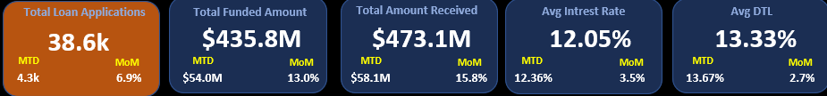
Details Dashboard
- A holistic snapshot of key loan-related metrics and borrower profiles.
- Includes insights into loan applications, funding, repayments, and loan statuses.
- Serves as a centralized source of information for assessing lending operations.

Slide 11
Name: Rohit Jangam
Gmail: jangamrohit88@gmail.com
Linkdin: linkedin.com/in/rohitjangam/
GitHub: github.com/RohitGovindJangam

