Slide 1
Blinkit Analysis
India's Last Minute App

Slide 2
Methodology
1. Requirement Gathering
2. Data Cleaning and Quality Check
3. Data Modeling and Processing
4. DAX Calculations
5. Dashboard Layout and Visualization
6. Insights Generation

Slide 3
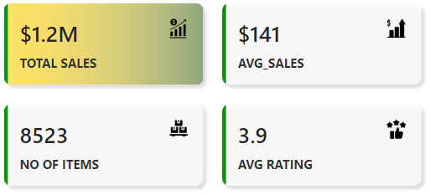
Business Requirements
- Conduct a comprehensive analysis of Blinkit's sales performance. KPIs:
- Total Sales: $1.2M
- Average Sales: $141
- Number of Items: 8523
- Average Rating: 3.9

Slide 4
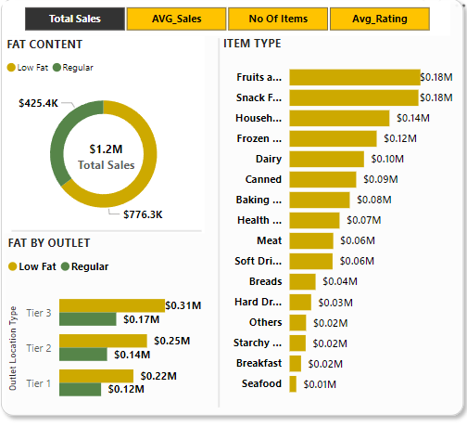
Analysis 1: Total Sales by Fat Content
- Donut chart analyzing sales based on fat content.
- Key Insight: Regular fat contributes $776.3K, Low fat $425.4K.
- Bar chart of item type performance.
- Key Insight: Highest sales from Fruits & Vegetables and Snack Foods.

Slide 5
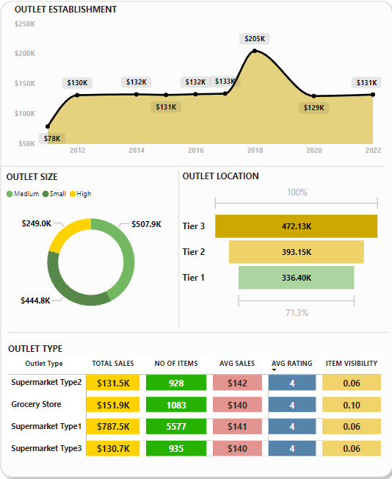
OUTLIET ESTABLISHMEST, SIZE, LOCATION, TYPES
- Line chart of OUTLIET ESTABLISHMEST performance.
- Donut Chart: OUTLIET SIZE from HIGH, MEDIUM, SMALL
- Funnel chart of item type performance are Tier1, Tier2, Tier3.
- Matrix Chart: OUTLIER TYPE ------>

Slide 6
Blinkit Analysis
India's Last Minute App
Name : Rohit Jangam
Gmail: jangamrohit88@gmail.com
LinkedIn: linkedin.com/in/rohitjangam/
GitHub: github.com/RohitGovindJangam/

