Slide 1
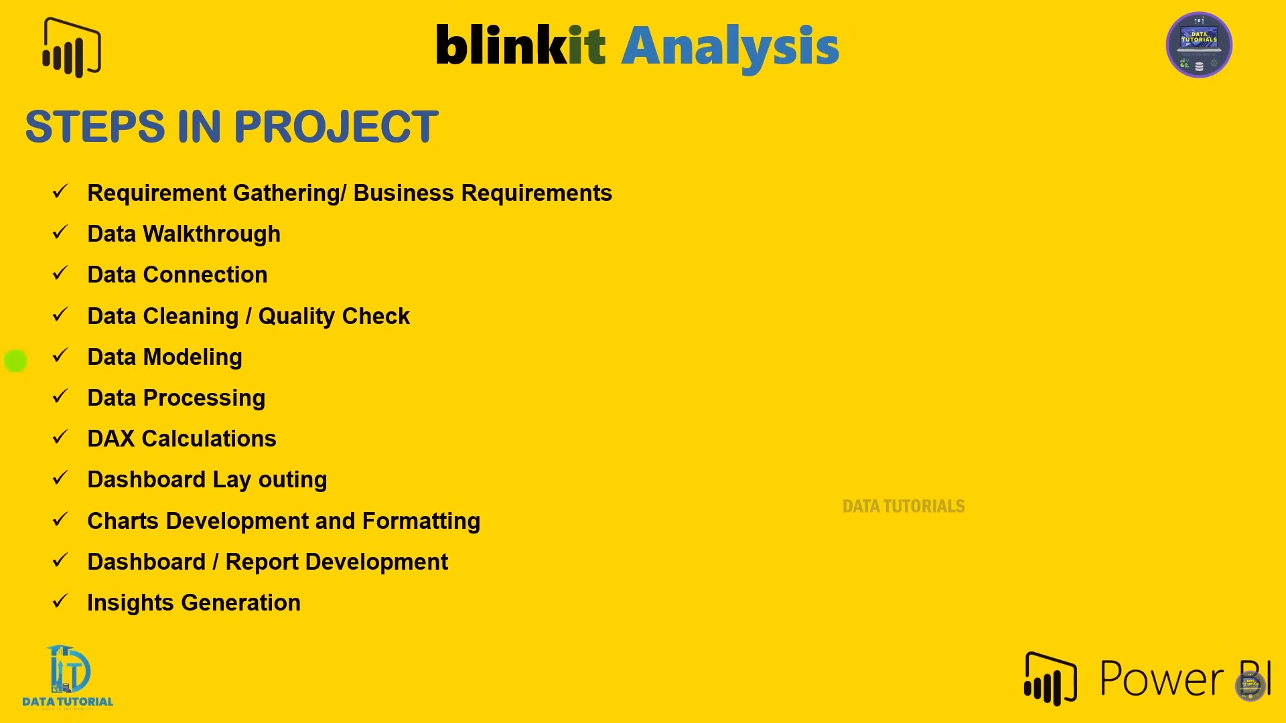
Steps in Project

Slide 2
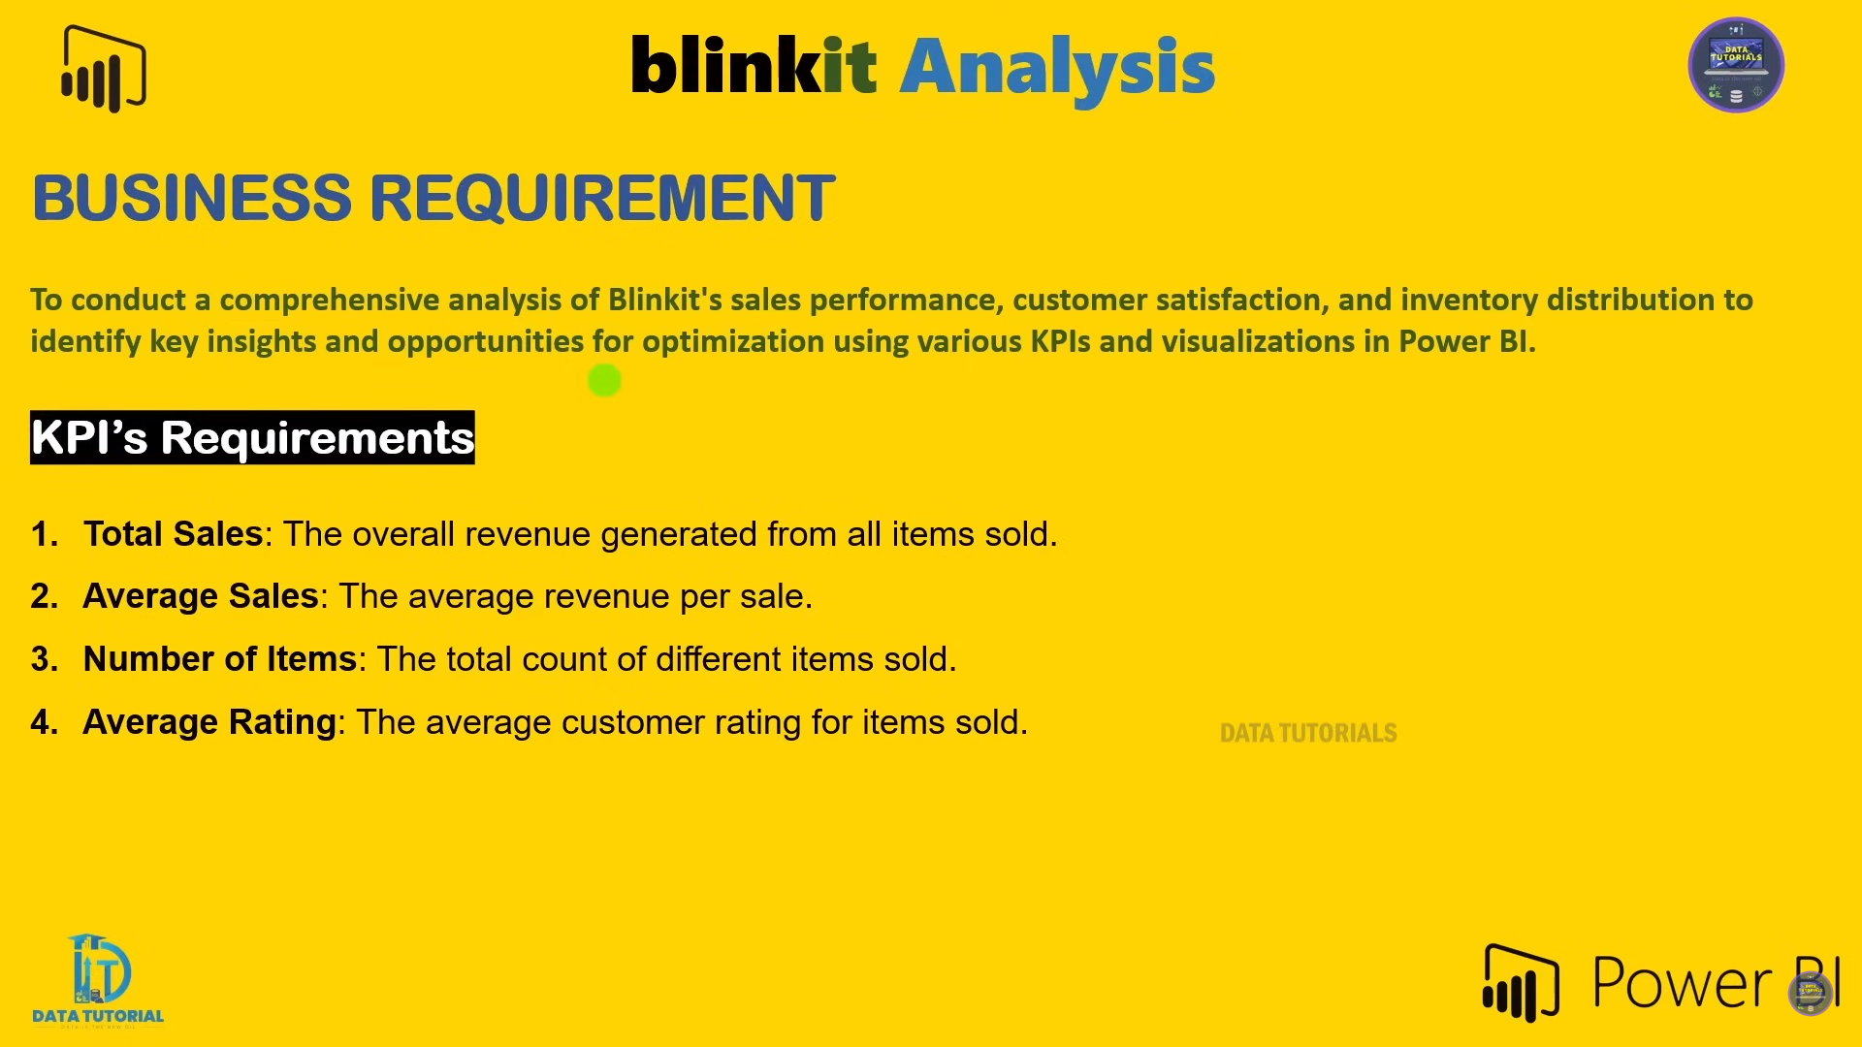
Business Requirement (KPIs)

Slide 3
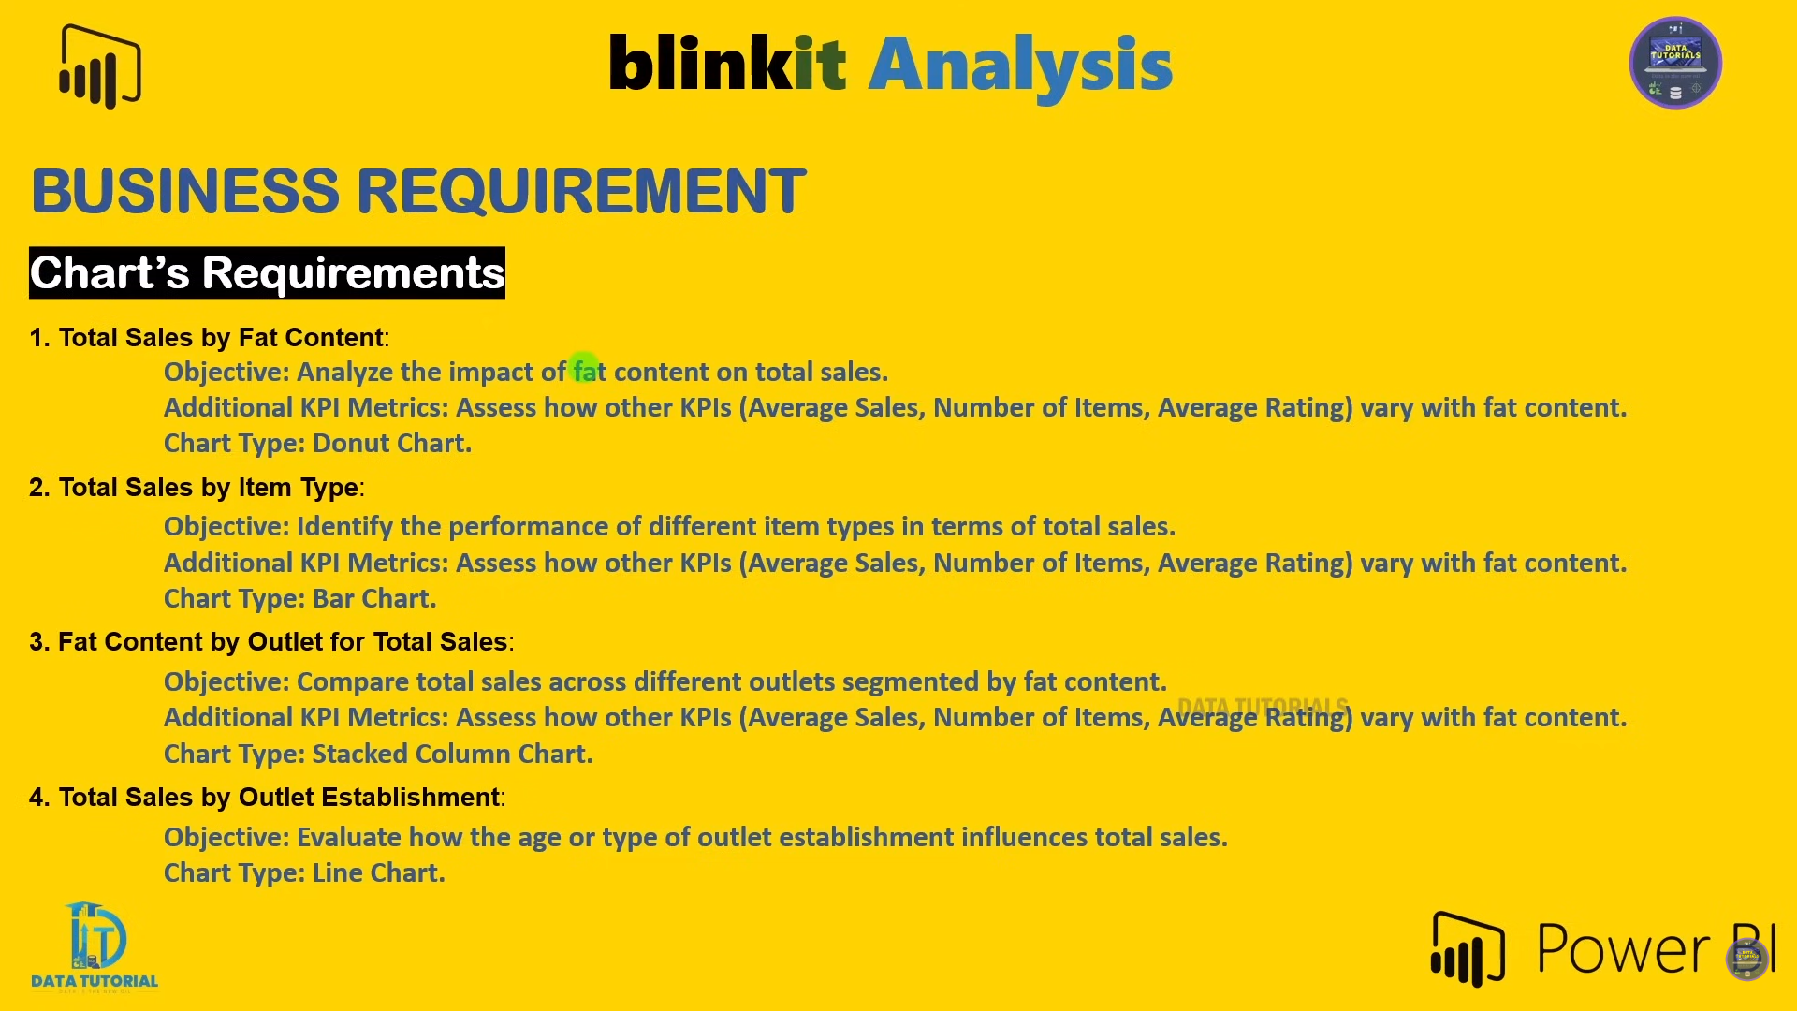
Business Requirement (Charts)

Slide 4
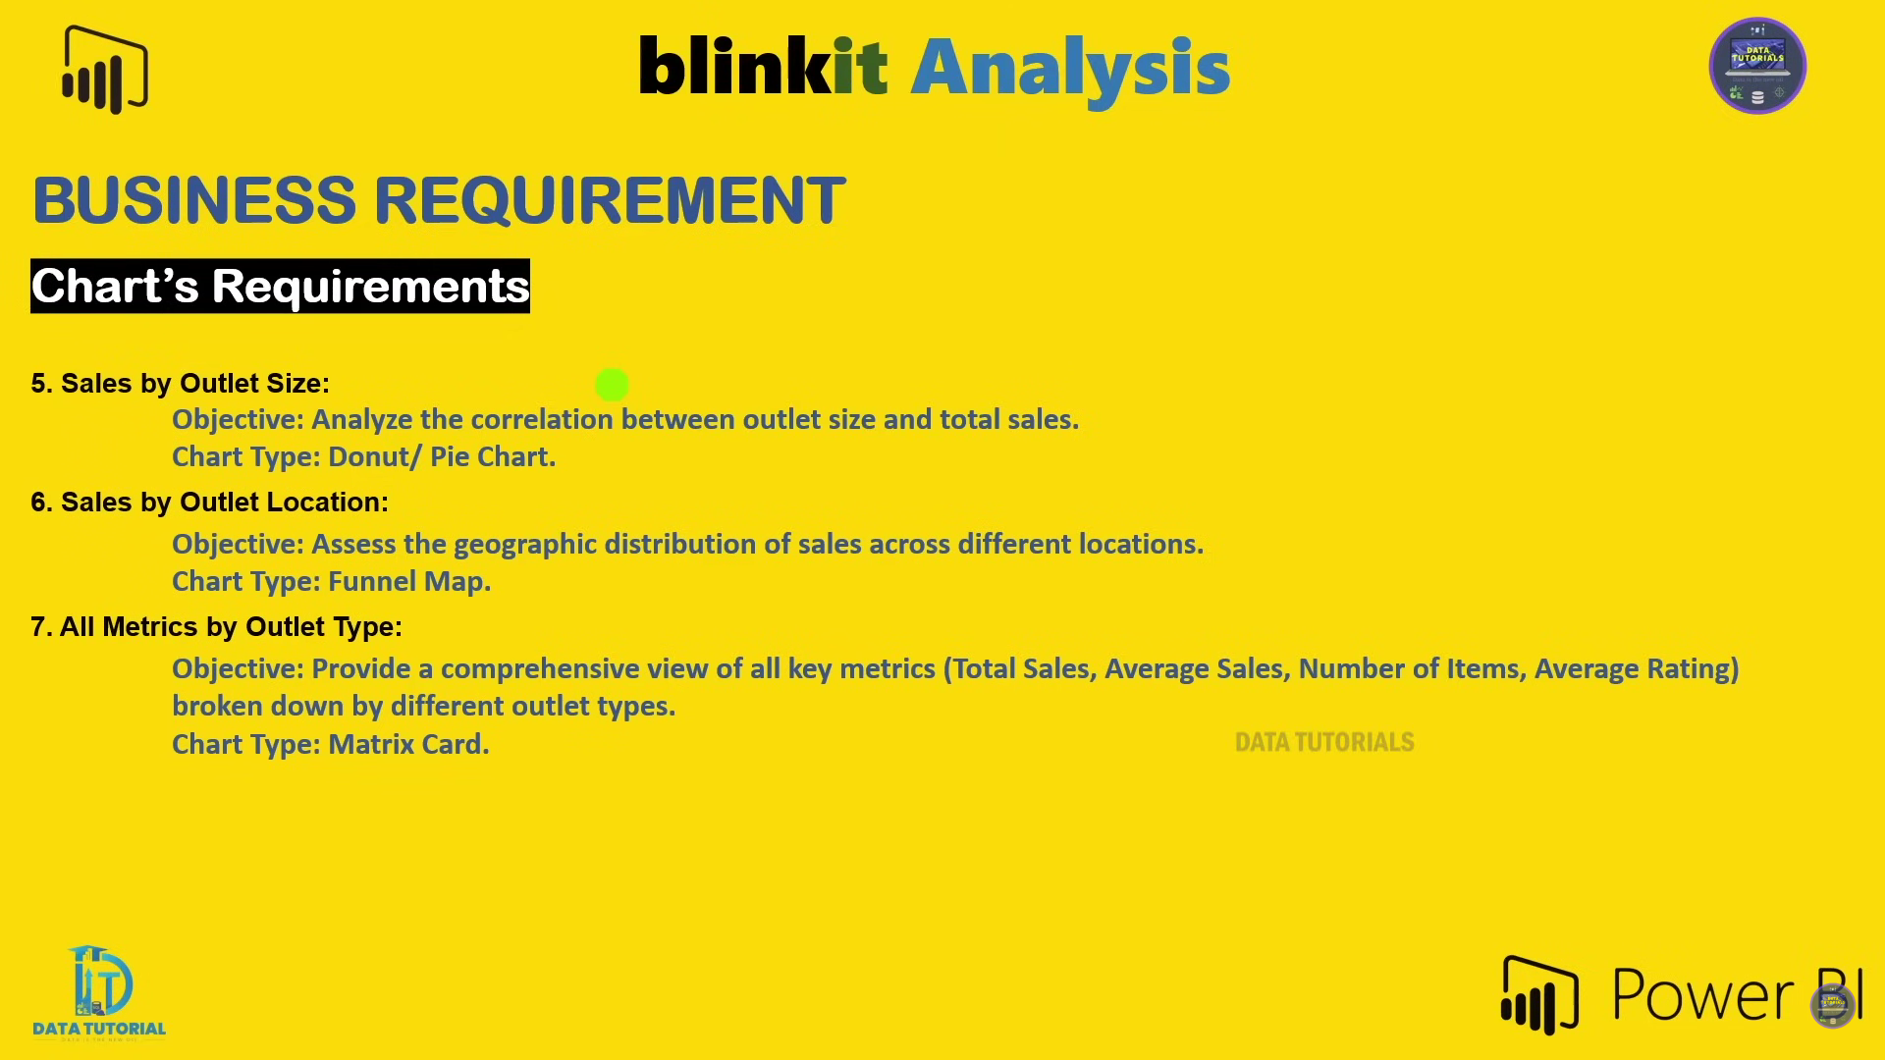
Business Requirement (Charts)

