Slide 1

DEPARTMENT OF COMPUTER SCIENCE Project Presentation (BCS 554) Decentralized AI Trip Generator
Dr Amit Sanger (Professor)
Project Members
1.Shivam Tyagi 2200290120161 C
2.Rohan Pandey 2200290120137 C
3.Sammer Matoria 2200290120146 C
4.Rohit Halsana 2200290120138 c

Slide 2
Table of content
5. Diagrams
6. Patent Status
7. Research Paper Status
8. Project Status
9.Refrences
Problem Statement.
Objectives.
Technology Used.
Literature Survey

Slide 3
Problem Statement
Current travel planning systems rely heavily on centralized platforms that store and process vast amounts of user data in a single location. This centralized approach poses significant risks related to data breaches, misuse of personal information, and lack of transparency. Additionally, these platforms often provide generic travel suggestions, lacking the ability to adapt to the unique preferences, needs, and real-time circumstances of each traveller.

Slide 4
Objectives
Maintains user privacy and control over data
Generates personalized travel itineraries
Enhances security and trust

Slide 5
Technology Used
Blockchain
2. MERN STACK
3. Gemini API

Slide 6
Literature Survey
1. Introduction to Decentralization in Travel Planning
2. Personalization through AI
3. Community-driven Content and User Contributions
4. Blockchain Technology in Travel
5. Real-time Adaptability and Data Integration

Slide 7
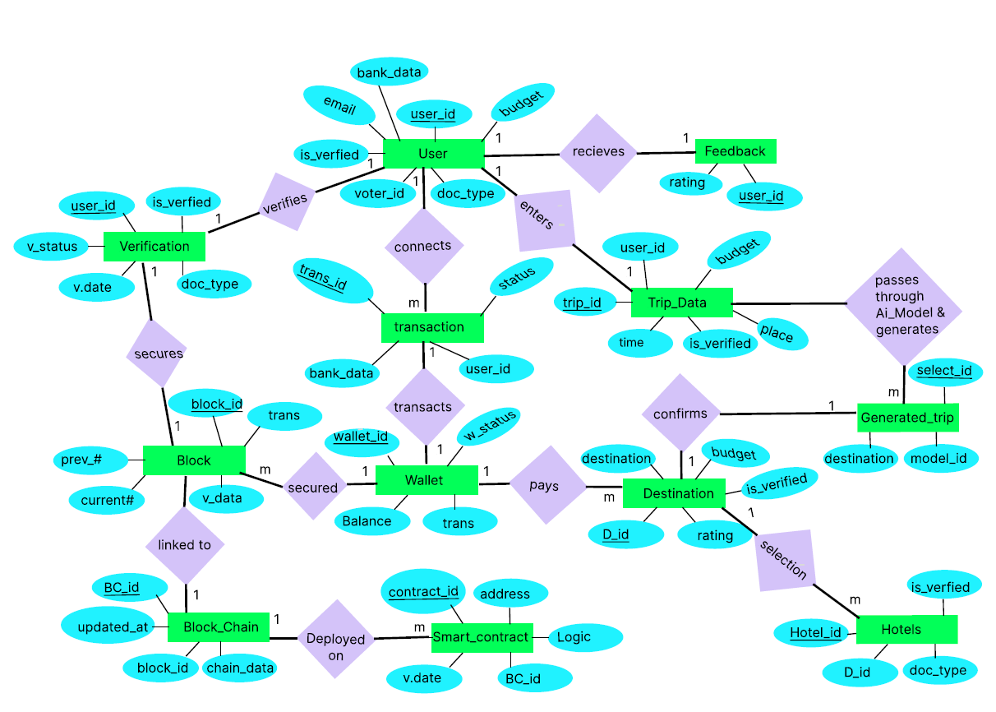
ER Diagram

Slide 8
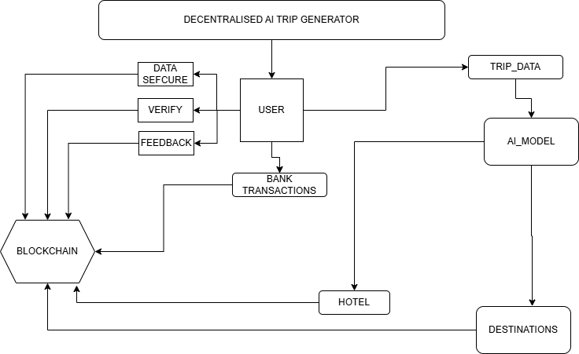
Flow Chart

Slide 9
Patent Status – in process

Slide 10
Project Status
Github Link.
SameerMatoria/AI-trip-planner: An Ai based Trip planner webapp that will help the user to find the best way they can plan there trip

Slide 11
References
Kim, J. H., et al. (2024). Do you trust ChatGPTs? Effects of the ethical and quality issues of generative AI on travel decisions
Chen, A., et al. (2021). TravelAgent: An AI Assistant for Personalized Travel Planning. Proceedings of
Jabeen, F., et al. (2021). Automation and artificial intelligence in hospitality and tourism
Unnamed authors (2020). BloHosT: Blockchain Enabled Smart Tourism and Hospitality Management.

