Slide 1

Exploratory Project
29-November-2018 | Low cost blood pressure monitor device for developing countries
Department - Biomedical engineering
Roll no. – 17024012 Name – Rohit Kumar Hansdah
Roll no. – 17024014 Name – Saurabh Kumar Yadav

Slide 2
Introduction:
Taking the Blood Pressure (BP) with a traditional sphygmomanometer requires a trained user. In developed countries, patients who need to monitor their BP at home usually acquire an electronic BP device with an automatic inflate/deflate cycle that determines the BP through the oscillometric method. For patients in resource constrained regions automated BP measurement devices are scarce because supply channels are limited and relative costs are high. Consequently, routine screening for and monitoring of hypertension is not common place. In this project we aim to offer an alternative strategy to measure BP and Heart Rate (HR) in developing countries. Given that mobile phones are becoming increasingly available and affordable in these regions, we designed a system that comprises low-cost peripherals with minimal electronics, offloading the main processing to the phone. A simple pressure sensor passes information to the mobile phone and the oscillometric method is used to determine BP and HR. Data are then transmitted to a central medical record to reduce errors in time stamping and information loss.

Slide 3
Objective of project:
The objective of this project is to design and make a low cost blood pressure device for developing countries.
Scope of work:
New innovations are made in the field of digital Blood Pressure measuring machines, cuffless Blood Pressure are a new field of research. Lot of scope is there in digital Blood Pressure machine there I are researches going on in order to improve the Blood Pressure device and the internal hardware is made more compact . In this era of semiconductor technology new compact circuits can be made for digital Blood Pressure’s and regular Blood Pressure checkup can be done and the data can be stored in the computer database in digital form. Further the collected data can be used for diagnosis. Blood Pressure related diseases can be easily diagnosed by using the data in the computer and now a days new software are also developed which read different Blood Pressure graphs and give us the proper treatment.

Slide 4
Circuit Description:
Materials required:
Arduino uno
Breadboard
Force sensitive resistor
LED
10KOhm & 220 Ohm resistors
BP cuff

Slide 5
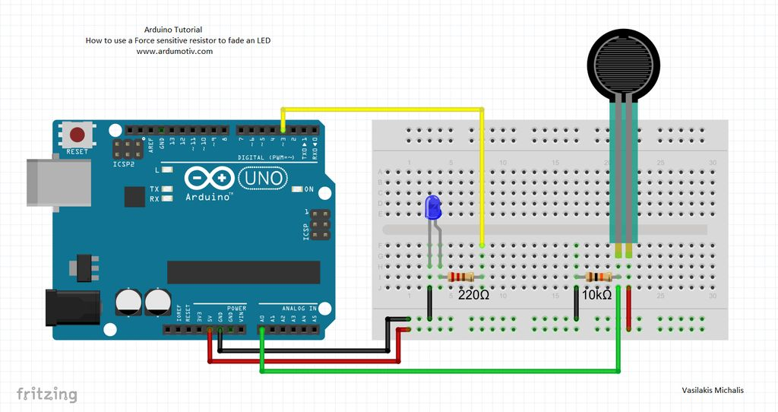

Slide 6
FSR(Force Sensitive Resistor):
Force sensitive resistor definition
A force sensitive resistor is a type of variable resistor whose resistance decreases when the applied force increases. Force sensitive resistors are also known as force sensing resistors, FSR, force sensor, or pressure sensor.
Construction and working of force sensitive resistor
The force sensitive resistor consists of conductive polymer whose resistance changes when the force is applied. It is normally supplied as polymer sheet or ink that can be applied by a technique called screen-printing. Screen-printing is a technique used to transfer ink into a substrate.
The sensing film consists of both electrically non-conducting and conducting particles suspended in matrix. When the force is applied, the sensing film causesparticles to touch the conducting electrodes. As a result, the resistance of the film decreases.
The resistance of the force sensitive resistor is depends on the amount of force applied. If large amount of force is applied, the resistance of the force sensitive resistor decreases and provides low resistance to the electric current. On the other hand, if little force or no force is applied to the force sensitive resistor, the resistance remains same and provides high resistance to the electric current.

Slide 7
Arduino uno:
Arduino is an open-source electronics platform based on easy-to-use hardware and software. Arduino boards are able to read inputs - light on a sensor, a finger on a button, or a Twitter message - and turn it into an output - activating a motor, turning on an LED, publishing something online. You can tell your board what to do by sending a set of instructions to the microcontroller on the board. To do so you use the Arduino programming language (based on Wiring), and the Arduino Software (IDE), based on Processing.Over the years Arduino has been the brain of thousands of projects, from everyday objects to complex scientific instruments. A worldwide community of makers - students, hobbyists, artists, programmers, and professionals - has gathered around this open-source platform, their contributions have added up to an incredible amount of accessible knowledge that can be of great help to novices and experts alike.

Slide 8
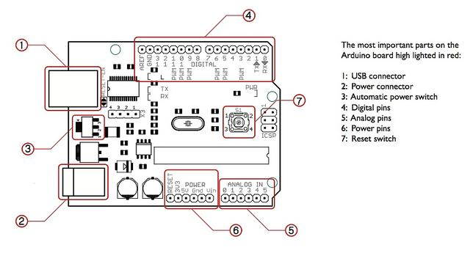

Slide 9
Blood Pressure:
Blood pressure (BP) is the pressure of circulating blood on the walls of blood vessels. Used without further specification, "blood pressure" usually refers to the pressure in large arteries of the systemic circulation. Blood pressure is usually expressed in terms of the systolic pressure (maximum during one heart beat) over diastolic pressure (minimum in between two heart beats) and is measured in millimeters of mercury (mmHg), above the surrounding atmospheric pressure.
Blood pressure is one of the vital signs, along with respiratory rate, heart rate, oxygen saturation, and body temperature. Normal resting blood pressure in an adult is approximately 120 millimetres of mercury (16 kPa) systolic, and 80 millimetres of mercury (11 kPa) diastolic, abbreviated "120/80 mmHg".
Traditionally, blood pressure was measured non-invasively using a mercury-tube sphygmomanometer, or an aneroid gauge, which is still generally considered to be the gold standard of accuracy for auscultatory readings.^{[1]} More recently other semi-automated methods have become common, largely due to concerns about potential mercury toxicity,^{[2]} although cost and ease of use havealsoinfluenced this trend.^{[1]} Early automated alternatives to mercury-tube sphygmomanometers were often seriously inaccurate, but validated devices allow for an average difference between two standardized reading methods of 5 mm Hg or less and a standard deviation of less than 8 mm Hg.

Slide 10
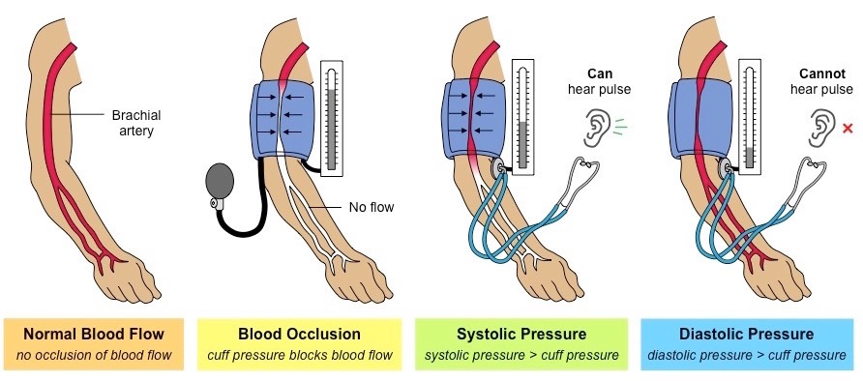

Slide 11
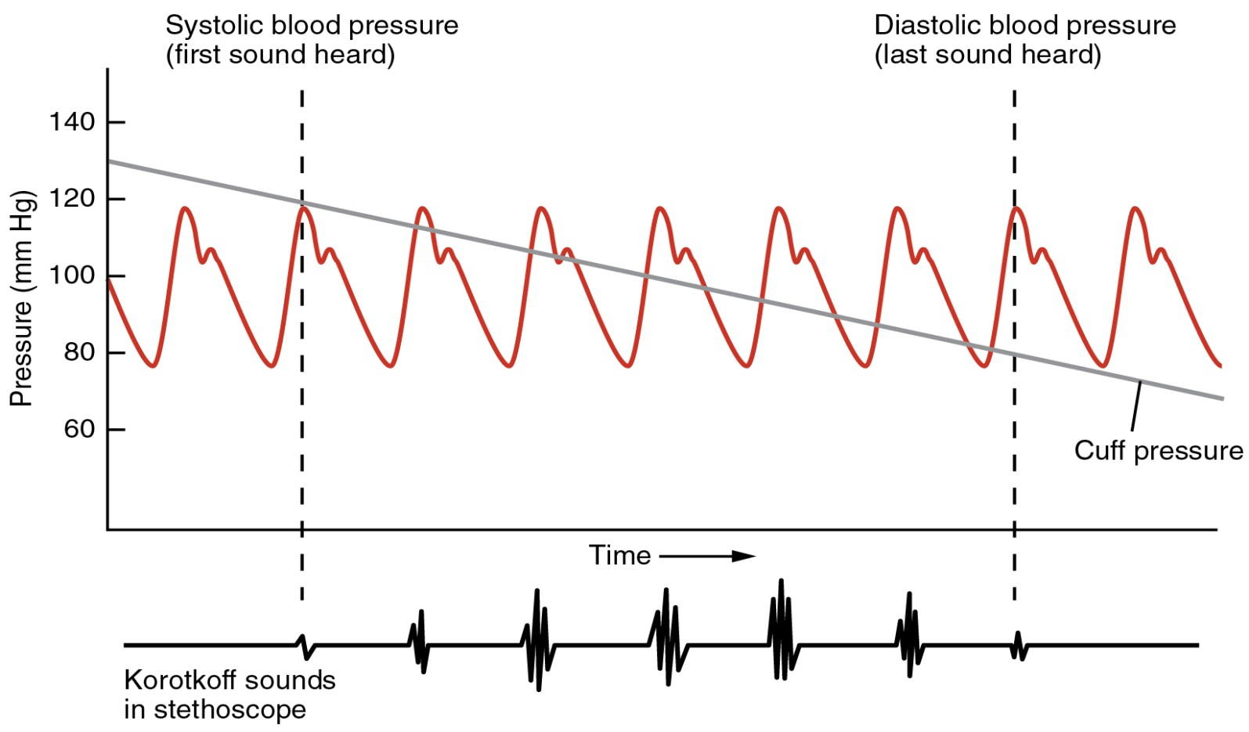
Graph Analysis:

Slide 12
Thank you

