Slide 1
Gaussian Process Regression and Classification
Rohit Jain
Roll No. - 14MF3IM13
Project Guide - Dr. Swanand Ravindra Khare

Slide 2
Motivation
In our daily life we come across many situations where we need to predict something so as to prevent a cause or optimize the outcome.
This is where predictive modelling and data analysis comes into picture.
One such algorithm for doing so is Gaussian Processes.

Slide 3
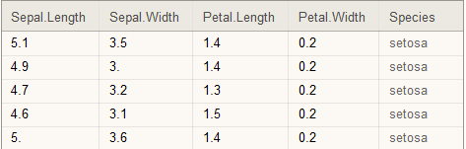
Motivation(continued)
Suppose we have some dataset as shown and we need to predict Species based on the other 4 columns(variables).
This is said to be predictive modelling.
This looks easy but as the size of the dataset becomes bigger, it gets difficult to predict this.

Slide 4
Motivation(continued)
Other methods used for predictive modelling are based on a training process or learning process which are derivative based. This has many drawbacks including local optimum finding and non-differentiable functions.
The reason for picking this algorithm is that it tends to handle non-linearity and linearity with equal ease and thus could be used anywhere.
A better approach could be to use prior and posterior probabilities estimation for the same which is indeed the case with Gaussian processes.

Slide 5
Mathematical Introduction
Classification Problem
The objective of pattern recognition is to set a decision rule that optimally partitions the data space into c regions, one for each class Ck. The boundaries between regions are the decision boundaries.
The most general classification approach is to use the posterior probability of class membership i.e. p(Ck|x).
To minimize the probability of misclassification, one should select the maximum a posterior rule and assign x to class Ck.

Slide 6
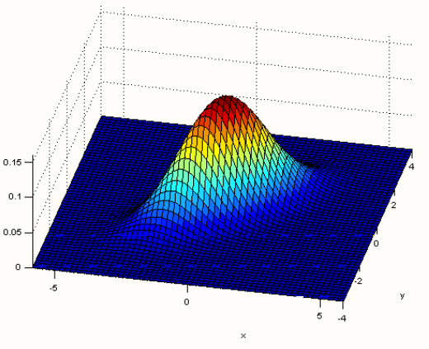
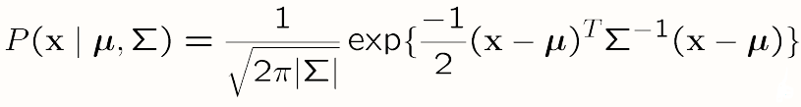
Multivariate Gaussian Distribution
It is the same as 1-D but in
2 or more dimensions.
Rasmussen and Williams

Slide 7
Covariance Function
From a modeling point of view, we wish to specify prior covariance that contains our prior beliefs about the structure of the function we are modeling.
Formally, we are required to specify a function that will generate a non-negative definite covariance matrix for any set of input points.

Slide 8
Gaussian processes
In more general sense it makes points which are similar in 'x' co-ordinates similar in 'y' too.
This is incorporated by the kernel matrix or the covariance matrix.
A kernel is basically a function that measures similarity between the points given in the training set or the points plotted.

Slide 9
Gaussian process regression
Initially we note different points in X axis where the points are given. Then we have to see for the prior similarity between the points which is done using the kernel formula defined earlier.
As we have assumed that these points will follow a multivariate Gaussian distribution in itself we note down the mean and variance of the distribution.
We take µ(mean) as 0 for the prior distribution. Also setting the hyper parameter values accordingly.

Slide 10
Gaussian process regression(continued)
We use the multivariate Gaussian theorem to find the conditional
probability distribution of f(posterior) using the formula:
where,
K* is Kernel Matrix associating both prior and posterior.
K** is a kernel matrix which is computed using all pair of points from only posterior points set.

Slide 11

Gaussian Process Classification
For the two-class problem, we use the logistic function to produce an output that can be interpreted as psi(x) = sigma(y(x)), the probability of the input x belonging to class 1.
Making classiffcation for a test input x* given a set of training data, with a fixed set of hyperparameters, requires the calculation of the integral defined:-

Slide 12
The second part of this integral when calculated becomes analytically intractable.
Faced with this problem, there are two ways to evaluate the integral, namely 1) to use an analytic approximation or 2) to use Monte Carlo methods.
We consider an analytic approximation based on Laplace's method for our analysis.

Slide 13
Novel gas dataset
The 5 datasets for the experiment is 'Gas Sensor Array Drift Dataset' from UCI Machine Learning repository.
The experimental equipment for it consists of gas pumps, mass flow controllers, a sensor chamber, and a computer used for data acquisition and the experiment control.
In a gas chamber, a sensor array is placed based either on the commercial TGS or MHP microelectronic gas sensors.
Vapors were injected into the gas chamber at a flow rate determined by the mass flow controllers.

Slide 14
Experiments setups
First experiment: A sensor array composed of five commercial tin oxide gas sensors, have been used to discriminate between ethanol and butanol.
Second experiment: For the detection of CO in the presence of CH4, we have used an array of eight microelectronic gas sensors.
Third experiment: It has the same experimental procedure as the second one but detects CO in the presence of hydrogen.

Slide 15
Fourth experiment: The aim of fourth experiment is to separate the signatures of carbon monoxide and the mixture of carbon monoxide and methane.
Fifth experiment: Methane, carbon monoxide, or their mixture vapors were injected into the gas chamber at a flow rate determined and accurately controlled by the mass flow controllers.

Slide 16
Solution Strategy
The most important multivariate tool for exploratory analysis is the PCA(principal component analysis).
PCA was therefore used as a preprocessing stage for redundancy removing and feature reduction before applying a given classiffier.
The two first components allow us to take into account more than 95 percentage of the data variance, we limit our representation to these components.

Slide 17
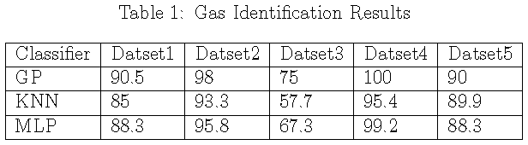
Results and Discussion
Using GP classiffers, we obtained results that are superior to both KNN and MLP for gas identification applications.
In addition, it was shown that the GP classiffier can be applied to the general case of identifying more than two gases.
PCA and GP classifier when mixed fetches us outstanding results as shown here.

Slide 18
Diesel Dataset
Data used in this paper was collected by Southwest Research Institute in a project sponsored by the U.S. Army. Eigenvector Research Incorporated provides 784 samples in Near Infrared Spectra of Diesel Fuels.
The main properties used in this dataset are Cetane Number, Boiling Point at 50% Recovery and Viscosity.

Slide 19
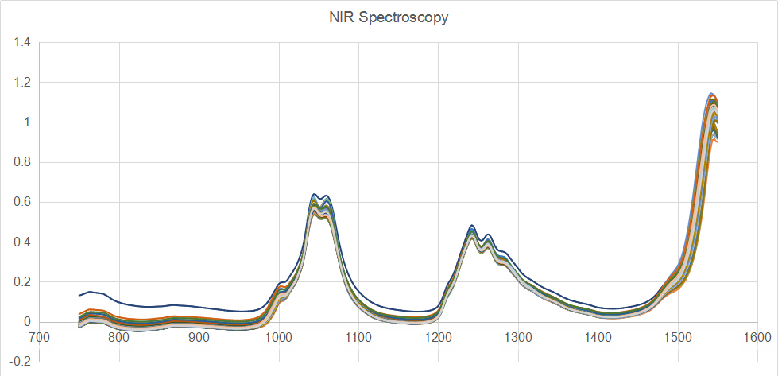
NIR Spectroscopy
The plot shows the variation of Absorbance with frequency for all the samples in the dataset.
We could see similar trend being followed.
Absorbance
Frequency(nm)

Slide 20
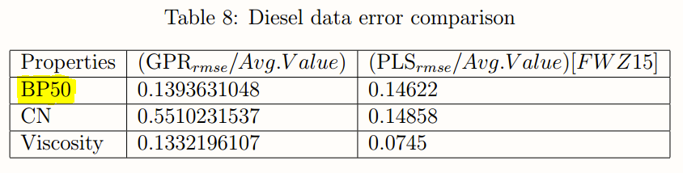
Results and Discussion
The results came out to be in par with other experiments done using other algorithms.
Main algorithms used apart from GPR are LS-SVM, PLS, genetic multivariate analysis, PCR etc.
But in most of the papers we have some form of pre processing of data being used to improve the performance of the result.
Also, other papers referred here uses only 3 types of diesel whereas in this paper we have used all the types making it more difficult to analyze and model.

Slide 21
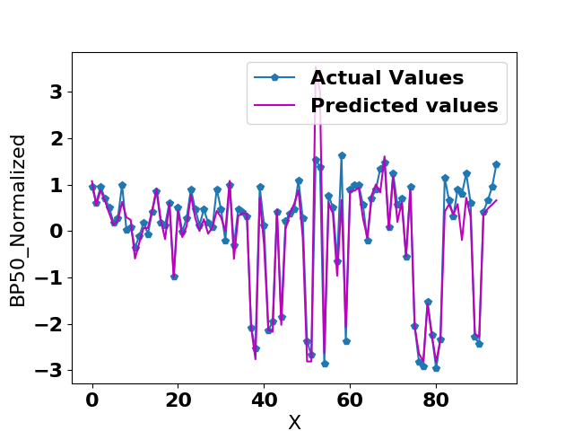
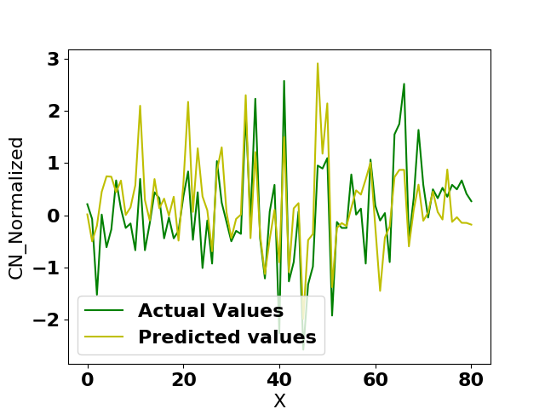
Diesel Data Results

Slide 22
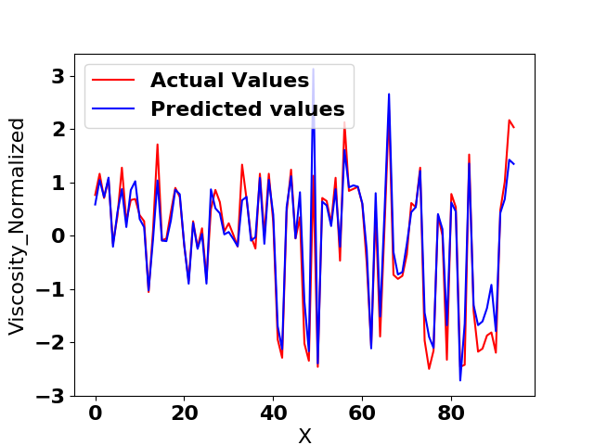
Diesel Data Results (continued)

Slide 23
Conclusion and Future Work
The algorithm discussed in this paper is universal in nature and thus could be used in any applications.
But there could be more improvement in the results through more data pre-processing as seen in other related papers.
Apart from that, the outcomes are more than satisfactory to be used in real life applications.
There are many future scopes of the model as discussed further and we intend to work on it near future.

Slide 24
Future Work
Tuning hyper parameters - If we try to optimize these hyperparameters, we see that while differentiating the log likelihood equation w.r.t these hyperparameters we get K(kernel) also in it and hence we need to calculate K^-1 and dK/d(theta) for each iteration in gradient based optimizer which is not feasible(making complexity very high). Thus many techniques have been used to overcome this pitfall such as maximizing log likelihood by conjugate gradients method or by using various sampling techniques like HMC(hybrid Monte Carlo sampling), MCMC(Markov chain Monte Carlo).

Slide 25
Thank You!

