Slide 1
Gaussian Process Regression and its applications
Rohit Jain
Roll No. - 14MF3IM13
Project Guide - Dr. Swanand Ravindra Khare

Slide 2
Motivation
In our daily life we come across many situations where we need to predict something so as to prevent a cause or optimize the outcome.
This is where predictive modelling and data analysis comes into picture.
One such algorithm for doing so is Gaussian Process Regression.

Slide 3
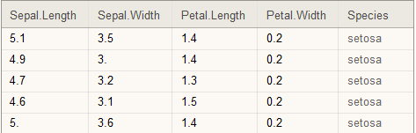
Motivation(continued)
Suppose we have some dataset as shown and we need to predict Species based on the other 4 columns(variables).
This is said to be predictive modelling.
This looks easy but as the size of the dataset becomes bigger, it gets difficult to predict this.

Slide 4
Motivation(continued)
Other methods used for predictive modelling are based on a training process or learning process which are derivative based. This has many drawbacks including local optimum finding and non-differentiable functions.
The reason for picking this algorithm is that it tends to handle non-linearity and linearity with equal ease and thus could be used anywhere.
A better approach could be to use prior and posterior probabilities estimation for the same which is indeed the case with Gaussian process regression.

Slide 5
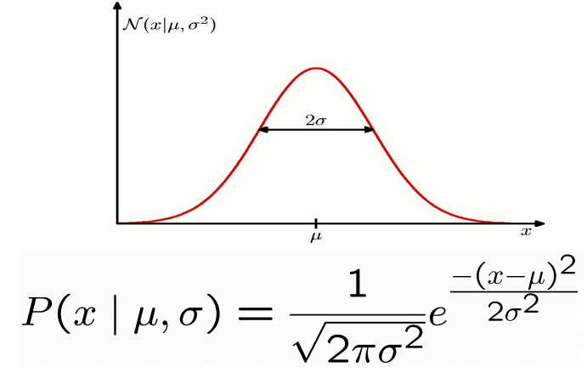

Mathematical Introduction
1-D Gaussian Distribution
It is 1 dimensional distribution of probabilities over variable 'x' like a bell-shape as shown.
Notations are as follows:-
Rasmussen and Williams

Slide 6
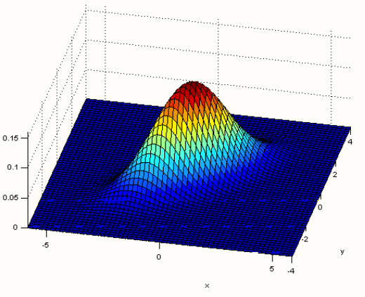
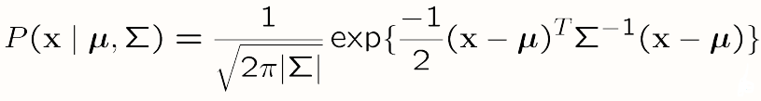
Multivariate Gaussian Distribution
It is the same as 1-D but in
2 or more dimensions.
Rasmussen and Williams

Slide 7
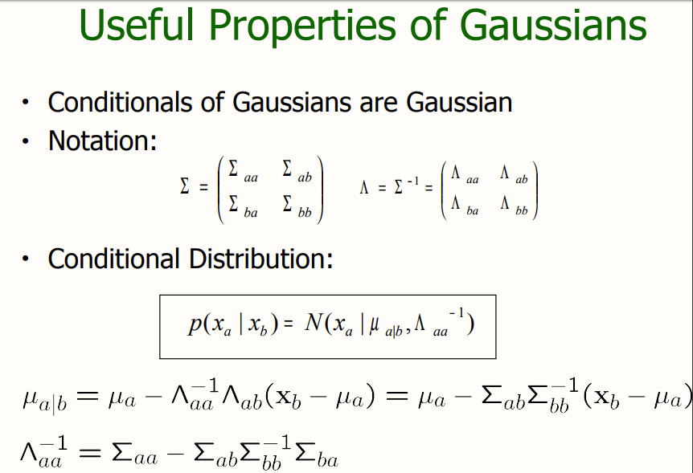


Conditionals of Multivariate Normal Distribution
Notation:
Conditional Distribution:
where,

Slide 8
Gaussian process regression
In more general sense it makes points which are similar in 'x' co-ordinates similar in 'y' too.
This is incorporated by the kernel matrix or the covariance matrix.
A kernel is basically a function that measures similarity between the points given in the training set or the points plotted.

Slide 9
Solution Methodology
Initially we note different points in X axis where the points are given. Then we have to see for the prior similarity between the points which is done using the kernel formula defined earlier.
As we have assumed that these points will follow a multivariate Gaussian distribution in itself we note down the mean and variance of the distribution.
We take µ(mean) as 0 for the prior distribution. Also setting the hyper parameter values accordingly.

Slide 10
Solution Methodology (continued)
We use the multivariate Gaussian theorem to find the conditional
probability distribution of f(posterior) using the formula:
where,
K* is Kernel Matrix associating both prior and posterior.
K** is a kernel matrix which is computed using all pair of points from only posterior points set.

Slide 11
Diesel Dataset
Data used in this paper was collected by Southwest Research Institute in a project sponsored by the U.S. Army. Eigenvector Research Incorporated provides 784 samples in Near Infrared Spectra of Diesel Fuels.
The main properties used in this dataset are Cetane Number, Boiling Point at 50% Recovery and Viscosity.

Slide 12
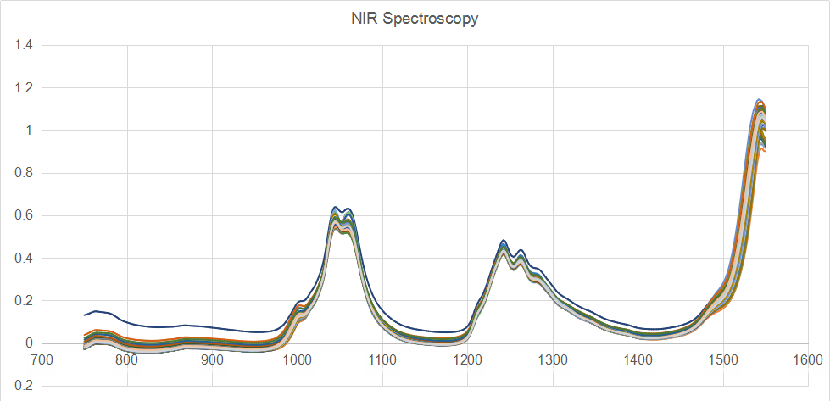
NIR Spectroscopy
The plot shows the variation of Absorbance with frequency for all the samples in the dataset.
We could see similar trend being followed.
Absorbance
Frequency(nm)

Slide 13
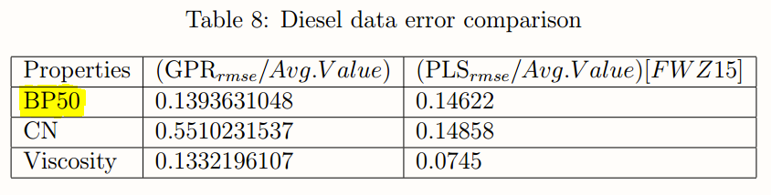
Results and Discussion
The results came out to be in par with other experiments done using other algorithms.
Main algorithms used apart from GPR are LS-SVM, PLS, genetic multivariate analysis, PCR etc.
But in most of the papers we have some form of pre processing of data being used to improve the performance of the result.
Also, other papers referred here uses only 3 types of diesel whereas in this paper we have used all the types making it more difficult to analyze and model.

Slide 14
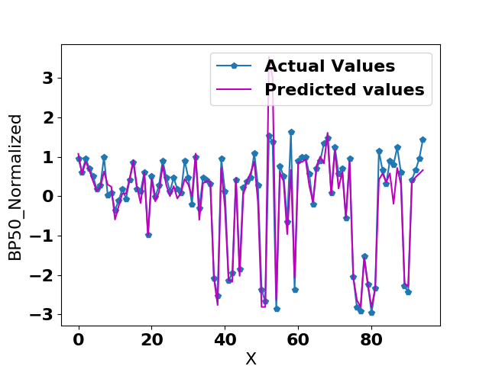
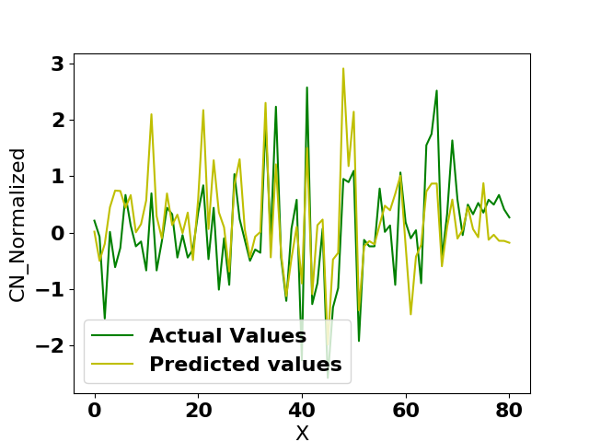
Diesel Data Results

Slide 15
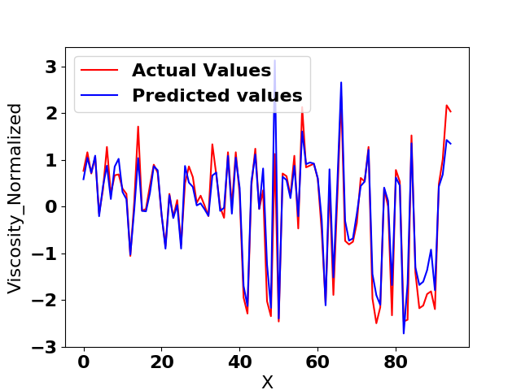
Diesel Data Results (continued)

Slide 16
Sample data simulation
We generate a sample dataset by randomly generating a number between a range and then using linear relationship or spline relationship we find the 'y' variable making 2 sets of datasets.
We then normalize the 'y' variable as the algorithm assumes that the output variable is normalized.

Slide 17
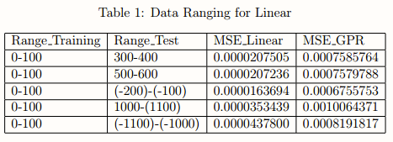
Results and Observations
We see the results for different ranges of sample dataset thus produced in Table 1.
We mostly observe that the accuracy in case of linear regression overcomes GPR. But, the results could be said to be in par.

Slide 18
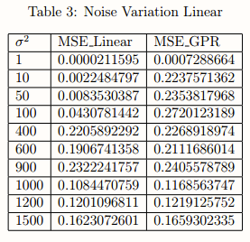
Results and Observations(continued)
Now, in the case of variation of σ values of the noise given to the y values, we see that as noise increases the error also increases.
For the non-linear case we see that the error shows consistency with the previous results.

Slide 19
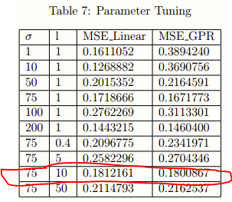
Results and Observations(continued)
For this we observe an anomally as we keep increasing the values of 'l'.
This could be accounted due to the overfitting the hyperparameter to its new model.

Slide 20
Conclusion and Future Work
The algorithm discussed in this paper is universal in nature and thus could be used in any applications.
But there could be more improvement in the results through more data pre-processing as seen in other related papers.
Apart from that, the outcomes are more than satisfactory to be used in real life applications.
There are many future scopes of the model as discussed further and we intend to work on it near future.

Slide 21
Future Work
Tuning hyper parameters - We observe here that while using kernel function we assumed that both ’σ’ and ‘l’ used as hyperparameters were taken as 1. But this was only used for simplicity. We could first estimate the noise and then sample around that using any of the above mentioned sampling techniques to reach optimum result.
Recursive Gaussian Process Regression - It takes long hours for getting a set of observation values. Also, as we go on doing experiments the setup and accuracy of measurement of instruments changes, thereby affecting our observations. Thus, in future we hope to incorporate an online algorithm inspired by this to deal with this problem.

Slide 22
Thank You!

